Slide 1


Physical Chemistry Year 1 - AS
3.1.1 Atomic structure
Dr John R Griffiths
SciExcel Tuition
www.sciexcel.org

Slide 2
Physical Chemistry Year 1
3.1.1 Atomic structure
3.1.1.1 Fundamental particles
3.1.1.2 Mass number and isotopes
3.1.1.3 Electron configuration

Slide 3
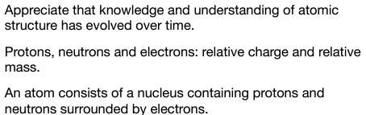
3.1.1.1 Fundamental particles

Slide 4
Development of atomic structure
Early 20th Century – J.J. Thompson discovered the electron and proposed the PLUM PUDDING model of the atom. This was;
  A ball of positive charge (suet) with negative electrons (plums) distributed throughout.
To confirm this model, Ernest Rutherford conducted an experiment by firing alpha particles (from Radium) at a thin GOLD FOIL sheet and detecting their trajectories. However, the results suggested a different atomic structure;
  Most particles past through undeflected → atom is mostly empty space,
  Some particles were deflected → Atom contained a source of positive charge (protons) to deflect the positive alpha particles,
  A few particles were rebounded backwards → The result of a large mass within the atom (nucleus). (This was a truly startling result!).

Slide 5
Development of atomic structure
In 1913, Niels Bohr proposed that the electrons in an atom were;
  Present in discrete energy levels,
  Had stable orbits around the nucleus but can jump from one energy level to another given appropriate amounts of energy (QUANTA).
Later (1932), James Chadwick discovered a new particle in the nucleus – the NEUTRON.

Slide 6
Summary of atomic structure models
J.J. Thompson
E. Rutherford
N. Bohr
J. Chadwick
1904
1909
1913
1932
Plum pudding
Gold foil expt.
Quanta
Neutron
-
Detector
Nucleus of Sodium
-
n
p
-
Au foil
-
n
p
n
p
-
α source
b
-
n
-
-
-
-
-
p
n
n
-
-
-
n
p
p
a
n
n
p
n
-
-
-
p
-
-
p
-
-
c
-
n
p
n
p
Diffuse positive charge with electrons throughout
Mostly space
Positive charge
High mass region
Electrons reside at discrete (quanta) energy levels
Discovered the Neutron

Slide 7
Rutherford's gold foil experiment
Detector
Au foil
α source
b
Mostly space
Positive charge
High mass region
a
c
In 1909 at the University of Manchester, Ernest Rutherford, along with Hans Geiger and Ernest Marsden, carried out the famous gold foil experiment which led to a new proposal for the structure of the atom.
They fired alpha particles at a thin piece of gold foil and detected where the particles emerged. The current plum pudding model predicted that all of the particles would pass through without deflection. However, whilst most of the alpha particle did this, some were deflected off-centre, and a few were “bounced” back.
The conclusions drawn by Rutherford from the data were that the atom consists mainly of space, there is a positive charge in the centre, and a high mass region in the centre.
This led to the discovery of the proton and subsquently James Chadwick discovered the neutron.

Slide 8
Components of the atom
The nucleus contains most (nearly all) of the mass i.e. protons + neutrons. These are called NUCLEONS
The electrons orbit the nucleus in stable energy levels.
Most of the atom is empty space. The diameter of the nucleus is around 1/100,000 of the diameter of the whole atom.
Particle | Relative Charge | Relative Mass
Proton | +1 | 1 (1 amu)
Neutron | 0 | 1 (1 amu)
Electron | -1 | 1/1840 (negligible)
This model is a gross simplification, however, it is sufficient for GCSE level Chemistry. We need to expand upon this at A level.......

Slide 9
Components of the atom
Actual masses and charges on the sub-atomic particles
Property | Proton | Neutron | Electron
Mass / kg | 1.673 x 10⁻²⁷ | 1.675 x 10⁻²⁷ | 0.911 x 10⁻³⁰ (very nearly 0)
Charge / C | +1.602 x 10⁻¹⁹ | 0 | -1.602 x 10⁻¹⁹
Position | In the nucleus | In the nucleus | Around the nucleus

Slide 10
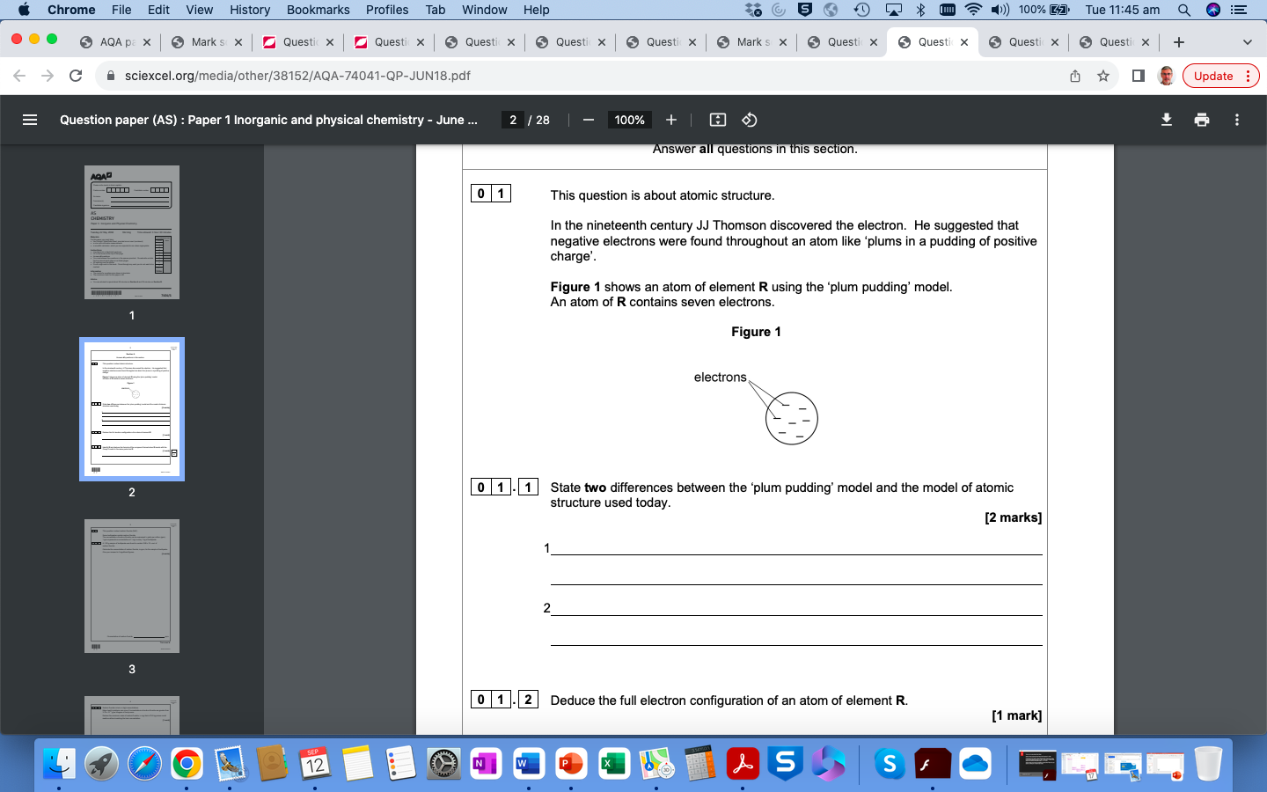
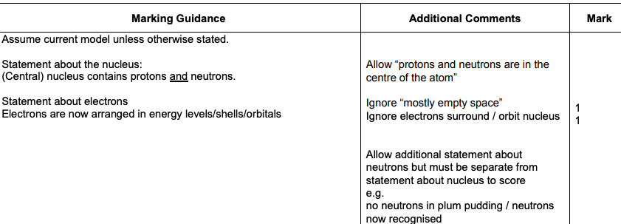
Quick test

Slide 11
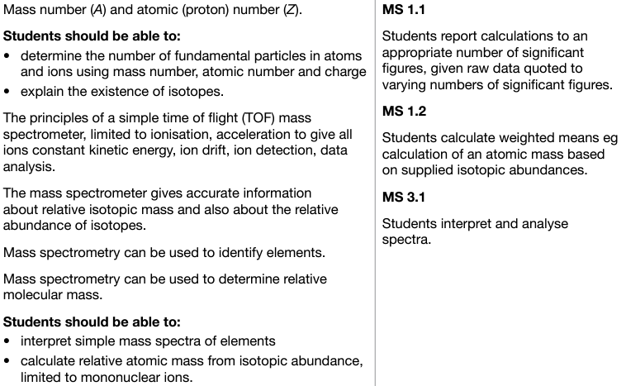
3.1.1.2 Mass number and isotopes

Slide 12
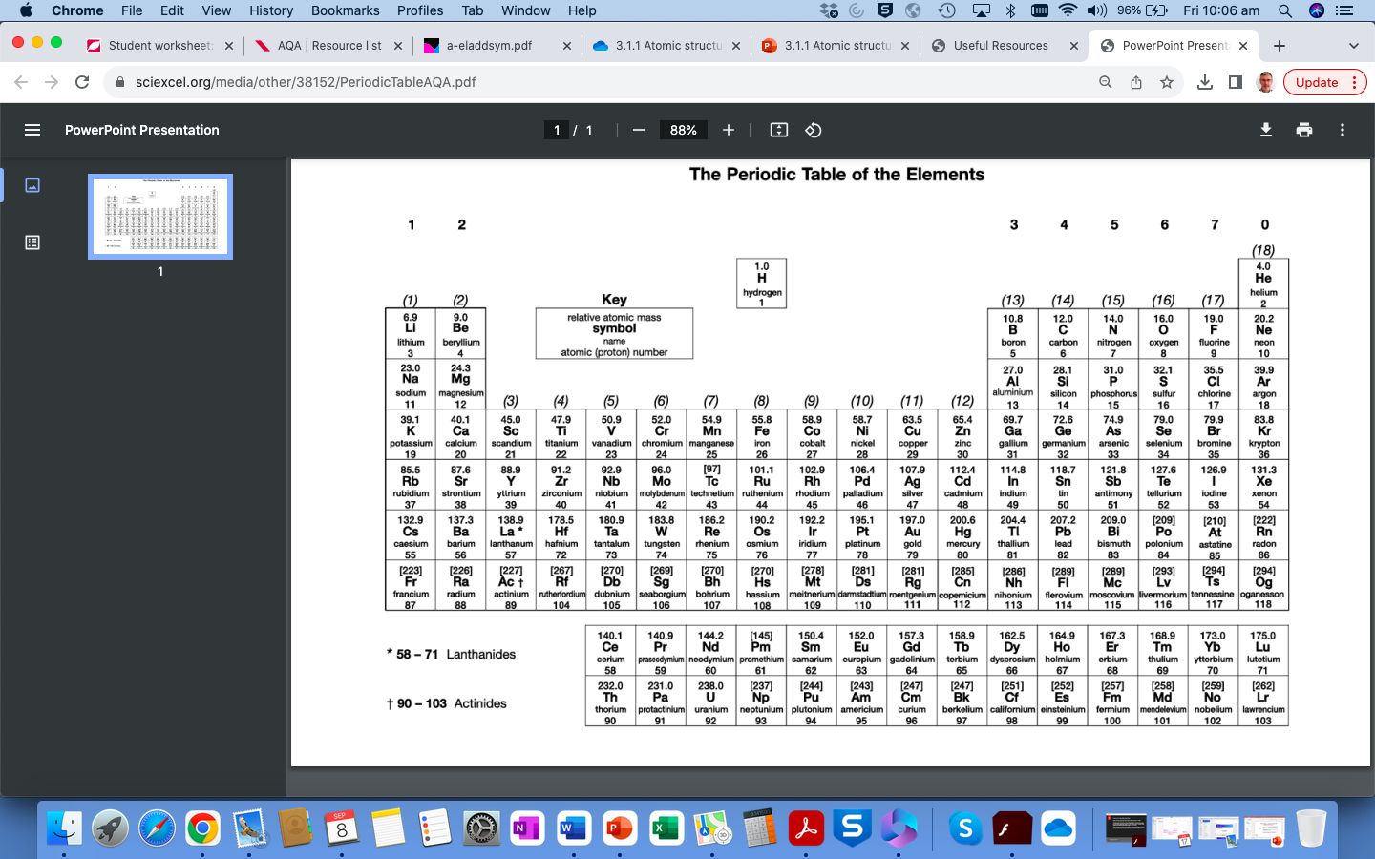
Atomic number (Z), atomic mass (A) and relative atomic mass (A_{r})
The ATOMIC NUMBER (Z) is also called the PROTON NUMBER, and is the number of protons in the nucleus. This defines the element i.e. only sodium has the atomic number 11. Since elements in the periodic table are NEUTRAL, this is also the number of ELECTRONS which the element has.
The ATOMIC MASS (A) is the total number of nucleons, i.e. the number of PROTONS plus number of NEUTRONS.
The RELATIVE ATOMIC MASS (A_{r}) is the weighted average mass for the element’s isotopes, relative to 1/12th the mass of Carbon-12 ………………

Slide 13
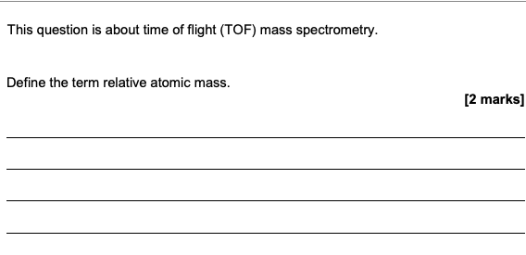
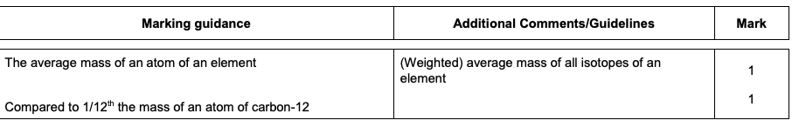
Relative atomic mass, A_{r}

Slide 14
Isotopes
Most elements exist as ISOTOPES, that is, they have different numbers of neutrons in the nucleus.
Carbon exists as 3 isotopes, ¹²C (6 protons and 6 neutrons), ¹³C (6 protons and 7 neutrons) and ¹⁴C (6 protons and 8 neutrons). In nature the relative abundance of these is approximately 99 % : 1% : <<<1% respectively.
The RELATIVE ATOMIC MASS (A_{r}) is relative to Carbon-12 being exactly 12.0000.
Chlorine has two isotopes of mass 35 and 37 with relative abundances of 75% and 25% respectively. A_{r} for Cl is calculated to be (0.75 x 35) + (0.25 x 37) = 35.5.

Slide 15
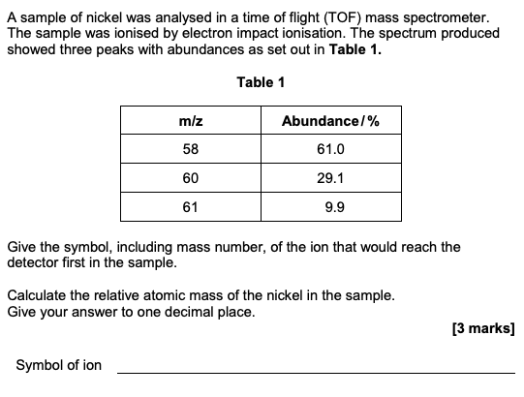
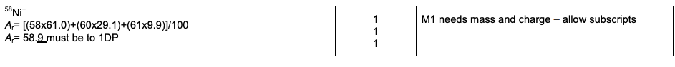
Quick test

Slide 16

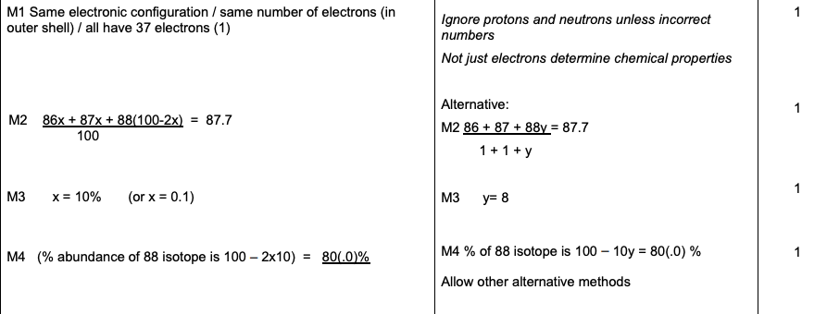
Quick test

Slide 17
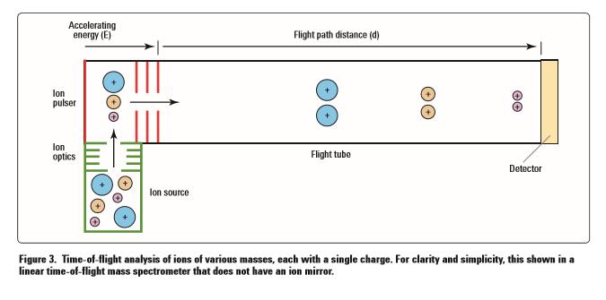
Principles of Time of Flight (TOF) Mass spectrometry
Isotopes have different masses, and this allows them to be separated and identified by mass spectrometry. It involves a mass spectrometer, an instrument used to measure the relative masses (strictly the mass:charge ratio) of isotopes, and to find the relative abundance of the isotopes in a sample of an element.
There are five main stages to creating mass spectra;
Ionisation
Acceleration
Ion drift
Ion detection
Data analysis

Slide 18


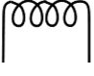
Stage 1 – IONISATION (OF SMALL MOLECULES)
Electron impact ionization – X_{(g)} → X⁺_{(g)} + e⁻
Sample is first vapourised
A heated filament emits a beam of high energy electrons (electron gun)
The gas-phase sample passes through the beam and becomes ionised by losing an electron
An electron is knocked off each particle by the high-energy electrons to form 1+ ions
Positive ions are accelerated by a negative electric plate
Electron gun
(hot wire filament)

Slide 19
Stage 1 – IONISATION (OF LARGE MOLECULES)
Electrospray ionization - M(g) + H⁺ → MH⁺(g) molecule gains a proton
Sample is first dissolved in a volatile solvent such as acetonitrile/water.
Next, it is forced through a hollow needle that is connected to the positive terminal of a high voltage supply (several kV).
Each molecule gains a proton to become the MH⁺ ion.
Particles gain a proton as they leave the needle
Fine mist
Sample in volatile solvent
Positive ions are accelerated by a negative electric plate
Hypodermic needle attached to positive terminal of high-voltage power supply
© www.chemsheets.co.uk

Slide 20
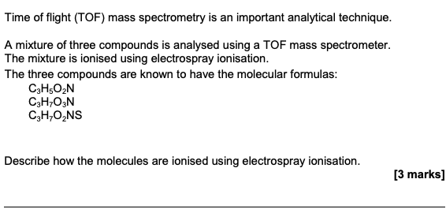
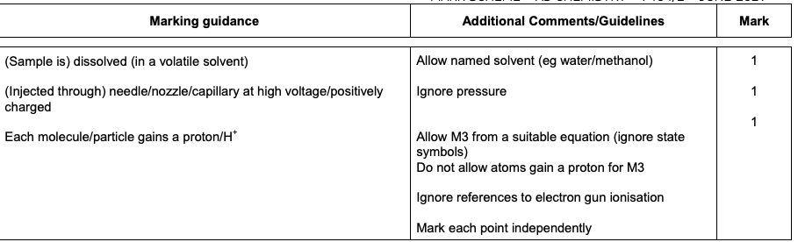
Quick test

Slide 21
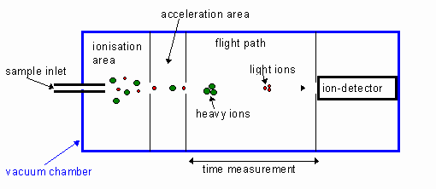
Stage 2 – ACCELERATION
A fixed strength electric field is applied to the positive ions, giving each 1+ ion the same kinetic energy.
As kinetic energy= ½ mv² (m= mass and v= velocity) and all particles are given the same kinetic energy, the heavier particles (larger M_{r}) move more slowly than lighter particles
Notes:
The analyte solution flow passes through the electrospray needle that has a high potential difference (with respect to the counter electrode) applied to it (typically in the range from 2.5 to 5 kV). This forces the spraying of charged droplets from the needle with a surface charge of the same polarity to the charge on the needle. The droplets are repelled from the needle towards the source sampling cone on the counter electrode (shown in blue). As the droplets traverse the space between the needle tip and the cone and solvent evaporation occurs. This is circled on the figure 1 and enlarged upon in figure 2.

Slide 22
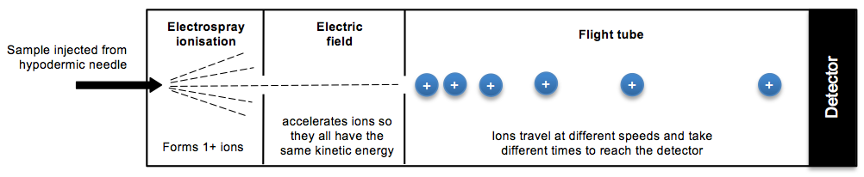
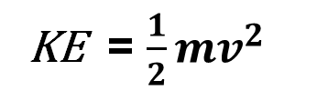
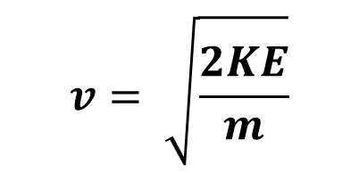
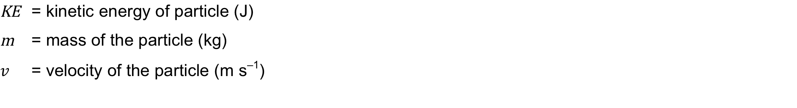
Stage 2 – ACCELERATION
KE = $\frac{1}{2}mv^{2}$
$$v= \sqrt{\frac{2KE}{m}}$$
NB – UNITS for v, m and KE!!
© www.chemsheets.co.uk

Slide 23
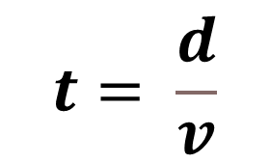
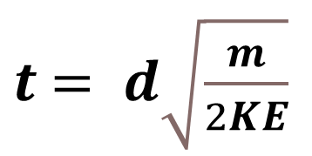
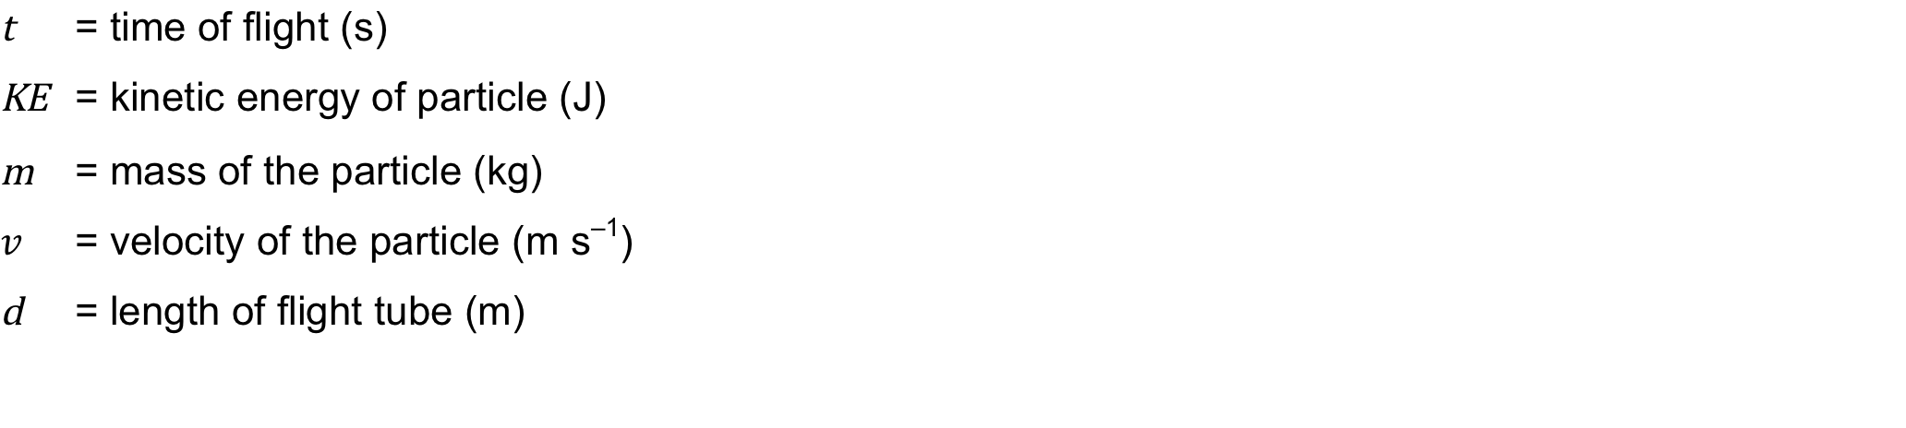
Stage 3 – FLIGHT TUBE
$$t= \frac{d}{v}$$
$t$ $= d\sqrt{\frac{m}{2KE}}$
Lighter (smaller m/z) particles move faster and so have shorter flight times
© www.chemsheets.co.uk

Slide 24
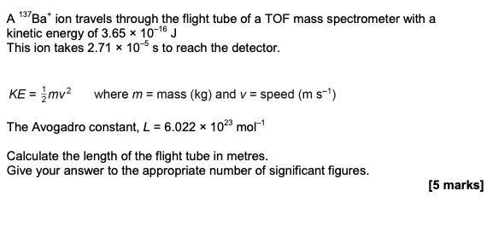
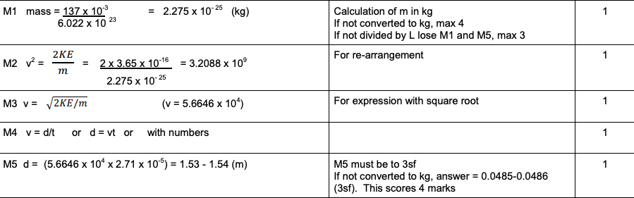
Quick test

Slide 25
Stage 3 – FLIGHT TUBE
Once accelerated to the same KE, the ions enter a field-free region called the flight tube.
This is the drift region and here the ions are separated based on their velocities.
The lighter faster ions travel through the flight tube much more rapidly and arrive at the detector first.

Slide 26
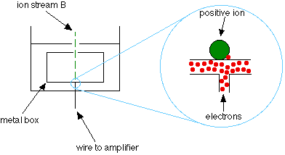
Stage 4 – DETECTION
Detector records the flight times of the ions striking it.
The +ve ions hit a –ve detector plate where they gain electrons and produce an electric current
size of current proportional to number of ions (abundance)
© www.chemsheets.co.uk AS 1011 15-July-2016

Slide 27
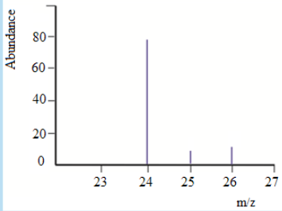
Stage 5 – DATA ANALYSIS
The flight times are analysed and recorded as a mass spectrum by a data analyser
These are plotted as relative abundance against mass to charge ratio (m/z)
e.g. Magnesium

Slide 28
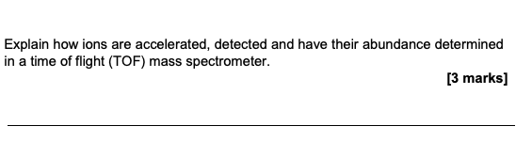
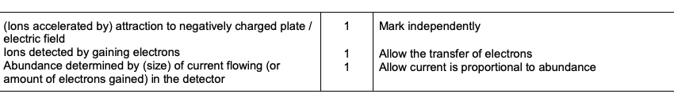
Quick test

Slide 29
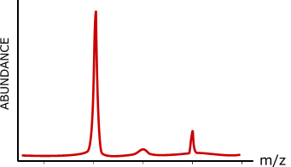
An early mass spectrum of neon
²⁰Ne 90.92%
²¹Ne 0.26%
²²Ne 8.82%
19 20 21 22 23
Francis Aston (Nobel Prize, 1922) demonstrated that naturally occurring neon consisted of three isotopes ... ²⁰Ne, ²¹Ne and ²²Ne.
positions of the peaks gives atomic mass
peak intensity gives the relative abundance
highest abundance is usually scaled to 100% and other values are adjusted accordingly

Slide 30
Example calculation
Calculate the average relative atomic mass of neon using data below;
Out of every 100 atoms... 90.92 are ²⁰Ne , 0.26 are ²¹Ne and 8.82 are ²²Ne
Average = (90.92 x 20) + (0.26 x 21) + (8.82 x 22) = 20.179
100
In calculations of this type...
multiply each relative mass by its abundance
add up the total of these values
divide the result by the sum of the abundances
Ans. = 20.18

Slide 31
What does the spectrum show us ?
This spectrum shows that?....
10% have a mass of 82
10% have a mass of 83
60% have a mass of 84
20% have a mass of 86

Slide 32
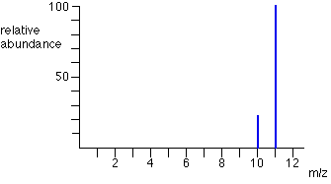
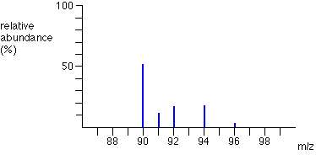
Example spectra of elements
Boron
Zirconium

Slide 33
Example calculation
Naturally occurring potassium consists of potassium-39 and potassium-41.
Calculate the percentage of each isotope present if the average is 39.1.
Assume that there are x nuclei of ³⁹K in every 100; there will then be (100-x) of ⁴¹K.
so 39x + 41 (100-x) = 39.1
100
thus - 2x = - 190 so x = 95 Ans. 95% ³⁹K and 5% ⁴¹K

Slide 34
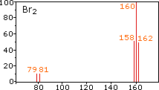
Mass spectrum of bromine
Possible peaks
Bromine gas contains the isotopes ⁷⁹Br and ⁸¹Br in almost equal proportions.
Show the full spectrum of the molecular ion peaks of Br₂⁺ .

Slide 35
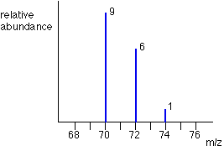
Mass Spectrum for Chlorine
Why are there these peaks?
There are two isotopes of chlorine;
³⁵Cl ³⁷Cl
So combining the two atoms we could get;
³⁵Cl and ³⁵Cl= 70
³⁵Cl and ³⁷Cl= 72
³⁷Cl and ³⁷Cl= 74
But why are there these ratios, given their abundances are?
³⁵Cl= 75%
³⁷Cl= 25%
³⁵Cl and ³⁵Cl= 70 Probability= 0.75 x 0.75= 0.5625
³⁵Cl and ³⁷Cl= 72 Probability= 0.75 x 0.25= 0.1875
³⁷Cl and ³⁵Cl= 72 Probability= 0.25 x 0.75= 0.1875
³⁷Cl and ³⁷Cl= 74 Probability= 0.25 x 0.25= 0.0625
The ratio is therefore
⁷⁰Cl₂= 0.5625/0.0625= 9
=0.375
⁷²Cl₂= 0.375/0.0625= 6
⁷⁴Cl₂= 0.0625/0.0625= 1

Slide 36
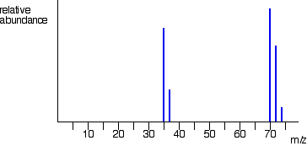
Overall Mass Spectrum for Chlorine

Slide 37
Test question
A mass spectrum shows the presence of two isotopes of m/z values 38 and 40. Both have been formed as unipositive ions.
Redraw the diagram with the most abundant isotope scaled up to 100%.
Calculate the average relative atomic mass.
What would be a) the m/z values and b) the abundance if 2+ ions had been formed?
100%
60%
40%
ABUNDANCE
0 10 20 30 40 m/z values
The new values are 100 and 66.7 (see diagram)
New scale atoms of mass 38; abundance = 100
atoms of mass 40; abundance = 66.7
Average = (100 x 38) + (66.7 x 40) = 38.80
166.7
By doubling the charge to 2+, m/z value is halved; new peaks at 19 and 20. The abundance is the same.
100%
100%
66.7%
ABUNDANCE
0 10 20 30 40 m/z values

Slide 38
What use is mass spectrometry ?
Identify structures of biomolecules, such as carbohydrates and nucleic acids
Sequence and quantify proteins (proteomics)
Determine how drugs behave in the body (pharmacokinetics)
Perform forensic analyses such as quantitation of illegal drugs in sport
Analysis of pesticides in rivers (environmental)
Determine the age and origins of specimens in geochemistry and archaeology
Identify and quantitate compounds of complex organic mixtures (with LC)
Perform ultrasensitive, multi element, inorganic analyses (isotopic distribution)
MASS SPECTROMETRY IS A UBIQUITOUS TECHNIQUE EMPLOYED BY MOST ANALYTICAL LABORATORIES

Slide 39
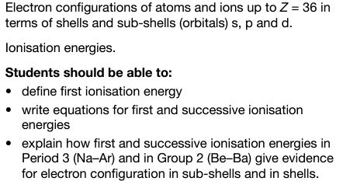
3.1.1.3 Electron configuration

Slide 40
The sub-levels
sub-level
max no. electrons
There are four sub-levels, labelled in order of increasing energy: s, p, d and f. Each holds a different number of electrons.
s
2
p
6
d
10
f
14
principal energy
level, n
sub-levels
max no.
electrons
Each principal energy level contains a different number of sub-levels.
1
1s
2
2
2s, 2p
8
3
3s, 3p, 3d
18
4
4s, 4p, 4d, 4f
32
Notes:
Teacher notes
The electron arrangement at levels above n = 4 is:
n = 5: sub-levels = 5s, 5p, 5d, 5f
n = 6: sub-levels = 6s, 6p, 6d, 6f
n = 7: sub-levels = 7s, 7p, 7d, 7f

Slide 41
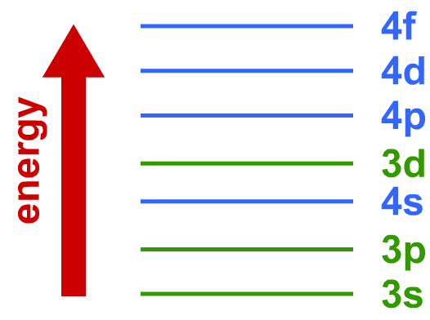
The Aufbau principle
As part of his work on electron configuration, Niels Bohr developed the Aufbau principle, which states how electrons occupy sub-levels.
The Aufbau principle states that the
lowest energy sub-levels are occupied first.
This means the 1s sub-level is filled first, followed by 2s, 2p, 3s and 3p.
However, the 4s sub-level is lower in energy than the 3d, so this will fill first (AND EMPTY FIRST!).
Notes:
Teacher notes
The word ‘aufbau’ is German for ‘construction’.

Slide 42
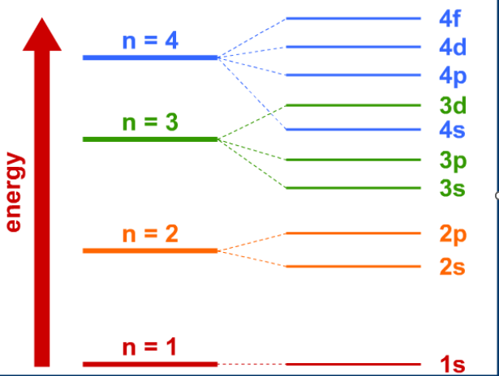
Writing electron configuration

Slide 43
Electron configuration of Cr and Cu
The electron configurations of chromium and copper are exceptions to the normal rules of orbital filling:
chromium
copper
1s²2s²2p⁶3s²3p⁶4s¹3d⁵
1s²2s²2p⁶3s²3p⁶4s¹3d¹⁰
In each case the 4s orbital contains one electron. This is because the 4s and 3d sub-levels lie very close together in energy, and the 3d being either half full or completely full is a lower energy arrangement.
With larger atoms like this it can be useful to shorten the electron arrangement. Copper can be shortened to [Ar]4s¹3d¹⁰.
Notes:
Teacher notes
Students should be reminded that they should not write abbreviated electron arrangements in exam answers but write them out in full.

Slide 44
Electron configuration of transition metals
Although the 3d sub-level is in a lower principal energy level than the 4s sub-level, it is actually higher in energy.
This means that the 4s sub-level is filled before the 3d sub-level.
Example: what is the electron structure of vanadium?
1. Count number of electrons in atom
23
2. Fill sub-levels, remembering 4s is filled before 3d
1s²2s²2p⁶3s²3p⁶4s²3d³

Slide 45
Electron configuration of ions
When writing the electron configuration of ions, it is important to add or subtract the appropriate number of electrons.
For negative ions add electrons.
For positive ions remove electrons.
For non-transition metals, the sub-levels are then filled as for atoms.
Example: what is the electron structure of O²⁻?
1. Count number of electrons in atom
8
2. Add or remove electrons due to charge
8 + 2 = 10
3. Fill sub-levels as for uncharged atom
1s²2s²2p⁶

Slide 46
Electronic configuration of transition metal ions
When transition metals form ions, it is the 4s electrons that are removed before the 3d electrons.
Example: what is the electron structure of Ni²⁺?
1. Count number of electrons in atom
28
2. Fill sub-levels, remembering 4s is filled before 3d
1s²2s²2p⁶3s²3p⁶4s²3d⁸
3. Count number of electrons to be removed
2
4. Remove electrons starting with 4s
1s²2s²2p⁶3s²3p⁶3d⁸

Slide 47
Atomic orbitals
It is impossible to exactly locate the position of an electron within an energy sub-level. By measuring the electron density around the nucleus, it is possible to define regions where electrons are most likely to be found at any one time. These regions are called orbitals.
Each energy sub-level has one or more orbitals, each of which can contain a maximum of two electrons.
sub-level
no. orbits
max no.
electrons
s
1
2
p
3
6
d
5
10
f
7
14

Slide 48
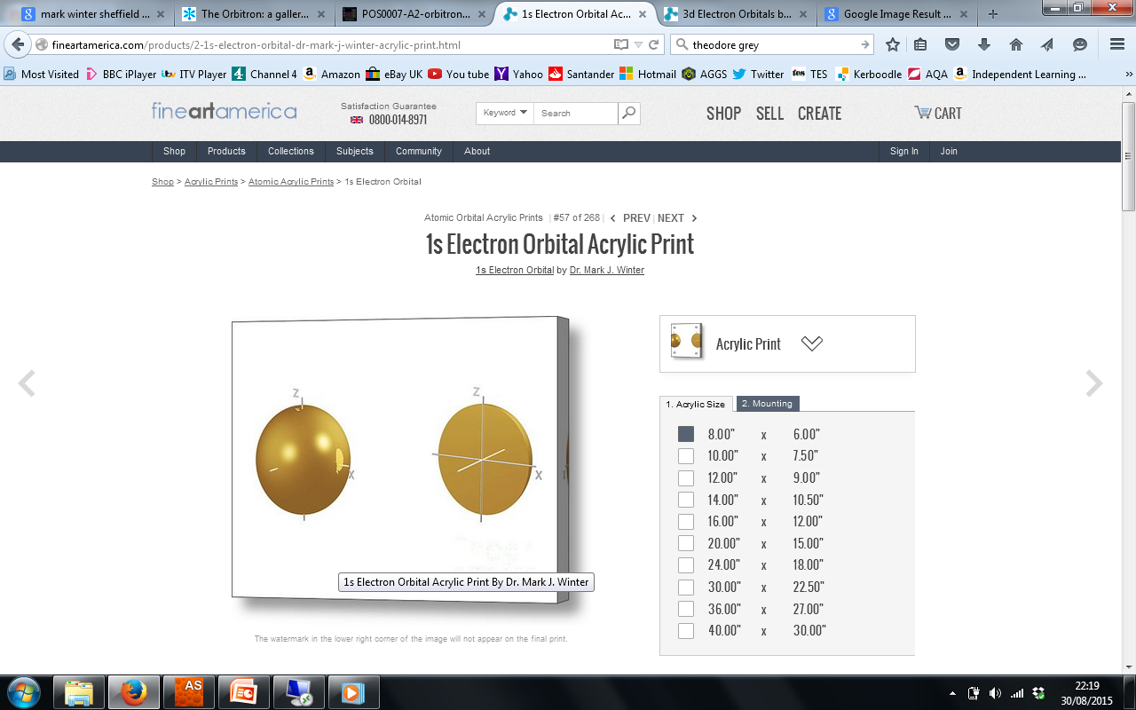
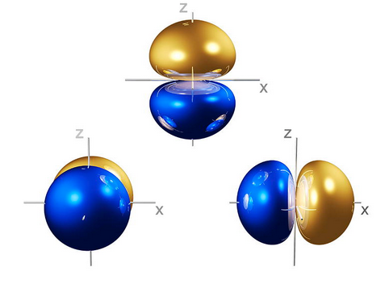
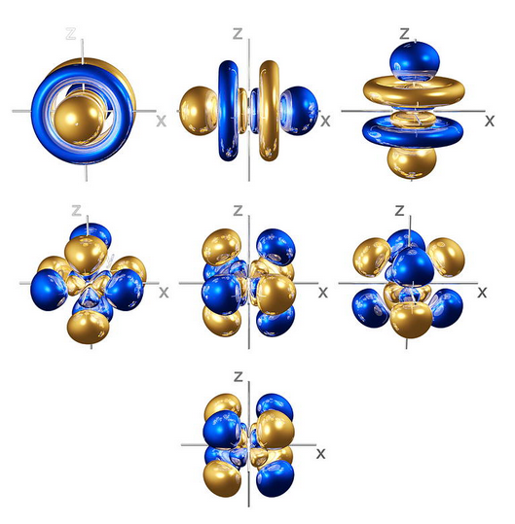
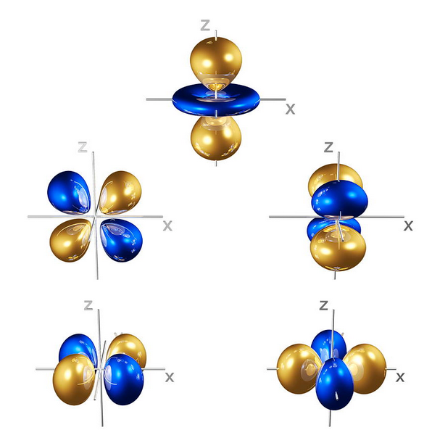
Shapes of atomic orbitals
p
s
d
f

Slide 49
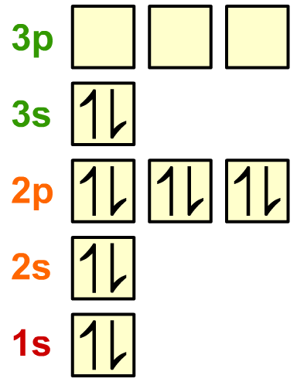
The Pauli exclusion principle and spin
The Pauli exclusion principle states that each orbital may contain no more than two electrons.
It also introduces a property of electrons called spin, which has two states: ‘up’ and ‘down’. The spins of electrons in the same orbital must be opposite, i.e. one ‘up’ and one ‘down’.
A spin diagram shows how the orbitals are filled. Orbitals are represented by squares, and electrons by arrows pointing up or down.
spin diagram for magnesium, 1s²2s²2p⁶3s²
Notes:
Teacher notes
Wolfgang Ernest Pauli (1900–1958) was an Austrian theoretical physicist. His ‘exclusion principle’ was developed in 1925.

Slide 50
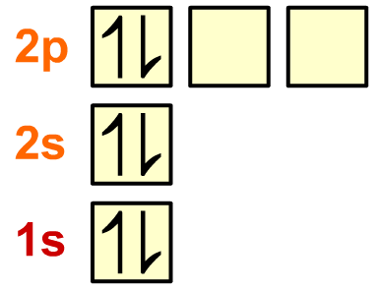
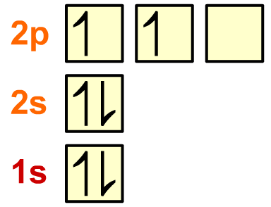


Rules for filling electrons
When two electrons occupy a p sub-level, they could either completely fill the same p orbital or half fill two different p orbitals.
Hund’s rule states that single electrons occupy all empty orbitals within a sub-level before they start to form pairs in orbitals.
If two electrons enter the same orbital there is repulsion between them due to their negative charges. The most stable configuration is with single electrons in different orbitals.
Notes:
Teacher notes
Friedrich Hund (1896–1997) was a German physicist. His ‘Rule of maximum multiplicity’ dates 1925 and was one of several rules he developed that govern electron configuration.

Slide 51
Ionisation energies
First ionisation energy
X_{(g)} → X⁺_{(g)} + e⁻ ΔH +ve (endothermic)
Depends upon three factors;
Atomic radius (how far e- are from the attractive power of the nucleus)
Nuclear charge (how many protons are attracting the outer electrons)
Shielding by inner electrons (how many electrons are between the nucleus and the outer electrons so shielding the attractive power of the nucleus)

Slide 52
Trends in atomic radius in period 3
The atomic radius of the elements across period 3 decreases.
Element
Proton number
Atomic radius (nm)
Na
11
0.190
This might seem counter-intuitive, because as the numbers of sub-atomic particles increase, the radius might be expected to also increase.
Mg
12
0.145
Al
13
0.118
Si
14
0.111
However, more than 99% of the atom is empty space – the nucleus and electrons themselves occupy a tiny volume of the atom.
P
15
0.098
S
16
0.088
Cl
17
0.079
Ar
18
0.071
Notes:
Teacher notes
Observed values for covalent radii follow the same trend as the calculated values given here, apart from the value for argon. The covalent radius is half the covalent bond length. Argon does not normally form covalent bonds (it is monatomic) therefore either no value is given for argon or the value is anomalously high.
Covalent bond lengths are:
Na 0.166nm
Mg 0.141nm
Al 0.121nm
Si 0.111nm
P 0.107nm
S 0.105nm
Cl 0.102nm
Ar 0.106nm

Slide 53
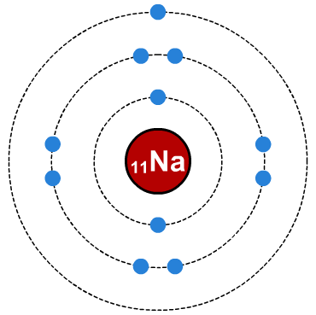
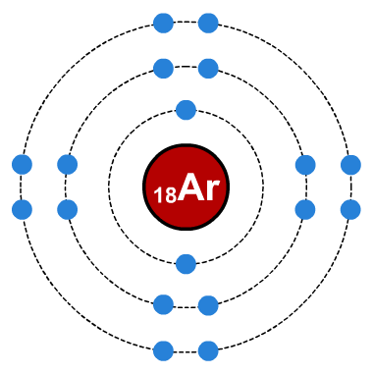
Increasing proton number (nuclear charge)
The number of protons in the nucleus of atoms increases across a period.
₁₁Na
₁₂Mg
₁₃Al
₁₄Si
₁₅P
₁₆S
₁₇Cl
₁₈Ar
This increase in the number of protons increases the nuclear charge of the atoms. The nucleus has stronger attraction for the electrons, pulling them in closer and so the atomic radius decreases across the period.
increased nuclear charge pulls electrons closer

Slide 54
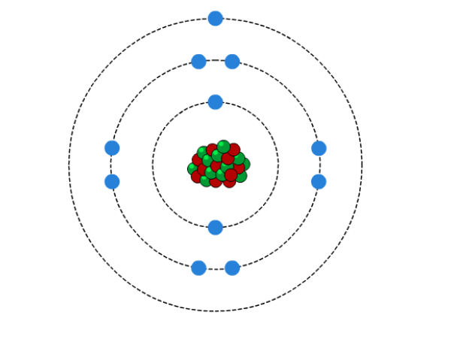
Shielding
Notes:
Teacher notes
This animation only describes the shielding effect. In the final stage, each atom is portrayed as being of a similar size across the period because there is very little variation in shielding. It may be worth reminding students that, when the increase in nuclear charge is taken into account, atomic radius decreases across the period.

Slide 55
Explaining atomic radius in Period 3
Proton number increases across Period 3, but shielding remains approximately constant.
Element
Proton number
Atomic radius (nm)
Na
11
0.190
This causes an increase in effective nuclear charge, leading to a greater attraction between the nucleus and the outermost electrons.
Mg
12
0.145
Al
13
0.118
Si
14
0.111
P
15
0.098
This pulls these electrons closer to the nucleus and results in a smaller radius.
S
16
0.088
Cl
17
0.079
Ar
18
0.071

Slide 56
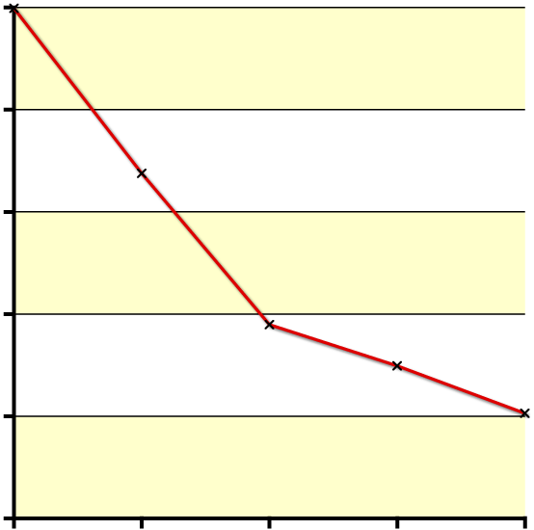
First ionisation energy down a group
The first ionization energies of group 2 elements also show evidence for the existence of different principal energy levels.
900
Even though the nuclear charge increases down the group, the first ionization energy decreases.
800
700
first ionization energy
(kJ mol⁻¹)
This means electrons are being removed from successively higher energy levels, which lie further from the nucleus and are less attracted to the nucleus.
600
500
400
Be
Mg
Ca
Sr
Ba
element
Notes:
Teacher notes
See the ‘Trends in Group 2’ presentation for information about the shielding effect.

Slide 57
Explanation of the trend in 1st ionisation energy (down group)
Atoms get bigger (outer electrons are further away from the nucleus), increased atomic radius
Increased shielding (Be→Ca shielding effect from inner s and p electrons) (Ca→Ba shielding effect from 3d electrons)
Therefore weaker attraction (less effective nuclear charge) from nucleus to electron in outer shell, less energy required to remove.

Slide 58
Graph showing Group 2 first ionisation energy
First ionisation energy decreases down a group, since;
Atomic radius increases
Shielding by inner electrons increases
So less energy needed to remove the electron

Slide 59
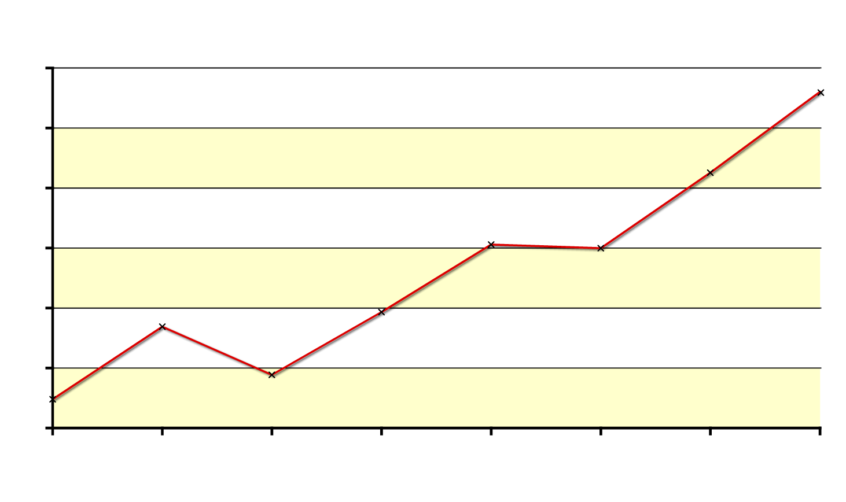
General trend in first ionisation energies
There is a general increase in the first ionization energies across period 3.
1600
1400
1200
ionization energy (kJ mol⁻¹)
1000
Across period 3, the proton number increases but the amount of shielding does not change significantly
800
600
400
Na
Mg
Al
Si
P
S
Cl
Ar
element
The effective nuclear charge therefore increases.
The greater attraction between the nucleus and the outermost electrons means that more energy is required to remove an electron.

Slide 60
Explaining trends in first ionisation energies
More protons moving across a period results in an increased nuclear charge
Inner electrons remain the same , therefore, the shielding remains the same as electrons are all entering the 3s and 3p energy level
3. Atomic radii get smaller across the period
4. Therefore there is an increase in the effective nuclear charge on the electrons in the outer shell → harder to remove.

Slide 61
Period 3 first ionisation energies
First ionisation energy increases across a period
Atomic radius decreases
Nuclear charge increases
Shielding by inner electrons the same
More energy required to remove the electron

Slide 62
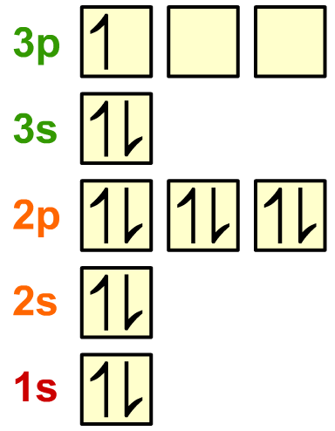
First ionisation energies of Al vs Mg
The first ionization energy of aluminium is less than that of magnesium, even though aluminium has a higher nuclear charge.
The electron removed when aluminium is ionized is in a 3p sub-level, which is higher in energy than the 3s electron removed when magnesium is ionized. Removing an electron from a higher energy level requires less energy.
magnesium
aluminium
Notes:
Teacher notes
See the ‘Electron Arrangement’ presentation for more information about energy levels and electron orbitals.

Slide 63
Trends in first ionisation energies
X_{(g)} → X⁺_{(g)} + e⁻

Slide 64
Trends in first ionisation energies
Mg → Al
Electron lost from Al is from 3p sub level, while that lost from Mg element is from 3s sub level.
3p sub level is higher energy than 3s, so easier to lose the electron. The 3s² electrons also shield the 3p electrons slightly, making them easier to remove.
Mg = 1s²2s²2p⁶3s²
Al = 1s²2s²2p⁶3s²3p¹

Slide 65


Quick test

Slide 66
Trends in first ionisation energies
X_{(g)} → X⁺_{(g)} + e⁻

Slide 67


The first ionization energy of sulphur is less than that of phosphorus, even though sulphur has a higher nuclear charge (extra proton).
The highest energy electron in both phosphorus and sulphur is in the 3p sub-level. However, in sulphur this electron is paired, while in phosphorus each 3p orbital is singly occupied. Mutual repulsion between paired electrons means less energy is required to remove one of them.
phosphorus
sulphur
Notes:
Teacher notes
See the ‘Electron Arrangement’ presentation for more information about energy levels and electron orbitals.

Slide 68

Graph showing how 1st ionisation energy changes with atomic number

Slide 69

Successive ionisation energies
Plotting the successive ionization energies of magnesium clearly shows the existence of different energy levels, and the number of electrons at each level.
6
Successive ionization energies increase as more electrons are removed.
5
Large jumps in the ionization energy reveal where electrons are being removed from the next principal energy level, such as between the 2nd and 3rd, and 10th and 11th ionization energies for magnesium.
4
ionization energy
3
2
1st
2nd
3rd
4th
5th
6th
7th
8th
9th
10th
11th
12th
electron removed
Notes:
Teacher notes
Note that the y-axis shows the ‘log₁₀’ ionization energy

Slide 70



Quick test

