Slide 1


Physical Chemistry Year 1 - AS
3.1.2 Amount of substance
Dr John R Griffiths
SciExcel Tuition
www.sciexcel.org

Slide 2
Physical Chemistry Year 1
3.1.2 Amount of substance
3.1.2.1 Relative atomic mass and relative molecular mass
3.1.2.2 The mole and the Avogadro constant
3.1.2.3 The ideal gas equation
3.1.2.4 Empirical and molecular formula
3.1.2.5 Balanced equations and associated calculations

Slide 3

Physical Chemistry Year 1
3.1.2 Amount of substance

Slide 4
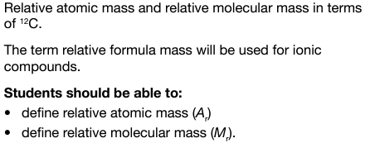
3.1.2.1 Relative atomic mass and relative molecular mass

Slide 5
Relative atomic mass, A_{r}
Chemists need to know how many atoms, molecules and ions (particles) they have in a reaction, however it is extremely difficult to count these.
We can work out how many we have if we know the mass of the substance.
As it is very difficult to measure the mass of an individual atom, we use a RELATIVE scale called the Relative Atomic Mass

Slide 6
Relative atomic mass, Ar
Is the weighted average mass of an atom of an element, taking into account its naturally occurring isotopes, relative to 1/12th the relative atomic mass of an atom of carbon-12.
relative atomic mass, Ar = average mass of one atom of an element
1/12th mass of one atom of ¹²C
No units as it's a ratio
The Ar of oxygen is 16.0. ​
It is 16 times heavier than a hydrogen atom ​
(Ar = 1.0)​
It is 4 time heavier than a helium atom (Ar = 4.0)

Slide 7
Relative molecular mass, M_{r}
Is the mass of a molecule compared to 1/12th the relative atomic mass of an atom of carbon-12
relative molecular mass, M_{r} = average mass of one molecule
1/12th mass of one atom of ¹²C
Mr CO₂ = 44.0 Mr of H₂ = 2.0 hence one molecule of
CO₂ is 22 times heavier than one molecule of hydrogen
Relative molecular mass is the sum of the relative atomic masses of the atoms in the molecule

Slide 8
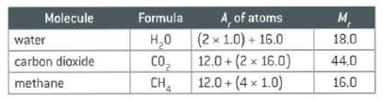
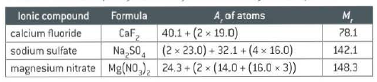
Relative formula mass, M_{r}
As ionic compounds do not exist as molecules, the relative formula mass is used instead. This is the same as M_{r}

Slide 9
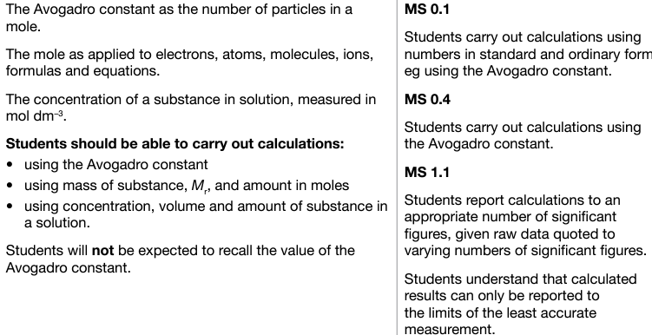
3.1.2.2 The mole and the Avogadro constant

Slide 10
Avogadro constant
The Avogadro constant is;
6.022 x 10²³
A VERY big number
602,214,150,000,000,000,000,000
so we call it 1 mole

Slide 11
Try this
What is the M_{r} of........
Cu(NH₃)₄SO₄.2H₂O
263.6
NB!! – At A-level we use A_{r} and M_{r} values to 1 d.p.

Slide 12
The Mole
The mole is simply a quantity
Just like £1 means there are 100 pence of them.........
A mole of something means there are a fixed number (6.022 x 10²³) of particles (atoms, molecules).

Slide 13
The Mole
The mole is the amount of a substance that has a mass of its A_{r} or M_{r} in grams
So one mole of carbon (C) has a mass of 12.0 g
One mole of calcium (Ca) has a mass of 40.1 g
One mole of copper (Cu) has a mass of 63.5 g
One mole of hydrogen (H₂) has a mass of 2.0 g

Slide 14
So.....
One mole of any substance has the same number of particles but a different mass....
Just like one dozen feathers and one dozen bricks
There are the same number of each but they have a different mass

Slide 15
What do the numbers here mean?
N₂ + 3H₂ → 2NH₃
1 MOLE of nitrogen (we don’t put in the number 1) reacts with 3 MOLES of hydrogen to make 2 MOLES of ammonia

Slide 16
So why is this useful?
When we are doing chemical reactions we can express and compare the amounts (and ratios) of substances in moles
2Mg + O₂ 2MgO
Use two moles of Mg for every one mole of oxygen to make two moles of MgO
Use 10 moles of Mg for every five moles of oxygen to make ten moles of MgO
Easier to weigh out a substance in moles rather than individual atoms/molecules/ions

Slide 17
Essential equation
Number of moles = mass/mass of 1 mole
n = m/M_{r} (or A_{r})
Q: How many moles of atoms are there in 64.2 g of sulphur?
A: n = m/M_{r} so n_{s} = 64.2/32.1 = 2.00 mol
Units of the mole = mol
In general give answers to the least number of s.f. given in the question (usually 3 s.f.)

Slide 18
Avogadro Constant
The total number of particles in a mole of a substance = 6.02 x 10²³
This is the Avogadro Constant or Number

Slide 19
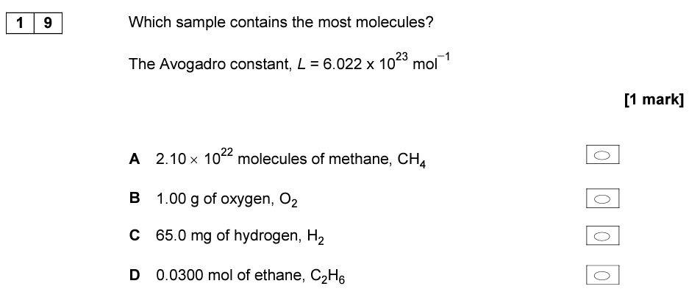
Quick test

Slide 20
Moles in solutions
When a solute dissolves in a solvent to give a solution the concentration of the solution is given in either g dm⁻³ or, more commonly, mol dm⁻³
1 dm⁻³ = 1000 cm⁻³
i.e. if I take 58.5 grams of NaCl and dissolve it in 500 cm³ of water, we get a concentration of 117 g dm⁻³ . Since the Mr for NaCl is 58.5, this is equal to 2 mol dm⁻³

Slide 21
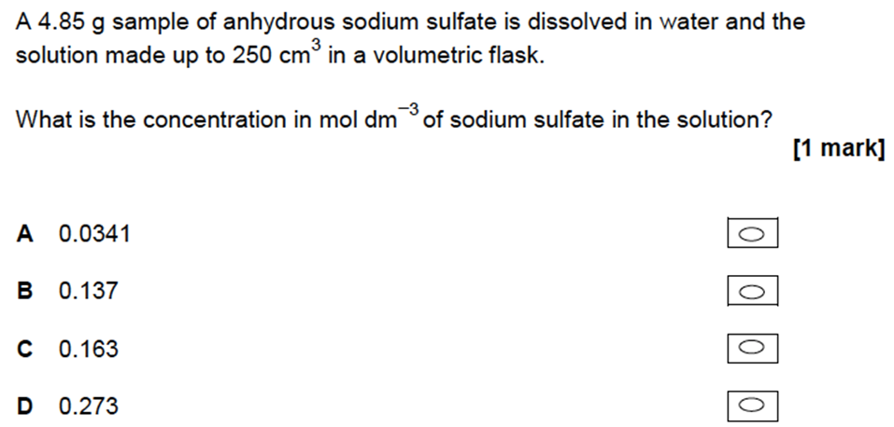
Quick test

Slide 22
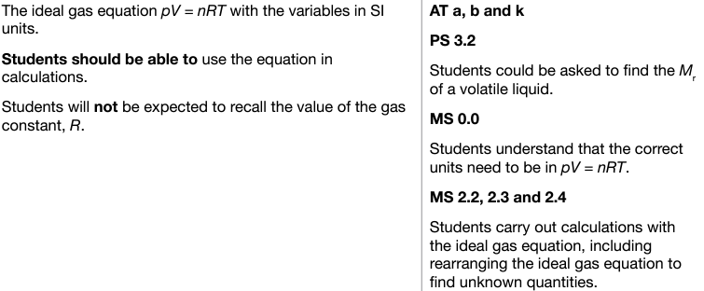
3.1.2.3 The ideal gas equation

Slide 23
Avogadro’s law
Avogadro’s law:
Equal volumes of different gases, at the same pressure and temperature, will contain equal numbers of particles.
For example, if, at a certain temperature and pressure, there are 3 moles of Cl₂ in 100 dm³ of chlorine gas, then there will be 3 moles of N₂ in 100 dm³ of nitrogen gas and 3 moles of CH₄ in 100 dm³ of methane gas at the same temperature and pressure.
The volume that a gas occupies will depend on the number of moles, n, of the gas.
Notes:
Pg 11

Slide 24
The ideal gas equation
Gas constant
8.31 J K⁻¹ mol⁻¹
(no need to learn this)
PV = nRT
Pressure (Pa)
Temperature (K)
Volume (m³)
Number of moles of gas (mol)
n = mass/Mr

Slide 25
Ideal gas equation: converting units
Most questions relating to the ideal gas equation will require some unit conversions
Pressure
to convert kPa to Pa:
× 1000 e.g. 11.2 kPa = 11200 Pa
Volume
to convert dm³ to m³:
to convert cm³ to m³:
÷ 1000 (10³) e.g. 24 dm³ = 2.4 x 10⁻² m³
÷ 1 000 000 (10⁶) e.g. 24 cm³ = 2.4 x 10⁻⁵ m³
Temperature
to convert °C to Kelvin:
+ 273 e.g. 20 °C = 293 K

Slide 26
TASK - Convert the following units into standard units for PV = nRT
28 ºC
400 kPa
50 m³
5000000 cm³
1000000 dm³
298 K
5 MPa
301K
400,000 Pa
50 m³
5 m³
1000 m³
298 K
5,000,000 Pa

Slide 27
TASK - Rearrange PV=nRT making the following the subject;
P =
V =
n =
T =
nRT
V
nRT
P
PV
RT
PV
nR

Slide 28
TASK
A sample of ammonia gas occupied a volume of 1.53 × 10^{–2} m³ at 37 °C
and a pressure of 100 kPa.
(The gas constant R = 8.31 JK^{–1} mol^{–1})
Calculate the amount, in moles, of ammonia in this sample.
PV = nRT
n = PV P = 100000 Pa
RT V = 1.53 x 10⁻² m³
R = 8.31 JK⁻¹mol⁻¹
n = 100000 x 1.53 x 10⁻² T = 310 K
8.31 x 310
n = 0.594 mol

Slide 29
TASK
CaC_{2(s)} + 2H₂O_{(l)} → Ca(OH)_{2(aq)} + C₂H_{2(g)}
A student reacted a 1.33g sample of impure calcium carbide with an excess of water and collected the ethyne gas produced. The volume collected was 3.88 x 10⁻⁴ m³.
State the ideal gas equation and use it to calculate the number of moles of ethyne collected at 284K and 101 kPa.
PV = nRT
n = PV P = 101000 Pa
RT V = 3.88 x 10⁻⁴ m³
R = 8.31 JK⁻¹mol⁻¹
n = 101000 x 3.88 x 10⁻⁴ T = 284 K
8.31 x 284
n = 0.017 mol

Slide 30
Quick test
Use your previous answer (0.0166 mol) to calculate the mass of calcium carbide (M_{r}=64.1) which reacted with water. Hence calculate the percentage purity of the 1.33g sample of impure calcium carbide used.
CaC_{2(s)} + 2H₂O_{(l)} → Ca(OH)_{2(aq)} + C₂H_{2(g)}
Since 1 mole of C₂H₂ from 1 mole of CaC₂ then there must have been 0.0166 mol of CaC₂. That equates to 64.1 x 0.0166 grams of calcium carbide i.e 1.064 g. As this is from 1.33 g of impure material, the purity must be (1.064/1.33) x 100 = 80 %

Slide 31
Quick test
Boron trichloride (BCl₃) can be prepared as shown by the following equation.
B₂O_{3(s)} + 3C_{(s)} + 3Cl_{2(g)} → 2BCl_{3(g)} + 3CO_{(g)}
A sample of boron oxide (B₂O₃) was reacted completely with carbon and chlorine.
The two gases produced occupied a total volume of 5000cm³ at a pressure of 100 kPa and a temperature of 298 K.
Calculate the mass of boron oxide that reacted.
Give your answer to 3 significant figures.
(The gas constant R = 8.31 JK^{–1} mol^{–1})

Slide 32
B₂O_{3(s)} + 3C_{(s)} + 3Cl_{2(g)} → 2BCl_{3(g)} + 3CO_{(g)}
PV = nRT, so n = PV/RT P = 100000 Pa
V = 5 x 10⁻³ m³
T = 298 K
R = 8.31 JK^{–1} mol^{–1}
n = 0.2019 moles (of gas produced)
Since 1 mole of boron oxide gives rise to 5 moles of gas produced,
There must have been 0.040 moles of B₂O_{3(s)}. This is equal to a mass of, 0.04038 x 69.6 (the Mr of B₂O_{3(s)}) =2.81 g to 3 s.f.

Slide 33
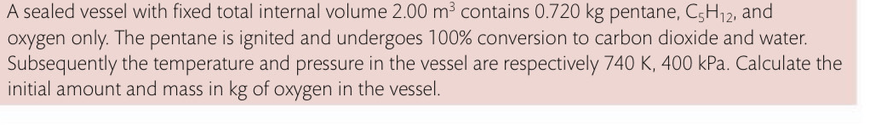
TRICKIER TASK
Moles of CO₂, H₂O and any excess O₂ at end ….
PV =nRT P = 400,000 Pa
T = 740 K
V = 2.00 m³
R = 8.31 J⁻¹mol⁻¹
n = PV/RT
n = 130 moles (50 moles CO₂ + 60 moles H₂O
AND 20 moles left over O₂)
Moles pentane = 720/72 = 10
Total moles of oxygen used = 80 from your equation ratios
Total moles of oxygen = 80 + 20 = 3200g = 3.20 kg

Slide 34
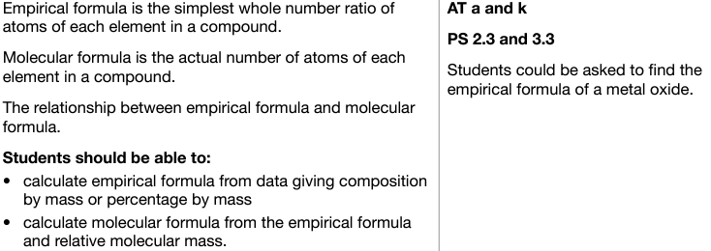
3.1.2.4 Empirical and molecular formula

Slide 35
Empirical formula
The formula that represents the simplest ratio of atoms of each element present in a compound.
Empirical formula of carbon dioxide = CO₂
(ratio of two oxygen atoms per carbon)
This ratio stays the same e.g.
100 molecules of CO₂ contain 100 atoms of carbon and 200 atoms of oxygen
1 mole of CO₂ contains one mole of carbon atoms and 2 moles of oxygen atoms
6 moles of CO₂ contains 6 moles of carbon atoms and 12 moles of oxygen atoms.
Notes:
Example on board pg.3 – CH4

Slide 36
Empirical formula
gives the actual number of atoms of each element in one molecule of the compound
Sometimes the empirical formula and molecular formula for a compound are the same e.g. In the case of CO₂.
Sometimes they are different, meaning that there are several units of the empirical formula in the molecular formula e.g.
Molecular formula of ethane = C₂H₆ (molecule contains two carbon atoms and six carbon atoms).
Empirical formula of ethane = CH₃ (ratio of one carbon to three hydrogen atoms)
There are two units of the empirical formula in the molecular formula.

Slide 37
Calculating empirical and molecular formula
Find the masses of each of the elements present in a compound by experiment. If given as a % then % = g for example make 23% C = 23g C
Work out the number of moles of atoms of each element by using:
Number of moles = mass/Ar
3. Find the simplest ratio of moles of each element and convert into a whole number ratio by dividing through by the smallest number of moles
4. You may need to scale up to get the smallest whole number ratio
5. Mr of MF = no. of units of EF in molecule
Now multiply EF by this number to find MF
Mr of EF
Notes:
Example on board pg.4 CH2 Mr=42, molecular formula = C3H6

Slide 38
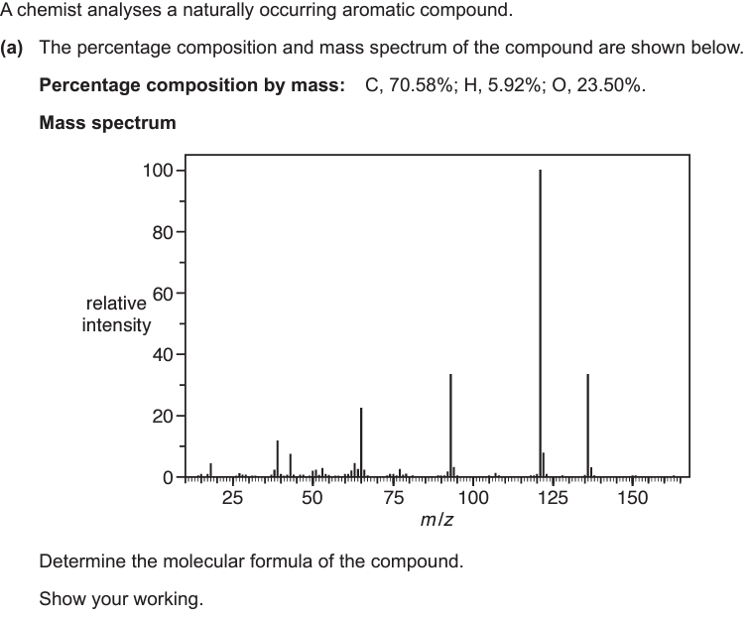
Quick test

Slide 39
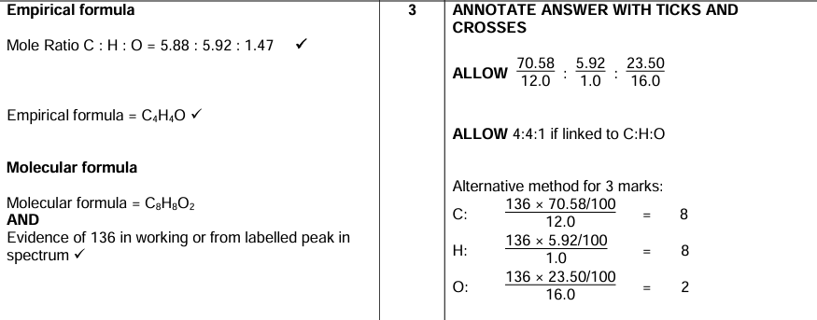
Answer

Slide 40
Combustion Analysis
X + O₂ → a.CO₂ + b.H₂O
How to approach these types of questions…
Step 1: Write a balanced symbol equation using the above.
Step 2: Write down any masses you have been given
Step 3: Calculate the number of moles and EF, then use the Mr to calculate the MF.
If you do not know the mass of X, don’t panic.
Do as above, but instead of Step 3, calculate how many moles of C and H there are, giving an empirical formula for just C and H. You then need to list possibilities for multiples of the empirical formula plus oxygen (O=16.0) that match the Mr.
Notes:
Example on board.

Slide 41
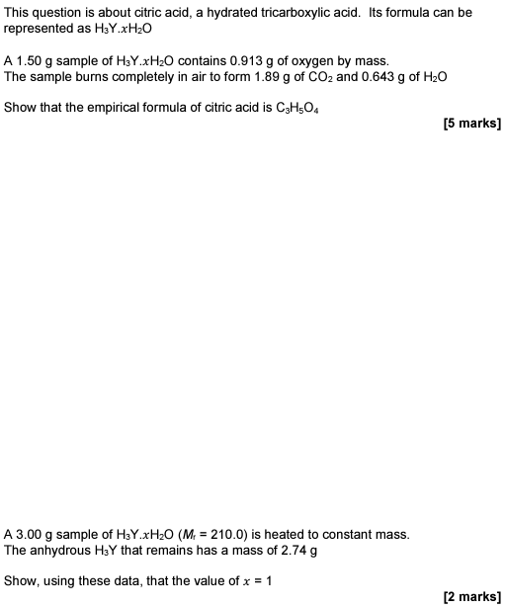
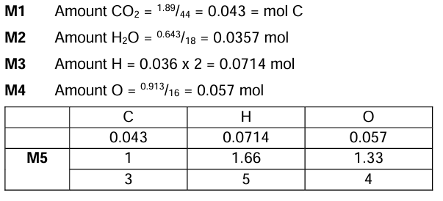
Quick test

Slide 42
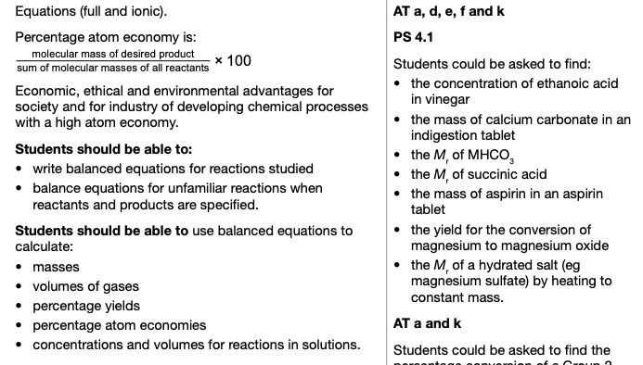
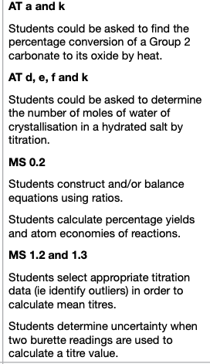
3.1.2.5 Balanced equations and associated calculations

Slide 43
Writing balanced symbol equations
Ensure that the number of all different atoms on each side of the equation are equal e.g. if there are 3 sulphur atoms on the left (reactant) side, then there MUST be 3 sulphur atoms on the left (product) side too.
Example. Balance the thermal decomposition of Lead (II) nitrate crystals to give solid Lead (II) oxide, Nitrogen dioxide gas and Oxygen. (State symbols are USUALLY only required for Ionic equations (see later) but it is good practice to add them if you can.
Write out the unbalanced equation Pb(NO₃)_{2(s)} → PbO_{(s)} + NO_{2(g)} + O_{2(g)}
Taking each atom in turn, compare the numbers on each side –
Pb has 1 on both sides – leave for the time being
There are 2 Ns on the left but only 1 on the right – Add a 2 in front of NO₂
Pb(NO₃)_{2(s)} → PbO_{(s)} + 2NO_{2(g)} + O_{2(g)}
There are now 6 Oxygens on the left but 7 on the right – Since any number can go in front of the O₂ we can change this to ½ O₂
The balanced equation is now, Pb(NO₃)_{2(s)} → PbO_{(s)} + 2NO_{2(g)} + ½ O_{2(g)}
NB If you prefer integer values, simply multiply everything by x2.
2Pb(NO₃)_{2(s)} → 2PbO_{(s)} + 4NO_{2(g)} + O_{2(g)}
Notes:
Pentane b.p=36oc

Slide 44
TASK – Balance the following equations
Calcium reacting with steam to form calcium oxide and hydrogen
Hydrogen reacting with oxygen to form water
Nitrogen reacting with hydrogen to form ammonia.
Calcium carbonate reacting with hydrochloric acid to form calcium chloride, water and carbon dioxide.
Pentane burning in oxygen to form carbon dioxide and water
Aluminium reacting with sulphuric acid to form aluminium sulphate and hydrogen
Iron III oxide reacting with carbon monoxide to form carbon dioxide and iron.
Ca_{(s)} + H₂O_{(g)} → CaO_{(s)} + H_{2(g)}
2H_{2(g)} + O_{2(g)} → 2H₂O_{(l)}
N_{2(g)} + 3H_{2(g)} → 2NH_{3(l)}
CaCO_{3(s)} + 2HCl_{(aq)} → CaCl_{2(aq)} + H₂O_{(l)} + CO_{2(g)}
C₅H_{12(l)} + 8O_{2(g)} → 5CO_{2(g)} + 6H₂O_{(g)}
Al_{(s)} + 3H₂SO_{4(aq)} → Al₂(SO₄)_{3(aq)} + 3H_{2(g)}
Fe₂O_{3(s)} + 3CO_{(g)} → 3CO_{2(g)} + 2Fe_{(s)}
Notes:
Pentane b.p=36oc

Slide 45
Writing ionic equations
Work out chemical formulae for each compound
Write a balanced equation
Include state symbols
Separate any aqueous ions. Leave out any covalent or metallic substances.
Cancel out spectator ions
Write overall equation (ensure state symbols are included)
Check charges – the total charges on each side must be the same.
Example Ionic equation for the reaction between barium chloride and magnesium sulphate to form magnesium chloride and barium sulphate precipitate,
Barium chloride = BaCl_{2(aq)}, Magnesium sulphate = MgSO_{4(aq)}, Magnesium chloride = MgCl_{2(aq)},
Barium sulphate = BaSO_{4(s)}
BaCl_{2(aq)} + MgSO_{4(aq)} → MgCl_{2(aq)} + BaSO_{4(s)}
Separate aqueous ions Ba²⁺_{(aq} + 2Cl⁻_{(aq)} + Mg²⁺_{(aq)} + SO₄²⁻_{(aq)} → Mg²⁺_{(aq)} + 2Cl⁻_{(aq)} + BaSO_{4(s)}
Cancel ions on both sides Ba²⁺_{(aq} + 2Cl⁻_{(aq)} + Mg²⁺_{(aq)} + SO₄²⁻_{(aq)} → Mg²⁺_{(aq)} + 2Cl⁻_{(aq)} + BaSO_{4(s)}
(these are the spectator ions)
What remains is the ionic equation Ba²⁺_{(aq} + SO₄²⁻_{(aq)} → BaSO_{4(s)}
Notes:
Pg 69 clark Q1-3

Slide 46
TASK – Write out the following IONIC equations
Magnesium reacting with sulphuric acid
Nitric acid reacting with sodium hydroxide
Calcium carbonate reacting with hydrochloric acid
The reaction between iron and copper (II) sulphate solution
Mg_{(s)} + 2H⁺ _{(aq)} → Mg²⁺_{(aq)} + H_{2(g)}
H⁺_{(aq)} + OH⁻_{(aq)} → H₂O_{(l)}
CO₃²⁻_{(s)} + 2H⁺_{(aq)} → CO_{(g)} + H₂O_{(l)}
Fe_{(s)} + Cu²⁺_{(aq)} → Cu_{(s)} + Fe²⁺_{(aq)}
Notes:
Pentane b.p=36oc

Slide 47
Water of crystallisation
Zinc forms many different salts including zinc sulfate, zinc chloride and zinc fluoride.
People who have a zinc deficiency can take hydrated zinc sulfate (ZnSO₄.xH₂O) as a dietary supplement, where x ios the number of moles of water associated with each mole of ZnSO₄.
A student heated 4.38 g of hydrated zinc sulfate to constant mass, and obtained 2.46 g of anhydrous zinc sulfate.
Use these data to calculate the value of the integer x in ZnSO₄.xH₂O
Mass of water lost = 4.38 – 2.46 = 1.92 g
Moles of water = 1.92/18 = 0.107 mol
Moles of ZnSO₄ = Mass of anhydrous zinc sulphate/ Mr ZnSO₄ = 2.46/161.5 = 0.0152 mol
x is the ration of moles H₂O : ZnSO₄ = 0.107/0.0152 = 7 (as an integer)

Slide 48
TASK – Calculate the value of x for the following compound
Hydrated calcium nitrate can be represented by the formula Ca(NO₃)₂.xH₂O where x is an integer.
A 6.04 g sample of Ca(NO₃)₂.xH₂O was heated in a crucible to constant mass. The resultant anhydrous solid had a mass of 4.20 g.
4.20 g Ca(NO₃)₂
Ca(NO₃)₂ H₂O
4.20 1.84
164(.1) 18
0.0256 0.102
1 : 3.98
x = 4

Slide 49
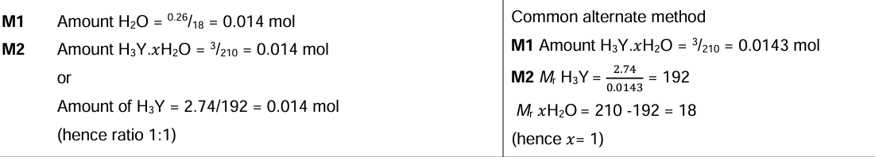
Quick test

Slide 50
Percentage yield
CH₄ + 2Cl₂ → CH₂Cl₂ + 2HCl
In an ideal world in which chemical reactions are performed perfectly, the maximum amount of desired product possible would be produced (e.g. For every 1 mole of CH₄ and 2 moles of Cl_{2,} 1 mole of CH₂Cl₂ would be produced.
Unfortunately, this is very difficult to achieve. Often reactions do not go to completion or some of one of the reactants is converted to by-products (or a combination of the two) or there are losses in purification steps.
We therefore must calculate the percentage yield for a reaction to take these things into account.

Slide 51
Percentage yield is a practical measure of the efficiency of a reaction.
It takes into account reactions that do not go to completion as well as experimental losses.
It can only be calculated from experimental data.
Percentage Yield = Actual mass obtained of the desired product X 100
Maximum theoretical mass of the desired product
The maximum theoretical mass is governed by the reaction stoichiometry and the number of moles of the LIMITING REACTANT.

Slide 52
Percentage yield
If a reaction can “theoretically” produce 200 g of a product, but only 140 g is “actually” obtained, then the percentage yield is;
140g
200g x 100 = 70%

Slide 53
Example:
In an experiment 21.3 g of CH₂Cl₂ were produced when 8.0 g of methane were reacted with an excess of chlorine.
Calculate the percentage yield of dichloromethane (CH₂Cl₂) produced.
CH₄ + 2Cl₂ → CH₂Cl₂ + 2HCl
Step 1: calculate the number of moles of the known reactant (CH₄)
= 8.0/16 = 0.5 mol
Step 2: use molar ratio to work out the number of moles of desired product produced (CH₂Cl₂)
1:1 molar ratio so 0.5 mol
Step 3: calculate the theoretical mass of product produced
0.5 mol x 85 = 42.5 g
Step 4: use formula to calculate % yield
21.3/42.5 x 100 = 50.1 %

Slide 54
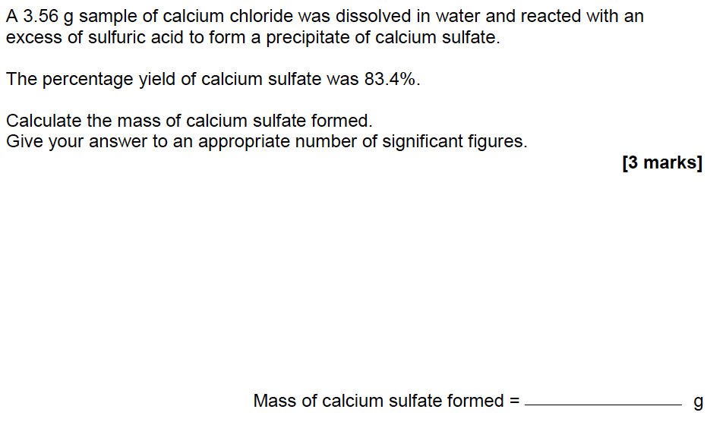
Quick test
CaCl₂ + H₂SO₄ → CaSO₄ + 2HCl
Moles CaCl₂ = 3.56/111.1 = 0.0320
Moles CaSO₄ formed = 0.0320 x 83.4/100 = 0.0267
Mass CaSO₄ formed = 0.0267 x 136.2 = 3.64 g

Slide 55
Atom economy
The atom economy is a measure of how much of a desired product in a reaction is formed from the reactants.
It is a theoretical quantity calculated from a balanced equation.

Slide 56
Atom economy
A company wants to synthesis dichloromethane (CH₂Cl₂) by the following process:
CH₄ + 2Cl₂ → CH₂Cl₂ + 2HCl
As you can see not all of the atoms that go into the chemical reaction are contained in the desired product – some are wasted!
CALCULATION
1. Calculate the mass of the desired product and the reactants using n=m/Mr and the molar ratios.
Mass of one mole of CH₂Cl₂ = 85 (Desired product)
Mass of one mole of CH₄ = 16
Mass of two moles of Cl₂ = 142
2. Put masses into equation to calculate % atom economy
% atom economy = 85/158 x 100 = 53.8 % (to 3 sf)

Slide 57
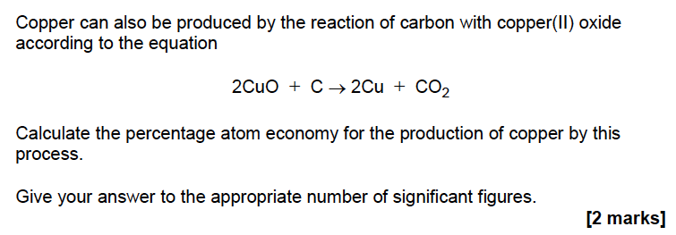

Quick test

Slide 58
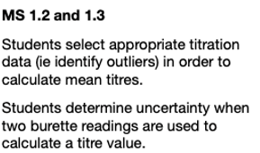
Concentrations and volumes for reactions in solutions

Slide 59
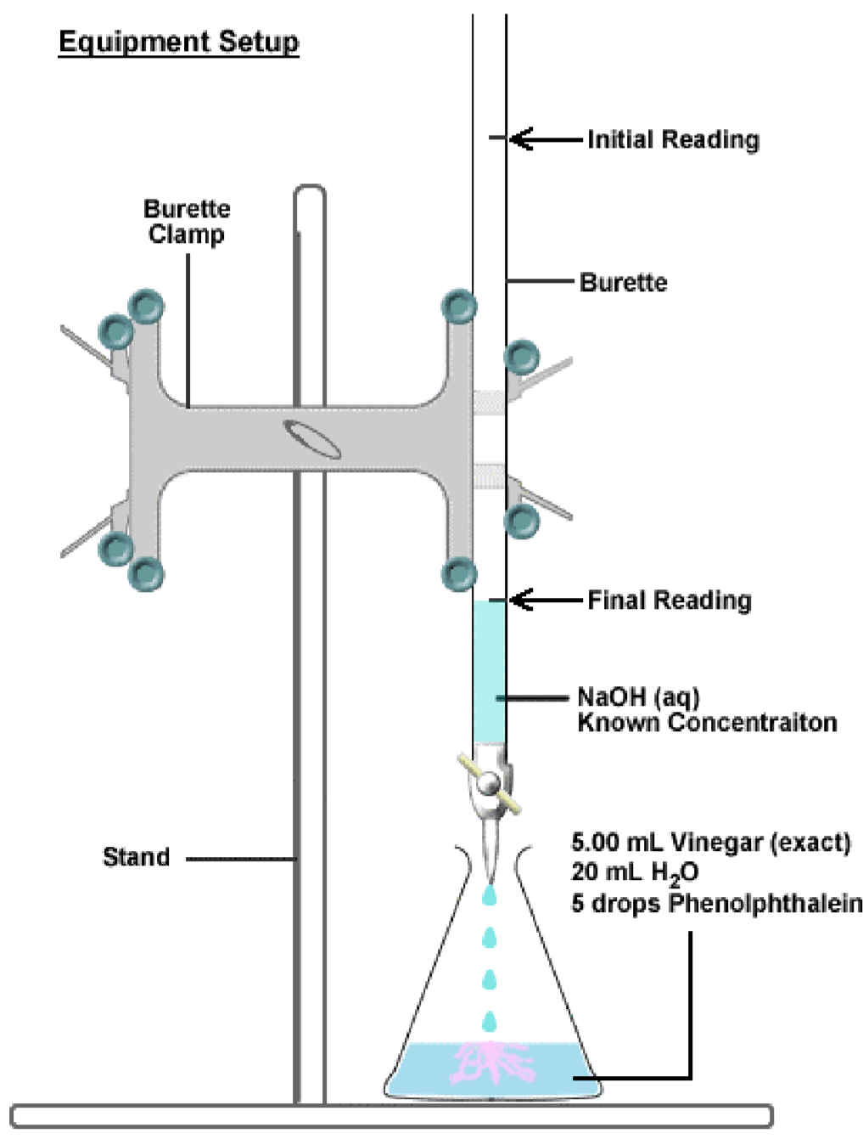
Titrations
Titrations enable chemists to determine the amount (moles) of an unknown solution (typically an acid or alkali), by reacting it with a known amount of standard solution.
For a neutralisation reaction where the acid concentration is to be determined, the equipment opposite may be used.
Firstly, an accurate (using a pipette) volume of the acid is added to a conical flask. A few drops of indicator are added, and the flask is placed over a white tile (or paper).
Next, a known concentration of the alkali (titrant) is placed into a burette, and then added to the acid until the endpoint is reached.
Using the balanced equation, we can now work out the amount of acid present and hence its concentration.
Unknown concentration of acid

Slide 60
Good practice in titrations
Use of the PIPETTE
Rinsing with solution being titrated
No bubbles
Empties under gravity
Transfers from pipette without spillage
Touches surface of solution with pipette
Overfills pipette first and allows to drop down to line
Use of the BURETTE
Removes the funnel before titrating
De-ionised water bottle
Dropwise addition near the endpoint
Swirls mixture
Reads burette correctly
White tile and use of paper

Slide 61
Calculating the mean titre
Titration number | 1 (Rough) | 2 | 3 | 4 | 5
Final burette reading/ cm³ | 26.75 | 32.65 | 28.60 | 37.15 | 34.00
Initial burette reading/ cm³ | 0.00 | 6.60 | 2.65 | 11.15 | 7.75
Titre/ cm³ | 26.75 | 26.05 | 25.95 | 26.00 | 26.25
Titre volumes to 0.05 cm³.
Your aim is to obtain a minimum of two titres which are within 0.10 cm³ of each other. You will take an average of these titres and this will be your final mean titre result. It is important that you indicate which readings you used when calculating your mean titre. DO NOT include the rough titre.
Here the mean titre = 26.00 cm³

Slide 62
Worked example from Clark, Calculations in AS/A level Chemistry p62
25.0 cm³ of a solution of 0.100 mol dm⁻³ sodium hydroxide (NaOH) was neutralised by 23.5 cm³ of a dilute solution of hydrochloric acid (HCl). What is the concentration of the HCl?
Step 1: Write balanced equation and work out molar ratios (it may help to highlight the known and unknown values in different colours).
NaOH + HCl →NaCl + H₂O,
therefore 25.0 cm³ of 0.100 mol dm⁻³ NaOH is equivalent to 23.5 cm³ of unknown HCl
Step 2: Convert given values into correct units.
25.0 cm³ = 0.025 dm³ and 23.5 cm³ = 0.0235 dm³
Step 3: Calculate the no. moles of the known substance (NaOH in this case) using the information given in the question and C=n/V → n=CV
n NaOH = 0.025 x 0.1 = 0.0025 mol
Step 4: Use the molar ratio to work out no. of moles of unknown substance (HCl in this case) that reacts.
n HCl = n NaOH = 0.0025 mol
Step 5: Use the no. moles of unknown (HCl) to calculate its concentration/ volume/ mass etc (C=n/V and/or mass = n x Mr).
Concentration HCl = 0.0025 mol / 0.0235 dm³ = 0.106 mol dm⁻³

Slide 63
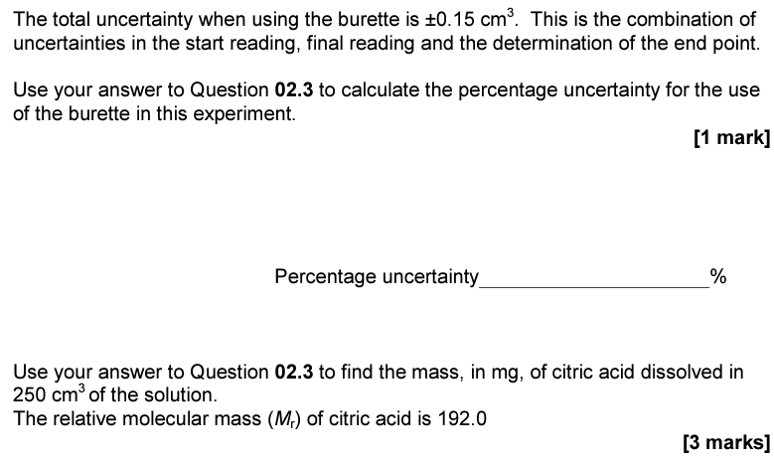
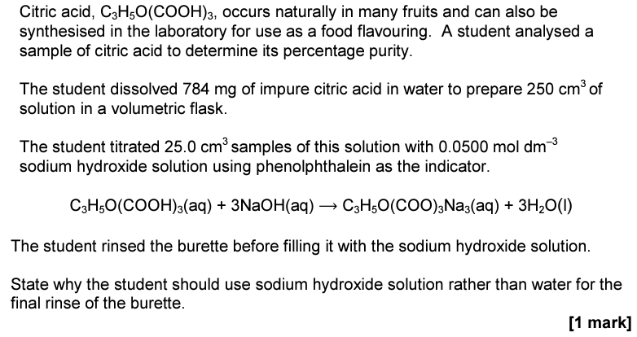
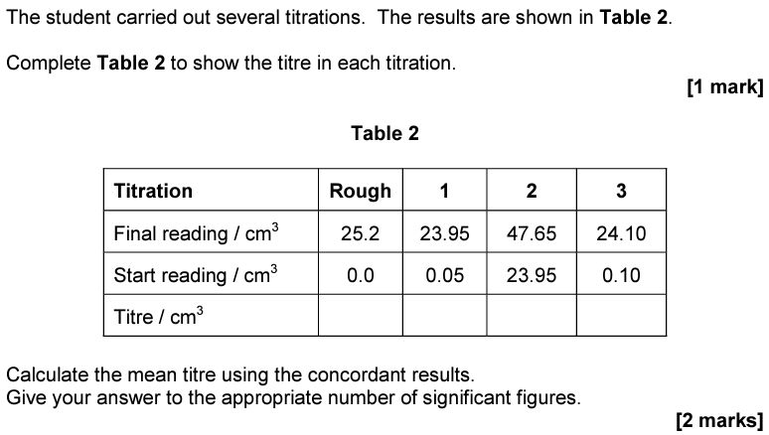
Try this

Slide 64
Extra - Uncertainty
Every measurement that we take has an associated uncertainty attached to it. This is typically expressed as % uncertainty or ± a specific value.
If we use a 25 cm³ pipette to accurately measure some liquid, the pipette will have a stated tolerance stamped on it eg. ± 0.05 cm³
This is equivalent to a percentage relative uncertainty of 0.2%.
When a burette is used for titrations, there are two volume readings to consider, both of which are subject to uncertainty. If the tolerance for each reading is
± 0.05 cm³, then the overall delivered volume will be ± 0.10 cm³

Slide 65
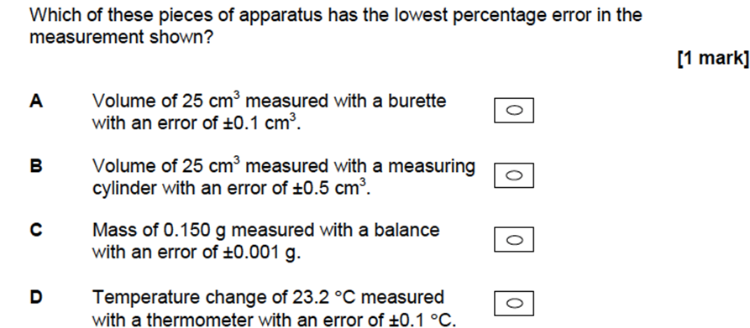
Extra - Uncertainty

Slide 66
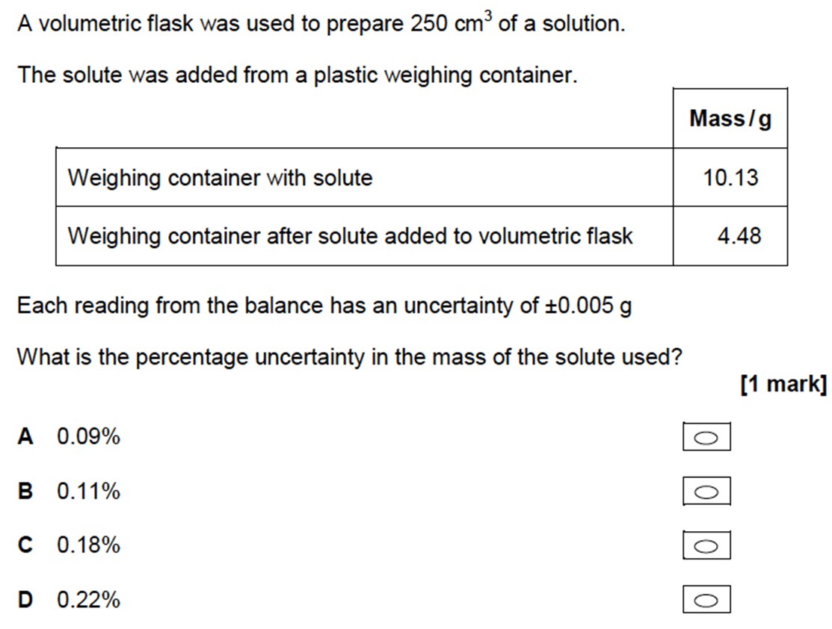
Extra - Uncertainty

