Slide 1


Physical Chemistry Year 1 - AS 3.1.3 Bonding
Dr John R Griffiths
Sci-Excel Tuition
www.sciexcel.org

Slide 2
Physical Chemistry Year 1 3.1.3 Bonding
3.1.3.1 Ionic bonding
3.1.3.2 Nature of covalent and dative covalent bonds
3.1.3.3 Metallic bonding
3.1.3.4 Bonding and physical properties
3.1.3.5 Shapes of simple molecules and ions
3.1.3.6 Bond polarity
3.1.3.7 Forces between molecules

Slide 3
3.1.3.1 Ionic bonding
Ionic bonding involves electrostatic attraction between oppositely charged ions in a lattice.
The formulae of compound ions, eg sulfate, hydroxide, nitrate, carbonate and ammonium most be known.
Students should be able to:
predict the charge on a simple ion using the position of the element in the Periodic Table
construct formulae for ionic compounds

Slide 4
Charges on ions
Ion name | Formula and charge | Example
Sulfate | SO₄ ²⁻ | H₂SO₄ - sulfuric acid
Hydroxide | OH ⁻ | NaOH - sodium hydroxide
Nitrate | NO₃ ⁻ | HNO₃ - nitric acid
Carbonate | CO₃ ²⁻ | CaCO₃ - calcium carbonate
Phosphate | PO₄ ³⁻ | H₃PO₄ - phosphoric acid
Ammonium | NH₄ ⁺ | NH₄Cl - ammonium chloride
It is important to LEARN these common ions and their charges

Slide 5
Charges on ions
Group Number | Charge on ion | Example
1 | 1+ | Na ⁺
2 | 2+ | Mg ²⁺
3 | 3+ | Al ³⁺
5 | 3- | N ³⁻
6 | 2- | O ²⁻
7 | 1- | Cl ⁻
Transition metals have multiple charge states eg Cu⁺ and Cu²⁺
Group 0 elements do not form ions readily – Noble gases
Carbon and silicon do not form ions readily – Covalent bonding

Slide 6
Ionic compounds
Positive and negative charges must balance in an uncharged ionic compound. Predict the following ionic compound formulae…….
Cation | Anion | Formula
Sodium | Sulfate
Magnesium | Oxide
Aluminium | Chloride
Ammonium | Phosphate
Potassium | Nitrate
Calcium | Hydroxide

Slide 7
Ionic compounds
Positive and negative charges must balance in an uncharged ionic compound. Predict the following ionic compound formulae…….
Cation | Anion | Formula
Sodium | Sulfate | Na₂SO₄
Magnesium | Oxide | MgO
Aluminium | Chloride | AlCl₃
Ammonium | Phosphate | (NH₄)₃PO₄
Potassium | Nitrate | KNO₃
Calcium | Hydroxide | Ca(OH)₂

Slide 8
Ionic compounds
TASK
For each of the following atoms/ions, write the electron arrangement,
e.g. Magnesium, Mg = 1s² 2s² 2p⁶ 3s²
Na =
Cl ⁻ =
C =
O ²⁻ =
Al =

Slide 9
Ionic compounds
TASK
For each of the following atoms/ions, write the electron arrangement,
e.g. Magnesium, Mg = 1s² 2s² 2p⁶ 3s²
Na = 1s² 2s² 2p⁶ 3s¹
Cl ⁻ = 1s² 2s² 2p⁶ 3s² 3p⁶
C = 1s² 2s² 2p²
O ²⁻ = 1s² 2s² 2p⁶
Al = 1s² 2s² 2p⁶ 3s² 3p¹

Slide 10
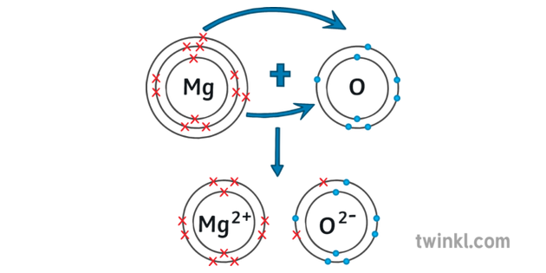
Ionic bonding
Ionic bonding occurs between metals and non-metals
Electrons are transferred from metal atoms to non-metal atoms
Positive and negative ions are formed
Ionic bonds are the result of strong electrostatic forces between these ions
Transfer of 2 electrons
e.g.
Mg atom
12 protons, 12 electrons
1s² 2s² 2p⁶ 3s²
O atom
8 protons, 8 electrons
1s² 2s² 2p⁴
Mg²⁺ ion
12 protons, 10 electrons
1s² 2s² 2p⁶ 3s⁰
O²⁻ ion
8 protons, 10 electrons
1s² 2s² 2p⁶
strong electrostatic forces of attraction

Slide 11
Ionic bonding
TASK
Show, using dot cross diagrams, how aluminium and oxygen form aluminium oxide

Slide 12
Ionic bonding
Aluminium
Oxygen
The formula is Al₂O₃ so two aluminium atoms combine with three oxygen atoms via electron transfer…………..
+

Slide 13
Ionic bonding
Aluminium
Oxygen
2-
3+
2-
The formula is Al₂O₃ so two aluminium atoms combine with three oxygen atoms via electron transfer…………..
3+
2-

Slide 14
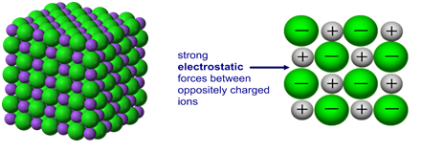
Ionic bonding
Strong electrostatic forces between oppositely charged ions
3D structure is a giant ionic lattice
The strong electrostatic attraction extends throughout the whole structure
How does this effect the properties ?

Slide 15
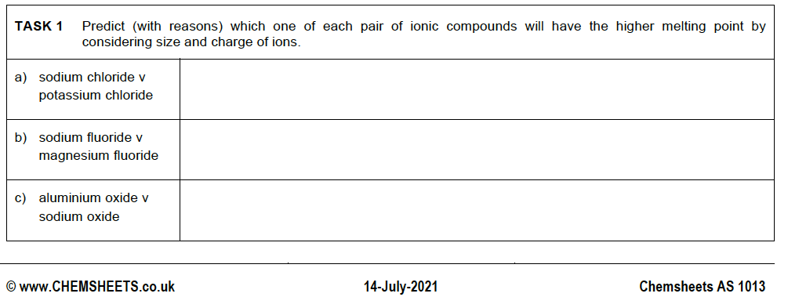
Ionic bonding
TASK

Slide 16
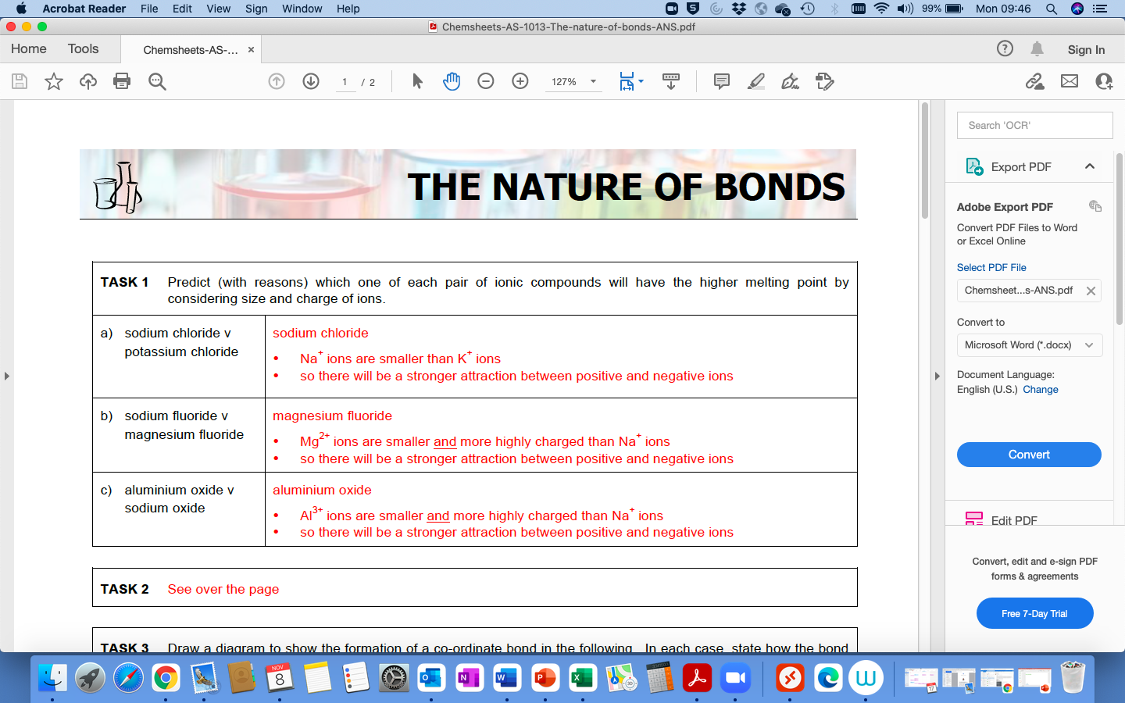
Ionic bonding
TASK

Slide 17
3.1.3.2 Nature of covalent and dative covalent bonds
A single covalent bond contains a shared pair of electrons.
Multiple bonds contain multiple pairs of electrons.
A co-ordinate (dative covalent) bond contains a shared pair of electrons with both electrons supplied by one atom.
Students should be able to represent:
a covalent bond using a line
a co-ordinate bond using an arrow.

Slide 18
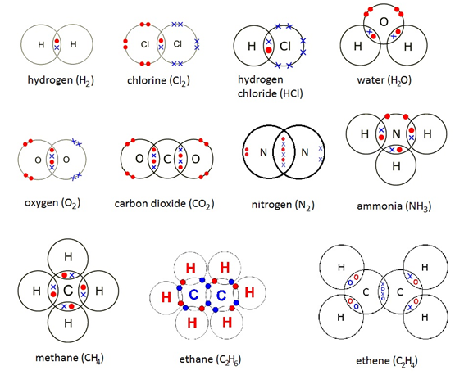
Covalent bonds
Each covalent bond contains a shared pair of electrons. A double bond contains two shared pairs and a triple bond has three shared pairs e.g.
H₂ is H-H O₂ is O=O N₂ is N≡N

Slide 19
Covalent bonds – An attractive force
Electron
A covalent bond is an electrostatic attraction between the nuclei and the shared electrons.
The attractive force is black and the repulsive forces are red.
These forces balance when the nuclei are a particular distance apart.
−
+
+
Proton
Proton
−
Electron
Hydrogen molecule

Slide 20
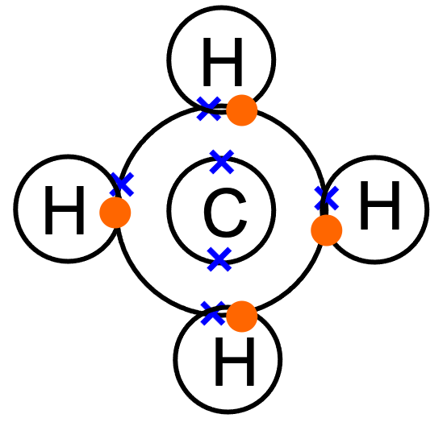
Covalent bonds
Hydrochloric acid - HCl
Methane – CH₄
Cl
H
No electrons have been added or taken away – a bond represents a shared pair of electrons

Slide 21
Covalent bonds
TASK – Draw dot cross diagrams to represent;
Water, carbon dioxide and ammonia

Slide 22
Co-ordinate (dative covalent) bonding
When ONE atom provides BOTH electrons in a covalent bond it is called co-ordinate, or dative covalent bonding
Write an equation for the reaction between ammonia and hydrogen chloride
Draw a dot/cross diagram to show what happens in the formation of ammonium chloride

Slide 23
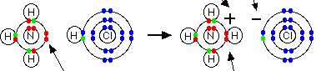
Co-ordinate (dative covalent) bonding
H
H
H
=
=
H
N
H
H
N
H
H
N
H
H
H
H
ammonium ion
N lone pair “donated”

Slide 24
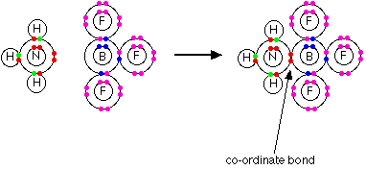
The reaction between ammonia and boron trifluoride
Draw a representation of this in terms of dot and cross diagrams

Slide 25
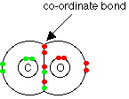
Carbon monoxide - CO

Slide 26
Quick test
Using a dot cross diagram, show how a dative bond is present in nitric acid (HNO₃)

Slide 27
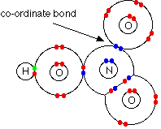
Nitric acid - HNO₃

Slide 28
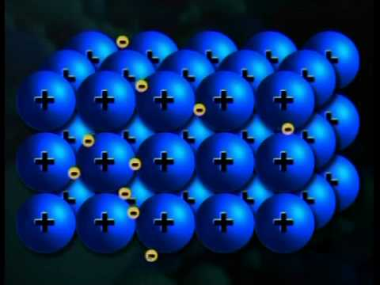
3.1.3.3 Metallic bonding
Metallic bonding involves attraction between a “sea” of delocalised (outer) electrons and positive ions arranged in a giant lattice.
e⁻
e⁻
M⁺
M⁺
M⁺
M⁺
M⁺
e⁻
e⁻
e⁻
e⁻
e⁻
M⁺
M⁺
M⁺
M⁺
M⁺
e⁻
e⁻
e⁻
e⁻
e⁻
e⁻
M⁺
M⁺
M⁺
M⁺
M⁺
e⁻
e⁻
e⁻
e⁻
Positive metal ions in a sea of delocalized electrons
3D giant lattice arrangement

Slide 29
Metallic bonding
TASK – With reference to the bonding in metals, explain why the melting point of Magnesium (650 ∘C) is higher than that of Sodium (98 ∘C).

Slide 30
3.1.3.4 Bonding and physical properties
The four types of crystal structure:
ionic
metallic
macromolecular (giant covalent)
molecular.
The structures of the following crystals as examples of these four types of crystal structure:
diamond, graphite, ice, iodine, magnesium, sodium chloride.
Students should be able to:
relate the melting point and conductivity of materials to the type of structure and the bonding present
explain the energy changes associated with changes of state
draw diagrams to represent these structures involving specified numbers of particles.

Slide 31
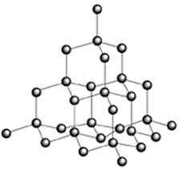
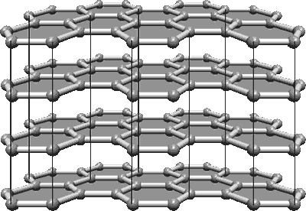
Types of structure – Macromolecular crystals (Giant covalent)
Diamond Graphite

Slide 32
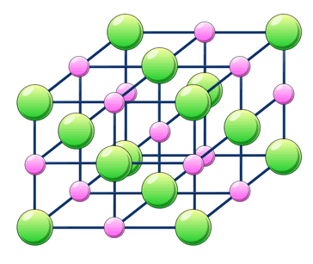
Types of structure – Ionic crystals (Giant ionic)
Sodium chloride

Slide 33
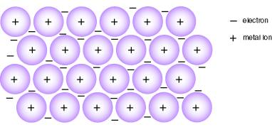
Types of structure – Metallic crystals (Giant metallic)
e.g. sodium

Slide 34
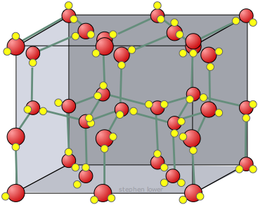
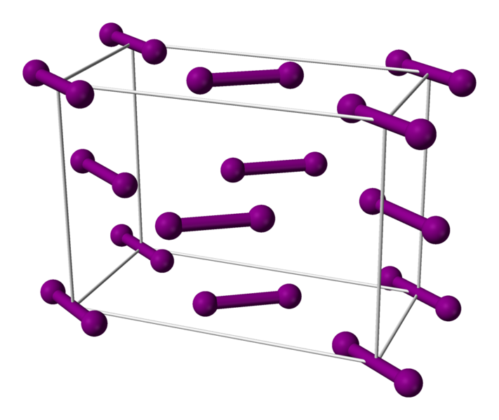
Types of structure – Molecular crystals (Simple molecular)
Ice Iodine

Slide 35
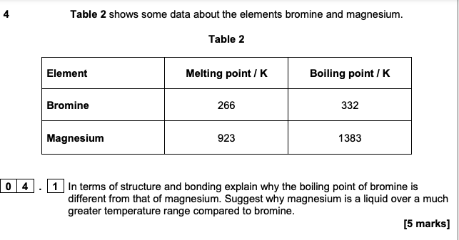
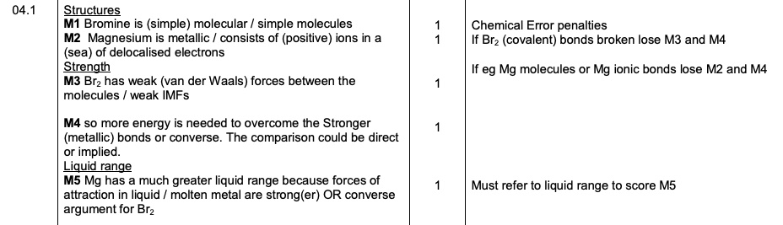
Example question

Slide 36
3.1.3.5 Shapes of simple molecules and ions
Bonding pairs and lone (non-bonding) pairs of electrons as charge clouds that repel each other.
Pairs of electrons in the outer shell of atoms arrange themselves as far apart as possible to minimise repulsion.
Lone pair–lone pair repulsion > lone pair–bond pair repulsion > bond pair–bond pair repulsion.
The effect of electron pair repulsion on bond angles.
Students should be able to:
explain the shapes of, and bond angles in, simple molecules and ions with up to six electron pairs (including lone pairs of electrons) surrounding the central atom.

Slide 37
Shapes of molecules and ions
Electron pair repulsion theory
Outer electrons are arranged in pairs
Electron pairs can be considered clouds of electron density which repel each other so they are as far apart as possible
Lone pair–lone pair repulsion > lone pair–bond pair repulsion > bond pair–bond pair repulsion.

Slide 38
Shapes of molecules and ions
Work out electrons in outer shell i.e group no. (noble gases are 8)
Add 1 electron for each bond formed (allows for electrons from atoms bonded to)
Allow for any ion charge
Divide total no.electrons by 2
Assume single bonds formed and work out bonding pairs from lone pairs

Slide 39


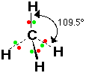

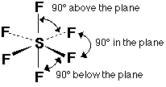
Working out the shape
2 electron pairs linear
3 electron pairs trigonal planar
4 electron pairs tetrahedral
5 electron pairs trigonal bipyramid
6 electron pairs octahedral

Slide 40
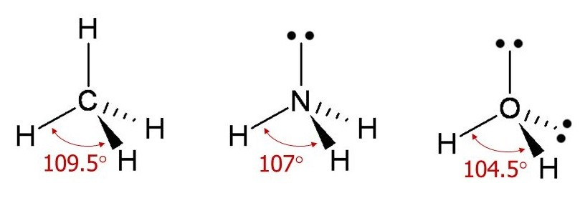
Molecules with lone pairs of electrons
e.g. ammonia (3 BP and 1 LP) and water (2 BP and 2 LP)
Lone pair–lone pair repulsion > lone pair–bond pair repulsion > bond pair–bond pair repulsion.
Non-linear
(V-shaped orBent)
Tetrahedral
Pyramidal
Bond angle is reduced by approx. 2.5∘ for each lone pair

Slide 41
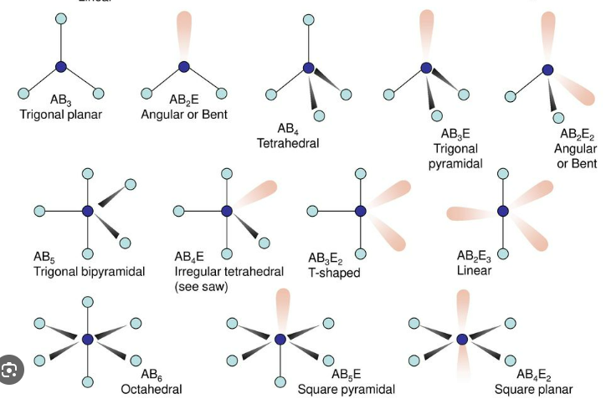

Shapes of molecules – a more comprehensive view
A = Central atom
B = Bonding pairs
E = Lone pairs

Slide 42
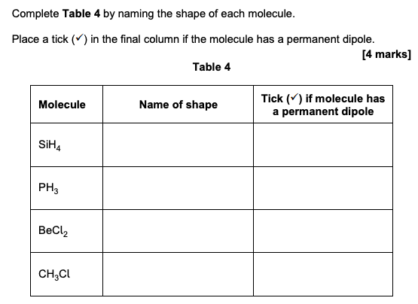
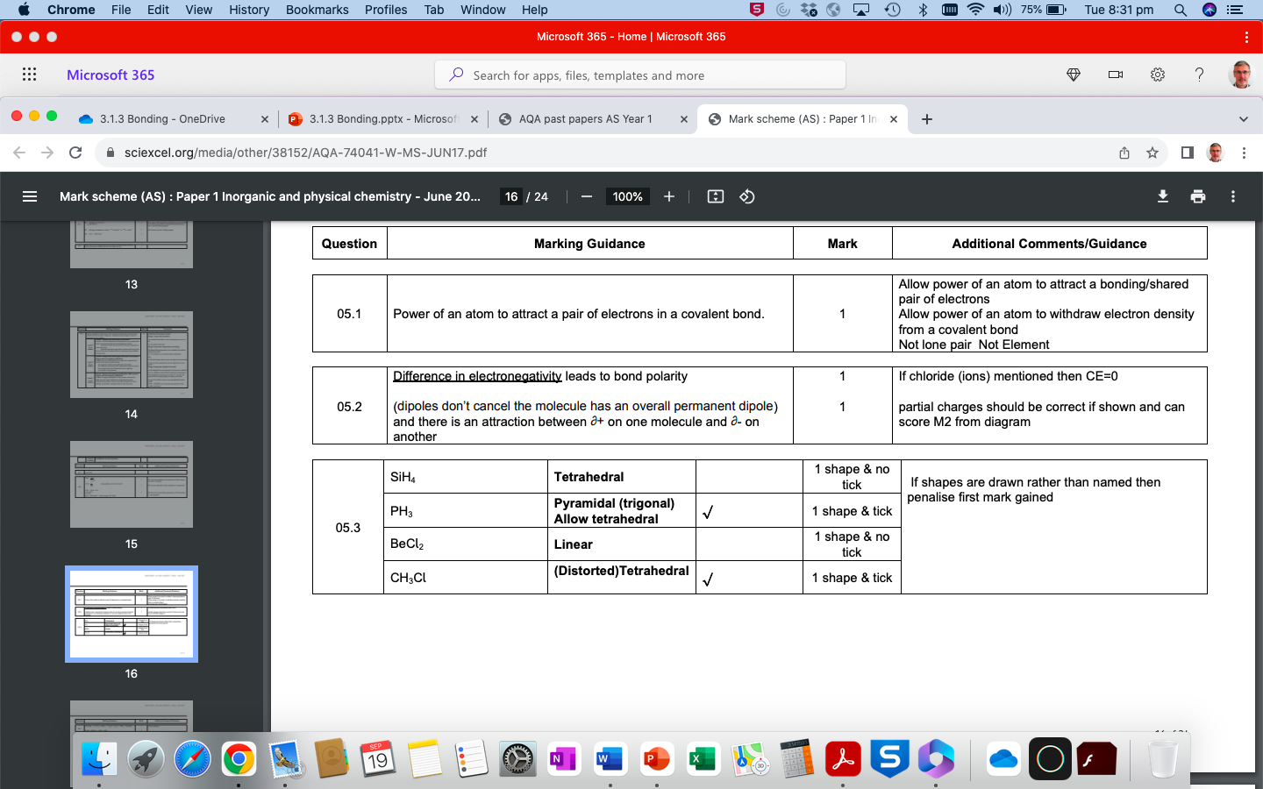
Example question

Slide 43
3.1.3.6 Bond polarity
Electronegativity as the power of an atom to attract the pair of electrons in a covalent bond.
The electron distribution in a covalent bond between elements with different electronegativities will be unsymmetrical. This produces a polar covalent bond, and may cause a molecule to have a permanent dipole.
Students should be able to:
use partial charges to show that a bond is polar
explain why some molecules with polar bonds do not have a permanent dipole.

Slide 44
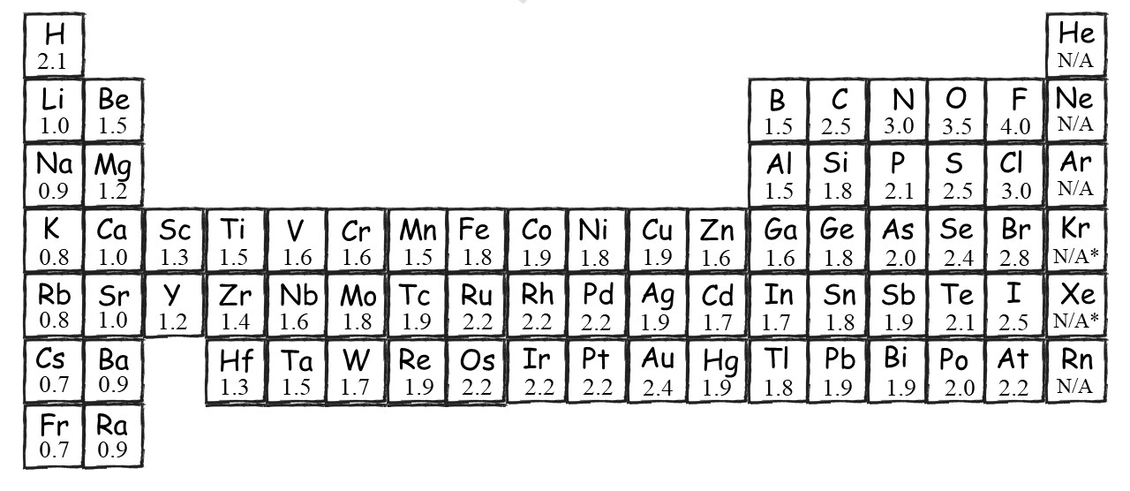
Electronegativity values
INCREASING ELECTRONEGATIVITY

Slide 45
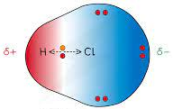
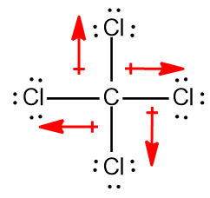
Partial charges
The electron distribution in a covalent bond between elements with different electronegativities will be unsymmetrical.

Slide 46
Polarity
TASK – Show which of the following molecules are polar;
CHCl₃
F₂
H₂O
CO₂
SF₆
Which of the molecules above have polar bonds

Slide 47
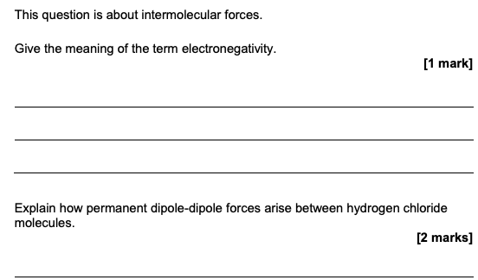
Example question

Slide 48
3.1.3.7 Forces between molecules
Forces between molecules:
permanent dipole–dipole forces
induced dipole–dipole (van der Waals, dispersion, London) forces
hydrogen bonding.
The melting and boiling points of molecular substances are influenced by the strength of these intermolecular forces.
The importance of hydrogen bonding in the low density of ice and the anomalous boiling points of compounds.
Students should be able to:
explain the existence of these forces between familiar and unfamiliar molecules
explain how melting and boiling points are influenced by these intermolecular forces.

Slide 49
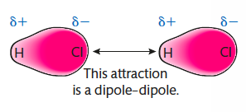
Dipole-dipole forces

Slide 50
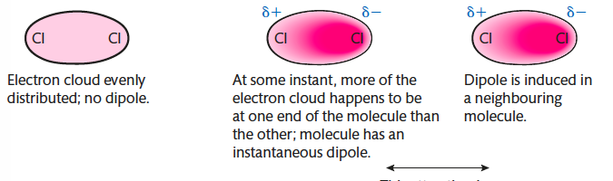
van der Waals forces (London forces)

Slide 51
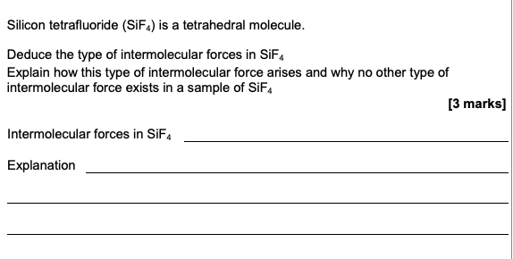
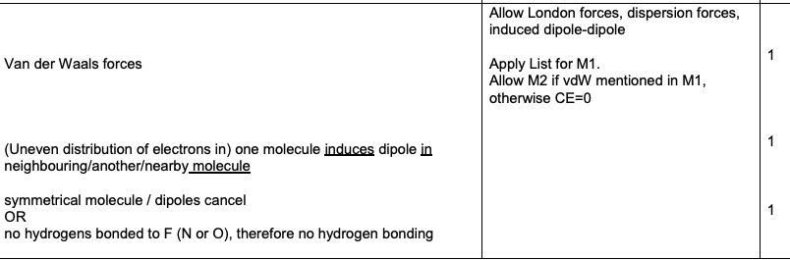
Example question

Slide 52
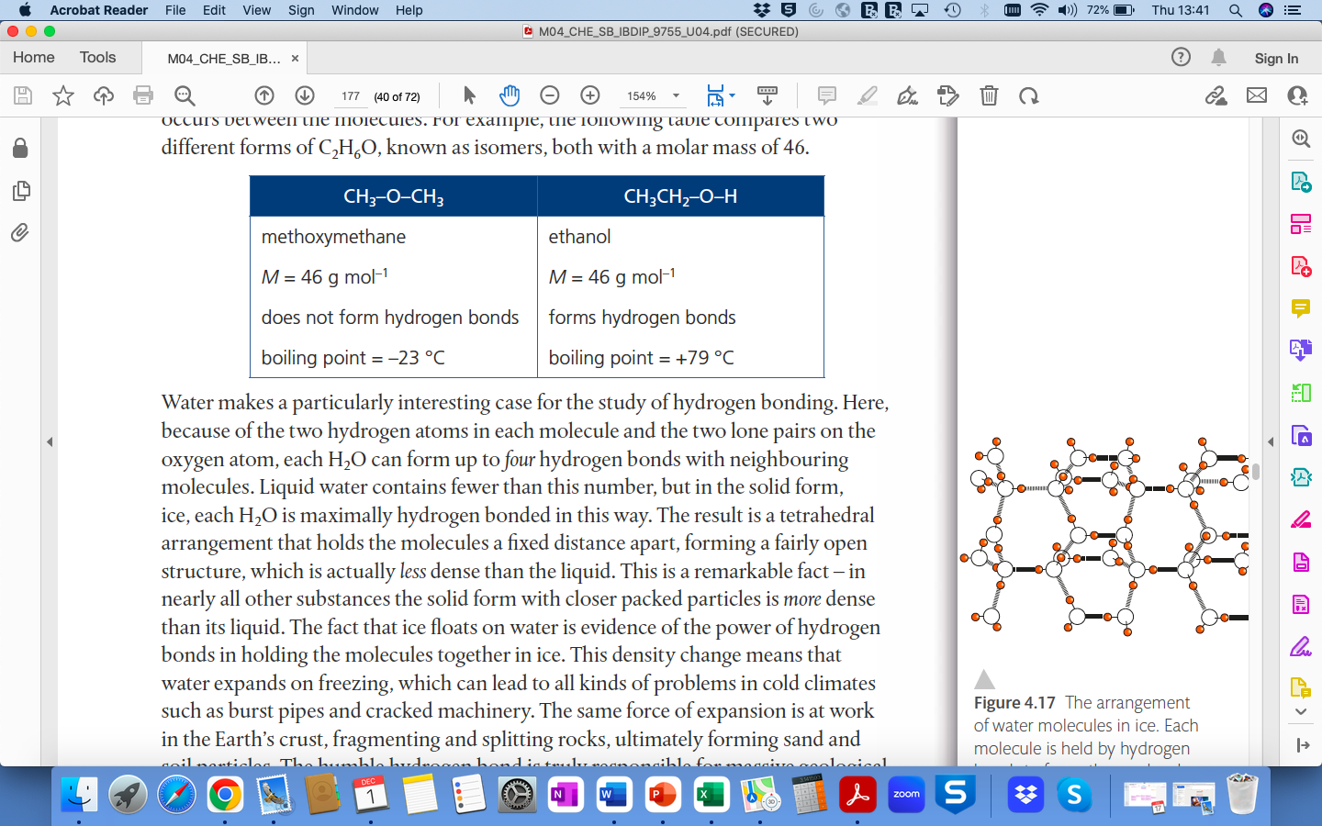
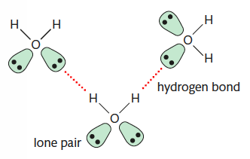
Hydrogen bonding

Slide 53
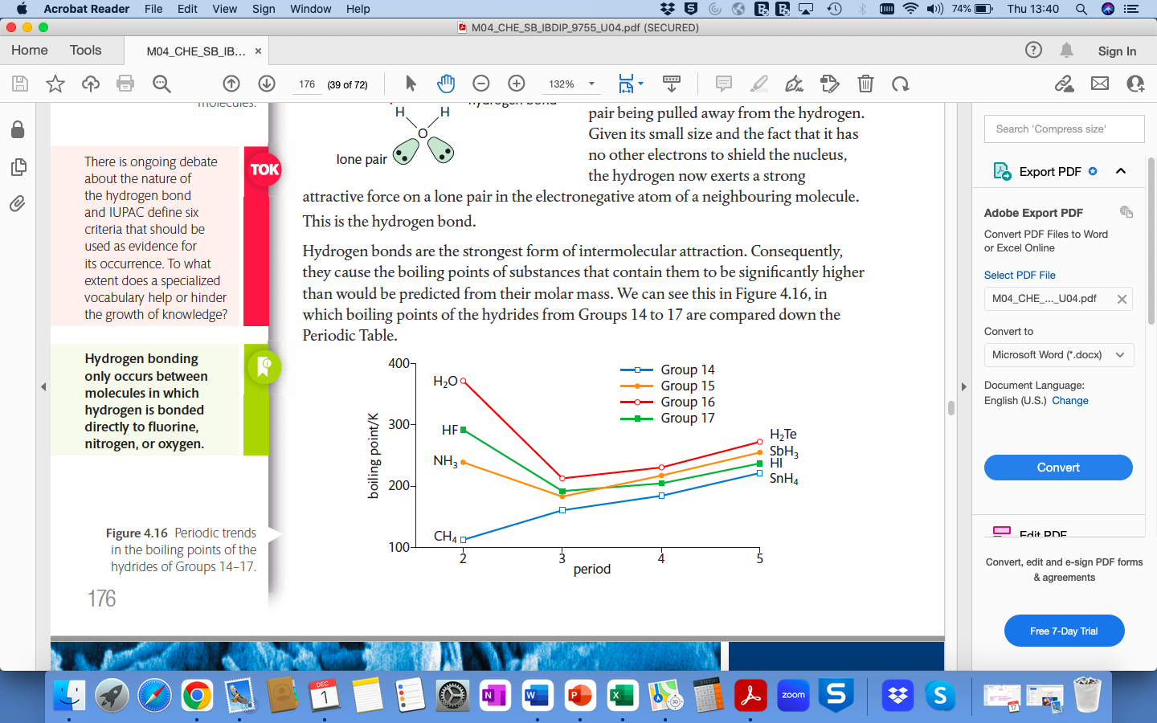
Hydrogen bonding

Slide 54
Hydrogen bonding

Slide 55
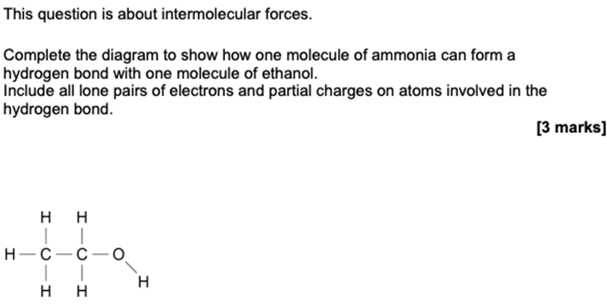
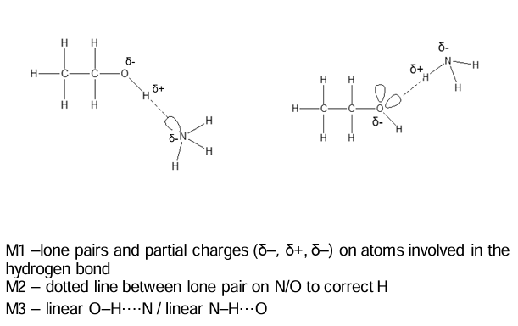
Example question

