Slide 1


Physical Chemistry Year 1 - AS
3.1.4 Energetics
Dr John R Griffiths
SciExcel Tuition
www.sciexcel.org

Slide 2
Physical Chemistry Year 1
3.1.4 Energetics
3.1.4.1 Enthalpy change
3.1.4.2 Calorimetry
3.1.4.3 Applications of Hess’s law
3.1.4.4 Bond enthalpies

Slide 3
3.1.4.1 Enthalpy change
Reactions can be endothermic or exothermic.
Enthalpy change (ΔH) is the heat energy change measured under conditions of constant pressure. Units are kJ mol⁻¹.
Standard enthalpy changes refer to standard conditions, ie 100 kPa and a stated temperature (eg ΔH₂₉₈^{Ɵ}).
Students should be able to:
define standard enthalpy of combustion (Δ_{c}H^{Ɵ})
• define standard enthalpy of formation (Δ_{f}H^{Ɵ}).

Slide 4
GCSE recap
Reactions where the products are at a lower energy than the reactants are called exothermic
Activation energy is the amount of energy required for a reaction to take place
A reaction which is endothermic transfers heat energy from the surrounding
When methane (CH₄) burns in oxygen (O₂), the reactant bonds between which atoms need to be broken and the new bonds in the products are formed

Slide 5
Change in energy
Chemical reactants have a certain amount of chemical energy stored within them (within the bonds).
When the reaction has taken place they have either more or less energy stored within them than before.
If they have MORE energy stored than before, then this has come FROM the surrounding and the reaction is ENDOTHERMIC
If they have LESS energy stored than before, then this has been released TO the surrounding and the reaction is EXOTHERMIC

Slide 6
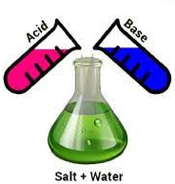

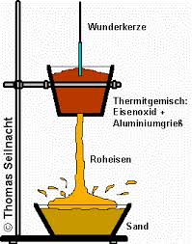
Exothermic
Heat Energy given out as the mixture returns back to room temp.
Thermite reaction
45º C
Neutralisation
Combustion
Notes:
Must be done in the fume cupboard

Slide 7
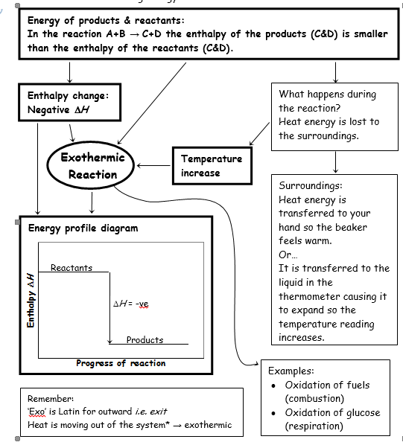
Exothermic

Slide 8
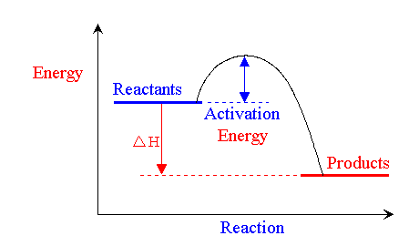
Exothermic

Slide 9
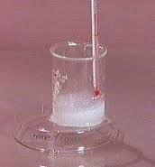

Endothermic
Heat Energy taken in as the mixture returns back to room temp.
10 ºC
10ºC
Ammonium nitrate + water
Photosynthesis
Notes:
Must be done in the fume cupboard

Slide 10
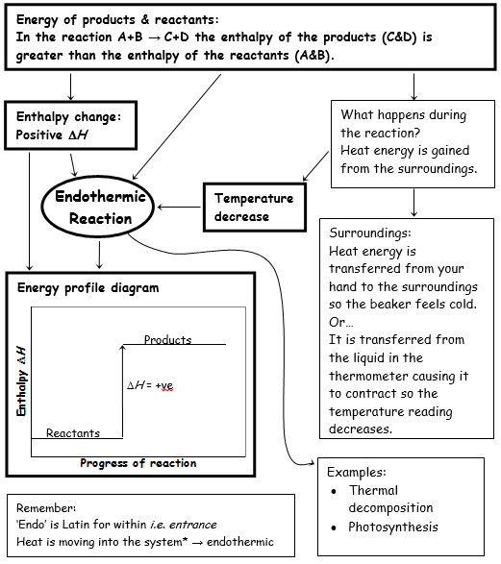
Endothermic

Slide 11
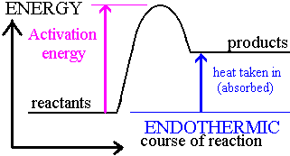
Endothermic

Slide 12
Combustion
Bond Energy
Consider the example of burning methane gas.
CH₄ + 2O₂ → CO₂ + 2H₂O
This reaction is highly exothermic, it is the reaction that takes place when we cook on a gas hob. However, mixing air (oxygen) with methane is not enough. We need to add sufficient energy (a spark) to overcome the activation energy, E_{a} , barrier.

Slide 13
What happens when the reaction gets enough energy?
Bond Energy
C
H
H
H
H
Bond
Breaking
O
O
O
O
Bond
Forming
H
O
Energy in chemicals
O
C
O
O
H
O
H
H
H
H
O
O
C
O
H
H
Progress of reaction

Slide 14
Bond Energy
If the energy for bonds being formed in products is larger than the energy needed to break bonds in the reactants, then the overall reaction will be exothermic (negative energy change).
If the energy for bonds being broken in the reactants is larger than the energy of bonds being formed in the products then the overall reaction is endothermic (positive energy change).
Overall energy change = Σ Bonds broken - Σ Bonds made

Slide 15
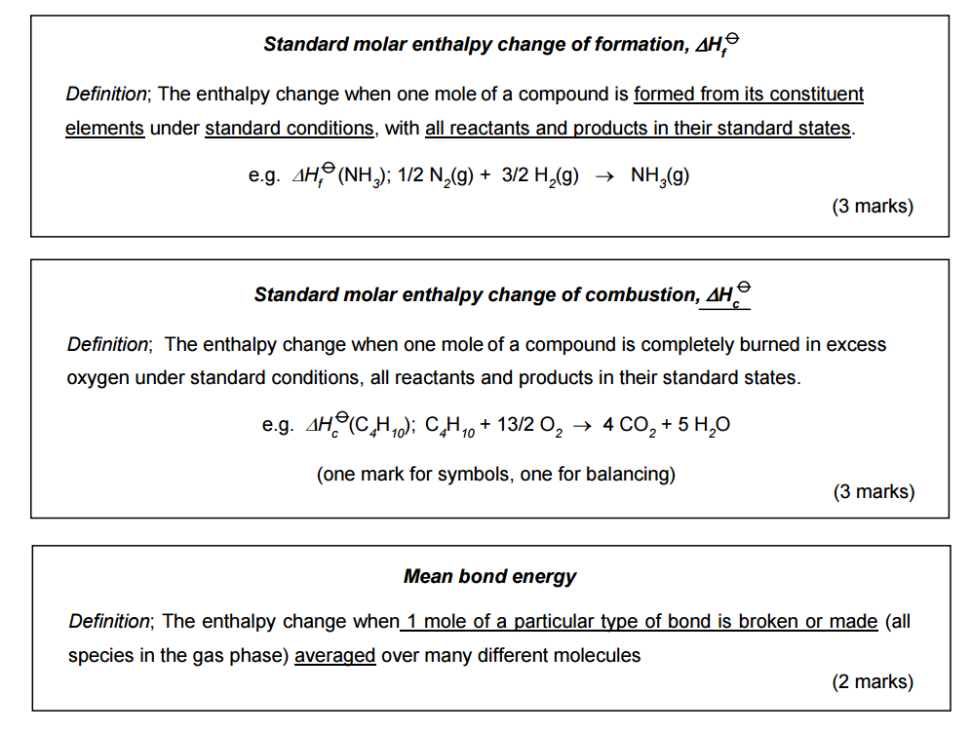
Standard enthalpy changes – LEARN THESE

Slide 16
3.1.4.2 Calorimetry
The heat change, q, in a reaction is given by the equation
q = mcΔT
where m is the mass of the substance that has a temperature change ΔT and a specific heat capacity c.
Students should be able to:
use this equation to calculate the molar enthalpy change for a reaction
use this equation in related calculations.
Students will not be expected to recall the value of the specific heat capacity, c, of a substance.

Slide 17
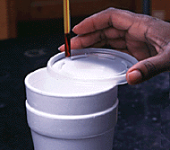
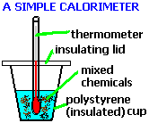
Calorimetry in the school laboratory
Insulation is used to reduce heat loss to the surroundings.
q = m c ∆T
Units for q are Joules
m is the mass in grams of the solution (NB it does NOT include the mass of any added solid such as Mg metal) NB- mass = volume x density
c is the specific heat capacity of the solution – this is usually assumed to be the same at water, which is 4.18 J g⁻¹ K⁻¹and is given in the question.
∆T is the difference between the initial temperature and maximum/minimum temperature reached by the solution (strictly in Kelvin, however it is equal to degrees Celsius).

Slide 18
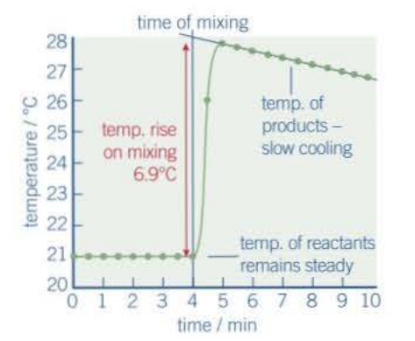
Calorimetry in the school laboratory
q = m c ∆T
∆T is the difference between the initial temperature and maximum/minimum temperature reached by the solution (strictly in Kelvin, however it is equal to degrees Celsius).
A more accurate initial temperature may be obtained by ensuring the solutions used have reached a stable temperature e.g. the temperature of the laboratory.
A more accurate maximum/minimum temperature is obtained through extrapolation (see opposite). Here, temperature readings are taken at regular intervals and plotted against time. The temperature at the point of mixing is then determined by extrapolation back to the time of mixing. This allows for heat loss from the reaction vessel (polystyrene cup).

Slide 19
100 cm³ of 1.0 mol dm⁻³ hydrochloric acid was added to 100 cm³ of 1.0 mol dm⁻³ sodium hydroxide solution. The temperature rose by 6.8°C. Calculate the enthalpy of neutralisation for this reaction. Assume that the density of the solution is 1.00 g cm⁻³, the specific heat capacity of the solution is 4.18 J g⁻¹ K⁻¹.
q = mc∆T
m = 200 g
c = 4.18 J g⁻¹ K⁻¹
∆T = 6.8 K
q = 200 g x 4.18 J g⁻¹ K⁻¹ x 6.8 K = 5685 J
∆H = q / mol
Mol HCl = conc x vol
= 1.0 mol dm⁻³ x ¹⁰⁰/₁₀₀₀ = 0.10 mol
Mol NaOH = conc x vol
= 1.0 mol dm⁻³ x ¹⁰⁰/₁₀₀₀ = 0.10 mol
HCl + NaOH → NaCl + H₂O
∆H = –5.685 KJ / 0.10 mol
NB – q is in J, BUT ∆H is in KJ mol⁻¹ so divide q by 1000 first.
= -56.9 kJ mol⁻¹ (to 3 sig fig)
NB - a minus sign is required to show that it is EXOTHERMIC

Slide 20
50 cm³ of 1.0 mol dm⁻³ nitric acid was added to 20 cm³ of 1.0 mol dm⁻³ barium hydroxide solution. The temperature rose by 7.9°C. Calculate the enthalpy of neutralisation for this reaction (per mole of nitric acid reacting). Assume that the density of the solution is 1.00 g cm⁻³, the specific heat capacity of the solution is 4.18 J g⁻¹ K⁻¹.
q = mc∆T
m = 70
c = 4.18
∆T = 7.9
q = 70 x 4.18 x 7.9 = 2312 J
∆H = q / mol
Mol HNO₃ = conc x vol
= 1.0 x ⁵⁰/₁₀₀₀ = 0.050
XS
Mol Ba(OH)₂ = conc x vol
= 1.0 x ²⁰/₁₀₀₀ = 0.020
2 HNO₃ + Ba(OH)₂ → Ba(NO₃)₂ + 2 H₂O
∆H = –2.312 / 0.040
= -57.8 kJ mol⁻¹ (3 sig fig)

Slide 21
100 cm³ of 0.20 mol dm⁻³ copper sulphate solution was put in a calorimeter and 2.0 g of magnesium powder added. The temperature of the solution rose by 25.1°C. Work out which reagent was in excess and then calculate the enthalpy change for the reaction. Assume that the density of the solution is 1.00 g cm⁻³, the specific heat capacity of the solution is 4.18 J g⁻¹ K⁻¹. Ignore the heat capacity of the metals.
q = mc∆T
m = 100
c = 4.18
∆T = 25.1
q = 100 x 4.18 x 25.1 = 10490 J
∆H = q / mol
Mol CuSO₄ = conc x vol
= 0.20 x ¹⁰⁰/₁₀₀₀ = 0.020
Mol Mg = mass / M_{r}
= 2.0 / 24.3 = 0.0823
XS
CuSO₄ + Mg → MgSO₄ + Cu
∆H = –10.49 / 0.020
= -525 kJ mol⁻¹ (3 sig fig)

Slide 22
50 cm³ of 0.10 mol dm⁻³ silver nitrate solution was put in a calorimeter and 0.2 g of zinc powder added. The temperature of the solution rose by 4.3°C. Work out which reagent was in excess and then calculate the enthalpy change for the reaction (per mole of zinc that reacts). Assume that the density of the solution is 1.00 g cm⁻³, the specific heat capacity of the solution is 4.18 J g⁻¹ K⁻¹. Ignore the heat capacity of the metals.
q = mc∆T
m = 50
c = 4.18
∆T = 4.3
q = 50 x 4.18 x 4.3 = 898.7 J
∆H = q / mol
Mol AgNO₃ = conc x vol
= 0.1 x ⁵⁰/₁₀₀₀ = 0.005
Mol Zn = mass / M_{r}
= 0.2 / 65.4 = 0.00306
XS
2 AgNO₃ + Zn → Zn(NO₃)₂ + 2 Ag
∆H = –0.8987 / 0.0025
= -359 kJ mol⁻¹ (3 sig fig)

Slide 23
3.53 g of sodium hydrogencarbonate was added to 30.0 cm³ of 2.0 mol dm⁻³ hydrochloric acid. The temperature fell by 10.3 K. Work out which reagent was in excess and then calculate the enthalpy change for the reaction. Assume that the density of the solution is 1.00 g cm⁻³, the specific heat capacity of the solution is 4.18 J g⁻¹ K⁻¹.
q = mc∆T
m = 30
c = 4.18
∆T = 10.3
q = 30 x 4.18 x 10.3 = 1292 J
∆H = q / mol
Mol HCl = conc x vol
= 2.0 x ³⁰/₁₀₀₀ = 0.060
XS
Mol NaHCO₃ = mass / M_{r}
= 3.53 / 84.0 = 0.0420
HCl + NaHCO₃ → NaCl + H₂O + CO₂
∆H = 1.292 / 0.0420
= +30.8 kJ mol⁻¹ (3 sig fig)

Slide 24
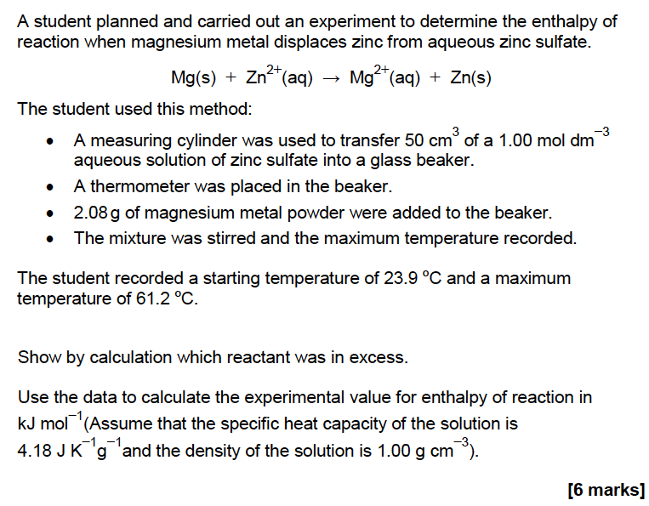
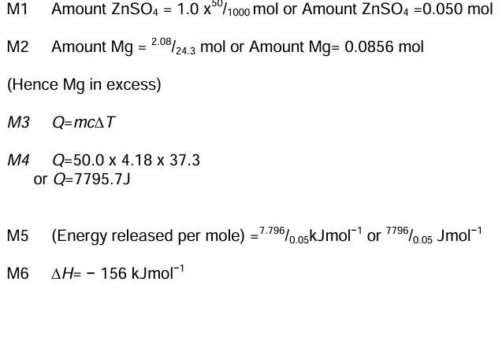
Quick test

Slide 25
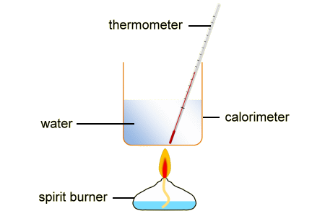
Fuels – Using a flame calorimeter

Slide 26
Laboratory Method
Put 100 cm³ of water in the calorimeter.
Record the temperature of the water.
Clamp the calorimeter in position about 10 cm above the protective mat.
Find the mass of a spirit burner containing an alcohol.
Place the burner under the calorimeter and light the wick.
Place the heat shield around the apparatus.
Stir the water with the thermometer.
Stop heating when the temperature has risen by 20 °C.
Replace the cap on the burner.
Reweigh the burner as soon as possible.
Keep noting the temperature – record the highest value reached.
If you can, repeat the experiment with other alcohols.
Try to keep all the factors the same

Slide 27
Calculation
Find out the amount of energy transferred to the water:
Energy (J) = m(water) x SHC(water) x temp change
Energy (J) = 100 x 4.2 x 20 = 8 400 J
Energy (kJ) = 8.4 kJ
Work out the mass of fuel burnt:
Mass of burner (before) – mass of burner (after)
For example: if the burner and ethanol fuel had a mass of 196.5g before and 195.4 g after.
Mass of fuel burned = 196.5 – 195.4 = 1.1g

Slide 28
Calculation
Number of moles of fuel burned:
You need to know the mass of the fuel burned and the molar mass.
For example: mass of ethanol = 1.1 g
Mr of ethanol = 46
Moles of ethanol (CH₃CH₂OH) = mass / molar mass
1.1 / 46 = 0.024 mol

Slide 29
Calculation
Divide the energy transferred to the water by the number of moles of alcohol to find the enthalpy change of combustion (ΔH).
For example:
Energy transferred to water = 8.4 kJ
Moles of ethanol burned = 0.024 moles
Enthalpy change of combustion (ΔH) = 8.4 / 0.024
Enthalpy change of combustion (ΔH) = 350 kJ mol⁻¹

Slide 30
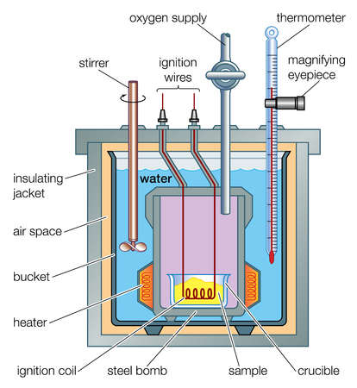
Evaluation
What are the main sources of error in this investigation?
How could they be reduced?
The main sources of error are through heat loss. This may be reduced by insulation and draught screening.
Also, the mass of fuel may not be accurate due to evaporation of some from the wick. Using a cap may help to improve this.
The experiment is also unlikely to be performed under standard conditions.
Incomplete combustion is also likely. Ensure a plentiful oxygen supply.

Slide 31
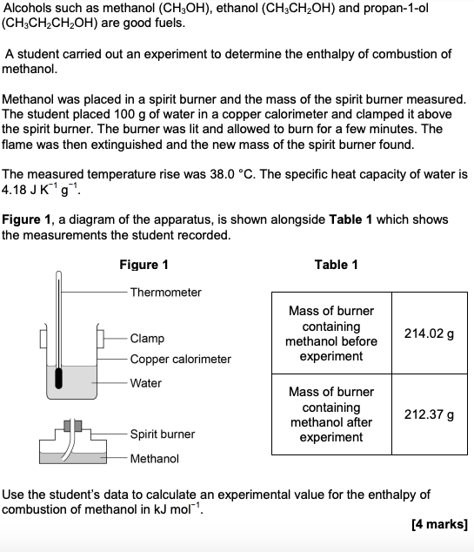
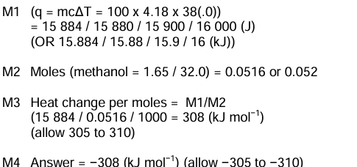
Quick test

Slide 32
3.1.4.3 Applications of Hess’s law
Hess’s law.
Students should be able to:
use Hess’s law to perform calculations, including calculation of enthalpy changes for reactions from enthalpies of combustion or from enthalpies of formation.

Slide 33

Hess’s law
Hess’ law states that, if a reaction can take place by more than one route and the initial and final conditions are the same, the total enthalpy change is the same.
direct route
ΔH₁
A
B
A → B
ΔH₁
ΔH₃
ΔH₂
A → C → B
ΔH₂ + ΔH₃
C
indirect route
Therefore: ΔH₁ = ΔH₂ + ΔH₃

Slide 34
Remember these ?? LEARN THEM !!

Slide 35
Example equations
Standard Enthalpy Change for Combustion of ΔHº_{c} of Butane
C₄H₁₀ + 6.5 O₂
4CO₂ + 5H₂O
Standard Enthalpy Change for Formation ΔHº_{f} of Butane
4C_{(s)} + 5H_{2(g)}
C₄H_{10 (g)}
Standard Enthalpy Change for Combustion ΔHº_{c} of constituent elements of Butane
C_{(s)} + O_{2(g)}
CO_{2(g)}
H_{2(g)} + 0.5O_{2(g)}
H₂O _{(l)}
4C_{(s)} + 5H_{2(g)}
+ 6.5 O_{2 (g)}
4CO_{2(g)} + 5H₂O _{(l)}

Slide 36
Using COMBUSTION data
The combustion of reactants and combustion of products is a useful way to complete the cycle in a way that can be experimentally determined.
ΔH_{r}
Reactants
Products
Σ ΔH_{c(reactants)}
Σ ΔH_{c(products)}
Combustion products
ΔH_{r} = Σ ΔH_{c(reactants)} – Σ ΔH_{c(products)}
Arrows point DOWNwards for combustion data (Burn the house DOWN)

Slide 37
Revisit butane
ΔHº_{f}
4C_{(s)} + 5H_{2(g)}
C₄H_{10 (g)}
ΔHº_{c1}
ΔHº_{c2}
4CO_{2(g)} + 5H₂O _{(l)}
ΔHº_{f} = ΔHº_{c1} - ΔHº_{c2}
Enthalpy of Combustion
Carbon = -393.5 kJmol⁻¹
Hydrogen = -285.9 kJmol⁻¹
Butane = -2877.5 kJmol⁻¹
ΔHº_{c1} = 4 x ΔHº_{c (CARBON)} + 5 x ΔHº_{c (HYDROGEN)}

Slide 38
Example
You are provided with the following enthalpy changes of combustion
Determine the enthalpy change for the following reaction:
2C(s) + 3H₂(g) + ½O₂(g) → C₂H₅OH(l)
Substance | C(s) | H₂(g) | C₂H₅OH(l)
ΔH_{c} kj/mol | -394 | -286 | -1367

Slide 39
Substance | C(s) | H₂(g) | C₂H₅OH(l)
ΔH_{c} kj/mol | -394 | -286 | -1367
ΔH_{r}
2C(s) + 3H₂ (g) + ½ O₂(g)
C₂H₅OH(l)
2ΔH_{c}(C)+ 3ΔH_{c}(H₂)
ΔH_{c}(C₂H₅OH)
Combustion products
ΔHr = (2 x -394) + (3 x -286) – (-1367) = -279 kJmol⁻¹

Slide 40
Using FORMATION data
As with ΔH_{c} many ΔH_{f} values have also been measured and can be looked up in tables
ΔH_{r}
Reactants
Products
Σ ΔH_{f(reactants)}
Σ ΔH_{f(products)}
Elements
ΔH_{r} = - Σ ΔH_{f(reactants)} + Σ ΔH_{f(products)}
Arrows point UPwards for formation data (Build the house UP)

Slide 41
Example
You are provided with the following enthalpy changes of formation
Determine the enthalpy change for the following reaction:
2NO (g) + O₂(g) → 2NO₂(g)
Substance | NO(g) | NO₂(g)
ΔH_{f} kj/mol | 90 | 33

Slide 42
Substance | NO(g) | NO₂(g)
ΔH_{f} kj/mol | 90 | 33
ΔH_{r}
2NO(g) + O₂ (g)
2NO₂(g)
2ΔH_{f}(NO)
2ΔH_{f}(NO₂)
Elements
ΔH_{r} = -(2 x 90) + (2 x 33) = -114 kJmol⁻¹

Slide 43
Other enthalpy cycles
In your AS course you have to be able to construct and use cycles that use combustion and formation data.
The same principles can be applied to any energy cycle provided it is constructed correctly.
Following the arrows ADD, opposite to the arrows SUBTRACT and you can’t go wrong.

Slide 44
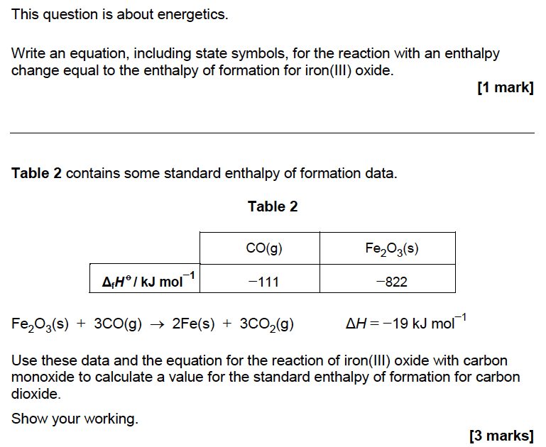
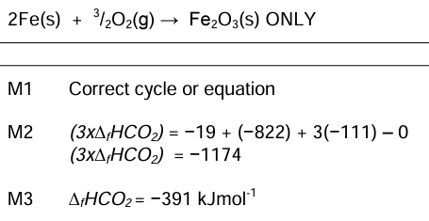
Quick test

Slide 45
3.1.4.4 Bond enthalpies
Mean bond enthalpy.
Students should be able to:
define the term mean bond enthalpy
use mean bond enthalpies to calculate an approximate value of ΔH for reactions in the gaseous phase
explain why values from mean bond enthalpy calculations differ from those determined using Hess’s law.

Slide 46
Burning methane
Consider the example of burning methane gas.
CH₄ + 2O₂ → CO₂ + 2H₂O
This reaction is highly exothermic, it is the reaction that gives us the Bunsen flame. However mixing air (oxygen) with methane is not enough. I need to add energy (a flame).

Slide 47
What happens when the reaction gets enough energy?
C
H
H
H
H
Bond
Breaking
O
O
O
O
Bond
Forming
H
O
Energy in chemicals
O
C
O
O
H
O
H
H
H
H
O
O
C
O
H
H
Progress of reaction

Slide 48
Bond energy
If the energy for bonds being formed in products is larger than the energy needed to break bonds in the reactants, then the overall reaction will be exothermic (negative energy change).
If the energy for bonds being broken in the reactants is larger than the energy of bonds being formed in the products then the overall reaction is endothermic (positive energy change).

Slide 49
Using bond enthalpies
By using the energy that it takes to break/make a particular bond we can work out the overall enthalpy/energy change for the reaction.
Sum (bonds broken in reactants) – Sum (bonds made in products) = Energy change
ΔH = (bond enthalpies of bonds broken) - (bond enthalpies of bonds made)

Slide 50
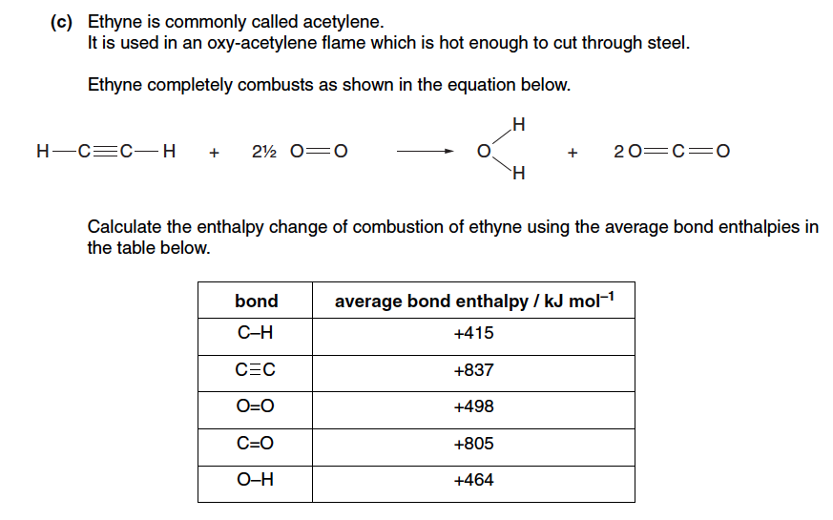
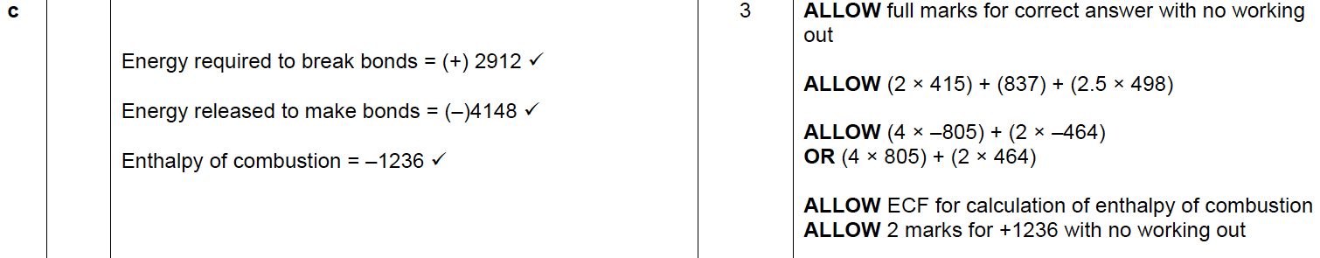
Quick test

Slide 51
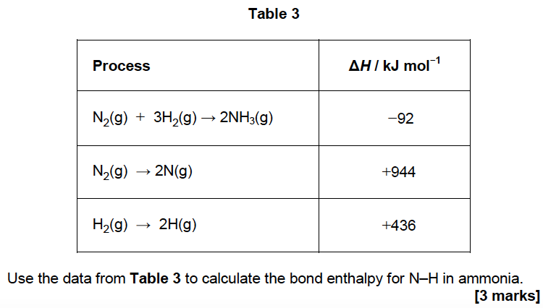
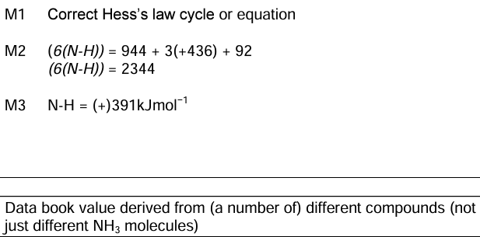
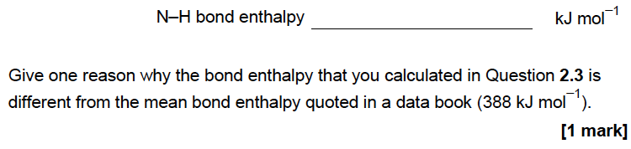
Quick test

