Slide 1


Physical Chemistry Year 1 - AS
3.1.5 Kinetics
Dr John R Griffiths
SciExcel Tuition
www.sciexcel.org

Slide 2
Physical Chemistry Year 1
3.1.5 Kinetics
3.1.5.1 Collision Theory
3.1.5.2 Maxwell-Boltzmann distribution
3.1.5.3 Effect of temperature on reaction rate
3.1.5.4 Effect of concentration and pressure
3.1.5.5 Catalysts

Slide 3
3.1.5.1 Collision theory
Reactions can only occur when collisions take place between particles having sufficient energy.
This energy is called the activation energy.
Students should be able to:
define the term activation energy
explain why most collisions do not lead to a reaction.

Slide 4
Collision theory
When reacting particles collide with the correct orientation and with sufficient energy (to break bonds), they are able to react together.
The rate of reaction is dependent upon the frequency of these collisions, the energy of the collisions and the energy barrier, termed the Activation Energy, E_{a}

Slide 5
Activation Energy
The minimum energy required for successful collisions between reactant particles is called the activation energy for the reaction.
Only a fraction of the total population of a chemical species will be able to collide with enough energy to react (E ≥ E_{a})
The activation energy is measured from the reactants to the top of the reaction profile curve.
The species (atoms, molecules or ions) at the top of the curve are called a TRANSITION STATE or ACTIVATED COMPLEX.

Slide 6
Activation Energy, E_{a}
Transition state
Enthalpy
E_{a}
Reactants
Products
Reaction progress

Slide 7
Factors affecting reaction rates - Recap
Temperature (See 3.1.5.3 below)
Pressure (gases) (See 3.1.5.4 below)
Concentration (solutions) (See 3.1.5.4 below)
Surface area (solids)
Catalyst (See 3.1.5.4 below)

Slide 8
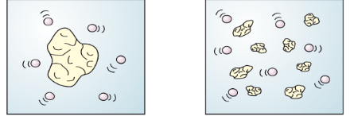
Surface area - solids only
The greater the available surface area for reaction is (of a solid reactant), the more collisions can take place with other reactants, per unit time (i.e. collision frequency increases).
e.g. If 1 gram of magnesium carbonate reacts with the same concentration and volume of HCl (at the same temperature), the powdered form (b) has a greater surface area available for reaction and will therefore have a faster reaction rate. It has a higher surface area:volume ratio
a) 1 gram piece of MgCl₂ b) 1 gram of powdered MgCl2

Slide 9
3.1.5.2 Maxwell-Boltzmann distribution
Maxwell–Boltzmann distribution of molecular energies in gases.
Students should be able to:
draw and interpret distribution curves for different temperatures.

Slide 10
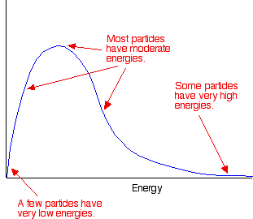
Maxwell-Boltzmann Distribution
In any system, the particles present will have a very wide range of energies. For gases, this can be shown on a graph called the Maxwell-Boltzmann Distribution which is a plot of the number of particles having each particular energy.
Fraction of particles with
energy E

Slide 11
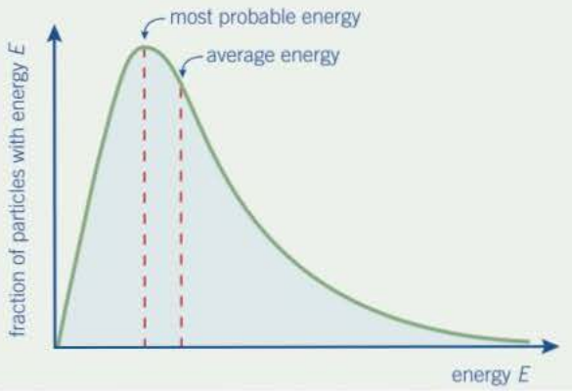
Maxwell-Boltzmann Distribution

Slide 12
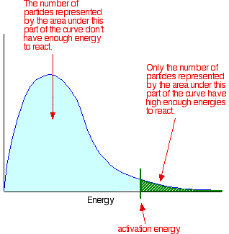
The Maxwell-Boltzmann Distribution and Activation Energy
Notice that the large majority of the particles don't have enough energy to react when they collide.
To enable them to react we either have to change the shape of the curve, or move the activation energy further to the left.
Fraction of particles with
energy E

Slide 13
3.1.5.3 Effect of temperature on reaction rate
Meaning of the term rate of reaction.​
The qualitative effect of temperature changes on the rate of reaction.​
Students should be able to:​
use the Maxwell–Boltzmann distribution to explain why a small temperature increase can lead to a large increase in rate.

Slide 14
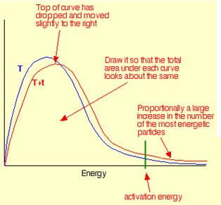
Maxwell-Boltzmann distribution and Temperature
Increasing the temperature:
  increases the average kinetic energy of the gas (slight shift to the right)
  Increases the number of particles whose energy exceeds the activation energy
Fraction of particles with
energy E

Slide 15
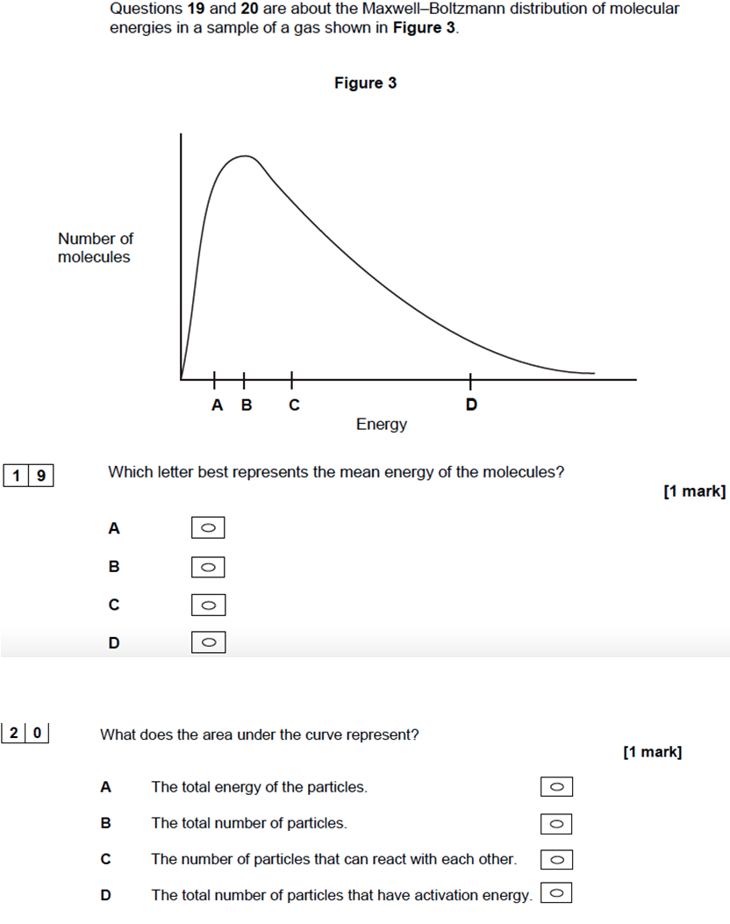
Quick test
C
Total number of particles

Slide 16
3.1.5.4 Effect of concentration and pressure
The qualitative effect of changes in concentration on collision frequency.
The qualitative effect of a change in the pressure of a gas on collision frequency.
Students should be able to:
explain how a change in concentration or a change in pressure influences the rate of a reaction.

Slide 17
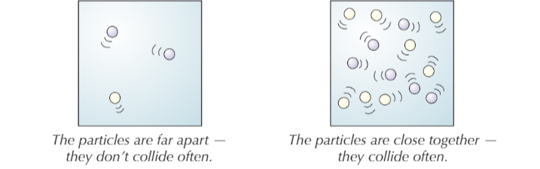
Effect of concentration (relates to a solution)
When the concentration of a solution is increased, the reactant particles are closer together and therefore experience more frequent collisions - faster reaction rate
Lower concentration
Higher concentration

Slide 18
Effect of pressure (relates to a gas)
When the pressure of a gas is increased, the reactant gas particles are "forced" closer together and therefore experience more frequent collisions - faster reaction rate
Lower pressure
Higher pressure

Slide 19
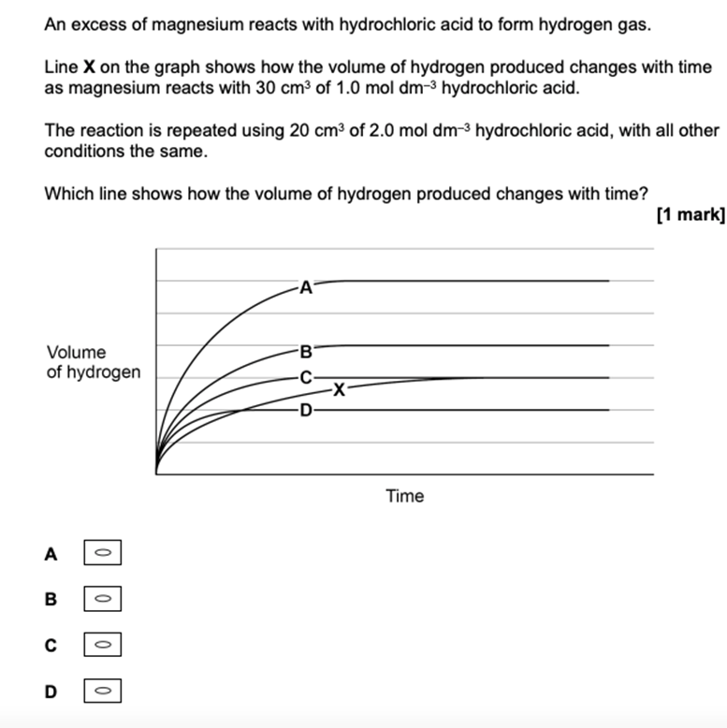
Quick test

Slide 20
3.1.5.5 Catalysts
A catalyst is a substance that increases the rate of a chemical reaction without being changed in chemical composition or amount.
Catalysts work by providing an alternative reaction route of lower activation energy.
Students should be able to:
use a Maxwell–Boltzmann distribution to help explain how a catalyst increases the rate of a reaction involving a gas.

Slide 21
Catalysts and Activation Energy
To increase the rate of a reaction you need to increase the proportion of successful collisions.
Catalysts increase the rate of reaction by providing an alternative pathway for the reaction to happen which has a lower activation energy.

Slide 22
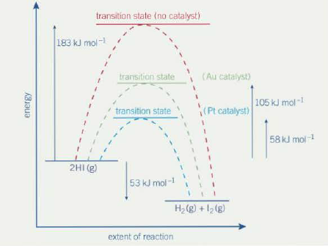
Catalysts and Activation Energy
Different catalysts have different effects on the activation energy. In this example, Pt proves to be the best catalyst for the decomposition of HI. Although often expensive, catalysts can be used again and again and are therefore economical since they reduce the energy requirements for a reaction. (Eventually a catalyst has to be replaced due to irreversible contamination, referred to as poisoning).

Slide 23
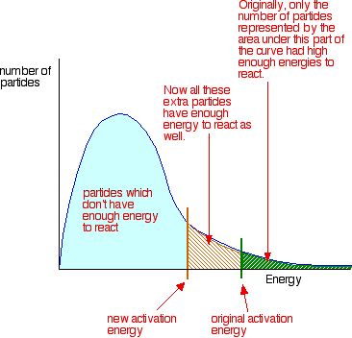
Maxwell-Boltzmann Distribution and Catalysts

Slide 24
Catalytic converters
Catalytic converters in car exhaust systems reduce the levels of certain pollutants by converting them to less noxious substances.
e.g.
Carbon monoxide + nitrogen oxides --> nitrogen + carbon dioxide
Hydrocarbons + nitrogen oxides --> nitrogen + carbon dioxide + water
Platinum and rhodium are the catalysts. These are coated onto the surface of a honeycomb structure of ceramic material. This creates a large surface area for reactions to take place and allows for a very thin coating of the expensive metals.

Slide 25
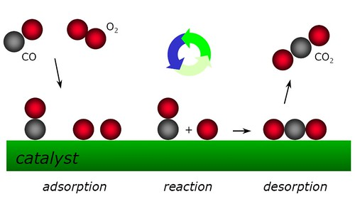
Catalytic converters
The gases are firstly adsorbed onto the catalyst surface (weak bonds are formed with the metal).
The gases then react on the surface. This requires less energy i.e. a lower activation energy.
The products then desorb from the metal surface.

Slide 26
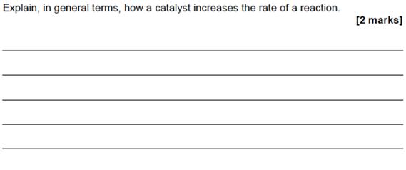
Quick test

Slide 27
Summary
Maxwell-Boltzmann Energy Distribution Curve
  distribution of a population of a chemical by energy
  Used to show effect of temperature and catalysts on the rate of a chemical reaction
Temperature
  changes average kinetic energy of population
  shifts and distorts the Maxwell-Boltzmann Distribution curve
  changes the proportion of particles with E_{a}.
Catalysts
  provide alternative pathway with a lower the activation energy
  E_{a} on Maxwell-Boltzmann curve is shifted left
  no effect on distribution curve itself

