Slide 1


Physical Chemistry Year 1 - AS
3.1.6 Chemical equilibria, Le Chatelier’s principle and K_{c}
Dr John R Griffiths
SciExcel Tuition
www.sciexcel.org

Slide 2
Physical Chemistry Year 1
3.1.6 Chemical equilibria, Le Chatelier’s principle and K_{c}
3.1.6.1 Chemical equilibria and Le Chatelier’s principle
3.1.6.2 Equilibrium constant, K_{c} for homogeneous systems

Slide 3
3.1.6.1 Chemical equilibria, Le Chatelier’s
Many chemical reactions are reversible.
In a reversible reaction at equilibrium:
  Forward and reverse reactions proceed at equal rates
  The concentrations of reactants and products remain constant
Le Chatelier's principle can be used to predict the effects of changes in temperature, pressure and concentration on the position of equilibrium in homogeneous reactions.
A catalyst does not affect the position of equilibrium.
Students should be able to:
Use Le Chatelier’s principle to predict qualitatively the effect of changes in temperature, pressure and concentration on the position of equilibrium
Explain why, for a reversible reaction used in an industrial process, a compromise temperature and pressure may be used.

Slide 4

Dynamic equilibrium
Not all reactions proceed in only one direction (Products → Reactants). Some reactions are REVERSIBLE ( ) .
If a reversible reaction is carried out in a closed system so that the reactants and products cannot escape, a state of dynamic equilibrium can be established.
A + B C + D
Both the forward and reverse reactions occur are the same rate, therefore, the net concentrations of the components of the reaction mixture remain constant.

Slide 5
Chromate/dichromate reaction
Adding acid
2 CrO₄²⁻ (aq) + 2 H⁺(aq) Cr₂O₇²⁻ (aq) + H₂O (l)
Chromate
Yellow
Dichromate
Orange
Adding alkali
Notes:
What happens if we change the surroundings for a reversible reaction?

Slide 6
Equilibria
A reversible reaction is where products can, under appropriate conditions, turn back into reactants.
Dynamic equilibrium is the equilibrium that exists in a closed system when the rate of the forward reaction is equal to the rate of the backwards reaction AND the concentrations of the reactants and products stays constant

Slide 7
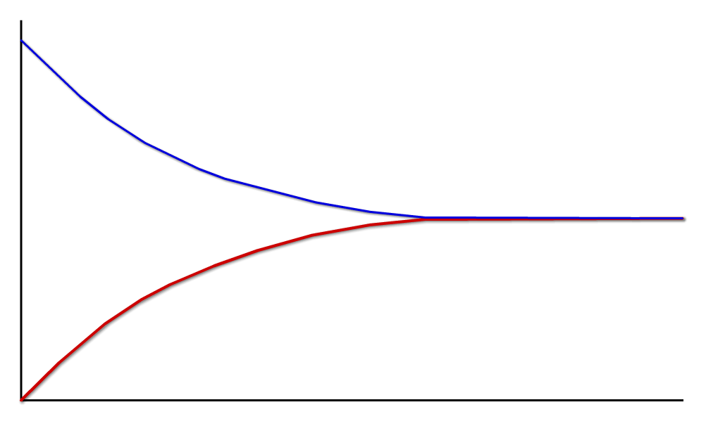
Dynamic equilibrium
This graph illustrates the dynamic nature of equilibrium.
It shows that both the forward and back reactions are taking place: they both have non-zero rate. When their rates are equal, equilibrium is reached.
forward reaction:
2SO_{2(g)} + O_{2(g)} → 2SO_{3(g)}
rate
rates are equal at equilibrium
reverse reaction:
2SO_{3(g)} → 2SO_{2(g)} + O_{2(g)}
time

Slide 8
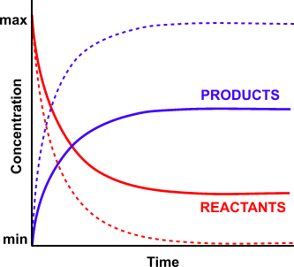
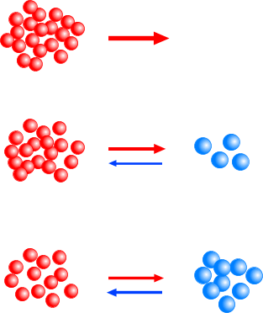
Equilibrium Reactions
Initially, there is no backward reaction but, as products form, it speeds up and provided the temperature remains constant there will come a time when the backward and forward reactions are equal and opposite; the reaction has reached equilibrium.
FASTEST AT THE START
NO BACKWARD REACTION
FORWARD REACTION SLOWS DOWN AS REACTANTS ARE USED UP
BACKWARD REACTION
STARTS TO INCREASE
In an equilibrium reaction, not all the reactants end up as products; there is not a 100% conversion.
BUT IT DOESN’T MEAN THE REACTION
IS STUCK IN THE MIDDLE
AT EQUILIBRIUM THE BACKWARD AND FORWARD REACTIONS ARE EQUAL AND OPPOSITE

Slide 9
Dynamic equilibrium
If we make a CLOSED SYSTEM by preventing any reactants or products escaping….
White copper sulphate (PRODUCT)
The RATE of the FORWARD REACTION
balances
the RATE of the REVERSE REACTION
So we have both REACTANTS AND PRODUCTS CONSTANTLY TURNING INTO EACH OTHER
Water (PRODUCT)
And the system is in EQUILIBRIUM
The “system” means the enclosed space containing all reactants and products reacting together with nothing going in or out
Blue copper sulphate
(REACTANT)

Slide 10
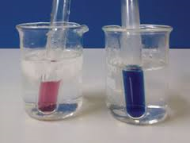
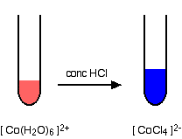
A colourful equilibrium
endothermic

Slide 11
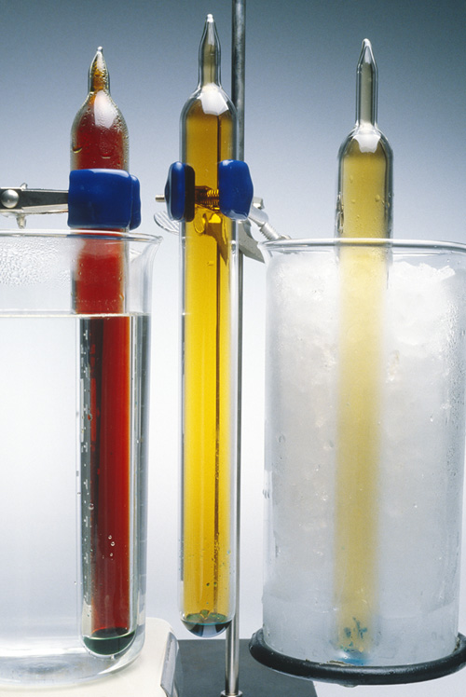
Composition of the reaction mixture
At equilibrium, the proportions of reactants and products present may not be a 50:50 mix.
The proportion of reactants and products depend on the particular reaction, as well as factors such as temperature, concentration and pressure.
However, for a given set of conditions, a particular reaction will always have the same proportions of reactants and products at equilibrium.
Notes:
Photo credit: Charles D. Winters / Science Photo Library
Teacher notes
The photo shows the temperature dependence of the equilibria between NO₂ and N₂O₄. Three identical tubes are placed in warm water (left), room temperature (middle) and iced water (right). The greater the proportion of NO₂, the darker the tube.

Slide 12
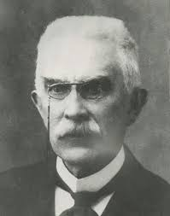
Le Chatelier’s principle
If a system at equilibrium is disturbed, the equilibrium moves in the direction that tends to reduce the disturbance.
So, if the conditions in a closed system change, the position of the equilibrium will shift to counteract the change.

Slide 13

The effect of concentration of the yield of Z.
Le Chatelier’s principle - Concentration
A_{(g)} + B_{(g)} Y_{(g)} + Z_{(g)}
If you increase the concentration of A then..............................................Yield of Z INCREASES
If you increase the concentration of Y then.............................................Yield of Z DECREASES
If you decrease the concentration of B then.............................................Yield of Z DECREASES
Makes sure you can explain these in terms of Le Chatelier’s principle (i.e. Equilibrium shifts to left/right)

Slide 14
Le Chatelier’s principle - Pressure
Fewer molecules exert a lower pressure
More molecules exert a higher pressure
We only consider effect of pressure in the GASEOUS state! Remember one mole of any gas exerts the same pressure at the same temperature.

Slide 15
Effect of pressure on yield of X
exothermic
2A_{(g)} + B_{(g)} C_{(g)} + X_{(g)}
endothermic
Increasing Pressure:
If I _________ the pressure, the system will try to ___________ the pressure, favouring the _____________ number of molecules. Equilibrium is therefore shifted to the __________, and _________ the yield of X.
increase
decrease
fewer
right
increases

Slide 16
Effect of pressure on yield of X
exothermic
2A_{(g)} + B_{(g)} C_{(g)} + X_{(g)}
endothermic
Decreasing Pressure:
If I _________ the pressure, the system will try to ___________ the pressure, favouring the _____________ number of molecules. Equilibrium is therefore shifted to the __________, and _________ the yield of X.
decrease
increase
most
left
decreases

Slide 17
Le Chatelier’s principle - Temperature
“If the temperature is raised the yield from the endothermic reaction increases and the yield from the exothermic reaction decreases”
This is because the system tries to oppose the increase in temperature by shifting the equilibrium in the endothermic direction.
What does yield mean?
Amount of product produced from a reaction, generally written as a mass or %

Slide 18
Effect of temperature on yield of X
exothermic
2A_{(g)} + B_{(g)} C_{(g)} + X_{(g)}
endothermic
Increasing Temperature:
If I _________ the temperature, the system will try to ___________ the temperature, favouring the _____________ reaction. Equilibrium is therefore shifted to the __________, and _________ the yield of X.
increase
decrease
endothermic
left
decreases

Slide 19
Effect of temperature on yield of X
exothermic
2A_{(g)} + B_{(g)} C_{(g)} + X_{(g)}
endothermic
Decreasing Temperature:
If I _________ the temperature, the system will try to ___________ the temperature, favouring the _____________ reaction. Equilibrium is therefore shifted to the __________, and _________ the yield of X.
decrease
increase
exothermic
right
increases

Slide 20
Effect of temperature and pressure on yield of X
exothermic
A(g) + B(g) 2C(g) + X(g)
What will happen to the Yield of X if I:
1: increased the pressure
2: decreased the temperature
endothermic
Decrease yield
Increase yield

Slide 21
Effect of temperature and pressure on yield of X
endothermic
A(g) + 3B(g) C(g) + X(l)
What will happen to the Yield of X if I:
1: increased the pressure
2: decreased the temperature
exothermic
Increase yield
Decrease yield

Slide 22
Effect of temperature and pressure on yield of X
Exothermic
- ΔH
A(g) + B(g) C(g) + X(g)
What will happen to the Yield of X if I:
1: increased the pressure
2: decreased the temperature
Endothermic
+ ΔH
No effect
Increase yield

Slide 23
Le Chatelier’s principle - Catalyst
The addition of a catalyst to a reversible reaction DOES NOT AFFECT the position of equilibrium. As a catalyst speeds up a reaction, it will reach equilibrium quicker but has NO EFFECT upon the yield (Increases the rate of reaction).

Slide 24
Le Chatelier’s principle - Summary
reactants ⇌ products
e.g. 2SO₂ (g) + O₂ (g) ⇌ 2SO₃ (g) ΔH = -197kJmol⁻¹
THE EFFECT OF CHANGING THE CONCENTRATION ON THE POSITION OF EQUILIBRIUM
INCREASE CONCENTRATION OF A REACTANT
EQUILIBRIUM MOVES TO THE RIGHT
DECREASE CONCENTRATION OF A REACTANT
EQUILIBRIUM MOVES TO THE LEFT
INCREASE CONCENTRATION OF A PRODUCT
EQUILIBRIUM MOVES TO THE LEFT
DECREASE CONCENTRATION OF A PRODUCT
EQUILIBRIUM MOVES TO THE RIGHT
THE EFFECT OF PRESSURE ON THE POSITION OF EQUILIBRIUM
INCREASE PRESSURE
MOVES TO THE SIDE WITH FEWER GASEOUS MOLECULES
DECREASE PRESSURE
MOVES TO THE SIDE WITH MORE GASEOUS MOLECULES
REACTION TYPE (Forward)
ΔΗ
INCREASE TEMP
DECREASE TEMP
EXOTHERMIC
-
TO THE LEFT
TO THE RIGHT
ENDOTHERMIC
+
TO THE RIGHT
TO THE LEFT

Slide 25
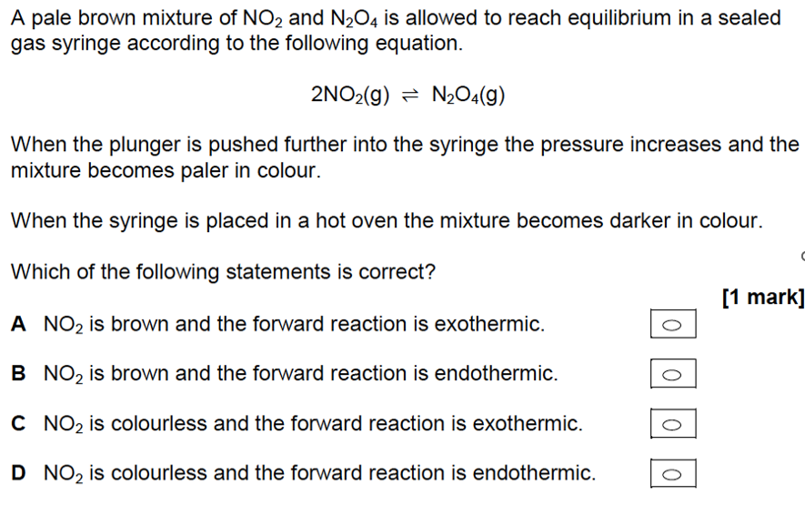
Quick test

Slide 26
Example from industry – The Haber process
H
H
H
H
H
H
H
H
N
N
H
H
N
N
H
H
H
H
H
H
H
H
N₂ + 3H₂ 2NH₃

Slide 27
A reversible reaction
H
H
FORWARD REACTION: Hydrogen & Nitrogen make Ammonia
N
N
EXOTHERMIC
+
H
H
H
H
REVERSE REACTION: Ammonia makes Hydrogen & Nitrogen
H
H
ENDOTHERMIC
N
N
H
H
H
H
BOTH REACTIONS ARE HAPPENING AT ONCE

Slide 28
HYDROGEN & NITROGEN IN
hydrogen + nitrogen
ammonia
HYDROGEN NITROGEN AMMONIA
UNUSED HYDROGEN & NITROGEN RECYCLED
TEMPERATURE and PRESSURE of the reaction vessel can be controlled
% YIELD =
% AMMONIA in main reaction vessel
Mixture cooled here. AMMONIA condenses
LIQUID
AMMONIA REMOVED

Slide 29
How to make the most ammonia quickly and cheaply
We can change 2 conditions inside the reaction vessel:
TEMPERATURE
PRESSURE
500°C
500 atmospheres
££ EXPENSIVE ££
££ CHEAP ££
20°C
(normal temp)
1 atmosphere
(normal pressure)

Slide 30
Effect of temperature
Since the forward reaction is exothermic (’releases heat’), the % YIELD of ammonia is GREATER at LOWER TEMPERATURES
(The ammonia molecules tend to split up again at high temps)
So it would seem that the temperature needs to be LOW……
BUT… LOW TEMPERATURES make the rate of reaction SLOW so you would have to wait a long time…
So a higher temperature (450°C) is actually used to make the ammonia FASTER even though the yield is lower.

Slide 31
Effect of pressure
H
H
H
H
H
H
H
H
N
N
N
N
H
H
H
H
H
H
H
H
H
H
4 molecules of gas
2 molecules of gas
Because the FORWARD reaction produces a SMALLER NUMBER OF MOLECULES, a HIGHER PRESSURE makes a LARGER YIELD of AMMONIA
BUT using a HIGH PRESSURE means much stronger and MORE EXPENSIVE pipes and reaction vessels are needed.
So.. a MEDIUM PRESSURE of 200 atmospheres is used.

Slide 32
A compromise solution
100%
200°C
IRON CATALYST used to speed reaction up further
80%
300°C
Yield of ammonia
60%
400°C
450°C
40%
500°C
Gives about 30% yield
20%
450°C and 200 atm
0%
0
100
200
300
400
500
Pressure (atmospheres)
TEMP:LOW enough for a reasonable yield but HIGH enough for a fast reaction
PRESSURE: LOW enough to not need expensive reinforced apparatus but HIGH enough to give a reasonable yield

Slide 33
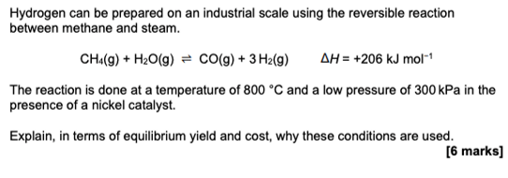
Quick test

Slide 34
3.1.6.2 Equilibrium constant, K_{c}, in homogeneous systems
The equilibrium constant K_{c} is deduced from the equation for a reversible reaction.
The concentration, in mol dm^{–3}, of a species X involved in the expression for K_{c} is represented by [X]
The value of the equilibrium constant is not affected either by changes in concentration or addition of a catalyst.
Students should be able to:
construct an expression for K_{c} for a homogeneous system in equilibrium
calculate a value for K_{c} from the equilibrium concentrations for a homogeneous system at constant temperature
perform calculations involving K_{c}
predict the qualitative effects of changes of temperature on the value of K_{c}

Slide 35
The equilibrium law
If the concentrations of all the substances present at equilibrium are raised to the power of the number of moles they appear in the equation, the product of the concentrations of the products divided by the product of the concentrations of the reactants is a constant, provided the temperature remains constant
There are several forms of the constant; all vary with temperature.
K_{c} the equilibrium values are expressed as concentrations of mol dm⁻³
K_{p} the equilibrium values are expressed as partial pressures (this comes into the A2 chemistry course).
The partial pressure expression can be used for reactions involving gases

Slide 36
The equilibrium constant, K_{c}
For an equilibrium reaction of the form...
aA + bB cC + dD
then (at constant temperature) [C]^{c} . [D]^{d} = a constant, (K_{c})
[A]ª . [B]^{b}
Where, [ ] denotes the equilibrium concentration in mol dm⁻³
K_{c} is known as the Equilibrium Constant

Slide 37
The equilibrium constant, K_{c}
Example Fe³⁺(aq) + NCS¯(aq) FeNCS²⁺(aq)
K_{c} = [ FeNCS²⁺ ] with units of dm³ mol⁻¹
[ Fe³⁺ ] [ NCS¯ ]

Slide 38
Try this....
Find the equilibrium constant, K_{c} for the following reaction in a volume of 1 dm³;
C₂H₅OH + CH₃COOH
CH₃COOC₂H₅ + H₂O
Initial moles
1.00 mol
1.00 mol
0.00 mol
0.00 mol
Equilibrium moles
0.33 mol
? mol
? mol
? mol

Slide 39
Try this....
Find the equilibrium constant, K_{c} for the following reaction;
C₂H₅OH + CH₃COOH
CH₃COOC₂H₅ + H₂O
Initial moles
1.00 mol
1.00 mol
0.00 mol
0.00 mol
Equilibrium moles
0.33 mol
? mol
? mol
? mol
Reagent | Initial moles | Final moles
C₂H₅OH | 1.00 | 0.33 (i.e. 1.00-0.67)
CH₃COOH | 1.00 | 1.00-0.67
CH₃COOC₂H₅ | 0.00 | 0.00+0.67
H₂O | 0.00 | 0.00+0.67

Slide 40
Check your answer
C₂H₅OH + CH₃COOH
CH₃COOC₂H₅ + H₂O
Reagent | Initial moles | Final moles
C₂H₅OH | 1.00 | 0.33
CH₃COOH | 1.00 | 0.33
CH₃COOC₂H₅ | 0.00 | 0.67
H₂O | 0.00 | 0.67

Slide 41
Check your answer
C₂H₅OH + CH₃COOH
CH₃COOC₂H₅ + H₂O
K_{p} = [CH₃COOC₂H₅] . [H₂0]
[C₂H₅OH] . [CH₃COOH]
= 0.67 x 0.67
0.33 x 0.33
= 4.12 No units

Slide 42
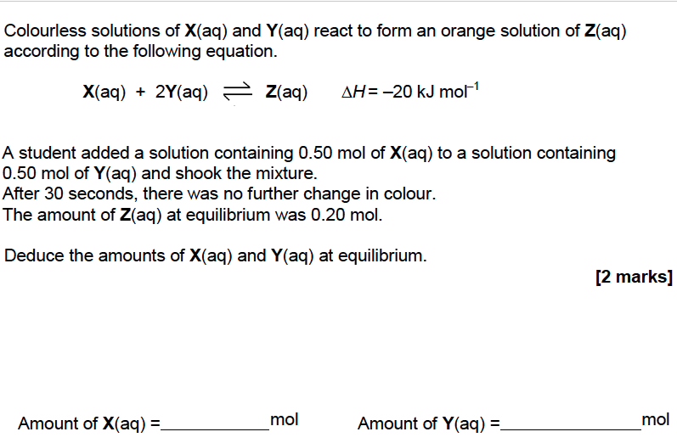

Quick test

Slide 43
Factors affecting K_{c} - Concentration
VALUE OF K_{c}
AFFECTED by; a change of temperature
NOT AFFECTED by; a change in concentration of reactants or products
a change of pressure
adding a catalyst

Slide 44
Factors affecting K_{c} - Concentration
The equilibrium constant is not affected by a change in concentration at constant temperature. To maintain the constant, the composition of the equilibrium mixture changes.
If you increase the concentration of a substance, the value of K_{c} will theoretically be affected. As it must remain constant at a particular temperature, the concentrations of the other species change to keep the constant the same. This is Le Chatelier's principle.

Slide 45
Factors affecting the position of equilibrium -
Concentration
example CH₃CH₂OH(l) + CH₃COOH(l) CH₃COOC₂H₅(l) + H₂O(l)
the equilibrium constant K_{c} = [CH₃COOC₂H₅] [H₂O] = 4 (at 298K)
[CH₃CH₂OH] [CH₃COOH]
INCREASING
[CH₃CH₂OH] - will make the denominator larger so K_{c} will INITIALLY go down
- to keep it constant, some CH₃CH₂OH reacts with CH₃COOH
- this reduces the value of the bottom line and increases the top
- the value of the constant will now be restored
DECREASING
[H₂O] - will make the numerator smaller
- some CH₃CH₂OH reacts with CH₃COOH to replace the H₂O
- more CH₃COOC₂H₅ is also produced
- this reduces the value of the bottom line and increases the top
- the value of the constant will now be restored

Slide 46
Factors affecting K_{p} – Pressure (see A2 topic)
The equilibrium constant is not affected by a change in pressure at constant temperature. To maintain the constant, the position of the equilibrium mixture changes.
If you increase the pressure of a gaseous reaction mixture, the value of K_{p} will theoretically be affected. As it must remain constant at a particular temperature, the position of equilibria shifts to the side with fewer gas molecules to keep the constant the same. This is Le Chatelier's principle.

Slide 47
Factors affecting K_{c} - Temperature
A change in temperature will affect both the equilibrium position AND K_{c}.
Type of reaction | Temperature change | Effect on K_{c} | Effect on products | Effect on reactants | Position of equilibrium
Endothermic | Decrease | Decrease | Decrease | Increase | Moves left
Endothermic | Increase | Increase | Increase | Decrease | Moves right
Exothermic | Increase | Decrease | Decrease | Increase | Moves left
Exothermic | Decrease | Increase | Increase | Decrease | Moves right

Slide 48
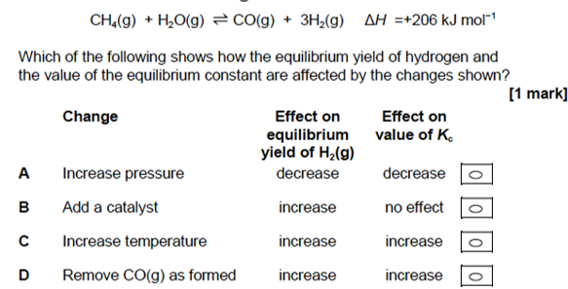
Quick test

