Slide 1


Physical Chemistry Year 1 - AS
3.1.7 Oxidation, reduction and Redox equations
Dr John R Griffiths
SciExcel Tuition
www.sciexcel.org

Slide 2
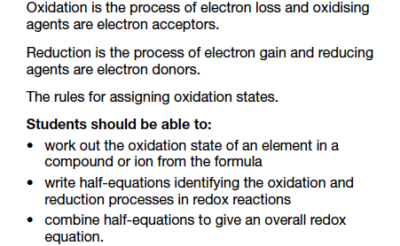
Physical Chemistry Year 1
3.1.7 Oxidation, reduction and Redox equations

Slide 3
Oxidation and Reduction - OIL RIG
OXIDATION IS LOSS
OF ELECTRONS
REDUCTION IS GAIN

Slide 4
Oxidation and Reduction - OIL RIG
GCSE
Ca – 2e → Ca²⁺ OXIDATION (loss of electrons)
Cl₂ + 2e → 2 Cl⁻ REDUCTION (gain of electrons)
For GCSE the equations may be written to shown + or - electrons
A-LEVEL
Ca → Ca²⁺ + 2e OXIDATION (still loss of electrons)
Cl₂ + 2e → 2 Cl⁻ REDUCTION (gain of electrons)
For A-level the equations are written to shown + electrons

Slide 5
REDOX
Reducing Agents lose electrons (electron donors) and are oxidised themselves.
Oxidising Agents gain electrons (electron acceptors) and are reduced themselves.
When magnesium is completely burnt in oxygen both reduction and oxidation take place. This is a REDOX reaction.
Mg + ½O₂ → MgO
In this reaction magnesium is being OXIDISED as it is losing electrons.
Mg → Mg²⁺ + 2e⁻
In this reaction oxygen is being REDUCED as it is gaining electrons.
½O₂ + 2e⁻ → O²⁻
Overall, electrons have been transferred from the reducing agent to the oxidizing agent

Slide 6
Oxidation states (Oxidation numbers)
The OXIDATION STATE or OXIDATION NUMBER (same) tell us how many electrons an element in a compound, has gained or lost compared to when the element is in an uncombined state (when it has an oxidation state of zero).
The oxidation number MUST have a sign (+/-), which by convention comes before the number.
A positive sign indicates that electrons have been lost (oxidation), whereas a negative sign shows the gaining of electrons (reduction).

Slide 7
Rules for assigning Oxidation numbers
Element | Oxidation number | Example
1. Uncombined Elements | Uncombined elements Always 0 | Br₂, Cu, N₂
2. Ions | Always same as charge on ion | Cl⁻ = -1 Mg²⁺ = +2
3. Group 1 | Always +1 | NaCl
4. Group 2 | Always +2 | CaBr₂
5. Aluminium | Always +3 | Al₂O₃
6. Fluorine | Always -1 | NaF
7. Hydrogen | +1 (except in hydrides (e.g. NaH) where it is -1) | KF
8. Oxygen | -2 (except it is -1 in peroxides (e.g H₂O₂) and +2 in OF₂) | Li₂O
9. Chlorine | -1 (except if in a compound with F or O – when it would have a positive value) | KCl
These rules must be learnt

Slide 8
Task - Work out the Oxidation States of the elements in red
NH₃
-3
H₂S
-2
O₂
0
H₂O₂
-1
H₂SO₄
+6
SO₄²⁻
+6

Slide 9
Elements with variable Oxidation States
One characteristic of transition metals is that they have variable oxidation states
To distinguish between the two forms of iron oxide shown, we use Roman numerals to indicate the oxidation state of the metal.
Fe₂O₃
Fe = +3
We call this Iron(III)Oxide (The III represents +3 oxidation state)
FeO
Fe = +2
We call this Iron(II)Oxide (The II represents +2 oxidation state)
VO²⁺
VO₂⁺
How would these two vanadium oxides be distinguished ?
Vanadium(IV)Oxide
Vanadium(V)Oxide

Slide 10
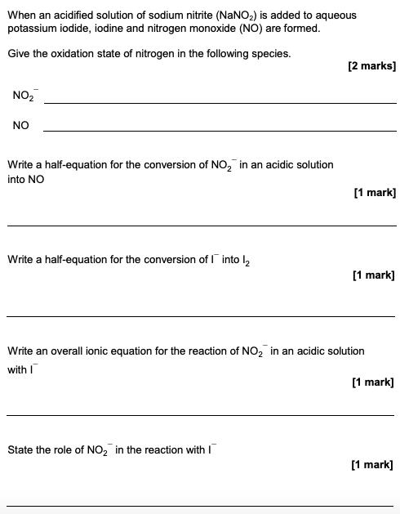
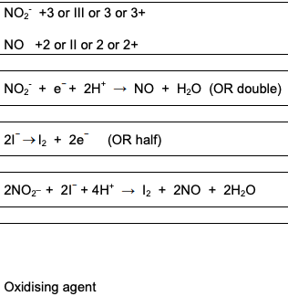
Example questions

Slide 11
Balancing Half Equations
*Steps 3 and 4 may not need to be done if there are no oxygens or hydrogens
Half equations show reduction and oxidation stages in 2 equations. ALL half equations must have electrons in.
THE RULES
Write a half equation showing the conversion of Fe²⁺ to Fe³⁺
1. Write down the species before and after a reaction
Fe²⁺ → Fe³⁺
2. Balance any atoms apart from oxygen and hydrogen (these will be dealt with later)
We need an oxidising agent to allow this to happen. (See next slide)
Fe²⁺ → Fe³⁺ (Already Balanced)
*3. Balance any oxygens with H₂O
Fe²⁺ → Fe³⁺ (No Oxygens)
*4. Balance any hydrogens with H⁺ ions
Fe²⁺ → Fe³⁺ (No Hydrogen)
5. Balance charges with electrons (e⁻)
Fe²⁺ → Fe³⁺ + e⁻
This shows OXIDATION

Slide 12
Balancing Half Equations
*Steps 3 and 4 may not need to be done if there are no oxygens or hydrogens
Half equations show reduction and oxidation stages in 2 equations. ALL half equations must have electrons in.
THE RULES
Write a half equation showing the conversion of MnO₄⁻ to Mn²⁺
1. Write down the species before and after a reaction
MnO₄⁻ → Mn²⁺
These 2 half equations can be combined to make a full ionic equation. (See next slide)
2. Balance any atoms apart from oxygen and hydrogen (these will be dealt with later)
MnO₄⁻ → Mn²⁺ (Already Balanced)
*3. Balance any oxygens with H₂O
MnO₄⁻ → Mn²⁺ + 4H₂O
This shows REDUCTION
*4. Balance any hydrogens with H⁺ ions
MnO₄⁻ + 8H⁺ → Mn²⁺ + 4H₂O
5. Balance charges with electrons (e⁻)
MnO₄⁻ + 8H⁺ + 5e⁻ → Mn²⁺ + 4H₂O

Slide 13
Combining Half Equations
2 half equations can be combined to make a full ionic equation. Just make sure your electrons balance!
This shows OXIDATION
Fe²⁺ → Fe³⁺ + e⁻
The electrons don’t balance so we need to multiply the top equation by 5
This shows REDUCTION
MnO₄⁻ + 8H⁺ + 5e⁻ → Mn²⁺ + 4H₂O
5Fe²⁺ → 5Fe³⁺ + 5e⁻
Cancel the electrons and combine the 2 equations.
MnO₄⁻ + 8H⁺ + 5Fe²⁺ → Mn²⁺ + 5Fe³⁺ + 4H₂O
IMPORTANT!
You should have NO electrons in the final ionic equation
Your full ionic equation shows both reduction and oxidation and so is a REDOX reaction

Slide 14
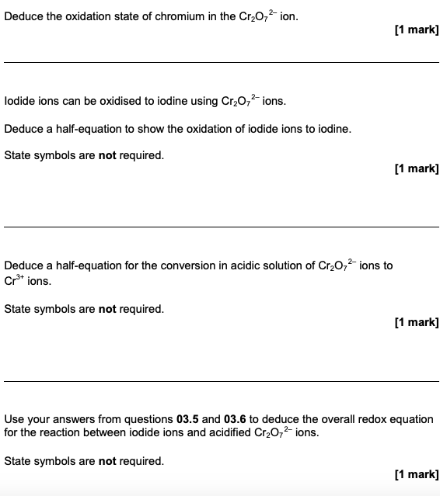
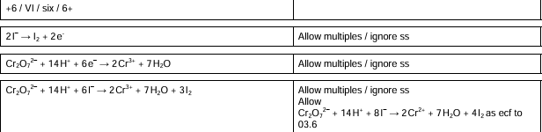
Example questions

