Slide 1


Inorganic Chemistry Year 1 - AS 3.2.1 Periodicity
Dr John R Griffiths
SciExcel Tuition
www.sciexcel.org

Slide 2

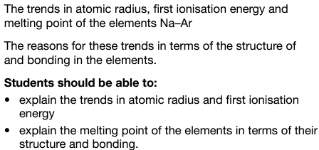
Inorganic Chemistry Year 1 3.2.1 Periodicity

Slide 3
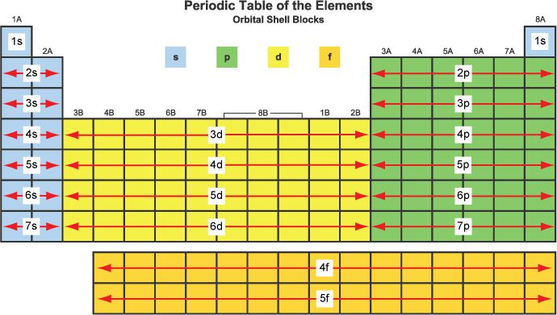
3.2.1.1 Classification

Slide 4
s, p, d, f block
Describes the orbitals of the highest energy electrons e.g.
Sodium, Na (1s² 2s² 2p⁶ 3s¹) is s-block,
Carbon, C (1s² 2s² 2p²) is p-block
Iron, Fe (1s² 2s² 2p⁶ 3s² 3p⁶ 4s² 3d⁶) is d-block
Remember, [Ne] 3s¹ is short-cut notation for sodium
Question – What is short-cut notation for Calcium ?
[Ar] 4s²

Slide 5
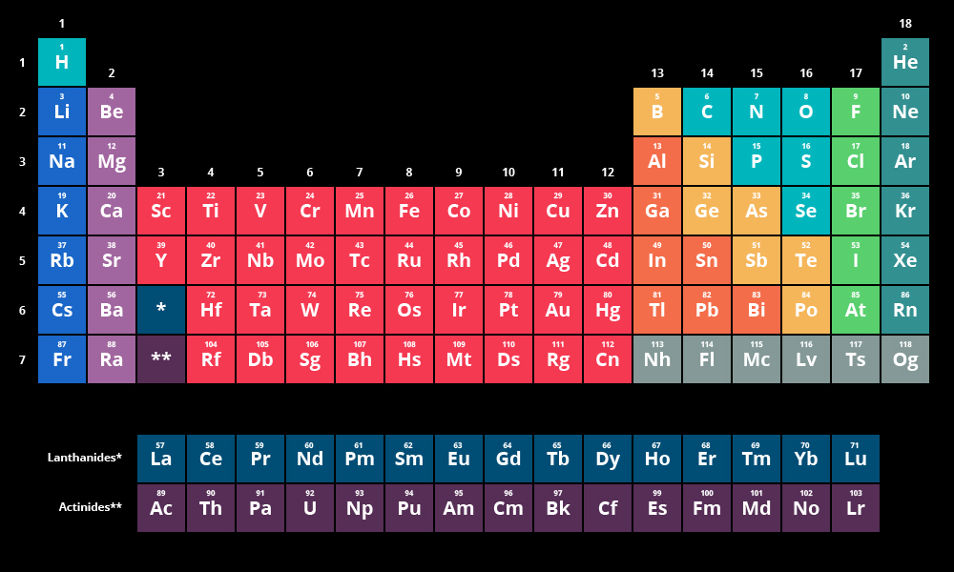
3.2.1.2 Physical properties of Period 3
GROUP NUMBER
1
2
3
4
5
6
7
0
s-block
p-block
Try to think of a way to remember the order of Period 3 elements.
(Period 2 - Little Betty Boron Could Never Order Flowers, Ney)

Slide 6
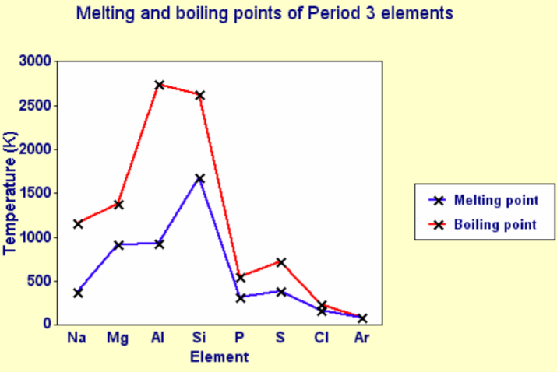
Trends in Melting points and Boiling points

Slide 7
Structures of the elements across Period 3
The structures of the elements change as you go across the period
The first three (Na, Mg, Al) are metallic, silicon is giant covalent, and the rest (P, S, Cl) are simple molecules – no need to consider Ar
This can explain properties like melting and boiling points

Slide 8
Structures of first three elements (Group 1-3)
Sodium, magnesium and aluminium all have metallic structures.
Melting and boiling points rise across the three metals because of the increasing strength of the metallic bonds.
The attractions and therefore the melting and boiling points increase because:
The nuclei of the atoms are getting more positively charged.
The "sea" is getting more negatively charged.
The "sea" is getting progressively nearer to the nuclei and so more strongly attracted.

Slide 9
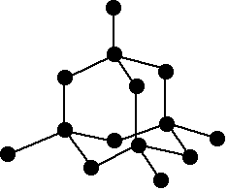
Structures of silicon (Group 4)
Silicon has a giant covalent structure (like diamond)
You have to break strong covalent bonds before it will melt or boil.

Slide 10
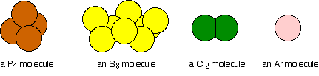
Simple molecular structures (Group 5-8)
The atoms in each of these molecules are held together by covalent bonds (apart from argon).
In the liquid or solid state, the molecules are held close to each other by weak van der Waals forces so low mp / bp compared to 1st four

Slide 11
Trends in electrical conductivity
Sodium, magnesium and aluminium are all good conductors of electricity.
None of the rest conduct electricity.
The three metals, conduct electricity because the delocalised electrons (the "sea of electrons") are free to move throughout the solid or the liquid metal and can carry charge.
The rest don't conduct electricity because they are simple molecular substances. There are no electrons (or ions) free to move around.

Slide 12
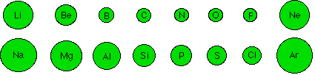
Trends in atomic radii
General trend is decreasing
Have to ignore noble gas as it doesn’t bond with other atoms so only weak van der Waals forces in place so not “squashed” by bonding as other atoms are

Slide 13
Atomic radii
The metallic or covalent radius is a measure of the distance from the nucleus to the electrons which make up the bond.
The increasing number of protons in the nucleus as you go across the period pulls the electrons in more tightly.
The amount of shielding is constant for all of these elements. (From lithium to fluorine, those electrons are all in the 2-level, being shielded by the 1s² electrons).

Slide 14
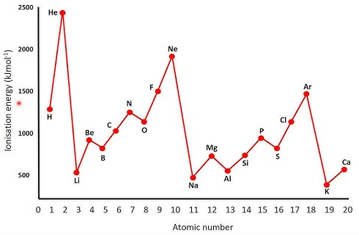
Trends in 1st ionisation energy
Period 2
Period 3

Slide 15
Definition of 1st ionisation energy
The first ionisation energy is the energy required to remove the most loosely held electron from one mole of gaseous atoms to produce 1 mole of gaseous ions each with a charge of 1+.
It is the energy needed to carry out this change per mole of X.

Slide 16
1st Ionisation energy across Period 3
The outer electrons are in 3-level orbitals so same shielding
Difference is the increasing number of protons in the nucleus.
That causes greater attraction between the nucleus and the electrons and so increases the ionisation energies.
The increasing nuclear charge also drags the outer electrons in closer to the nucleus.

Slide 17
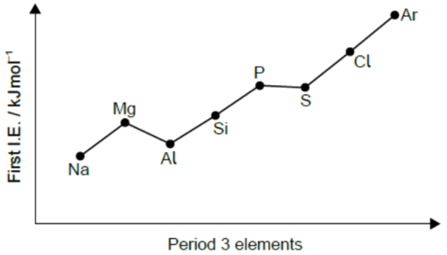
1st Ionisation energy governed by;
the charge on the nucleus;
the distance of the outer electron from the nucleus;
the amount of shielding by inner electrons;
whether the electron is alone in an orbital or one of a pair
Exceptions
Mg-Al
P-S

Slide 18
1st Ionisation energy Mg dip to Al
Expect the aluminium value to be more than the magnesium value because of the extra proton. Offsetting that is the fact that aluminium's outer electron is in a 3p orbital rather than a 3s.
The 3p electron is slightly more distant from the nucleus than the 3s, and partially shielded by the 3s electrons as well as the inner electrons. Both of these factors offset the effect of the extra proton.

Slide 19
1st Ionisation energy P to S
Something extra must be offsetting the effect of the extra proton
The shielding is identical
The difference is that in the sulphur case the electron being removed is one of the 3p x 2 pair.
The repulsion between the two electrons in the same orbital means that the electron is easier to remove than it would otherwise be.

Slide 20
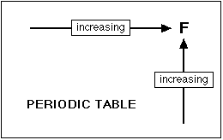
Trends in Electronegativity
Reminder - What is it?
Electronegativity is a measure of the tendency of an atom to attract a bonding pair of electrons.

Slide 21
Trends in Electronegativity
As you go across a period the electronegativity increases as the nuclear charge increases – attracts bonding pair of electrons
The attraction that a bonding pair of electrons feels for a particular nucleus depends on:
the number of protons in the nucleus;
the distance from the nucleus;
the amount of shielding by inner electrons.

Slide 22
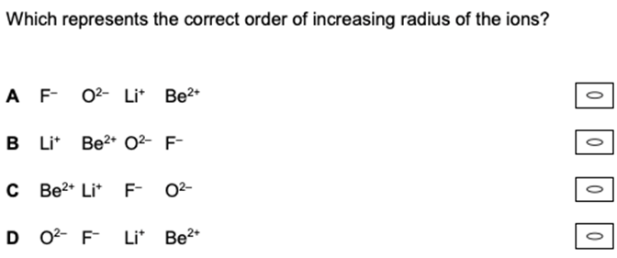
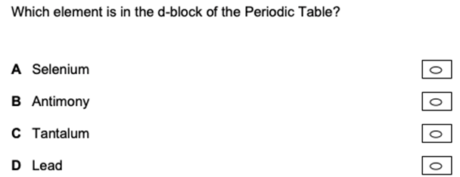
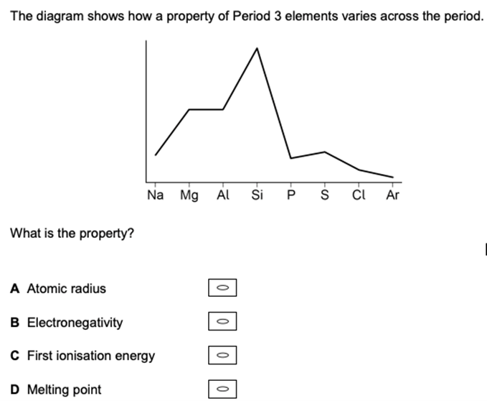
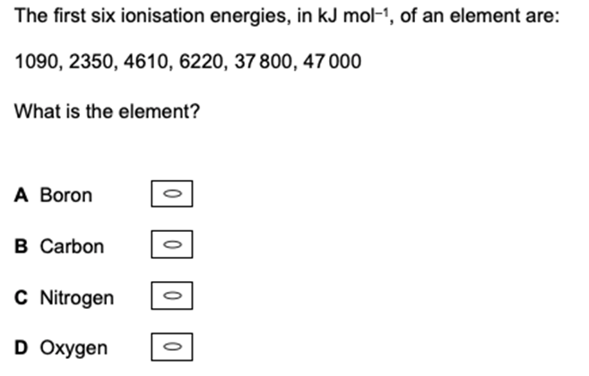
Example questions
Notes:
Photo credit: Wellcome Photo Library, Wellcome Images
Teacher notes
Here the X-ray image taken using barium sulfate reveals that the patient has a gastric ulcer.

