Slide 1


Inorganic Chemistry Year 1 - AS 3.2.2 Group 2 – The alkaline earth metals
Dr John R Griffiths
SciExcel Tuition
www.sciexcel.org

Slide 2
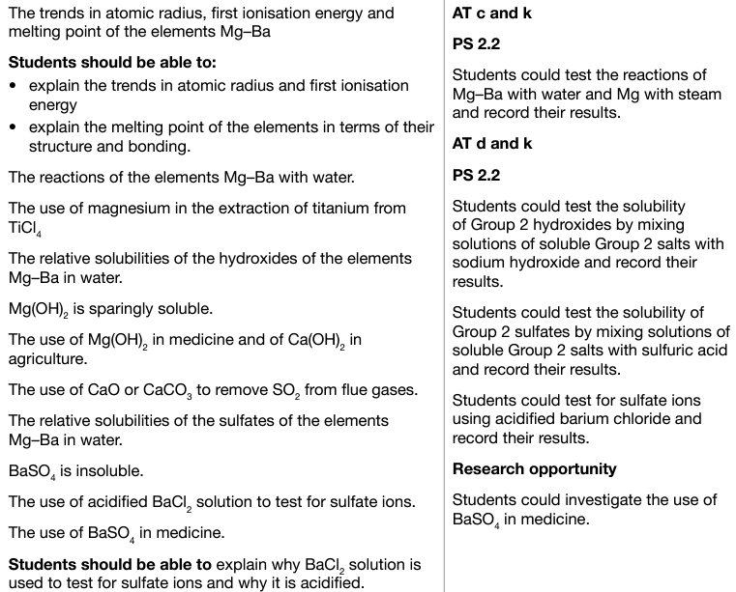
Inorganic Chemistry Year 1 3.2.2 Group 2 – The alkaline earth metals

Slide 3
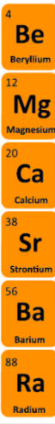
Physical properties
Group 2 of the periodic table is shown opposite. Trends that that we are required to know and understand as we go down the group are; atomic radius, first ionization energy and melting point.
Elements in the same group undergo similar chemical reactions due to the number of outermost electrons, i.e. in this case, 2.
Notes:
Teacher notes
Radium has not been included here because it is very radioactive. This affects its availability, its properties and the experiments that can easily be performed using it.

Slide 4
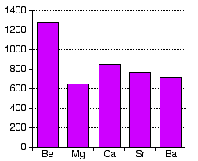
Melting Point
Melting points of the group 2 elements
Melting point, °C
General trend is a decrease in MPt
Element

Slide 5
Explaining the trend in melting points
They are all metals with high melting points. Each atom contributes its two outermost electrons to sea of delocalised electrons
The melting points of the elements decrease down group 2, with the exception of magnesium to calcium.
A metal’s melting point depends on the strength of its metallic bonds.
The metal ions become larger going down the group -> metallic bonding decreases due to decreasing charge (all +2) to size ratio -> less attraction for delocalised electrons
Notes:
Teacher notes
It is not as simple as the crystal packing in magnesium being different to that in the other group 2 metals. In fact, beryllium has the same type of structure as magnesium (hexagonal close-packed), calcium and strontium have another type of structure (face-centred cubic), and barium is different again (body-centred cubic). Melting points are complex phenomena and neither the packing in the crystal nor the increase in atomic radius fully account for the trend observed.
See the ‘Bonding and Intermolecular Forces’ presentation for more information about metallic bonding.

Slide 6
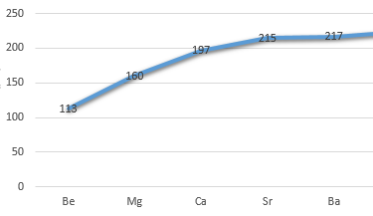
Trend in atomic radius
Atomic radii of the group 2 elements
General trend is an increase in atomic radius
Distance, pm
Element

Slide 7
Explaining the trend in atomic radius
The atomic radius of the elements increases down group 2 from beryllium to barium.
The number of protons increases down the group; however, so does the number of shielding electrons.
Effective nuclear charge therefore remains approximately constant.
The increase in radius is due to higher principle energy levels being filled, whose orbitals are located further from the nucleus.
Notes:
Teacher notes
See the ‘Trends in Period 3’ presentation for more information about atomic radius, shielding and effective nuclear charge.

Slide 8
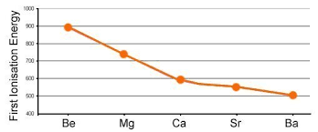
Trend in first ionization energy
1st ionisation energies of the group 2 elements
1st ionisation energy
General trend is a decrease in 1st IE
Element

Slide 9
Explaining the trend in 1st IE
The first ionisation energy is the energy required to remove the most loosely held electron from one mole of gaseous atoms to produce 1 mole of gaseous ions each with a charge of 1+;
e.g. Mg_{(g)} --> Mg⁺_{(g)} + e⁻
1st IE decreases going down the group as less energy is required to remove
the outermost electrons.
Due to, greater distance from nucleus and more shielding by inner electrons
Notes:
Teacher notes
See the ‘Trends in Period 3’ presentation for more information about atomic radius, shielding and effective nuclear charge.

Slide 10
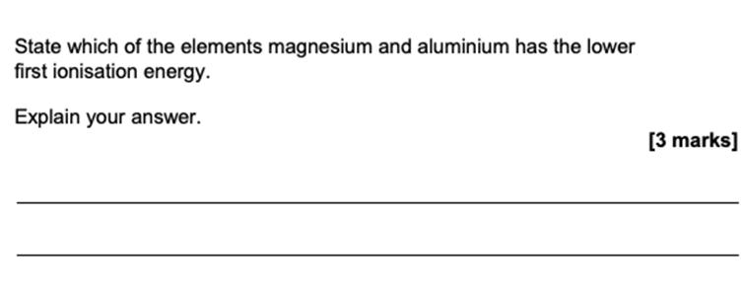
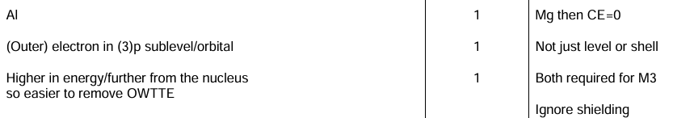
Example question
Notes:
Teacher notes
See the ‘Trends in Period 3’ presentation for more information about atomic radius, shielding and effective nuclear charge.

Slide 11
Reactions with water
Reactivity INCREASES going down the group (similar to Group 1 metals)
Be – no reaction
Mg – slowly with cold water – rapidly with steam
Cold water - Mg_{(s)} + 2H₂O_{(l)} --> Mg(OH)_{2(aq)} + H_{2(g)}
Steam - Mg_{(s)} + H₂O_{(g)} --> MgO_{(s)} + H_{2(g)}
Ca, Sr, Ba – react with cold water forming hydroxide and releasing hydrogen (same equation as Mg with cold water, but more vigorous).
Show that these are REDOX reactions.

Slide 12
Redox reaction
When group 2 metals react with water they form the metal hydroxide and hydrogen gas. For example:
Sr_{(s)} + 2H₂O_{(l)} → Sr(OH)_{2(aq)} + H_{2(g)}
What are the oxidation states for strontium, hydrogen and oxygen, before and after reaction?
Which elements have been REDUCED/OXIDISED ?
Notes:
Teacher notes
See the ‘Redox Reactions’ presentation for more information about oxidation and reduction.

Slide 13
Explaining the trend in reactivity
The reactivity of the elements down group 2 from beryllium to barium increases.
This is because it is successively easier to remove the outermost electrons to form the 2+ ion.
Although increased shielding cancels the increased nuclear charge down the group, the increase in atomic radius results in a decrease in the attractive force between the outer electrons and the nucleus.

Slide 14
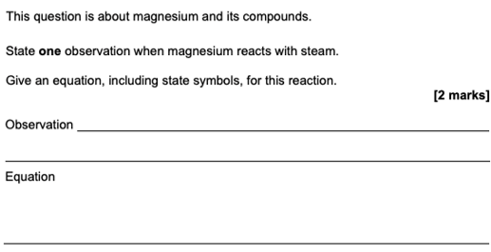
Example question

Slide 15
The use of magnesium in the extraction of titanium from TiCl₄
Titanium cannot be extracted from its oxide (ore) using carbon as it forms TiC. Instead, it is reacted with coke and chlorine the reduced using Mg.
Mg used to extract Ti from the ore rutile (TiO₂)
TiO₂ + 2C + Cl₂ ➔TiCl₄ + 2CO
TiCl_{4(l)} + 2Mg_{(s)} ➔Ti_{(s)} + 2MgCl_{2(s)}
LEARN THESE EQUATIONS !!

Slide 16
Solubilities of Group 2 hydroxides
M(OH)₂
Hydroxide solubility INCREASES on descending the group
Beryllium – virtually insoluble
Magnesium – sparingly
Calcium – forms lime water
Strontium - soluble
Barium – quite soluble and produces strongly alkaline solutions

Slide 17
Solubilities of Group 2 hydroxides
As the solubility of the group 2 hydroxides increases, so does the pH of the solutions formed. This is because the more of the hydroxide that dissolves, the greater the concentration of hydroxide ions (OH⁻) in the solution formed.

Slide 18
Applications of Group 2 hydroxides
A suspension of magnesium hydroxide is commonly called milk of magnesia. It is used in medicine as a laxative and to relieve acid indigestion.
Calcium hydroxide, also called slaked lime, is used in agriculture to raise the pH of soils which are acid. Soil pH is an important factor in agriculture.
Notes:
Photo credit: Russ Munn / Agstockusa / Science Photo Library
Teacher notes
Regulating soil pH is important because different plants have different pH requirements. Adjusting the soil pH to that at which a particular crop grows best can maximize the yield of that crop.

Slide 19
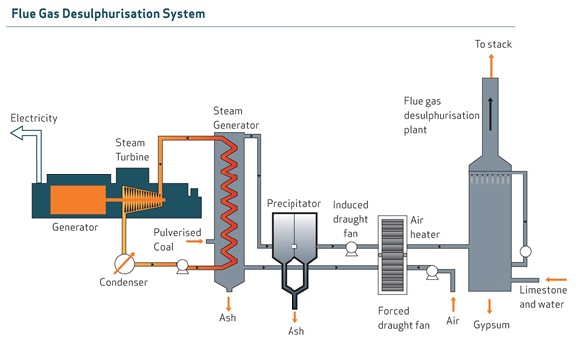
CaO in flue gas desulfurisation
CaO + SO₂ → CaSO₃
© www.chemsheets.co.uk AS 1061 3-July-15

Slide 20
Solubilities of Group 2 sulphates
Solubilities of the Group 2 sulfates are the opposite to the hydroxides
Test for sulfates
Dilute hydrochloric or nitric acid (removes carbonates) and a solution of barium ions (barium chloride or nitrate) are added to the solution being tested.
Appearance of a white ppt shows presence of sulphate ions (insoluble BaSO₄).
MgSO₄
soluble
CaSO₄
slightly soluble
SrSO₄
insoluble
BaSO₄
insoluble

Slide 21
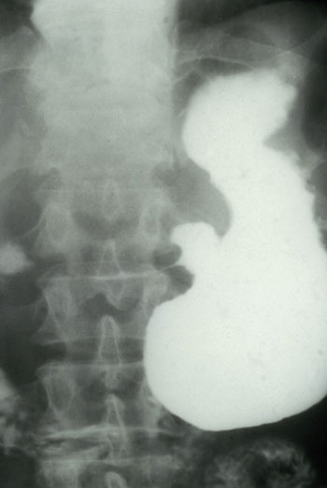
Applications of Group 2 sulfates
Barium sulfate is used as a radiocontrast agent to help take X-ray images of the digestive system. It is sometimes known as a ‘barium meal’.
Barium sulfate is insoluble, so is not absorbed by the body when swallowed. However, barium is a very good absorber of X-rays and it helps to define structures of the digestive system to aid in diagnosis.
Notes:
Photo credit: Wellcome Photo Library, Wellcome Images
Teacher notes
Here the X-ray image taken using barium sulfate reveals that the patient has a gastric ulcer.

Slide 22
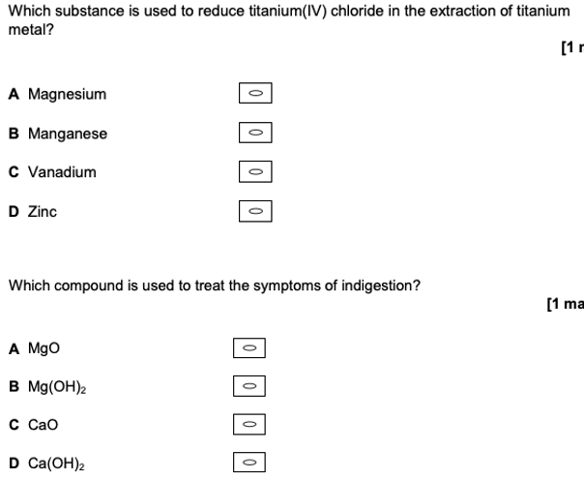
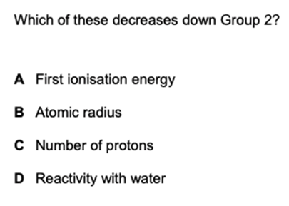
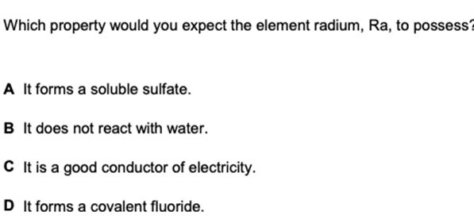
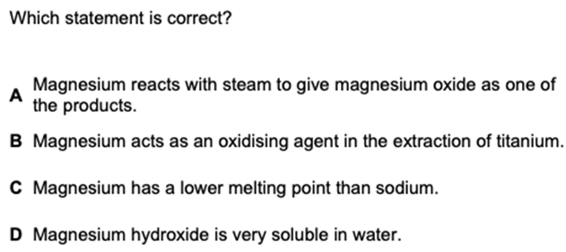
Example questions
Notes:
Photo credit: Wellcome Photo Library, Wellcome Images
Teacher notes
Here the X-ray image taken using barium sulfate reveals that the patient has a gastric ulcer.

