Slide 1


Inorganic Chemistry Year 1 - AS
3.2.3 Group 7 (17) – The halogens
Dr John R Griffiths
SciExcel Tuition
www.sciexcel.org

Slide 2
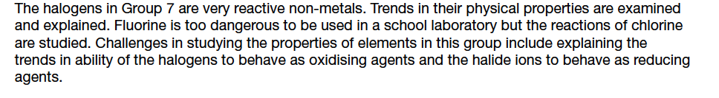
Inorganic Chemistry Year 1
3.2.3 Group 7 (17) – The Halogens

Slide 3
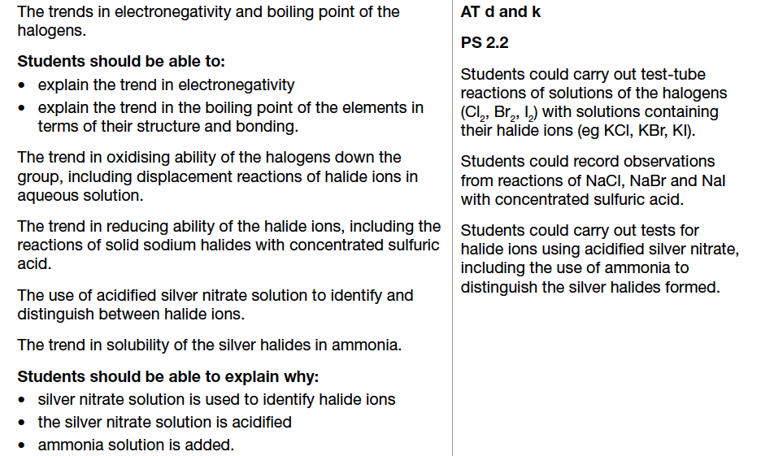
3.2.3.1 Trends in properties

Slide 4
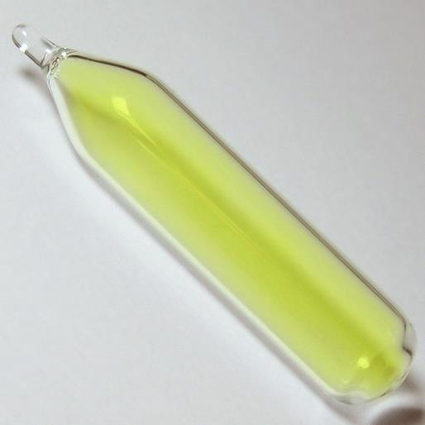
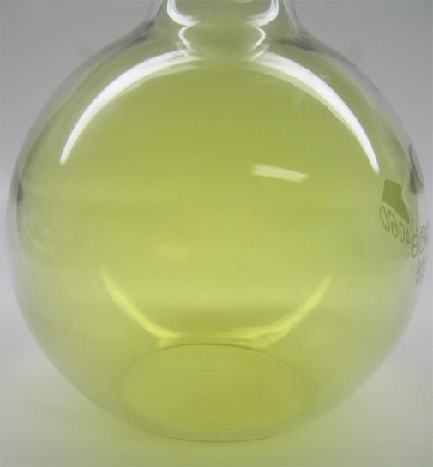
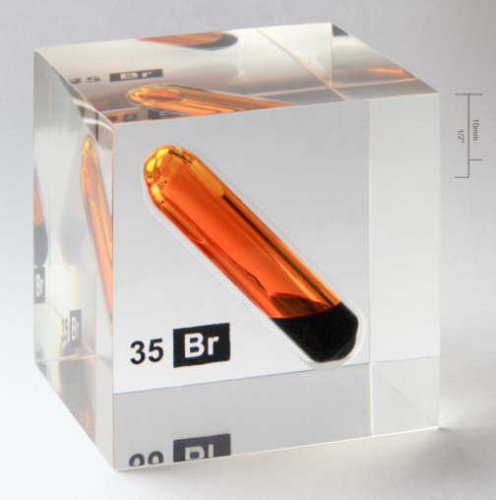
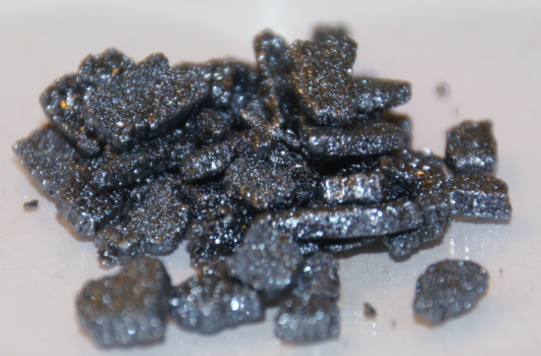
Diatomic molecules – States at room temperature
Fluorine - F₂ Bpt -188
Pale yellow gas (g)
very reactive
toxic
Chlorine - Cl₂ Bpt -35
greenish gas (g)
very reactive
toxic
Bromine – Br₂ Bpt +59
Red-brown liquid (l)
very reactive
toxic
Iodine – I₂ Bpt +184
Grey/black crystals (s)
reactive
toxic

Slide 5
Intermolecular forces
Boiling point (and Mpt) INCREASES going down Group 7 due to;
increased size (more electrons) makes the van der Waals (Intermolecular)forces increase
• more energy is required to separate the molecules
I
I
I
I
I
I
I
I
GAS I₂
I
I
I
I
I
I
SOLID I₂
I
I
I
I
I
I
I
I
I
I
LIQUID I₂

Slide 6
Atomic radius
More electron shells
SMALLER
F
……2s² 2p⁵
Ions are larger than atoms – increased electron repulsion from added electron so radius increases
Cl
……3s² 3p⁵
Br
……4s² 4p⁵
I
……5s² 5p⁵
At
……6s² 6p⁵
BIGGER

Slide 7
Electronegativity - (The ability of an atom to attract a pair of electrons, or electron density, in a covalent bond)
DECREASES going down Group 7
Since although the increasing nuclear charge due to the greater
number of protons should attract electrons more,
as the size of the atom increases, there is ...
an increasing number of shells;
∴ more shielding and less pull on electrons
an increasing atomic radius
∴ attraction of protons to bonding electrons drops off
as distance increases
Less important
More important

Slide 8
Bond Energies
Bond | Bond energy, KJ/mol
F-F | 158
Cl-Cl | 243
Br-Br | 193
I-I | 151
F-F bond is lower than expected due to the closeness of the two atoms, leading to repulsion between the non-bonding lone pairs of electrons on each Fluorine.

Slide 9
1st Ionisation energy
atoms get bigger going down a group
this results in more shielding
greater distance between outer electrons and nucleus (protons)
therefore, weaker attraction from nucleus to electron in outer shell

Slide 10
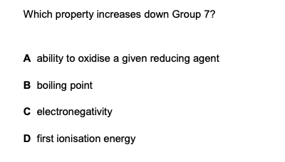
Example question

Slide 11
Trends in oxidizing ability of HALOGENS
When a HALOGEN acts as an oxidising agent, it gains electrons (taken from the oxidised species).
X₂ + 2 e⁻ → 2 X⁻
Cl
Down the group it becomes harder to gain an electron because:
atoms are larger & there is more shielding (due to extra electron shell)
Oxidising power gets weaker down the group
Br
I

Slide 12
Displacement reactions of the halogens
THE DECREASE IN REACTIVITY DOWN THE GROUP IS DEMONSTRATED USING DISPLACEMENT REACTIONS...
A SOLUTION OF THE HALOGEN IS ADDED TO A SOLUTION OF A HALIDE IONS
A MORE REACTIVE HALOGEN WILL DISPLACE A LESS REACTIVE ONE
e.g. CHLORINE + SODIUM BROMIDE BROMINE + SODIUM CHLORIDE
CHLORINE + SODIUM IODIDE IODINE + SODIUM CHLORIDE
BROMINE + SODIUM IODIDE IODINE + SODIUM BROMIDE
BUT BROMINE + SODIUM CHLORIDE CHLORINE + SODIUM BROMIDE
(Bromine is below chlorine in the Group so is less reactive)

Slide 13
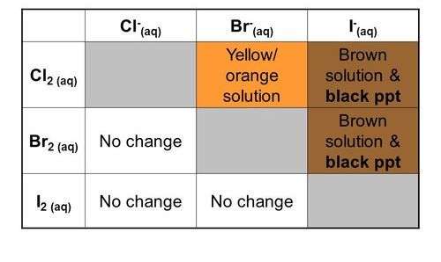
Oxidising power of the halogens
Chlorine oxidises bromide ions to bromine
Cl₂ + 2Br¯ ——> Br₂ + 2Cl¯
Chlorine oxidises iodide ions to iodine
Cl₂ + 2I¯ ——> I₂ + 2Cl¯
Bromine oxidises iodide ions to iodine
Br₂ + 2I¯ ——> I₂ + 2Br¯

Slide 14
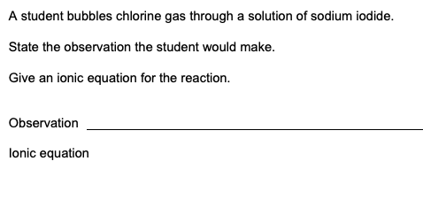
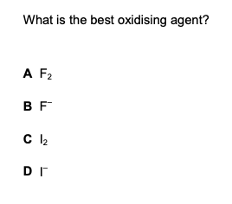

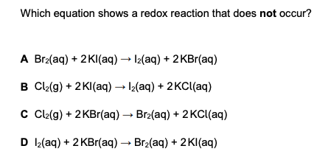
Example questions
Notes:
Photo credit: Wellcome Photo Library, Wellcome Images
Teacher notes
Here the X-ray image taken using barium sulfate reveals that the patient has a gastric ulcer.

Slide 15
Reducing power trend: Cl– < Br– < I–
Trends in reducing power of HALIDES
When a halide ion acts as a reducing agent, it loses electrons (given to the reduced species).
2 X– → X₂ + 2 e–
Cl–
Down the group it becomes easier to lose an electron because:
ions are larger & there is more shielding (due to extra electron shell)
Br–
I–
© www.chemsheets.co.uk AS 1065 3-July-15

Slide 16
Trends in reducing power of HALIDES
2 X– → X₂ + 2 e–
When a halide ion reduces another substance, the halide is oxidised to a halogen.
Comparison of the SOLID halides reactions with H₂SO₄ highlights the differences in the reducing power of the halide ions.

Slide 17
Comparison of the halide reactions with H₂SO₄
© www.chemsheets.co.uk AS 1065 3-July-15

Slide 18
Summary of observations of reactions with H₂SO₄
Halide Observation(s) Product Ox. State Reaction type
NaCl misty fumes HCl -1 Displacement of Cl¯
NaBr misty fumes HBr -1 Displacement of Br¯
brown vapour Br₂ 0 Oxidation of Br¯
colourless gas SO₂ +4 Reduction of H₂SO₄
NaI misty fumes HI -1 Displacement of I¯
purple vapour I₂ 0 Oxidation of I¯
colourless gas SO₂ +4 Reduction of H₂SO₄
yellow solid S 0 Reduction of H₂SO₄
bad egg smell H₂S -2 Reduction of H₂SO₄

Slide 19
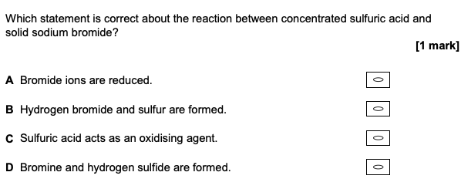
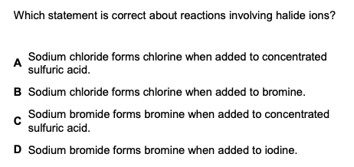
Example questions

Slide 20
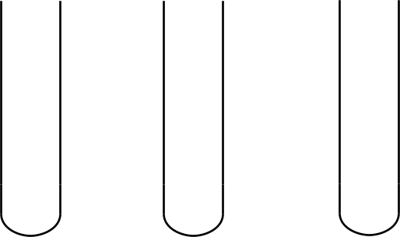
Testing for halides using silver nitrate
CHLORIDE
BROMIDE
IODIDE
Place a small amount (5 cm³) of the halide solution in to a test-tube
Add a few drops of dilute nitric acid (Why??)
Add some silver nitrate solution and mix

Slide 21



Results of silver nitrate test
CHLORIDE
BROMIDE
IODIDE
White precipitate
Cream precipitate
Yellow precipitate
THINK:- MILK CREAM BUTTER

Slide 22
Confirmation of silver nitrate test
To differentiate between the colours (can be hard to tell), do the following...
To the precipitates formed, add;
Dilute ammonia solution
  Chloride precipitate dissolves but the others remain
Concentrated ammonia solution
  Bromide precipitate dissolves but iodide precipitate remains

Slide 23
Summary of silver nitrate test
Halide ion | Action of AgNO₃(aq) | Action of dilute NH₃(aq) | Action of conc. NH₃(aq)
F–(aq) | No precipitate | - | -
Cl–(aq) | Ag⁺(aq) + Cl–(aq) → AgCl(s) white ppt | Soluble AgCl(s) + 2 NH₃(aq) → [Ag(NH₃)₂]⁺(aq) + Cl–(aq) | Soluble AgCl(s) + 2 NH₃(aq) → [Ag(NH₃)₂]⁺(aq) + Cl–(aq)
Br–(aq) | Ag⁺(aq) + Br–(aq) → AgBr(s) cream ppt | Insoluble (remains cream) | Soluble AgBr(s) + 2 NH₃(aq) → [Ag(NH₃)₂]⁺(aq) + Br–(aq)
I–(aq) | Ag⁺(aq) + I–(aq) → AgI(s) yellow ppt | Insoluble (remains yellow) | Insoluble (remains yellow)
© www.chemsheets.co.uk AS 1067 3-July-2015

Slide 24
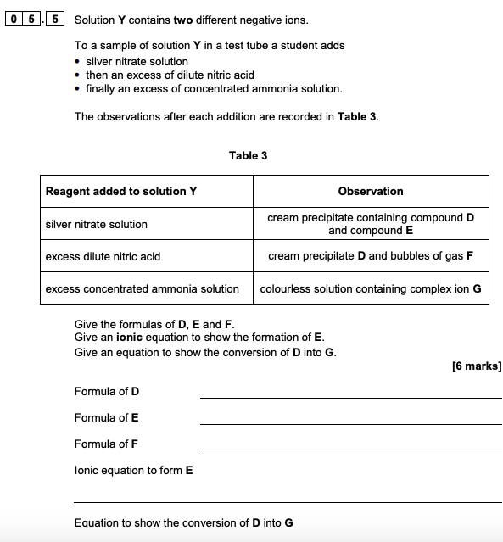
Example question

Slide 25
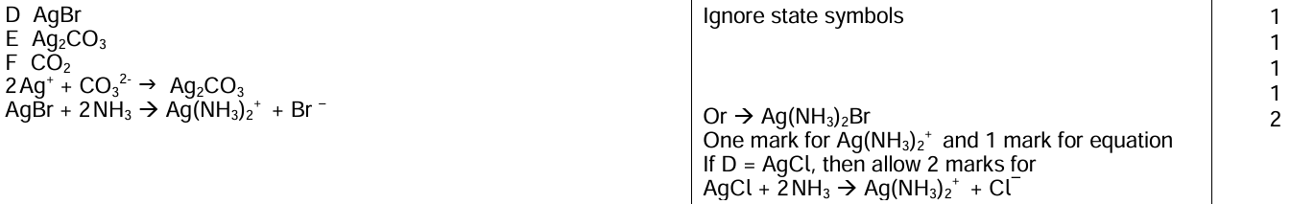
Answer

Slide 26
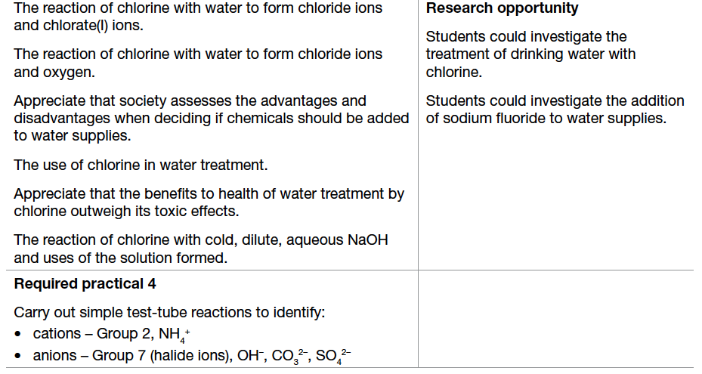
3.2.3.2 Uses of chlorine and chlorate (I)

Slide 27
Reaction of chlorine with water - 1
Halogens react with decreasing vigour down the group as
their oxidising power decreases
Litmus will be turned red then decolourised in chlorine water
This is an example of DISPROPORTIONATION …
‘simultaneous oxidation and reduction of a species’
Cl₂(g) + H₂O(l) HCl(aq) + HOCl(aq)

Slide 28
Reaction of chlorine with water - 2
In sunlight the following reaction occurs;
2Cl₂(g) + 2H₂O(l) --> 4HCl(aq) + O₂(g)

Slide 29
Reaction of chlorine with NaOH
Chlorine reacts with cold, aqueous sodium hydroxide as follows,
2NaOH(aq) + Cl₂(g) —> NaCl(aq) + NaOCl(aq) + H₂O(l)
This is another example of disproportionation. Chlorine (0) is oxidised to +1 oxidation state in sodium chlorate (I), and simultaneously reduced to –1 oxidation state in sodium chloride.
NaOCl is an oxidising agent and is used in bleach. It is also added to swimming pools as a disinfectant
NaOCl(s) + H₂O(l) Na⁺(aq) + OH⁻(aq) + HClO(aq)

Slide 30
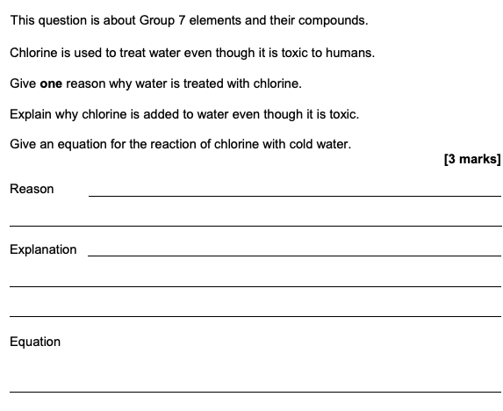
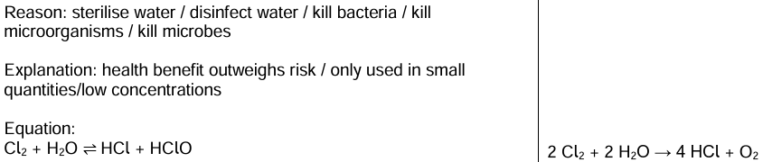
Example question

