Slide 1


Inorganic Chemistry Year 2 - A2
3.2.4 Properties of Period 3 elements and their oxides
Dr John R Griffiths
SciExcel Tuition

Slide 2
Inorganic Chemistry Year 2
3.2.4 Properties of Period 3 elements and their oxides
The reactions of Na and Mg with water. The trends in the reactions of the elements Na, Mg, Al, Si, P and S with oxygen, limited to the formation of Na₂O, MgO, Al₂O₃, SiO₂, P₄O₁₀, SO₂ and SO₃
The trend in the melting point of the highest oxides of the elements Na–S
The reactions of the oxides of the elements Na–S with water, limited to Na₂O, MgO, Al₂O₃, SiO₂, P₄O₁₀, SO₂ and SO₃, and the pH of the solutions formed.
The structures of the acids and the anions formed when P₄O₁₀, SO₂ and SO₃ react with water.
Students should be able to:
explain the trend in the melting point of the oxides of the elements Na–S in terms of their structure and bonding
explain the trends in the reactions of the oxides with water in terms of the type of bonding present in each oxide
• write equations for the reactions that occur between the oxides of the elements Na–S and given acids and bases.

Slide 3
Period 3 elements – General properties
The structures of the elements change as you go across the period
The first three (Na, Mg, Al) are metallic, silicon is giant covalent, and the rest (P, S, Cl) are simple molecules – no need to consider Ar
This can explain properties like melting and boiling points
Refer to AS Topic 3.2.1 - Periodicity

Slide 4
Reactions of Period 3 elements
1. Reactions of Na and Mg with water (LEARN THESE)
Sodium – Vigorous, exothermic reaction.
2Na_{(s)} + 2H₂O_{(l)} --> 2NaOH_{(aq)} + H_{2(g)}
Observations - sodium floats and moves quickly then disappears. Effervescence.
Solution of sodium hydroxide formed is strongly alkaline (pH 13-14).
Magnesium – With cold water – very slow.
Mg_{(s)} + 2H₂O_{(l)} --> Mg(OH)_{2(aq)} + H_{2(g)}
Observations - Very few bubbles of hydrogen.
Solution of magnesium hydroxide is less alkaline (pH 10).
– With steam – much faster.
Mg_{(s)} + H₂O_{(g)} --> MgO_{(s)} + H_{2(g)}
Observations - White solid and bubbles.

Slide 5
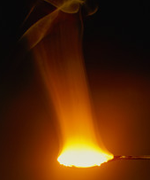
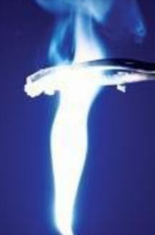

Reactions of Period 3 elements
2. Reactions with oxygen (LEARN THESE)
Sodium – Exothermic reaction in air.
2Na_{(s)} + 0.5O_{2(g)} --> Na₂O_{(s)}
Observations - Bright yellow flame.
White solid forms (sodium oxide).
Magnesium – Exothermic reaction in air.
2Mg_{(s)} + O_{2(g)} --> 2MgO_{(s)}
Observations - Bright white flame
White solid forms (magnesium oxide).
Aluminium – Exothermic reaction of powder in oxygen and air.
4Al_{(s)} + O_{2(g)} --> 2Al₂O_{3(s)}
Observations - Bright white flame.
White solid forms (aluminium oxide).
Aluminium is highly reactive, but readily forms a coat of the oxide which renders it unreactive.

Slide 6
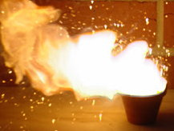
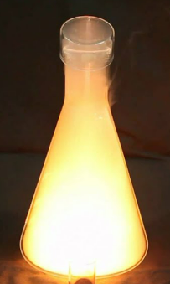
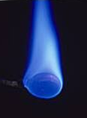
Reactions of Period 3 elements
2. Reactions with oxygen
Silicon – Heated strongly in air.
Si_{(s)} + O_{2(g)} --> SiO_{2(s)}
Observations - Bright white flame.
White solid forms (silicon dioxide).
Phosphorus – Exothermic reaction.
4P_{(s)} + 5O_{2(g)} --> P₄O_{10(s)}
Observations - Bright white flame.
White solid forms (phosphorus pentoxide).
Sulphur – Exothermic reaction.
S_{(s)} + O_{2(g)} --> SO_{2(g)}
Observations - Bright blue flame.
Colourless gas formed – SO₂ (a little SO₃ also formed).
Phosphorus exists as two allotropes (same element with different arrangement of atoms) – red and white.

Slide 7
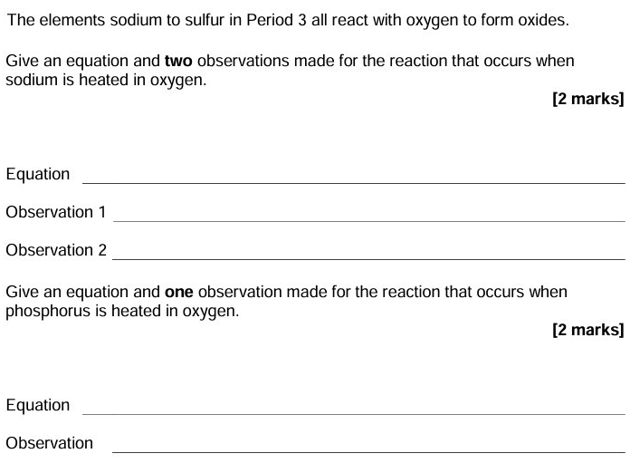
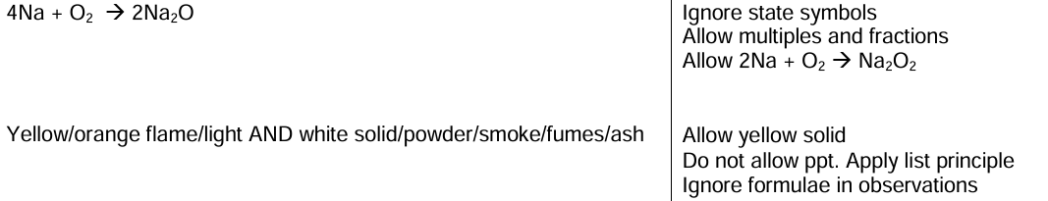
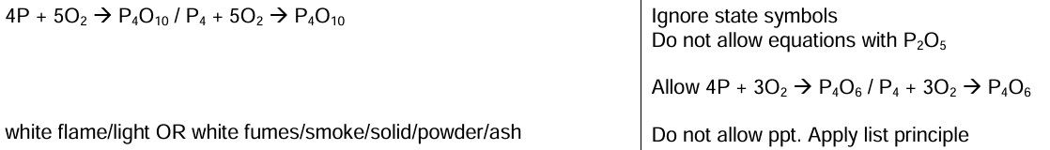
Example questions

Slide 8
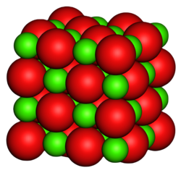
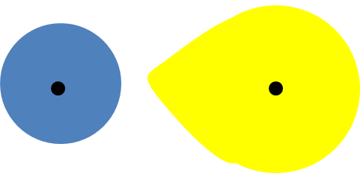
Period 3 oxides
1. Physical properties
Na₂O, MgO and Al₂O₃ – The metal oxides
Form GIANT IONIC LATTICE structures. Therefore, high melting points.
Al₂O₃ contains some covalent character, since the Al³⁺ is small
and highly charged. This somewhat distorts the O²⁻ ion's
electron cloud as it may approach closely.
Al³⁺
O²⁻

Slide 9
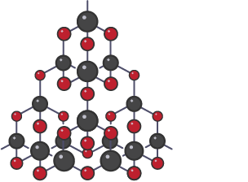
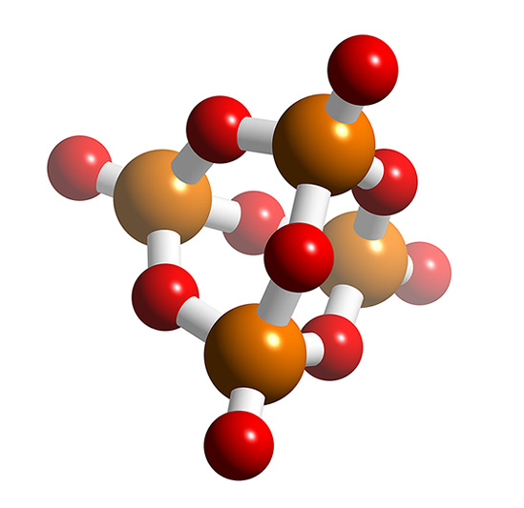
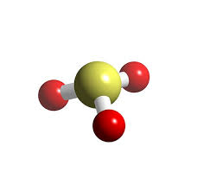
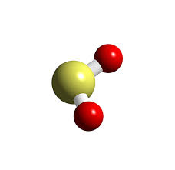
Period 3 oxides
1. Physical properties
SiO₂, P₄O₁₀, SO₃ and SO₂ – The non-metal oxides
Silicon dioxide has a giant covalent (MACROMOLECULAR) structure, with strong covalent bonds throughout the whole 3D structure. Therefore high melting point.
Oxides of phosphorous and sulphur exist as simple molecular structures, with weak intermolecular forces (van der Waal and dipole-dipole) between them. Therefore they have relatively low melting and boiling points (SO₂ and SO₃ are gases at room temp.) Melting point increases with size (number of electrons) i.e. P₄O₁₀>SO₃>SO₂
>
>

Slide 10

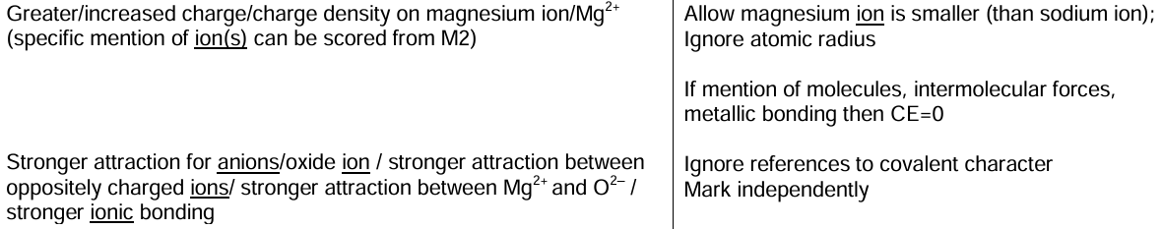
Example questions

Slide 11
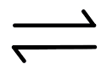
Period 3 oxides
2. Reactions with water
Both sodium and magnesium form basic oxides (Giant ionic structure) and form alkaline solutions (OH⁻_{(aq)}), NaOH_{(aq)} and Mg(OH)_{2(aq)}, with water. Since MgO is only sparingly soluble, it has an approximate pH in solution of 9, whereas Na₂O, which fully dissociates, gives a strongly alkaline solution (pH 13-14).
Na₂O_{(s)} + H₂O_{(l)} → 2Na⁺_{(aq)} + 2OH⁻_{(aq)} (pH approx. 14)
MgO_{(s)} + H₂O_{(l)} → Mg(OH)_{2(s)} Mg²⁺_{(aq)} + 2OH⁻_{(aq)} (pH approx. 9)
Aluminium oxide (Giant ionic structure but with some covalent bonding character) and silicon dioxide (Giant covalent structure) are both insoluble in water
Acidic solutions (with H⁺ ions in solution) result from the reaction of phosphorus pentoxide, sulphur dioxide and sulphur trioxide with water, as follows…..

Slide 12
Period 3 oxides
2. Reactions with water
Phosphorus
P₄O₁₀ reacts violently with water forming phosphoric acid;
P₄O_{10 (s)} + 6H₂O_{(l)} → 4H₃PO_{4(aq)} (Strong acid (*pH approx. 0-1))
Sulphur
Sulphur dioxide – Fairly soluble to give a solution of sulphurous acid;
SO_{2(g)} + H₂O_{(l)} → H₂SO_{3(aq)} (Weak acid (*pH approx. 2-3))
Sulphur trioxide reacts violently with water to give sulphuric acid;
SO_{3(g)} + H₂O_{(l)} → H₂SO_{4(aq)} (Strong acid (*pH approx. -1 to +1))
*Actual pH values depend upon concentration

Slide 13
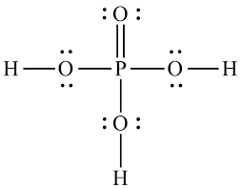
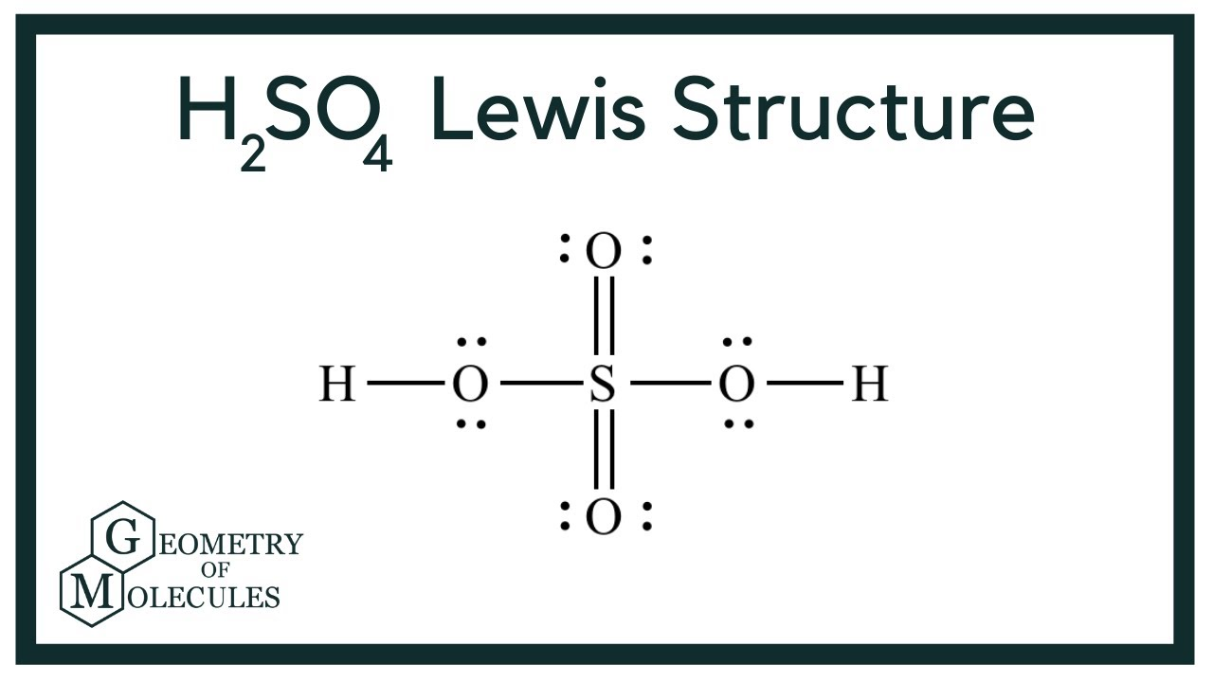
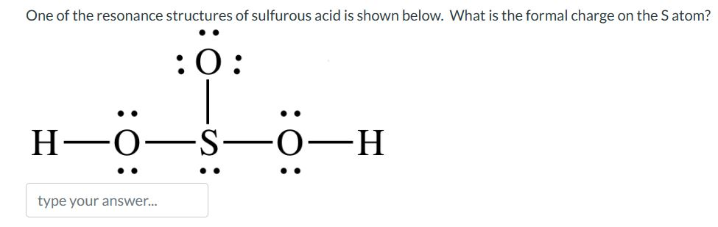
Period 3 oxides
Structures of oxo-acids and their anions
Phosphoric (V) acid
Sulphuric (VI) acid
Sulphuric (IV) acid
(Sulphurous acid)
-
-
-
-
-
-
-
Due to the delocalisation of the bonding electrons in PO₄³⁻ and SO₄²⁻ , the following shapes are adopted;
Tetrahedron [PO₄]³⁻ Tetrahedron [SO₄]²⁻ Trigonal-based pyramid [SO₃]²⁻

Slide 14
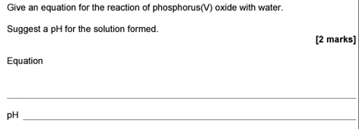
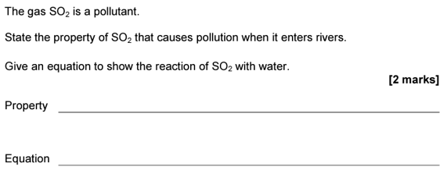
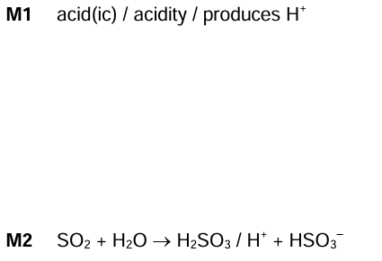
Example questions

Slide 15
Period 3 oxides
3. Acidic/basic nature
The basic oxides of sodium and magnesium react with acids in the usual way to give a salt plus water;
e.g. Na₂O_{(s)} + H₂SO_{4(aq)} → Na₂SO_{4(aq)} + H₂O_{(l)}
MgO_{(s)} + 2HCl_{(aq)} → MgCl_{2(aq)} + H₂O_{(l)}
Aluminium oxide (Al₂O₃) is called and AMPHOTERIC oxide. That is, it behaves as both and acid and a base and will therefore react with both acids and bases;
e.g. Al₂O_{3(s)} + 6HCl_{(aq)} → 2AlCl_{3(aq)} + 3H₂O_{(l)}
Al₂O_{3(s)} + 2NaOH_{(aq)} + 3H₂O_{(l)} → 2NaAl(OH)_{4(aq)}
HOT and CONCENTRATED

Slide 16
Period 3 oxides
3. Acidic/basic nature
Silicon dioxide reacts as a weak acid with strong bases;
e.g. SiO_{2(s)} + 2NaOH_{(aq)} → Na₂SiO_{3(aq)} + H₂O_{(l)}
HOT and CONCENTRATED
Sodium silicate solution
Phosphorous pentoxide forms phosphoric (V) acid in solution, which is triprotic. It sequentially reacts with sodium hydroxide giving the overall equation;
3NaOH_{(aq)} + H₃PO_{4(aq)} → Na₃PO_{4(aq)} + 3H₂O_{(l)}

Slide 17
Period 3 oxides
3. Acidic/basic nature
Sulphur dioxide solution reacts with sodium hydroxide to give sodium hydrogen sulphate (IV), followed by further reaction to give sodium sulphate (IV);
SO_{2(aq)} + NaOH_{(aq)} → NaHSO_{3(aq)}
NaHSO_{3(aq)} + NaOH_{(aq)} → Na₂SO_{3(aq)} + H₂O_{(l)}

Slide 18
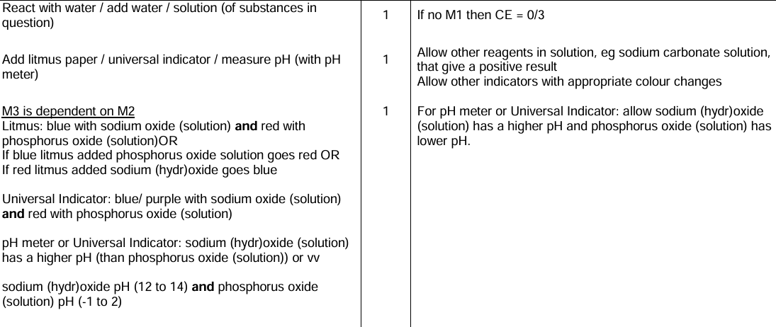
Example question
Describe a test you could carry out in a test tube to distinguish between sodium oxide and phosphorus pentoxide [3 Marks]

