Slide 1


Inorganic Chemistry Year 2 - A2
3.2.5 Transition metals
Dr John R Griffiths
SciExcel Tuition

Slide 2
Inorganic Chemistry Year 2
3.2.5 Transition metals
3.2.5.1 General properties of Transition metals
3.2.5.2 Substitution reactions
3.2.5.3 Shapes of complex ions
3.2.5.4 Formation of coloured ions
3.2.5.5 Variable oxidation states
3.2.5.6 Catalysts

Slide 3
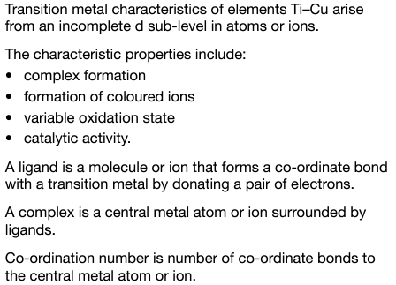
3.2.5.1 General properties

Slide 4
General physical properties of transition metals
Typical properties are;
Hard,
Strong,
Shiny,
High Mpt,
High Bpt,
Good conductors of heat and electricity
Try to explain these in terms of structure and bonding
Can you think of some uses of transition metals ?

Slide 5
Chemical properties of transition metals
Variable oxidation states,
Coloured compounds,
Act as catalysts,
Form complex ions

Slide 6
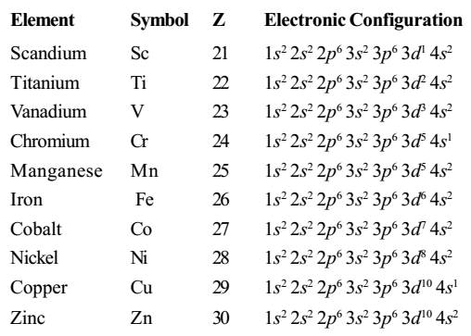
Electronic configuration
d-block
(Period 4)
Transition metals
[Ar]
A TRANSITION ELEMENT must be able to form at least one stable ion with a PART FULL d-shell of electrons. Sc only forms 3+ ions and Zn only 2+ → they are NOT classed as transition metals

Slide 7
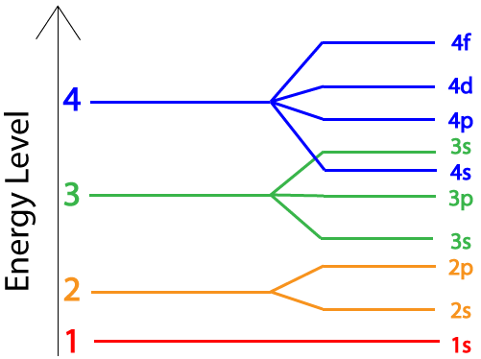
Electronic configuration of Cr and Cu
A full or half-full d-sub level is more stable.
To form ions, electrons are removed from the 4s level first, e.g.
V²⁺ = 1s²2s²2p⁶3s²3d³

Slide 8
Terminology
CO-ORDINATE (or dative) BOND - a bond in which both electrons come from the same ion or molecule. e.g one N-H bond in NH₄⁺ is a coordinate/dative bond
LIGAND - An ion or molecule with a lone pair of electrons that forms a co-ordinate bond with a transition metal by donating a pair of electrons. e.g. H₂O, NH₃, Cl⁻, OH⁻, CN⁻.
COMPLEX ION – When one or more ligands binds to a central metal ion. e.g [Cu(H₂O)₆]²⁺
CO-ORDINATION NUMBER – the number of co-ordinate bonds attached to the central metal ion e.g [Cu(H₂O)₆]²⁺ has a co-ordination number of 6.

Slide 9
Hexaaquachromium(III) ion
The overall charge of the complex is shown outside the square brackets.
[Cr(H₂O)₆ ]³⁺
Square brackets are used to group all of the parts of the complex ions together
Ligands are inside round brackets. The number of ligands is shown outside the brackets

Slide 10
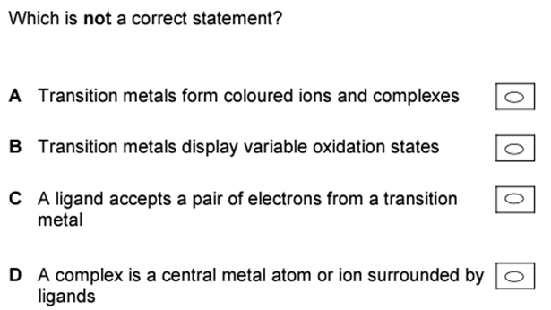
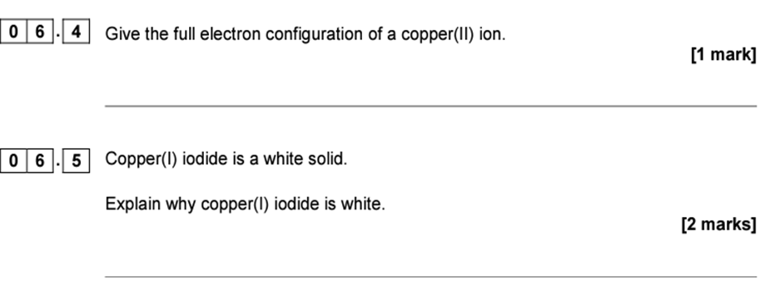
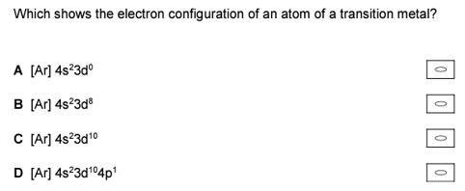
Try these....
1s²2s²2p⁶3s²3d⁹

Slide 11
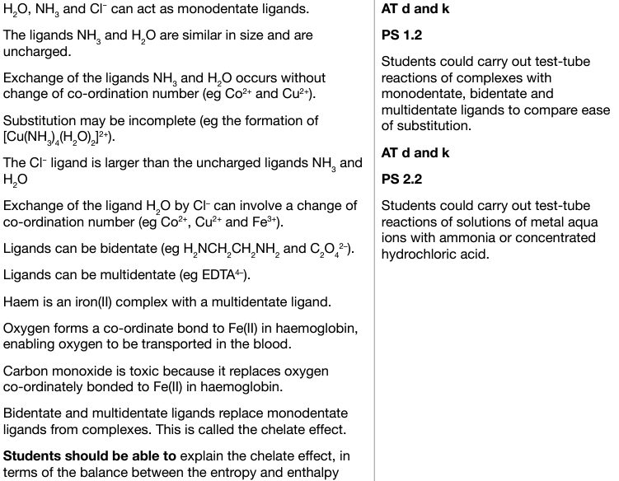
3.2.5.2 Substitution reactions

Slide 12
Ligands
Ligands which form only 1 co-ordinate bond each are single ions (e.g. Cl⁻, CN⁻) or small molecules with only one lone pair of electrons available for bonding (e.g. H₂O, NH₃). They are called UNIDENTATE.
MULTIDENTATE ligands have more than one atom with a lone pair of electrons which can bond to a transition metal ion.
  BIDENTATE ligand have 2 lone pairs available e.g. ethane-1,2-diamine
  EDTA is able to form 6 co-ordinate bonds per molecule – it is HEXADENTATE ligand
Complex ions with POLYDENTATE ligands are called CHELATES

Slide 13
Complex formation
A Lewis base is an electron pair donor – LIGANDS are Lewis bases
A Lewis acid is an electron pair acceptor – METAL ion is the Lewis acid

Slide 14
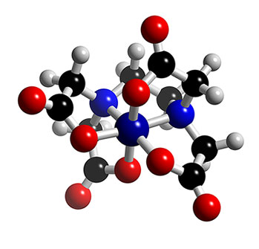
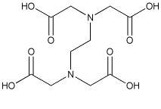
EDTA – a chelating ligand
Complex ions with POLYDENTATE ligands are called CHELATES​. Chelates can be used to remove d-block metal ions from solution.

Slide 15
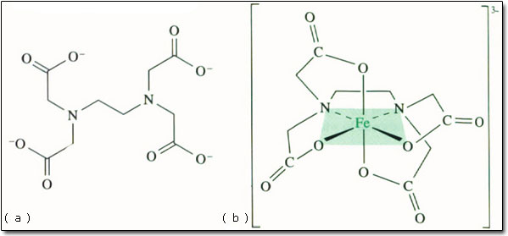
Iron EDTA complex – an example of chelation

Slide 16
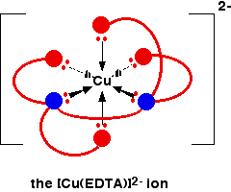
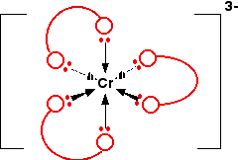
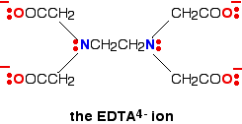
Complex formation

Slide 17
The chelate effect
If a hexadentate ligand such as EDTA is added to a solution of a transition metal salt like copper (II) sulphate solution, all six water ligands will be replaced by the EDTA;
[Cu(H₂O)₆]²⁺_{(aq)} + EDTA⁴⁻_{(aq)} --> [CuEDTA]²⁻_{(aq)} + 6H₂O_{(l)}
Two species on the left hand side of the equation are replaced by seven on the right. This results in an increase in entropy, driving the reaction to the right. This is called the CHELATE EFFECT and for this reason, chelate complexes with polydentate ligands are favoured over complexes with monodentate ligands.

Slide 18
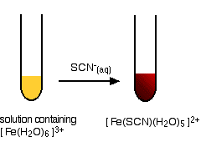
A ligand exchange reaction – test for Iron (III) ions
This provides an extremely sensitive test for iron(III) ions in solution.
Addition of thiocyanate ions, SCN⁻, (from, say, sodium or potassium or ammonium thiocyanate solution) to a solution containing iron(III) ions, an intense blood red solution containing the ion [Fe(SCN)(H₂O)₅]²⁺ develops.

Slide 19
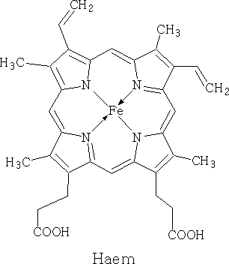
Haemoglobin
Heamoglobin transports oxygen around the body in red blood cells. It consists of a central Fe²⁺ metal ion attached to a porphyrin ring (ligand) through 4 coordinate bonds. Globin (protein) also coordinates to the iron as does oxygen. The bond with oxygen is weak allowing it to be released where needed in the body.
If present, carbon monoxide can replace O₂ in haemoglobin, as it binds more strongly to the metal. This makes it highly toxic leading to suffocation.
:O₂
Fe²⁺
Globin protein – N:

Slide 20
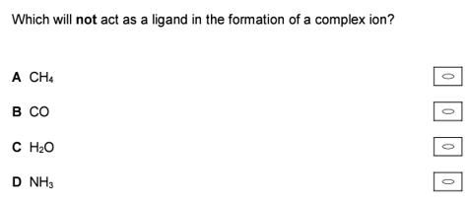
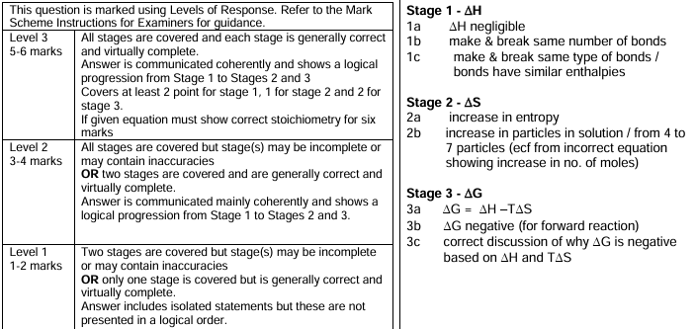
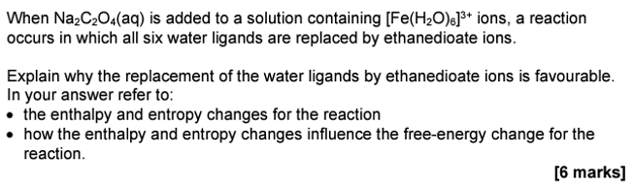
Try these....
There are no lone pairs to form a bond

Slide 21
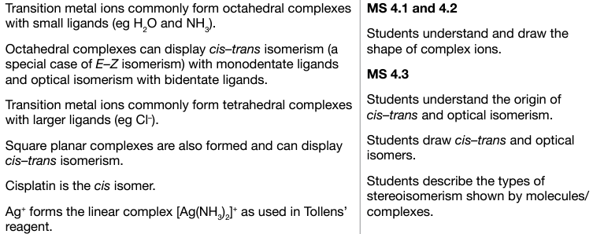
3.2.5.3 Shapes of complex ions

Slide 22
Shapes of complex ions
Transition metals commonly form octahedral complexes with small ligands, e.g. [Fe(H₂O)₆]²⁺
Transition metals commonly form tetrahedral complexes with larger ligands, e.g. [CoCl₄]²⁻
A few complexes with co-ordination number 4 are square planar, e.g.
[Pt(NH₃)₂Cl₂], [Ni(CN)₄]²⁻
Silver commonly forms linear complexes, e.g. [Ag(NH₃)₂]⁺
The shapes tend to depend upon the size of the ligands – STERIC factors

Slide 23
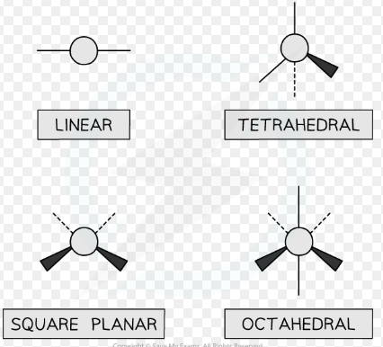
Shapes of complex ions

Slide 24
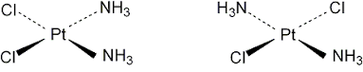
Isomerism in transition metal complexes –
Geometrical isomerism (cis/trans or E/Z forms)
Both octahedral and square planar complexes may exhibit this type of isomerism – the ligands differ in their spatial positioning relative to one another e.g. the square planar complex of [Pt(NH₃)₂Cl₂] exists as cis (Z) and trans (E) isomers;
cis-platin trans-platin
NB – Only the cis isomer is anti-cancer drug. Trans-platin has no therapeutic effect. Geometrical isomers have diferent chemical properties.

Slide 25
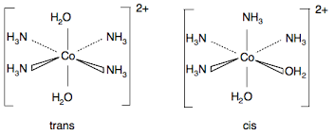
Isomerism in transition metal complexes –
Geometrical isomerism (cis/trans or E/Z forms)
e.g. the octahedral complex of [Co(NH₃)₄(H₂O)₂]²⁺ exists as cis (Z) and trans (E) isomers;

Slide 26
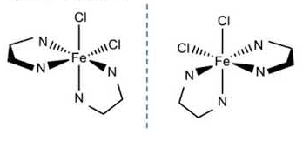
Isomerism in transition metal complexes –
Optical isomerism (requires 2 or more bidentate ligands in complex)
Transition metal complex ions may exhibit OPTICAL ISOMERISM in a similar way to some organic compounds. This occurs when two isomers are non-superimposable mirror images of one another, and may occur if two or more bidentate ligands are bound to the metal ion. They are CHIRAL and have identical chemical properties. The isomers rotate plane-polarised light in opposite directions, e.g.

Slide 27
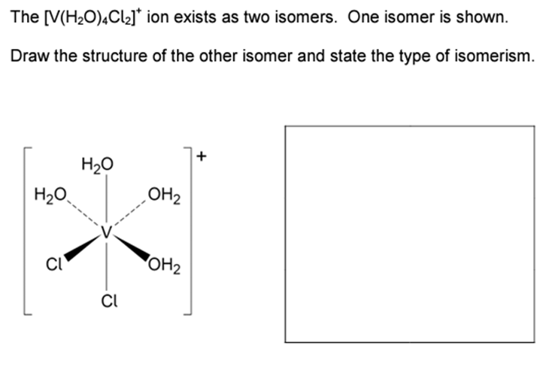
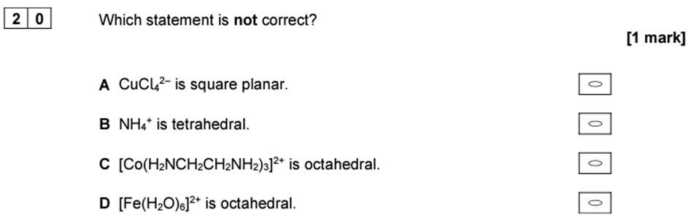
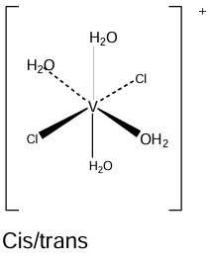
Try these....

Slide 28
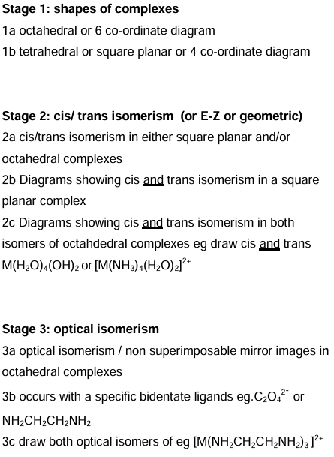
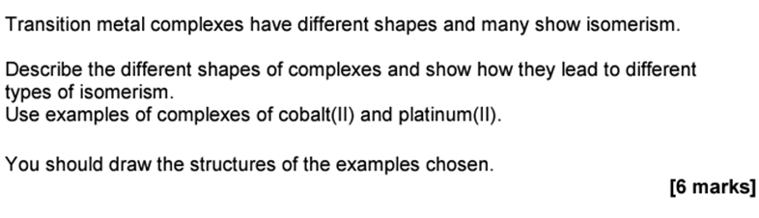
Try this....

Slide 29
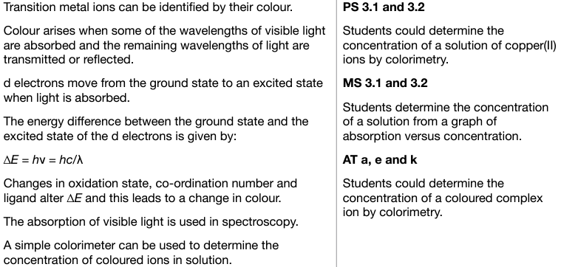
3.2.5.4 Formation of coloured ions

Slide 30

The reason for coloured ions
When white light hits a substance – part is absorbed / part reflected / part transmitted
If all wavelengths are absorbed = black,
If all wavelengths are reflected = white
Appears colourless if all radiation in visible region is transmitted equally
The colour depends on;
The oxidation state of the transition metal ion
The coordination number of the transition metal ion
The ligand coordinated to the transition metal ion

Slide 31
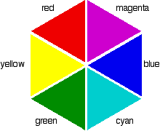
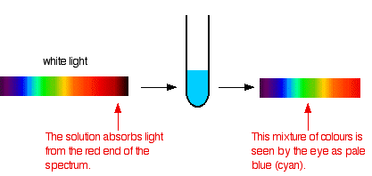
Why is Copper (II) sulphate solution blue?
Cu²⁺ ions appear as blue since they absorb wavelengths towards the red end of the visible spectrum. The complimentary colour of blue is the resultant colour of the combined remaining wavelengths.

Slide 32
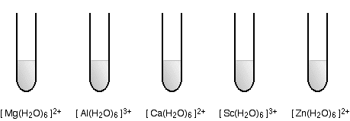
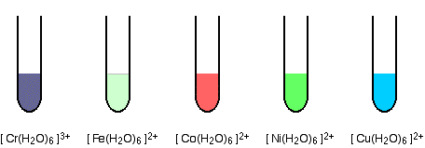
Transition metal aqueous ions versus non-transition metals
Colourless solutions
Coloured solutions

Slide 33
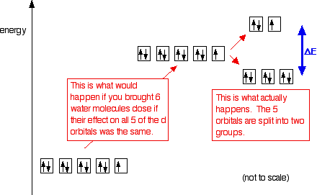
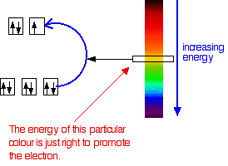

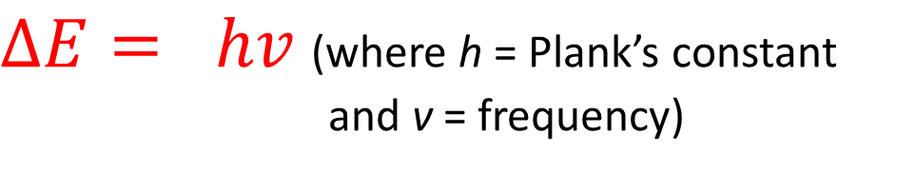
Why are transition metals coloured ?
Due to partly filled d-orbitals
When ligands bond to a transition metal ion, there is repulsion between electrons – raises energy of d-orbitals
Not all are raised by the same amount – they split into 2 groups
Size of the energy gap varies
White light passed through a solution, some energy is absorbed to promote an electron from lower (ground state) to upper set (excited state)
Leaves complementary colour
$$∆E$$
$∆E= hv$ (where h = Plank’s constant
and v = frequency)

Slide 34
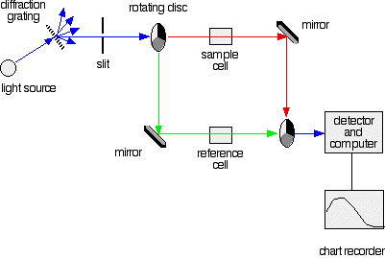
Colorimetry - Spectrophotometer
A colorimeter is a simple type of visible spectrophotometer
Light source – often 1 uv, 1 vis
Radiation is split and sent through a sample cell (cuvette) containing the solution under test and through a reference cell containing water
2 beams are compared by a light detector which determines the % of radiation absorbed or transmitted by the solution
Get a plot of absorbance against wavelength

Slide 35
Determination of metal ion concentration
Make up a set of standard solutions of the metal ions (e.g. 0.0, 0.5, 1.0, 1.5, 2.0, 2.5 mgL⁻¹)
Place an aliquot into the colorimeter
Record absorption spectrum for each standard solution
Measure absorbance for each at optimal wavelength (e.g. 450 nm)
Record absorbance of unknown at the same wavelength
Draw a calibration graph and read-off concentration of unknown

Slide 36
Determination of metal ion concentration
Calibration curve
Standard Number | Concentration, mg L⁻¹ | Absorbance
1 | 0.00 | 0.000
2 | 0.50 | 0.101
3 | 1.00 | 0.210
4 | 1.50 | 0.299
5 | 2.00 | 0.405
6 | 2.50 | 0.497
0.6
0.5
0.4
0.3
0.2
0.1
0.0
Unknown
Absorbance at 450 nm
Absorbance of unknown = 0.351
Concentration of unknown = 1.75 mg L⁻¹
0.00 0.50 1.00 1.50 2.00 2.50
Concentration, mg L-1

Slide 37
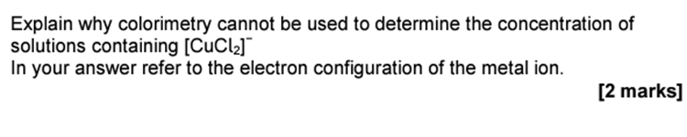

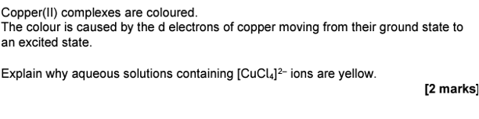

Try these....

Slide 38
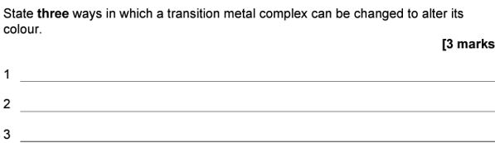

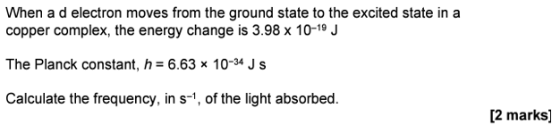

Try these....

Slide 39
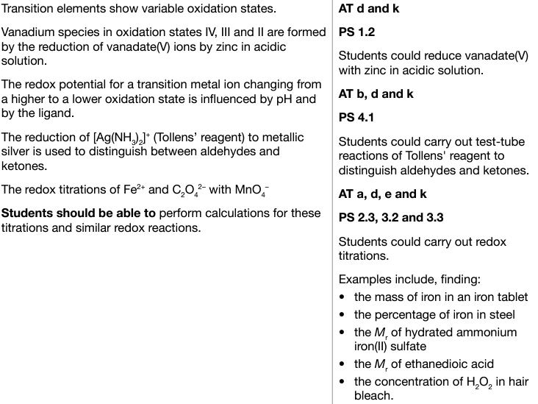
3.2.5.5 Variable oxidation states

Slide 40
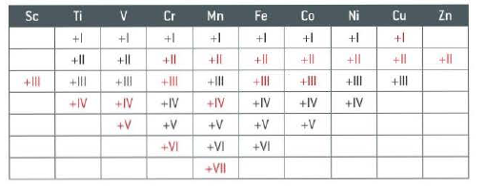
Transition metals and variable oxidation states
Why do transition metals have variable oxidation states?
  Formation of Fe²⁺ Fe³⁺
  When a compound is formed it is the most stable – the one in which most energy is released
  4s and 3d orbitals close in energy – not a huge jump in energy to remove third electron compared with first and second

Slide 41
Transition metals and variable oxidation states
Except Sc (+3 only) all have oxidation state +2 (4s electrons used in bonding)
For oxidation states >2 the 3d as well as the 4s electrons are used
For Sc to Mn the maximum oxidation state corresponds to the removal of all 4s and 3d electrons
After Mn the increasing nuclear charge means Fe does not show +8, the +2 charge becomes more stable which corresponds to just the removal of the 4s electrons

Slide 42
Transition metals ions as reducing and oxidising agents
Low oxidation states exist as M²⁺ and M³⁺
Higher ones exist as oxy ions where the very electronegative oxygen has attracted the electrons for use in bonding eg MnO₄⁻
The higher oxidation states are oxidising agents – gain electrons
Simple ions are reducing agents – lose electrons

Slide 43
Oxidation states of manganese
Has ions with oxidation states of +1 to +7
The most common ions are +2, +4 and +7
These have the following electron configuration;
+2, [Ar] 3d⁵
+4, [Ar] 3d³
+7, [Ar] 3d⁰

Slide 44
Effect of pH on oxidation state
At low pH, reduction of HIGHER STATES of transition metals is favoured.
In alkaline solution, oxidation of LOWER STATES of transition metals tends to happen, due to the increased tendency to form negative ions at higher pH.
In alkaline solution there is a tendency to form negative ions which can lose electrons easier (OIL rig) i.e. Oxidation is easier. Oxidation = alkali + oxidising agent
i.e.
pH of solution | Typical species | Charge
Low (acidic) | [M(H₂O)₆]²⁺ | Positive
Medium (neutral) | [M(H₂O)₄(OH)₂] | Neutral
High (alkali) | [M(H₂O)₂(OH)₄]²⁻ | Negative

Slide 45
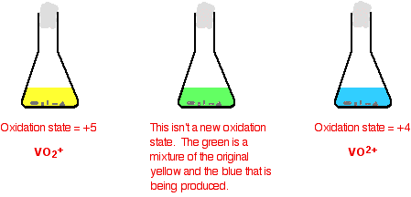
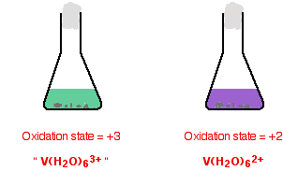
Oxidation states of vanadium
Zinc ions (Zn²⁺) in acidic solution will reduce Vanadium (V) through to V(II) producing the following coloured solutions

Slide 46
Redox titrations
Due to their variable oxidation states, many of the reactions of transition metals are Redox reactions.
Under acidic conditions (excess dilute sulphuric acid), high oxidation states such as Mn(VII) and Cr(VI) can be reduced.
To perform Redox titration calculations you must be able to construct half equations and combine them to form the full equation, and hence obtain the chemical stoichiometry.
Refer to slides for Section 3.1.7 from AS, if you need to remind yourself of how to deal with Redox equations.

Slide 47
Redox titrations
Potassium manganate (VII) as oxidising agent
i) May be used to oxidise Fe²⁺ to Fe^{3+,} under acidic conditions, typically for the determination of iron (II) content in iron tablets. Half equations are,
(RED) MnO₄⁻_{(aq)} + 8H⁺_{(aq)} + 5e⁻ --> Mn²⁺_{(aq)} + 4H₂O_{(l)}
(OX) Fe²⁺_{(aq)} --> Fe³⁺_{(aq)} + e⁻
This gives an overall equation of,
5Fe²⁺_{(aq)} + MnO⁴⁻_{(aq)} + 8H⁺_{(aq)} --> 5Fe³⁺_{(aq)} + Mn²⁺_{(aq)} + 4H₂O_{(l)}

Slide 48
Redox titrations
ii) May be used to oxidise C₂O₄²⁻ (from H₂C₂O₄ – ethanedioic acid) under acidic conditions.
Half equations are,
(RED) MnO₄⁻_{(aq)} + 8H⁺_{(aq)} + 5e⁻ --> Mn²⁺_{(aq)} + 4H₂O_{(l)}
(OX) C₂O₄²⁻_{(aq)} --> 2CO_{2(g)} + 2e⁻
This gives an overall equation of,
5C₂O₄²⁻_{(aq)} + 2MnO₄⁻_{(aq)} + 16H⁺_{(aq)} --> 10CO_{2(g)} + 2Mn²⁺_{(aq)} + 8H₂O_{(l)}

Slide 49
Titrations with manganese
When KMnO₄ (MnO₄⁻) is used in a Redox titration, it is added to the test substance using a burette. Since it is a dark purple colour, the burette readings are taken from the top of the liquid level as the meniscus cannot be discerned easily.
No indicator is required as MnO₄⁻ is an intense purple and Mn(II) is pale pink. The endpoint is therefore purple (when one extra drop of MnO₄⁻ is in excess).
Sulphuric acid is added to provide the H⁺ ions. It is used rather than other acids as it does not react with the MnO₄⁻ ions. Cl⁻ ions (from HCl) are readily oxidised to Cl₂ by MnO₄⁻, whereas SO₄²⁻ is not.

Slide 50
Redox titrations
2. Potassium dichromate (VI) as oxidising agent
May also be used to oxidise ions such as Fe²⁺ to Fe^{3+,} under acidic conditions. Half equations are,
(RED) Cr₂O₇²⁻_{(aq)} + 14H⁺_{(aq)} + 6e⁻ --> 2Cr³⁺_{(aq)} + 7H₂O_{(l)}
(OX) Fe²⁺_{(aq)} --> Fe³⁺_{(aq)} + e⁻
This gives an overall equation of,
6Fe²⁺_{(aq)} + Cr₂O₇²⁻_{(aq)} + 14H⁺_{(aq)} --> 6Fe³⁺_{(aq)} + 2Cr³⁺_{(aq)} + 7H₂O_{(l)}

Slide 51
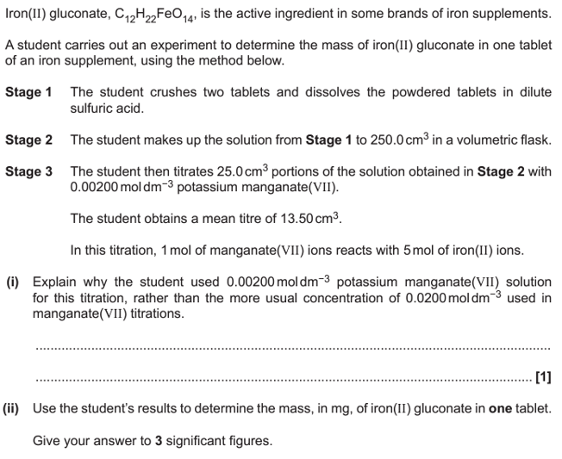
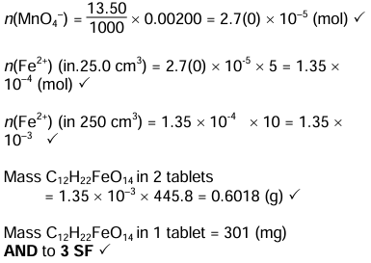

Try this....

Slide 52
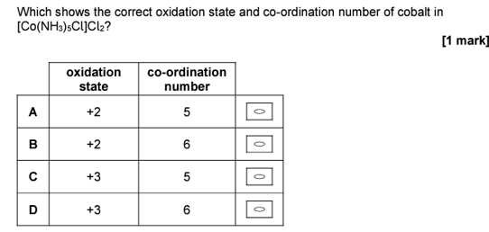
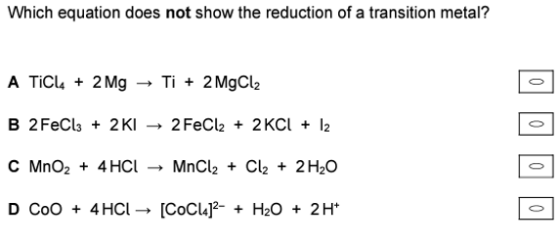
Try these....

Slide 53
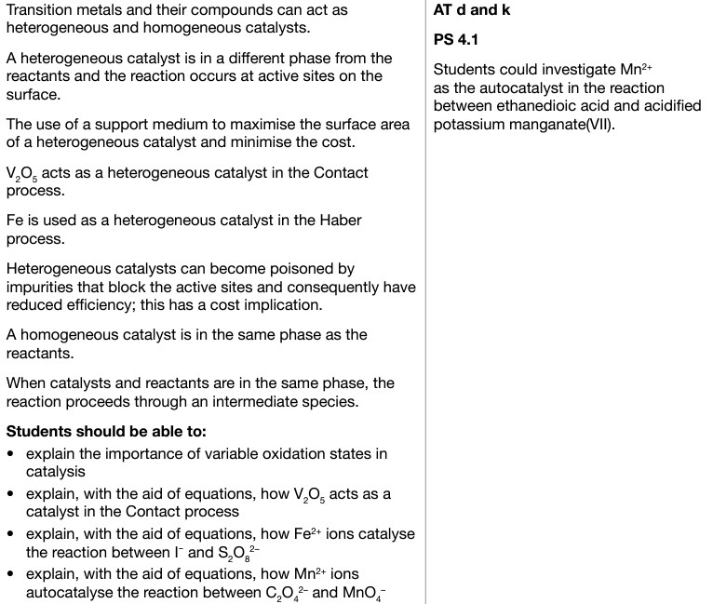
3.2.5.6 Catalysts

Slide 54
Catalysts
A catalyst is a substance which speeds up a reaction without itself being consumed. They do this by providing an alternative reaction pathway with a lower activation energy (hence, more particles have sufficient energy to react). They DO NOT affect the position of equilibrium of a reversible reaction, but the react will reach equilibrium faster.
There are two groups of catalysts;
HETEROGENEOUS catalysts, which are in a different phase to the reactants, and
HOMOGENEOUS catalysts which are in the same phase or state.

Slide 55

Catalysts – Lower the activation energy
© www.chemsheets.co.uk A2 1029 01-Jun-2016

Slide 56

Heterogeneous Catalysts
Usually a solid catalyst and gaseous reactants.
Most industrial catalysts are like this (e.g. Haber process, Fe_{(s)}; Contact process, V₂O_{5 (s)}).
1) Reactants adsorbed onto surface (onto active sites).
weakens reactant bonds
brings molecules closer
more favourable orientation
2) Reaction takes place.
3) Products are desorbed (leave the surface).
© www.chemsheets.co.uk A2 1029 01-Jun-2016

Slide 57


Nature of the catalyst
Large surface area for maximum contact for reactants.
Spread thinly over ceramic honeycomb support. Metals are often expensive (Pt, Pd, Rh) and this allows less to be used.

Slide 58
Poisoning of a catalyst
Although a catalyst may be used again and again, eventually it will need replacing. This is because some substances may block active sites (i.e. they are permanently adsorbed onto the surface and will not come off). This can ruin the catalyst.
e.g. Sulphur in the Haber process
e.g. Lead in vehicle catalytic converters

Slide 59
The Contact process - V₂O₅
The Contact process is used in the production of sulphuric acid. Vanadium in oxidation state +5 is reduced to +4 and sulphur is oxidised from +4 to +6 oxidation state. The V₂O₄ is then oxidised back to V₂O₅ by oxygen.
V₂O₅ + SO₂ → V₂O₄ + SO₃
V₂O₄ + ½ O₂ → V₂O₅
Overall: SO₂ + ½ O₂ → SO₃
LEARN THESE

Slide 60
Homogeneous Catalysts
The catalyst is in the same state (s,l,g) to the reactants.
Most typically, this involves reactions in solution with catalyst in solution, however there are some examples of gas phase reactions.
Catalyst reacts with a reactant to form intermediate.
2) Intermediate reacts to form product faster than original reactant (and regenerates catalyst).
H⁺
e.g. acid catalyst
X + Y → products
X + H⁺ → HX⁺
2) HX⁺ + Y → products + H⁺
© www.chemsheets.co.uk A2 1029 01-Jun-2016

Slide 61
Acid catalyst in esterification
e.g. CH₃COOH(l) + CH₃OH(l) → CH₃COOCH₃(l) + H₂O(l)
No H⁺ catalyst
SLOW step
With H⁺ catalyst
FASTER
© www.chemsheets.co.uk A2 1029 01-Jun-2016

Slide 62
Transition metal catalysts
Work by metal varying its oxidation state
Fe²⁺ or Fe³⁺
e.g. 2 I⁻ + S₂O₈²⁻ I₂ + 2 SO₄²⁻
Slow because both negative ions repel. However, using a Fe²⁺ catalyst,
2 Fe²⁺ + S₂O₈²⁻ → 2 Fe³⁺ + 2 SO₄²⁻
2) 2 Fe³⁺ + 2 I⁻ → 2 Fe²⁺ + I₂
© www.chemsheets.co.uk A2 1029 01-Jun-2016

Slide 63
Autocatalysis
An autocatalyzed react starts slowly, but as the concentration of the catalyst (one of the products) increases, the rate increases and then follows the normal rate of reaction (i.e. slows down as the reactants are used up. One example (try to learn this) of autocatalysis is that between ethanedioic acid and manganate (VII) ions (see below).
Mn²⁺
2 MnO₄⁻ + 16 H⁺ + 5 C₂O₄²⁻ → 2 Mn²⁺ + 8 H₂O + 10 CO₂
the reaction is catalysed by one of the products (Mn²⁺) so is autocatalysis
4 Mn²⁺ + MnO₄– + 8 H⁺ → 5 Mn³⁺ + 4 H₂O
2 Mn³⁺ + C₂O₄^{2–} → 2 CO₂ + 2 Mn²⁺
© www.chemsheets.co.uk A2 1029 01-Jun-2016

Slide 64


Try this....

Slide 65




Try these....

