Slide 1


Inorganic Chemistry Year 2 - A2 3.2.6 Reactions of ions in aqueous solutions
Dr John R Griffiths
SciExcel Tuition

Slide 2
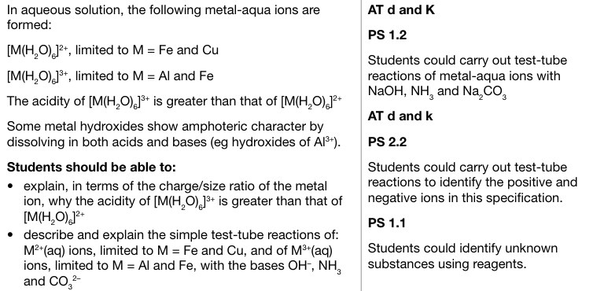
Inorganic Chemistry Year 2 3.2.6 Reactions of ions in aqueous solutions

Slide 3
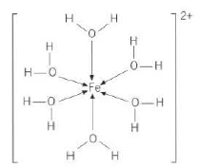
Metal aqua ions in solution
So, when thinking of a Fe²⁺ ion, it should be regarded as the metal ion surrounded by 6 water molecules through coordinate bonds, [Fe(H₂O)₆]²⁺. The same applies to Cu²⁺ and the 3+ ions of Al and Fe.
2+
3+
M
M

Slide 4
Reminder - Definitions of acids and bases
The Bronsted-Lowry definition of an acid is that of a proton (H⁺) donor, with a base being a proton acceptor.
Another definition of acids and bases was provided by Lewis. The Lewis theory states that acids are electron pair acceptors and bases are electron pair donors.
Therefore, in a metal complex ion, the ligands act as bases (by donating their lone pairs to the central metal) and the metal is an acid.

Slide 5
Acidity of Fe²⁺ compared to Fe³⁺ aqua ions
The two aqua ion [Fe(H₂O)₆]²⁺ and [Fe(H₂O)₆]³⁺, differ in their acidity as a consequence of the ease with which H⁺ ions are dissociated from the water ligands (Proton donor, Bronsted-Lowry definition). This is dependent upon the O-H bond strength in water.
Since the Fe³⁺ ion is both smaller and more highly charged than the Fe²⁺ ion (i.e. has a higher charge density), it is more highly polarising and attracts the electron density in the O-H bonds towards it. This in turn weakens the O-H bond leading to a greater degree of H⁺ dissociation from the water ligands.
Therefore, a solution of Fe³⁺_{(aq)} ions is more acidic than that of Fe²⁺_{(aq)} ions of the same concentration, and in general, M³⁺ aqua ions are more acidic than M²⁺ ones.

Slide 6
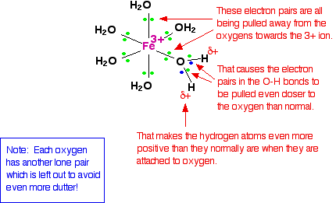

Fe³⁺ aqua ions weaken the O-H bonds
Relative acid strength
Fe³⁺_{(aq)} pKa = 2.2
Ethanoic acid pKa = 4.8
This is a hydrolysis reaction i.e. O-H water bonds are broken
[Fe(H₂O)₆]³⁺ _{(aq)} [Fe(H₂O)₅(OH)]²⁺ _{(aq)} + H⁺ _{(aq)}
https://www.chemguide.co.uk/inorganic/complexions/acidity.html

Slide 7
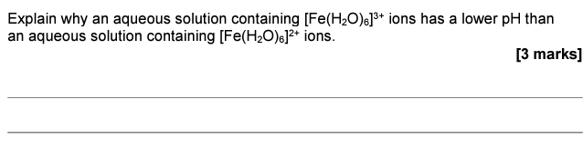
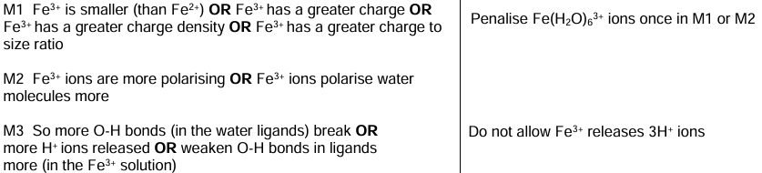
Example question

Slide 8
Acid-base reactions – M³⁺ (Al³⁺, Fe³⁺)
Addition of OH⁻ to aqua ions with a 3+ charge, results in stepwise H⁺ removal. Proton removal from three of the water ligands results in a neutral molecule, which is effectively M(OH)₃ – a precipitate (uncharged and insoluble).
[M(H₂O)₆]³⁺_{(aq)} + OH⁻_{(aq)} → [M(H₂O)₅(OH)]²⁺_{(aq)} + H₂O_{(l)}
[M(H₂O)₅(OH)]²⁺_{(aq)} + OH⁻_{(aq)} → [M(H₂O)₄(OH)₂]⁺_{(aq)} + H₂O_{(l)}
[M(H₂O)₄(OH)₂]⁺_{(aq)} + OH⁻_{(aq)} → [M(H₂O)₃(OH)₃]_{(s)} + H₂O_{(l)}

Slide 9
Acid-base reactions – M²⁺ (Cu²⁺ , Fe²⁺)
Addition of OH⁻ to aqua ions with a 2+ charge, results in a similar H⁺ removal, only this time two-step. Proton removal from two of the water ligands results in a neutral molecule, which is effectively M(OH)₂ – a precipitate (uncharged and insoluble).
[M(H₂O)₆]²⁺_{(aq)} + OH⁻_{(aq)} → [M(H₂O)₅(OH)]⁺_{(aq)} + H₂O_{(l)}
[M(H₂O)₅(OH)]⁺_{(aq)} + OH⁻_{(aq)} → [M(H₂O)₄(OH)₂]_{(s)} + H₂O_{(l)}

Slide 10
Acid-base reactions – Ammonia as a base
Ammonia, being a base and therefore a proton acceptor, has the same effect as OH⁻ in removing protons:
[M(H₂O)₆]³⁺_{(aq)} + 3NH_{3(aq)} → [M(H₂O)₃(OH)₃]_{(s)} + 3NH₄⁺_{(aq)}
[M(H₂O)₆]²⁺_{(aq)} + 2NH_{3(aq)} → [M(H₂O)₄(OH)₂]_{(s)} + 2NH₄⁺_{(aq)}

Slide 11
Reactions with CO₃²⁻
Why do carbonates of transition metal ions in the +2 oxidation state but not in the +3 oxidation state, exist in general?
The carbonate ion can remove protons from [Fe(H₂O)₆]³⁺_{(aq)} but not from [Fe(H₂O)₆]²⁺_{(aq)}. When this takes place, hydrated iron(III) hydroxide is formed along with the evolution of carbon dioxide gas;
Fe³⁺
2[Fe(H₂O)₆]³⁺_{(aq)} + 3CO₃²⁻_{(aq)} → 2[Fe(H₂O)₃(OH)₃]_{(s)} + 3CO_{2(g)} + 3H₂O_{(l)};
However, the reaction with Fe²⁺ results in the formation of insoluble iron(II) carbonate,
Fe²⁺
[Fe(H₂O)₆]²⁺_{(aq)} + CO₃²⁻_{(aq)} → FeCO_{3(s)} + 6H₂O_{(l)}

Slide 12
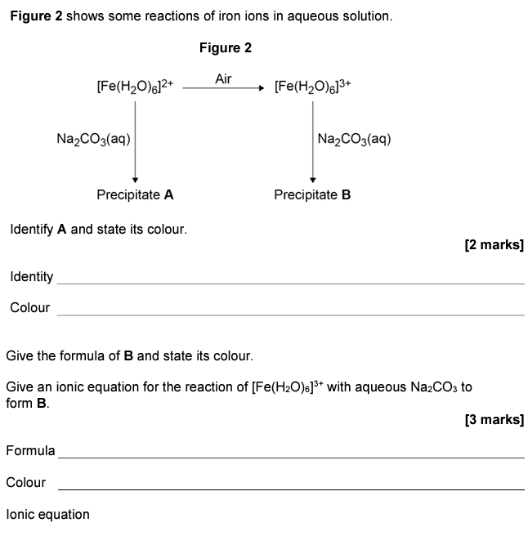

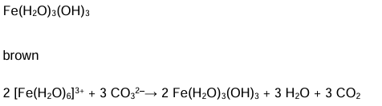
Example questions

Slide 13
Amphoteric nature of aluminium hydroxide
Aluminium hydroxide reacts with both acids and bases and is therefore AMPHOTERIC.
As expected for a typical metal hydroxide, it reacts with an acid (proton donor) as below;
Al(H₂O)₃(OH)₃ + 3HCl → Al(H₂O)₆³⁺ + 3Cl⁻
However, it will also behave as an acid with an excess of a strong base (such as sodium hydroxide);
Al(H₂O)₃(OH)₃ + OH⁻ → [Al(OH)₄]⁻+ 3H₂O

Slide 14
Ligand substitution reactions
Replacement of water ligands by ammonia
Ammonia molecules are of a similar size to water molecules and both are neutral. This results in no change in overall charge or coordination number.
For M²⁺ ions, sequential replacement of the water ligands occurs, thus;
​ [M(H₂O)₆]²⁺ + NH₃ [M(NH₃)(H₂O)₅]²⁺ + H₂O
[M(NH₃)(H₂O)₅]²⁺ + NH₃ [M(NH₃)₂(H₂O)₄]²⁺ + H₂O
[M(NH₃)₂(H₂O)₄]²⁺ + NH₃ [M(NH₃)₃(H₂O)₃]²⁺ + H₂O etc.....
Overall: [M(H₂O)₆]²⁺ + 6NH₃ [M(NH₃)₆]²⁺ + 6H₂O

Slide 15
Ligand substitution reactions
Replacement of water ligands by ammonia (continued)
[M(H₂O)₆]²⁺ + 6NH₃ [M(NH₃)₆]²⁺ + 6H₂O
However, since ammonia is also a base, a precipitate may form at first before redissolving;
[M(H₂O)₆]²⁺ + 2OH⁻_{(aq)} M(H₂O)₄(OH)_{2(s)} + 2H₂O_{(l)}
M(H₂O)₄(OH)_{2(s)} + 6NH_{3(aq)} [M(NH₃)₆]²⁺_{(aq)} + 4H₂O(l) + 2OH⁻_{(aq)}

Slide 16
Ligand substitution reactions
Cobalt (II) aqua ions
When ammonia is added to a solution of Co(II) ions a blue precipitate is initially formed. Ammonia again is acting as a base and removes a proton from to of the water ligands;
[Co(H₂O)₆]²⁺_{(aq)} + 2NH_{3(aq)} [Co(H₂O)₄(OH)₂]_{(s)} + 2NH₄⁺_{(aq)}
However, upon adding more (concentrated) ammonia, all six of the ligands are replaced by ammonia. Ammonia is a better ligand than water and it shifts the equilibria to the right;
[Co(H₂O)₄(OH)₂]_{(s)} + 6NH_{3(aq)} [Co(NH₃)₆]²⁺_{(aq)} + 4H₂O_{(l)} + 2OH⁻_{(aq)}
The pale yellow solution formed turns brown due to the oxidation of Co(II) to Co(III) in air.

Slide 17
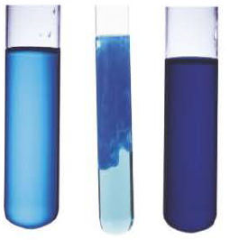
Ligand substitution reactions
Copper (II) aqua ions
When aqueous Cu²⁺ ions undergo ligand substitution with ammonia, only four of the water ligands are replaced.
[Cu(H₂O)₆]²⁺_{(aq)} + 4NH_{3(aq)} [Cu(H₂O)₂(NH₃)₄]²⁺_{(aq)} + 4H₂O_{(l)}
This occurs via a step-wise process similar that of Co (II). A blue precipitate of copper hydroxide forms initially, when protons are removed from two of the water molecules, thus . This goes on to form the soluble, dark blue product above with further
substitutions.
[Cu(H₂O)₄(OH)₂]_{(s)}

Slide 18
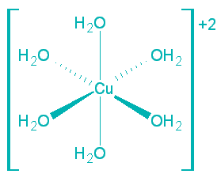
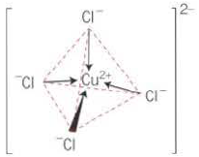
Ligand substitution reactions
Copper (II)
+ Conc. HCl
(4Cl⁻)
+ water
(6H₂O)
When copper (II) hexaaqua complex ions react with concentrated HCl, the six water ligands are replaced by four Cl⁻ ions. The shape changes from octahedral to tetrahedral and the coordination number changes from 6 to 4. This is due to the increased size of the chloride ligands such that it is not possible for six to fit around the central metal ion. The complex also changes colour from pale blue to yellow.

Slide 19
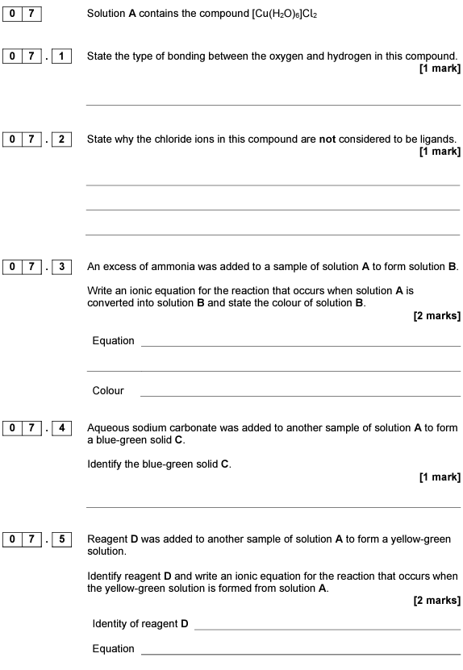



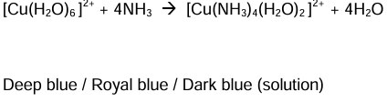
Example questions

Slide 20
Ligand substitution reactions
Chelation and the chelate effect
CHELATION is the term used to describe the formation of complexes with multidentate ligands. These may be bidentate, such as ethylene diamine, ethanedioate and benzene-1,2-diamine, or polydentate e.g. EDTA.
If a hexadentate ligand such as EDTA is added to a solution of a transition metal salt like copper (II) sulphate solution, all six water ligands will be replaced by the EDTA;
[Cu(H₂O)₆]²⁺_{(aq)} + EDTA⁴⁻_{(aq)} --> [CuEDTA]²⁻_{(aq)} + 6H₂O_{(l)}
Two species on the left hand side of the equation are replaced by seven on the right. This results in an increase in entropy, driving the reaction to the right. This is called the CHELATE EFFECT and for this reason, chelate complexes with multidentate ligands are favoured over complexes with monodentate ligands.

Slide 21
Acid-base substitution reactions - Summary
Base | [Fe(H₂0)₆]²⁺_{(aq)} (pale green) | [Fe(H₂0)₆]³⁺_{(aq)} (purple/yellow/brown) | [Cu(H₂0)₆]²⁺_{(aq)} (pale blue) | [Al(H₂0)₆]³⁺_{(aq)} (colourless)
OH⁻ dilute | Green gelatinous ppt of [Fe(H₂O)₄(OH)₂]* | Brown gelatinous ppt of [Fe(H₂O)₃(OH)₃] | Pale blue ppt of [Cu(H₂O)₄(OH)₂] | White ppt of [Al(H₂O)₃(OH)₃]
OH⁻ excess | Green gelatinous ppt of [Fe(H₂O)₄(OH)₂]* | Brown gelatinous ppt of [Fe(H₂O)₃(OH)₃] | Pale blue ppt of [Cu(H₂O)₄(OH)₂] | Colourless solution of [Al(OH)₄]⁻
NH₃ little | Green gelatinous ppt of [Fe(H₂O)₄(OH)₂]* | Brown gelatinous ppt of [Fe(H₂O)₃(OH)₃] | Pale blue ppt of [Cu(H₂O)₄(OH)₂] | White ppt of [Al(H₂O)₃(OH)₃]
NH₃ excess | Green gelatinous ppt of [Fe(H₂O)₄(OH)₂]* | Brown gelatinous ppt of [Fe(H₂O)₃(OH)₃] | Deep blue solution of [Cu(NH₃)₄(H₂O)₂]²⁺ | White ppt of [Al(H₂O)₃(OH)₃]
CO₃²⁻ | Green ppt of FeCO₃ | Brown gelatinous ppt of [Fe(H₂O)₃(OH)₃] and bubbles of CO₂ | Blue-green ppt of CuCO₃ | White ppt of [Al(H₂O)₃(OH)₃] and bubbles of CO₂
Distinguish Fe²⁺ from Fe³⁺
* Easily oxidised to brown [Fe(H₂O)₃(OH)₃]

