Slide 1


Organic Chemistry Year 1 - AS
3.3.1 Introduction to organic chemistry
Dr John R Griffiths
SciExcel Tuition
www.sciexcel.org

Slide 2
Organic Chemistry Year 1
3.3.1 Introduction to organic chemistry
3.3.1.1 Nomenclature
3.3.1.2 Reaction mechanisms
3.3.1.3 Isomerism

Slide 3
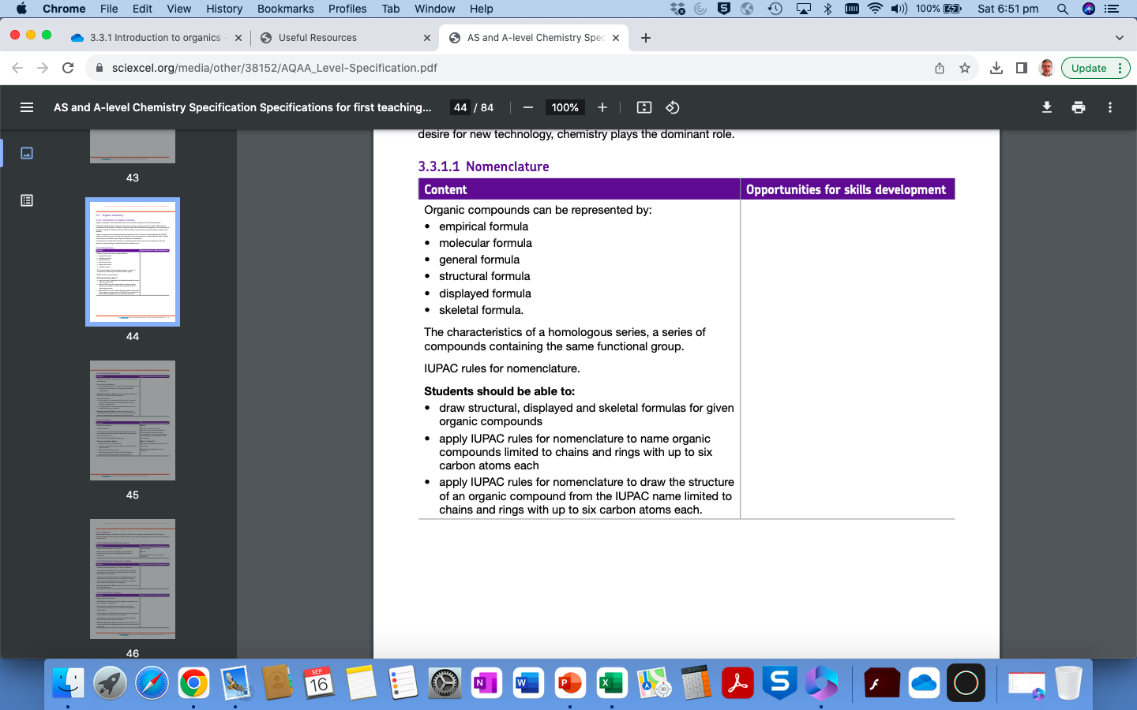
3.3.1.1 Nomenclature

Slide 4
What is organic chemistry
Modern organic chemistry involves the detailed study of carbon-containing compounds. To date, there are over 16,000,000 organic compounds known. So, why do so many compounds contain carbon?
Each carbon atom can form four covalent bonds to other atoms,
Carbon atoms can form long chains (and rings) by bonding to other carbon atoms,
Carbon can form single, double or triple bonds.
H
H
H
H
XO
XO
XO
XO
C
C
C
C
C
C
XXXXXX
XXXX
H
XX
H
H
H
XO
XO
XO
XO
XO
XO
XO
XO
H
H
H
H
Ethane Ethene Ethyne

Slide 5
What is organic chemistry
Carbon is in group 4 and so has 4 (valence) electrons in its outer shell for bonding.
Carbon-carbon bonds are relatively strong and are non-polar, as are carbon-hydrogen bonds (almost non-polar).
Organic compounds occur in nature but may also be made (synthesized) in the chemical laboratory.
Organic compounds are all around us and include pharmaceuticals, pesticides, plastics, flavorings, dyestuffs, cosmetics, fuels and many others.

Slide 6
Representations of organic compounds
Due to the complex nature of many organic compounds, chemists have developed universal ways of representing them;
Empirical formula
a chemical formula showing the simplest (integer) ratio of elements in a compound rather than the total number of atoms in the molecule
e.g. H₂NCH₂CH₂NH₂ (ethane-1,2-diamine) Empirical formula is CH₄N
C₆H₆ (benzene) Empirical formula is CH

Slide 7
Representations of organic compounds
2. Molecular formula
a chemical formula that gives the total number of atoms of each element present in a molecule
e.g. CH₄ methane (Empirical formula ALSO CH₄)
C₂H₆ ethane (Empirical formula CH₃)
C₃H₈ propane (Empirical formula ALSO C₃H₈)
C₆H₆ benzene (Empirical formula CH)

Slide 8
Representations of organic compounds
3. General formula
a type of empirical formula that represents the composition of any member of an entire class of compounds
e.g. alkanes General formula C_{n}H_{2n+2}
alkenes General formula C_{n}H_{2n} (NB this is also the general formula for cycloalkanes – 2 less Hydrogens)
alcohols General formula C_{n}H_{2n+1}OH

Slide 9
Representations of organic compounds
4. Structural formula
a chemical formula showing the composition and structure of a molecule
e.g. ClCH₂CH₂CH₃ is different to CH₃CHClCH₃ (they are ISOMERS – see later)
BOTH have the same Molecular Formula C₃H₇Cl

Slide 10
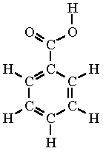
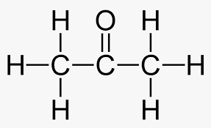
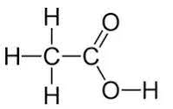
Representations of organic compounds
5. Displayed formula
shows all the bonds in the molecule as individual lines
e.g.

Slide 11
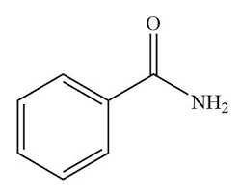
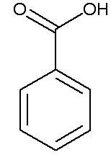
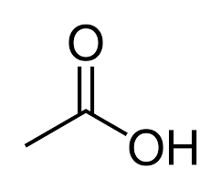
Representations of organic compounds
6. Skeletal formula
representation of molecular structure in which covalent bonds are shown as lines
e.g.
In Skeletal formulae, the C atoms and C-H bonds are not shown.

Slide 12

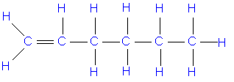
Representations of organic compounds – Hex-1-ene
CH₃CH₂CH₂CH₂CH=CH₃
Structural formula
Skeletal formula
CH₂
Empirical formula
H
H
H
H
H
H
C
C
C
C
C
C
H
H
H
H
H
H
Displayed formula
C₆H₁₂
Molecular formula
CnH2n
General formula

Slide 13
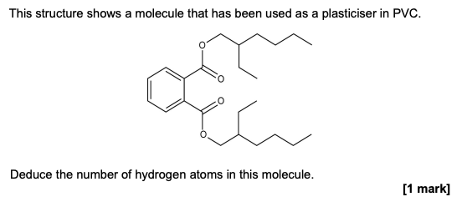
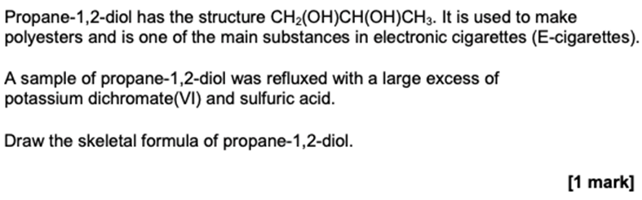
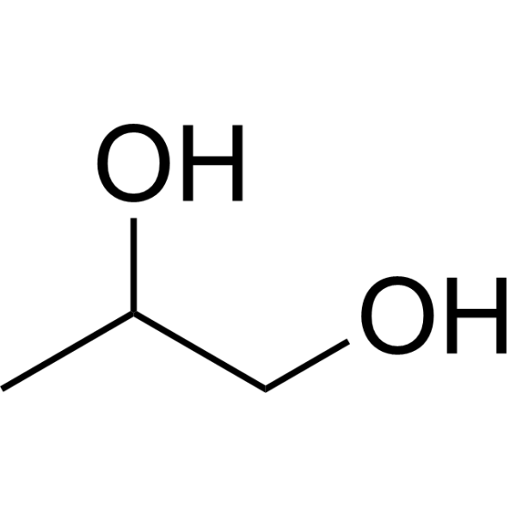
Example questions
There are 38 hydrogen atoms

Slide 14
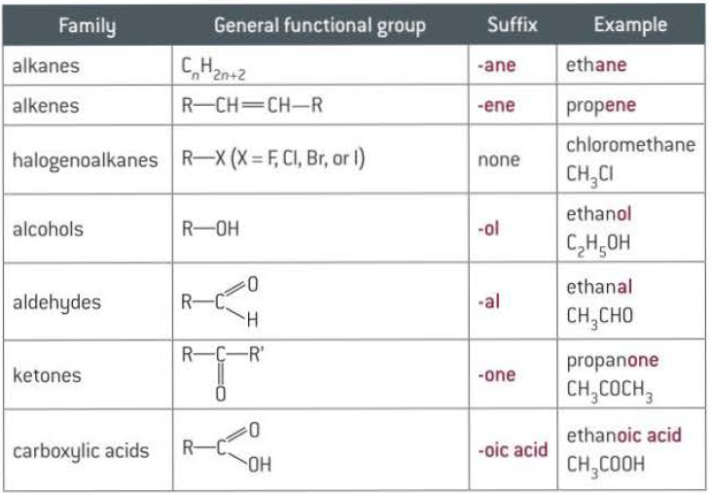
Functional groups
The REACTIVE groups in organic compounds are called FUNCTIONAL GROUPS. This means that compounds with the same functional group will react in similar ways.

Slide 15
Homologous series
An homologous series is a series of organic compounds which have the same functional group, but in which the formula of each successive member increases by –CH₂-
e.g. Alcohols CH₃OH, CH₃CH₂OH, CH₃CH₂CH₂OH etc
They have;
Similar chemical properties
Same general formula
Physical properties change steadily as the number of carbons increases

Slide 16
Nomenclature – naming of organic compounds
In order that chemists from around the world can understand each other, a common system of naming compounds was devised.
IUPAC – The International Union of Pure and Applied Chemistry
Allows us to draw the structure of a molecule from its name easily and systematically (and to name a molecule from its structure).

Slide 17
Naming straight-chain alkanes
Number of Carbons | Prefix | Molecular formula | Name of alkane (suffix –ane)
1 | Meth- | CH₄ | Methane
2 | Eth- | C₂H₆ | Ethane
3 | Prop- | C₃H₈ | Etc…..
4 | But- | C₄H₁₀
5 | Pent- | C₅H₁₂
6 | Hex- | C₆H₁₄
7 | Hept- | C₇H₁₆
8 | Oct- | C₈H₁₈
9 | Non- | C₉H₂₀
10 | Dec- | C₁₀H₂₂
11 | Undec- | C₁₁H₂₄
12 | Dodec- | C₁₂H₂₆

Slide 18
IUPAC naming rules
Find the longest continuous carbon chain in the compound (the root).
Identify any side groups. (Not hydrogen).
Number the carbon atoms (1,2,3….) in the main chain, starting from the end to give the smallest numeral for the side group.
Name the side group.
If two or more of the same side groups are present, name them with di-, tri-, tetra-, penta.
If different side groups are present, arrange them in alphabetical order.
When identifying the longest carbon chain in alkenes, we must make sure that the double bond is included in the chain. We then need to specify the position of the double bond by putting the smaller number of the carbon atom in which the double bond is.

Slide 19
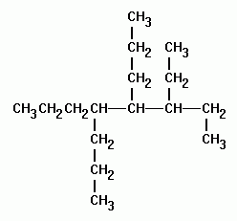
IUPAC naming rules
How would you name this molecule?

Slide 20
Rule 1 - Roots
IUPAC naming rules
Octane
Count the number of carbons in the longest chain.
Write down the corresponding root (prefix). Methane, Ethane, Propane, etc.

Slide 21
Rule 2 –
Side groups
IUPAC naming rules
8
7
6
5
2
4
3
1
3-ethyl, 4-propyl, 5-propyl
Number the carbon chain
Identify any side groups. This is an atom or group of atoms that are not hydrogen.
Use prefixes: methyl, ethyl, propyl etc.
Number these 1,2,3 etc. putting the smallest number for the side group.

Slide 22
Rule 3(a)+(b)
IUPAC naming rules
8
7
6
5
2
4
3
1
3-ethyl, 4,5-dipropyloctane
If two side groups are the same, name them with di-, tri-, tetra- etc.
Put them into alphabetical order!

Slide 23

IUPAC naming rules
How would you name this alkene?

Slide 24
Rule 1 - Roots
IUPAC naming rules
Butene
Count the number of carbons in the longest chain that includes the double bond(s).
Write down the corresponding root (prefix). Ethene, Propene, etc.

Slide 25
Rule 2 –
Identify Side groups
IUPAC naming rules
4
3
2
1
Number the carbon chain (start with the functional group)
Identify any side groups. This is an atom or group of atoms that are not hydrogen.
Use prefixes: methyl, ethyl, propyl etc.
Number these 1,2,3 etc. putting the smallest number closest to the C=C bond.
Double bonds take preference over side groups for smallest number!

Slide 26
Rule 3(a)+(b)
IUPAC naming rules
4
3
2
1
3,3-dimethyl
If two side groups are the same, name them with di-, tri-, tetra- etc.
Put them into alphabetical order if different !

Slide 27
Rule 4: numbering the double bonds
IUPAC naming rules
4
3
2
1
3,3-dimethylbut-1-ene
Count from the side that will result in the lowest numbers overall
Put the number in front of the ‘ene’
If more than one ‘ene’ it is diene, triene etc

Slide 28

2-’ene’s
IUPAC naming rules
3
2
4
1
2-methylbut-2-ene

Slide 29

Dienes, trienes etc.
IUPAC naming rules
4
1
2
3
Buta-1,2-diene

Slide 30
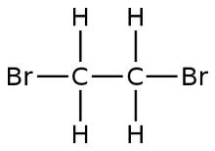
Haloalkanes
IUPAC naming rules
F = Fluoro
Cl = Chloro
Br = Bromo
I = Iodo
Same rules follow
1
2
1,2-dibromoethane

Slide 31
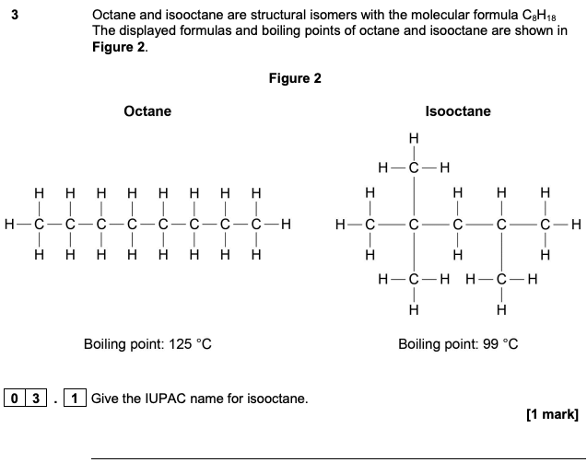
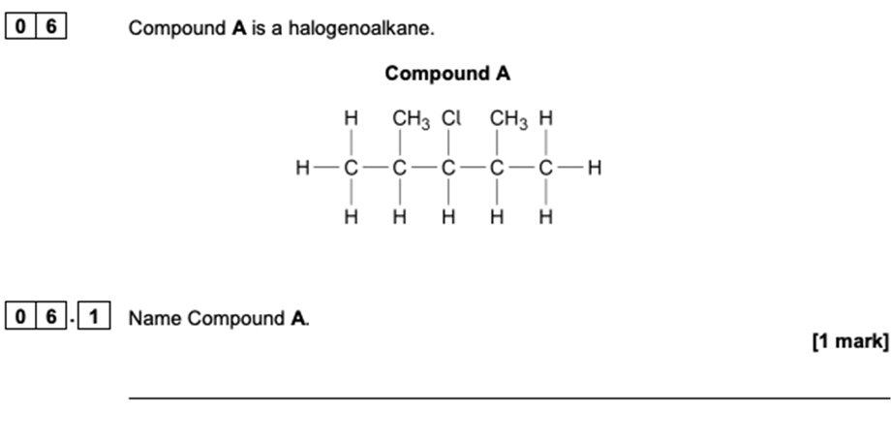
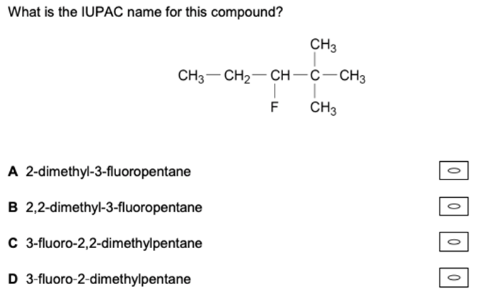
Example questions
3-chloro-2,4-dimethylpentane
2,4,4-trimethylpentane

Slide 32
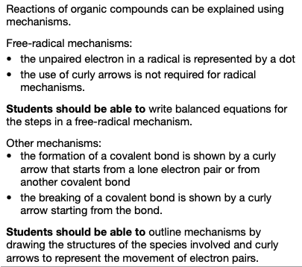
3.3.1.2 Reaction mechanisms

Slide 33
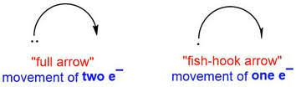
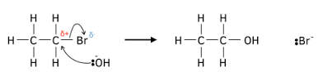
Free-radical mechanism
A CURLY ARROW is used to show the movement of a PAIR of electrons in an organic mechanism. The pair of electrons is either moving from a covalent bond or a lone pair on an atom, e.g.

Slide 34
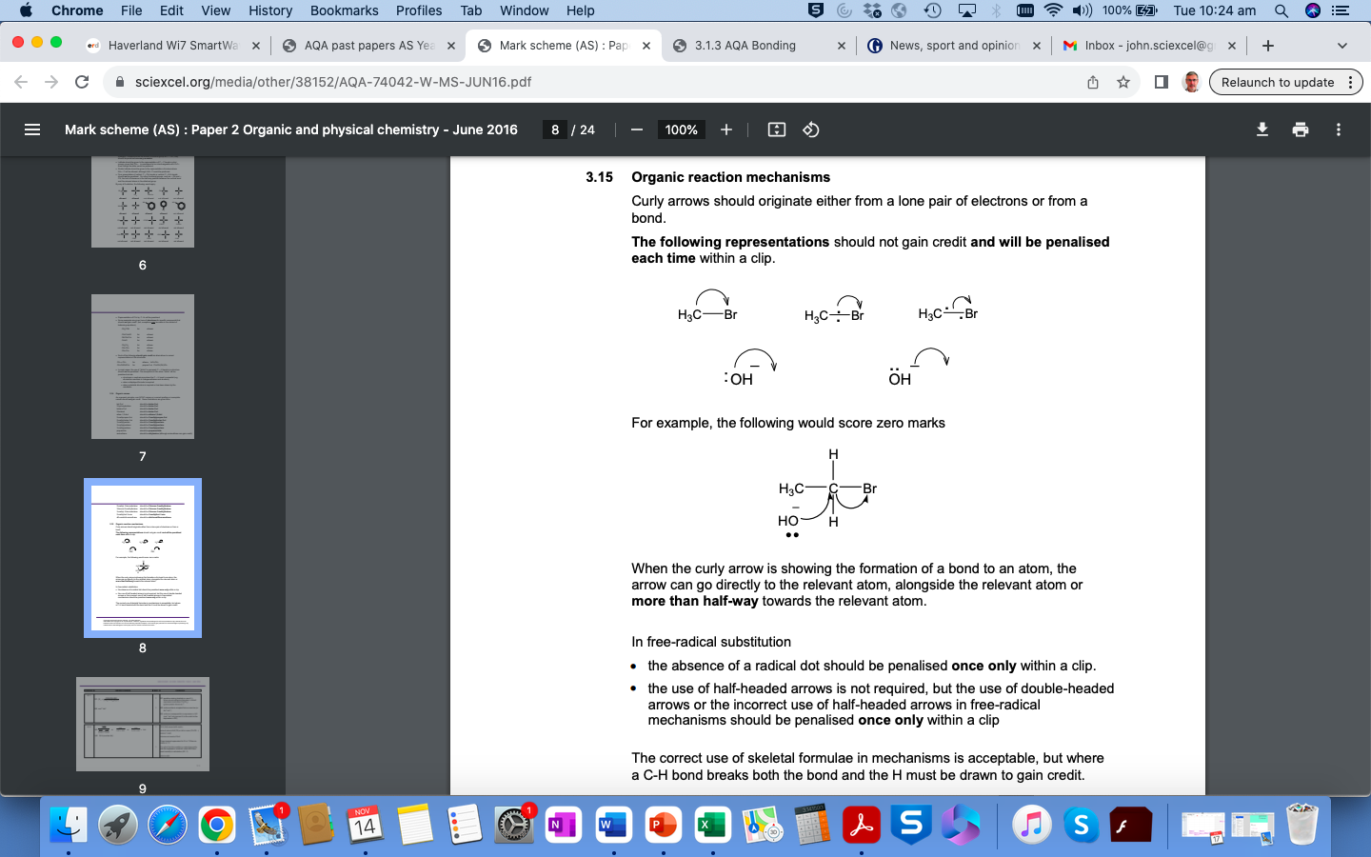
Drawing curly arrows
Taken from the AQA
exam markers’ guide

Slide 35
Free-radical mechanism
A free radical is an uncharged molecule or atom (typically highly reactive and short-lived) having an unpaired valency electron, which is represented by a dot, e.g.
Cl•, •CH₃
Taken from the AQA
exam markers’ guide

Slide 36
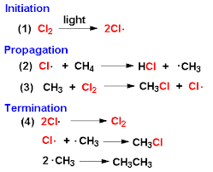
Free-radical mechanism - Example
See Topic 3.3.2 Alkanes

Slide 37
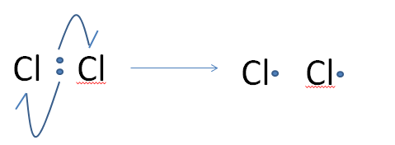
Free-radical substitution
Free-radical substitution reactions of alkanes with halogens to form halogenoalkanes occurs via a three step mechanism.
Initiation
Involves the formation of 2 halogen free radicals (which are highly reactive due to the unpaired electron) from a halogen molecule via homolytic fission caused by UV light (or heat).
Cl₂ ----> 2Cl
U.V. .
Homolytic fission
One electron from the two present in the covalent bond between the 2 Cl atoms goes to each Cl.

Slide 38
Free-radical substitution
2. Propagation (2 steps required)
Step 1 – The Cl. radical reacts with a methane molecule forming HCl and another radical species (the methyl free radical) .CH₃.
i.e. Cl. + CH₄ --> HCl + .CH₃
Step 2 – The methyl radical produced in step one, goes on to react with a chlorine molecule making another free radical product (chain reaction)
i.e. .CH₃ + Cl₂ --> CH₃Cl + Cl.
A propagation step requires a free radical to be present both in the reactants and products.

Slide 39
Free-radical substitution
3. Termination
When two free radicals come together, the reaction pathway comes to an end with the formation of a stable product (with no unpaired electrons).
This may happen by;
Cl. + Cl. → Cl₂
.CH₃ + Cl. → CH₃Cl
.CH₃ + .CH₃ → C₂H₆

Slide 40
Free-radical substitution
Since these chain reactions may result in further substitution of H-atoms with Cl-atoms, a mixture of products is often produced, such as , CH₃Cl, CH₂Cl₂, CHCl₃, CCl₄. This becomes even more complex with longer chain alkanes.
For this reason, haloalkanes are usually produced by alternative methods (see later in course)

Slide 41
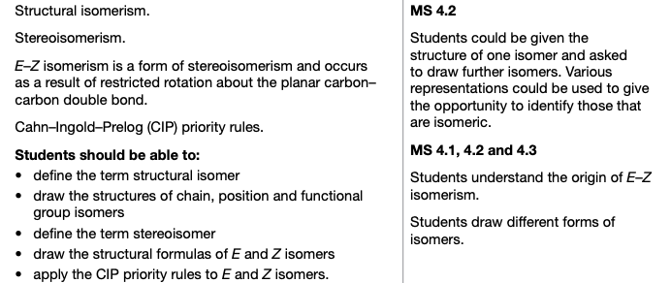
3.3.1.3 Isomerism

Slide 42
Structural isomers
Isomers: are molecules that have the same molecular formula but whose atoms are arranged differently.
Structural isomers: have the same molecular formula but different structural formulae. There are three types:
Chain,
Positional and
Functional Group.

Slide 43
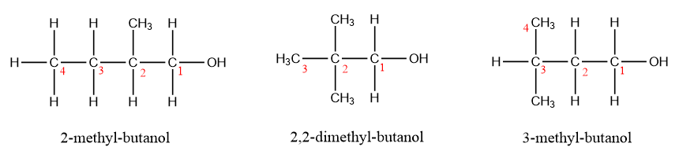
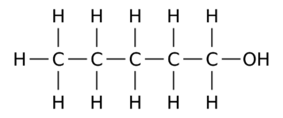
Chain isomers
CHAIN ISOMERS have a different arrangement of the hydrocarbon chain, such as branching;
These are chain isomers of pentan-1-ol
They all have the molecular formular C₅H₁₂O

Slide 44
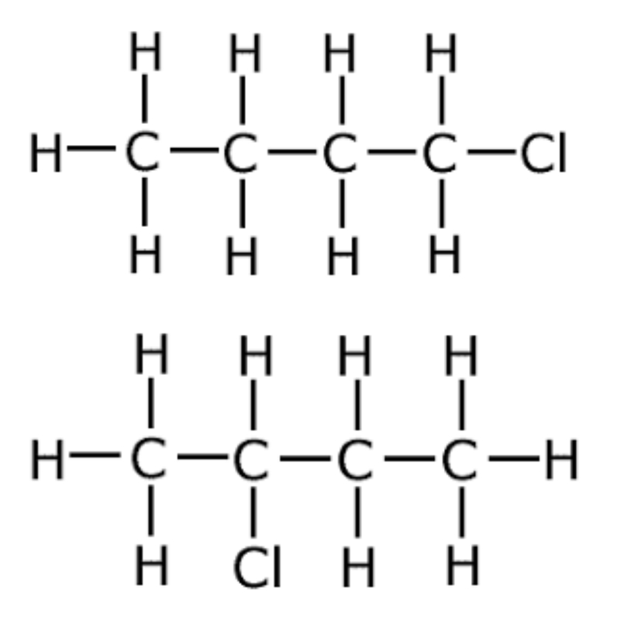
Positional isomers
POSITIONAL ISOMERS have the same functional group attached to the same main chain at different points;
1-chlorobutane
2-chlorobutane
They both have the molecular formular C₄H₉Cl

Slide 45
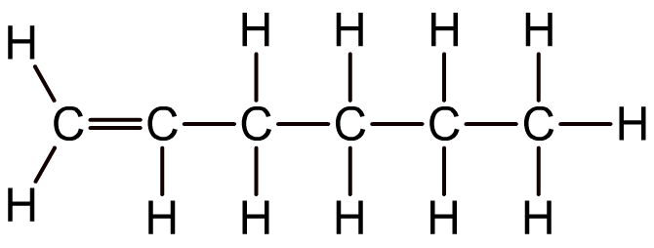
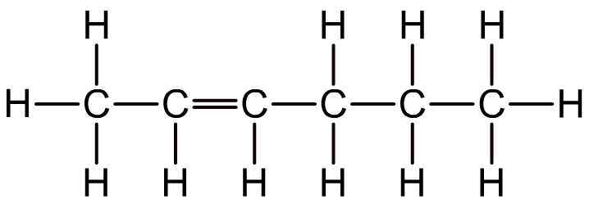
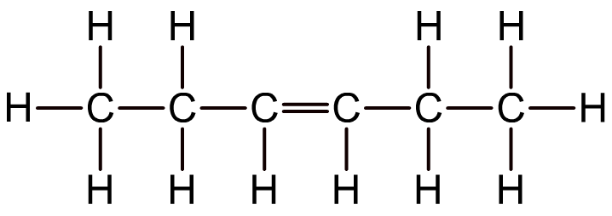
Positional isomers in alkenes
Position isomerism also exists in alkenes (C=C) with four or more carbon atoms.
For example, hexene has several position isomers, all with the molecular formula C₆H₁₂
hex-1-ene
hex-2-ene
hex-3-ene

Slide 46
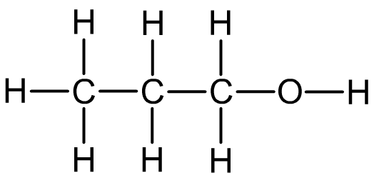
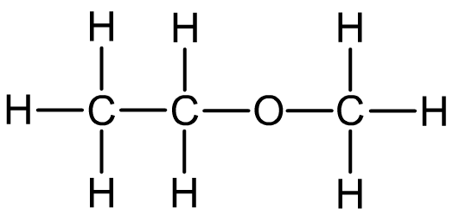
Functional group isomerism
Functional group isomers contain different functional groups and so are members of different homologous series.
For example, both alcohols and ethers have the general formula C_{n}H_{2n+2}O so they may be functional group isomers:
Propan-1-ol
Methoxyethane

Slide 47

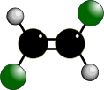
Geometric isomerism in alkenes
Br
H
C
Both of these molecules are 1,2-dibromoethene, BUT, due to the restricted rotation, they are not identical but GEOMETRIC ISOMERS.
Geometric isomerism is an example of stereoisomerism found in some, but not all, alkenes. It occurs due to the RESTRICTED ROTATION OF C=C bonds

Slide 48
Geometric isomerism in alkenes
Br
H
C
CIS (Z)
Groups/atoms are on the
SAME SIDE of the double bond
TRANS (E)
Groups/atoms are on OPPOSITE SIDES across the double bond
OLD cis-1,2-dibromoethane
NEW Z-1,2-dibromoethene
OLD trans-1,2-dibromoethane
NEW E-1,2-dibromoethene

Slide 49
Geometric isomerism in alkenes
Br
H
C
CIS (Z)
Groups/atoms are on the
SAME SIDE of the double bond
TRANS (E)
Groups/atoms are on OPPOSITE SIDES across the double bond
The OLD cis/trans naming does not work if 4 different groups are attached to the carbon atoms of the double bond. Nowadays, we use the Cahn-Ingold-Prelog (CIP) naming system.

Slide 50
Cahn-Ingold-Prelog convention
Br
Low
Low
H
C
High
High
Taking each of the carbon atoms in the double bond in turn, assign a priority based upon atomic number. If hydrogen is one of the atoms bonded, then it is ALWAYS low priority.
If the same atoms are bonded to the carbon, much along the chain to the first point of difference.
If the high priority group are on the same side of the double bond (as above), then this is the Z isomer
If the are on opposite sides of the double bond, then this is the E isomer

Slide 51
Cahn-Ingold-Prelog convention
Z-1,2-dibromoethene
E-1,2-dibromoethene
Low
Low
Low
High
Br
H
High
Low
High
High
C
Z (Zusammen - together) higher priority groups / atoms on
the SAME side of C=C bond
E (Entgegen - opposite) higher priority groups / atoms on
OPPOSITE sides of C=C bond

Slide 52
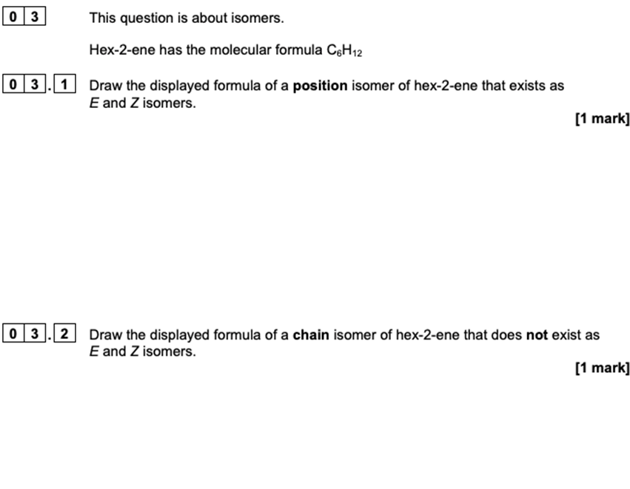
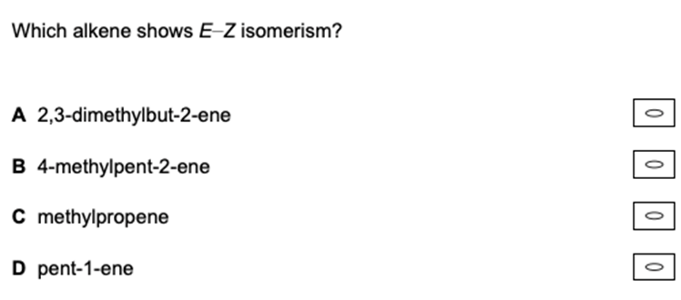
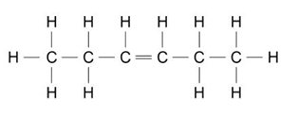
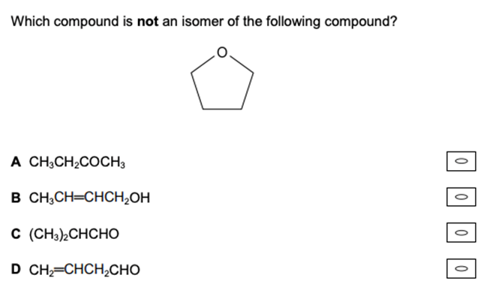
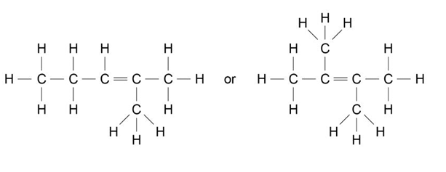
Example questions
Allow molecules that are both chain and position isomers, e.g. 2-methylpent-1-ene, 3-methylpent-1-ene, 4-methylpent-1-ene, 3,3-dimethylbut-1-ene, 2,3-dimethylbut-1-ene, 2-ethylbut-1-ene

