Slide 1

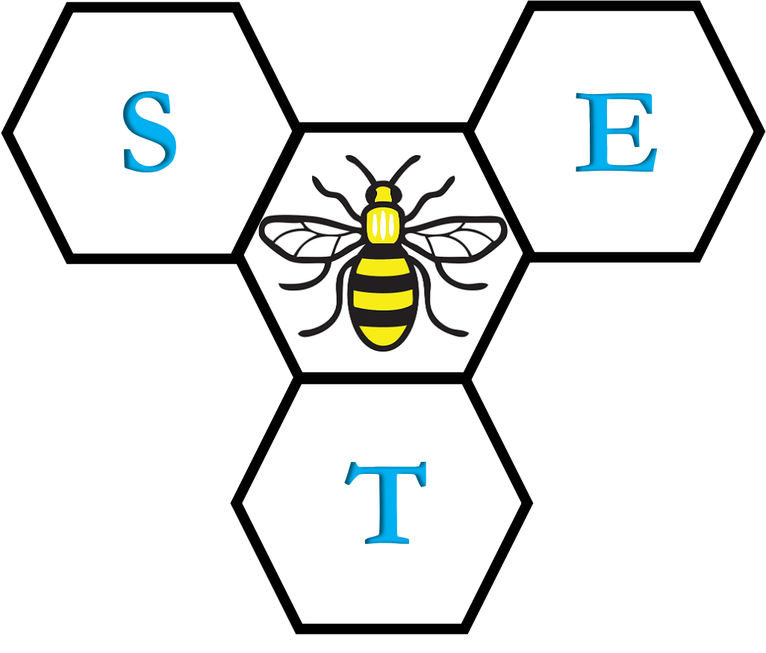
Organic Chemistry Year 1 - AS
3.1.2 Alkanes
Dr John R Griffiths
SciExcel Tuition
www.sciexcel.org

Slide 2
Organic Chemistry Year 1
3.1.2 Alkanes
3.1.2.1 Fractional distillation of crude oil
3.1.2.2 Modification of alkanes by cracking
3.1.2.3 Combustion of alkanes
3.1.2.4 Chlorination of alkanes

Slide 3
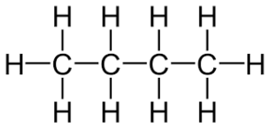
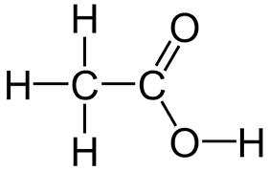
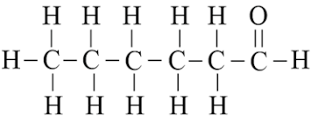
General Introduction
Alkanes are saturated hydrocarbons
Hydrocarbons are compounds which contain ONLY hydrogen and carbon atoms.
e.g. Pentane (C₅H₁₂), propene (C₃H₆), benzene (C₆H₆).
Saturated compounds have only SINGLE (no double or triple) bonds between carbon atoms.
e.g.
Butane
ethanoic acid
hexanal

Slide 4
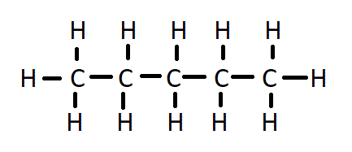
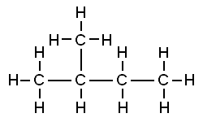
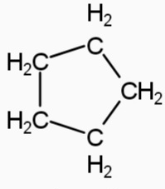
Alkanes are saturated hydrocarbons
Alkanes are saturated hydrocarbons, which may be straight-chain linear, branched chain or cyclic in nature.
Linear (whether straight-chain or branched) have the GENERAL FORMULA, C_{n}H_{2n+2}
e.g. pentane
and methylbutane
both have the molecular formula C₅H₁₂
Cyclic (rings) alkanes have the general formula C_{n}H_{2n}, which is the same as alkenes (see later in course).
e.g. cyclopentane – C₅H₁₀

Slide 5
Physical properties of Alkanes
You will need to be able to state and explain the following simple properties of alkanes;
BOILING POINT
POLARITY
SOLUBILITY

Slide 6
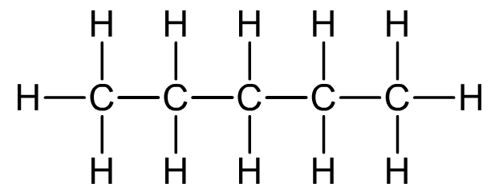
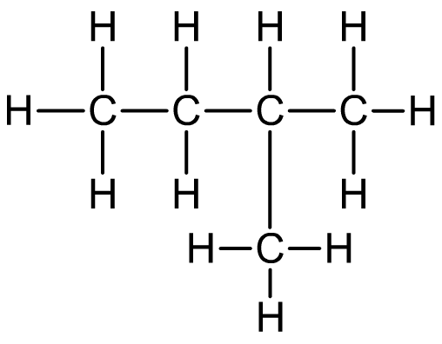
Boiling points
The boiling point of straight-chain alkanes increases with chain length due to increasing van der Waals forces between molecules.
As the length of the chain increases, so does its surface area, and so the van der Waals forces are stronger.
Branched-chain alkanes have lower boiling points because the chains cannot pack as closely together. There are fewer points of contact between molecules so the van der Waals forces are weaker.
Notes:
Teacher notes
See the ‘Bonding and Intermolecular Forces’ for more i

Slide 7
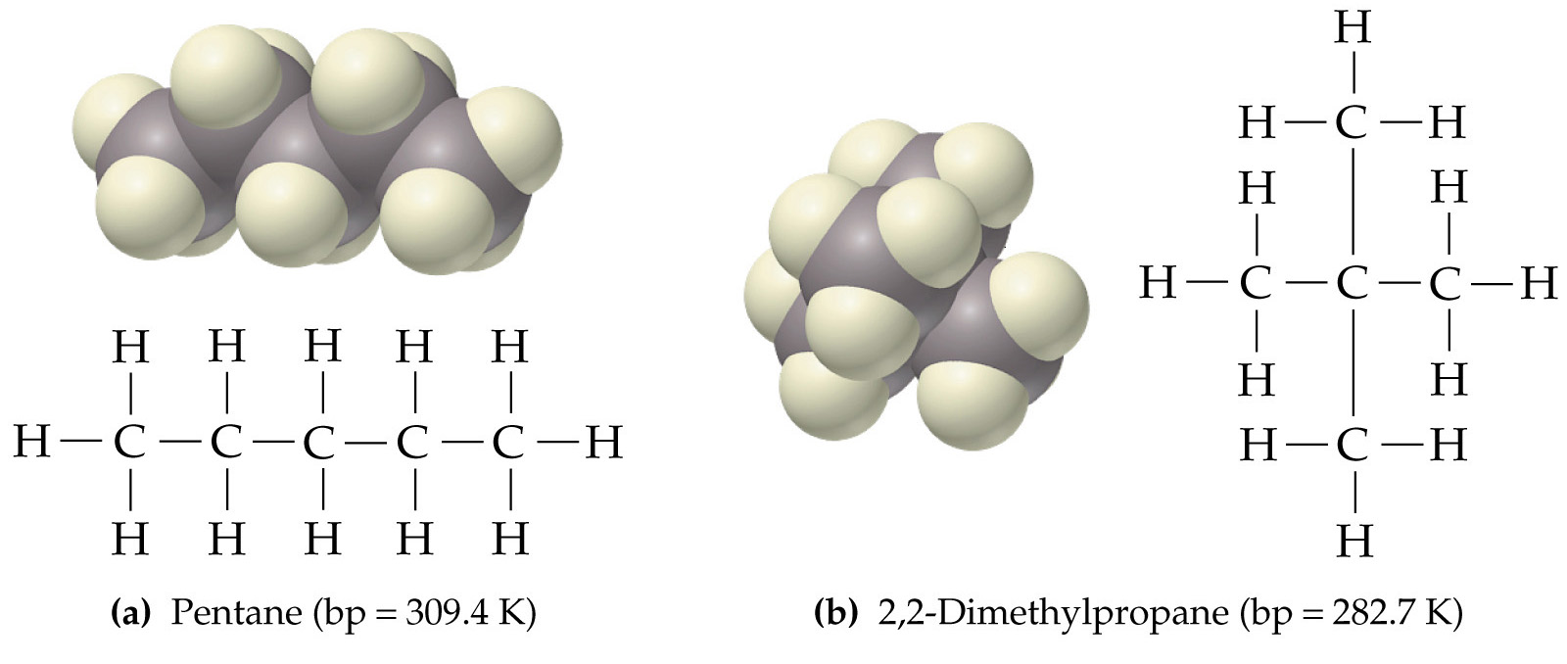
Boiling points
Increase in Branching
Decrease in Boiling Point

Slide 8
Example question
Arrange the following alkanes in order of increasing boiling point..
(a)
(b)
(c)
(d)

Slide 9
Answer
(c)
(a)
(d)
(b)
hexane
ethane
2,2-dimethylpropane
2,3-dimethylbutane
Increasing Boiling Point
Increase in Boiling Point

Slide 10
Polarity of alkanes
Since alkanes only consist of bonds between carbon and carbon, and carbon to hydrogen, both the bonds and overall molecules are NON-POLAR in nature. The electronegativity values for carbon (2.5) and hydrogen (2.1) are very similar, so no overall polarity exists.
As a result of this, the only intermolecular forces between alkane molecules are the weak van der Waals forces. These are what contribute to the boiling points of the alkanes (as above).
As well as being non-polar, the C-C and C-H bonds are relatively strong and therefore alkanes are not very reactive (do not react with acids, bases, oxidising agents or reducing agents).
They can react with halogens under certain conditions and they burn in oxygen - combustion (see later).
Notes:
Teacher notes
See the ‘Bonding and Intermolecular Forces’ for more i

Slide 11
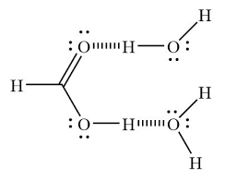
Solubility of alkanes
Being non-polar, alkanes are soluble in relatively non-polar solvents, but not in polar solvents such as water. The hydrogen bonding present between water molecules is much stranger than the van der Waal forces between alkane molecules and so solvation of the alkanes does not occur.
Notes:
Teacher notes
See the ‘Bonding and Intermolecular Forces’ for more i

Slide 12
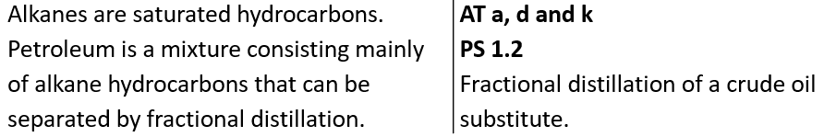
3.1.2.1 Fractional distillation of crude oil

Slide 13
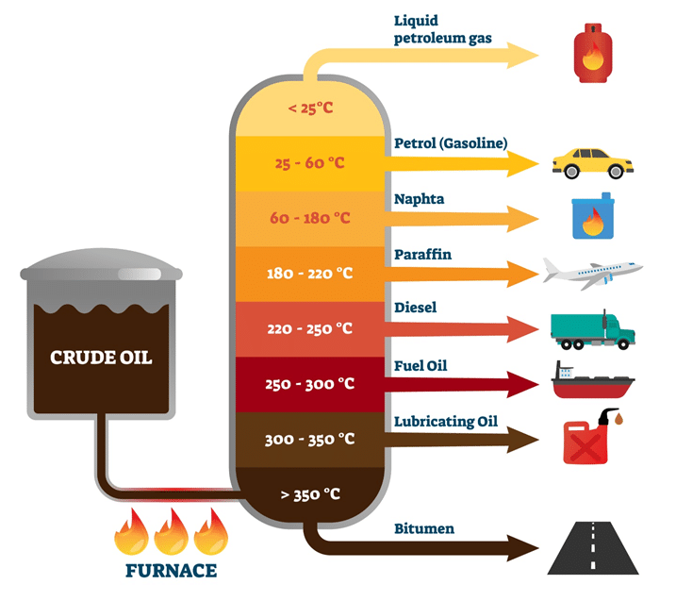
Fractional distillation
To convert crude oil into useful fractions we have to separate the MIXTURE by fractional distillation.
This involves heating the mixture and collecting the fractions that boil over different ranges of temperatures.
Each fraction that is separated by this method is a mixture of hydrocarbons of similar chain length and similar properties.
It is done in a fractionating tower (see opposite).
It is a PHYSICAL PROCESS so no covalent bonds within the molecules are broken – only the van de Waals forces are broken during vaporisation and are reformed on condensation.

Slide 14
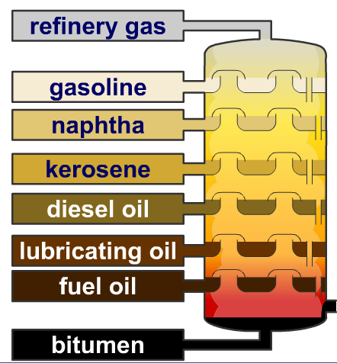
Fractionating tower
Top of tower =
lower temperature (400 K) =
shorter chain hydrocarbons with lower boiling points
Bottom of tower =
Higher temperature (630 K) =
Longer chain hydrocarbons with higher boiling points

Slide 15

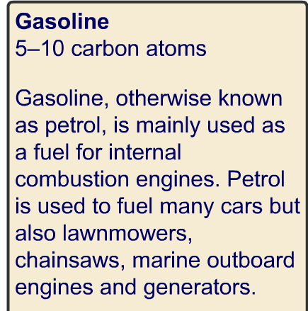
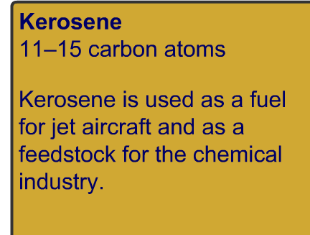
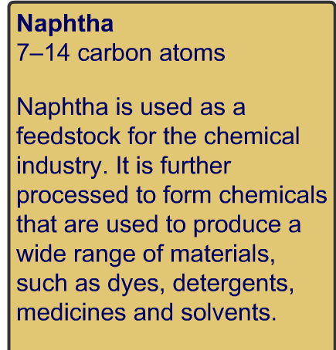
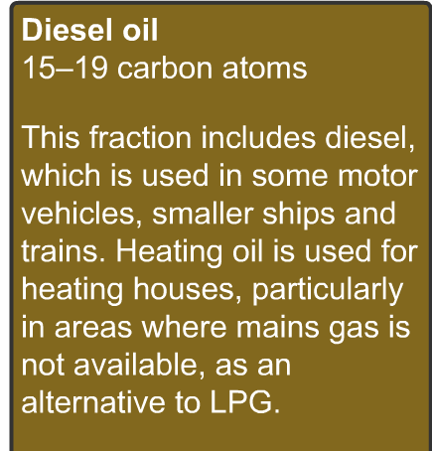
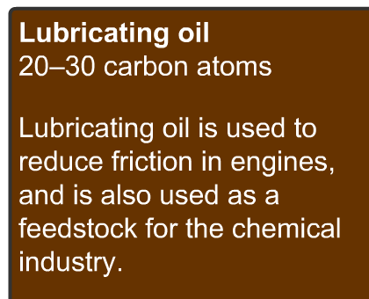
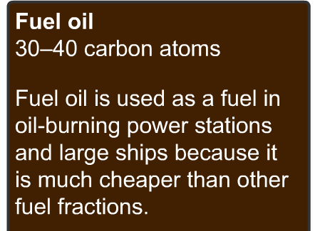
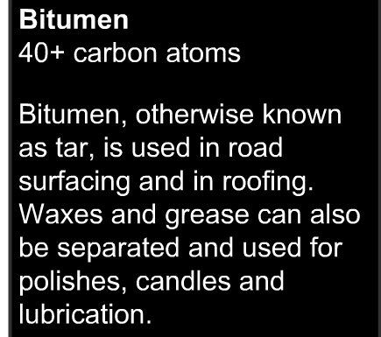
Various fractions

Slide 16
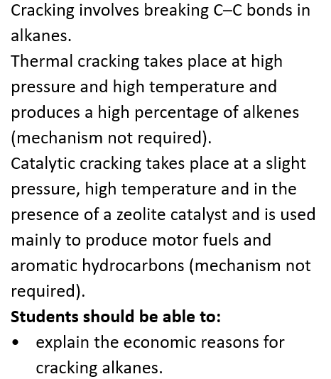
3.1.2.2 Modification of alkanes by cracking

Slide 17
Supply and demand of crude oil fractions
Fraction | Number of carbon atoms | % supplied | % demand
LPG | 1 - 4 | 2 | 4
Petrol and naphtha | 4 -14 | 16 | 27
Kerosene | 11 -15 | 13 | 8
Gas oil | 15 -19 | 23 | 19
Fuel oil and bitumen | > 30 | 50 | 38

Slide 18
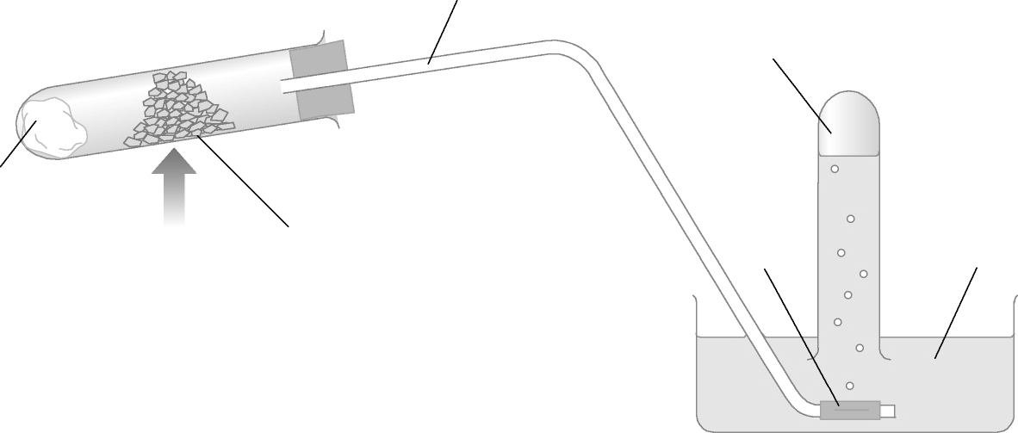
Cracking paraffin oil in the laboratory
Delivery tube
gas
Mineral wool
soaked with
paraffin oil
water
Broken porcelain
Soak the mineral wool in paraffin and put at end of boiling tube. About 2cm from the bung put 1 spatula full of catalyst and clamp around neck.
Heat the catalyst FIRST and then move the flame towards the paraffin
Collect the gas over water
When complete, remove the delivery tube from the water BEFORE switching off the burner!
Add a few drops of bromine water into the test tube and observe any colour change

Slide 19
Two types of cracking
 | Thermal | Catalytic
Temperature | 450 – 900 °C | 450 °C
Pressure | High | Moderate
Catalyst | None | Zeolites
Products | High proportion of straight-chain alkanes and alkenes | High proportion of branched alkanes and alkenes, and cyclic and aromatic hydrocarbons
Use of products | Alkenes – raw materials for chemical industry | Motor fuels
Comparative cost | More expensive | Less expensive
Method of separating products | Fractional distillation | Fractional distillation

Slide 20
Cracking equations
Cracking of a large alkane molecule always produces a smaller hydrocarbon molecules.
e.g. C₂₂H₄₆ → C₁₄H₃₀ + C₈H₁₆
alkane (shorter) alkene alkane
(Ensure that the number of hydrogens and carbons balance on each side of the equation)
Notes:
Summary from last lesson: refer to answers from wordsearch. Complete examples.

Slide 21
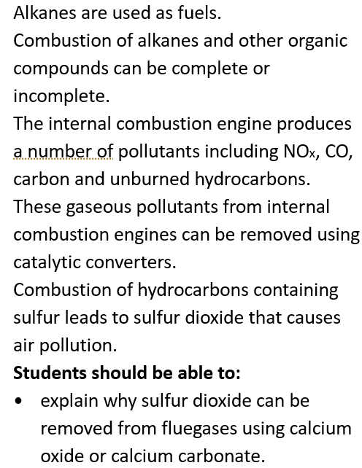
3.1.2.3 Combustion of alkanes

Slide 22
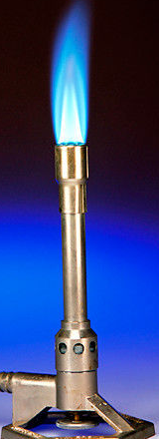

Combustion
Complete combustion (plentiful supply of oxygen)
Products = carbon dioxide + water
CH₄ + 2O₂ → CO₂ + 2H₂O ΔH = -890kJ mol⁻¹
Highly exothermic (large negative enthalpy of combustion) – making them excellent as fuels
Incomplete combustion (limited supply of oxygen)
Products = Either (a) carbon monoxide + water
CH₄ + 1.5O₂ → CO + 2H₂O
OR if even less oxygen
(b) Carbon (soot) + water
CH₄ + O₂ → C + 2H₂O
Chimney open
(plenty of O₂)
“Clean” flame
Chimney closed
(limited O₂)
Sooty flame

Slide 23
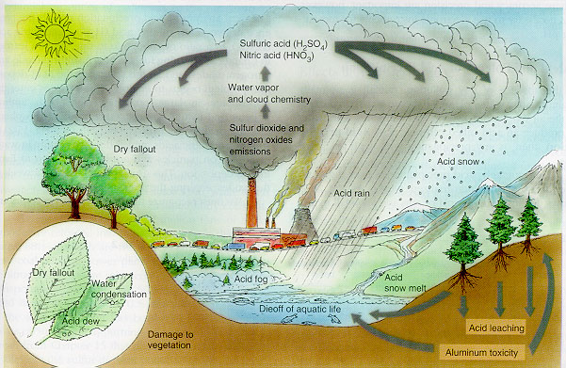
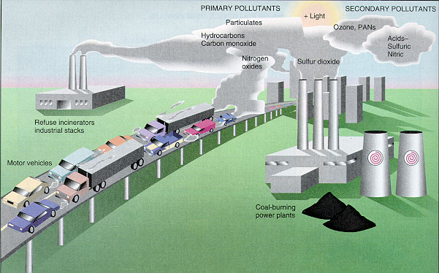
Air pollutants
Carbon-containing compounds
Sulfur-containing compounds
Nitrogen-containing compounds

Slide 24
Carbon-containing compounds
Carbon particles: Soot – formed through incomplete combustion (diesel engines). Particulates can enter the airways and lungs. May cause respiratory problems.
Carbon monoxide: pollutant, colorless, odorless gas. Toxic - binds to hemoglobin preventing uptake of oxygen. Formed by incomplete combustion mainly in cars and trucks. Also from faulty domestic boilers.
Carbon dioxide: Complete combustion of hydrocarbons etc. Cars, airplanes, power stations. Potent greenhouse gas.
Hydrocarbons: Again, incomplete combustion – greenhouse gases such as water vapour.

Slide 25
Sulphur-containing compounds
Fossil fuels contain small amounts of sulphur compounds
Upon combustion, one product present in the flue gas is sulphur dioxide, SO₂
This goes on to form sulphuric acid (acid rain) by combining with water and oxygen;
SO_{2(g)} + 0.5 O_{2(g)} +H₂O_{(l)} --> H₂SO_{4(l)}
This may be removed (flue gas desulphurisation) by reaction with calcium oxide (lime), sprayed as a slurry, which is further oxidised to form the useful product, gypsum (calcium sulphate - plaster).
CaO_{(s)} + 2H₂O_{(l)} + SO_{2(g)} + 0.5 O_{2(g)} --> CaSO₄.2H₂O_{(s)}
Alternatively, the sulphur dioxide may be removed by reaction with calcium carbonate;
CaCO_{3(s)} + SO_{2(g)} + 0.5 O_{2(g)} --> CaSO_{4(s)} + CO_{2(g)}

Slide 26
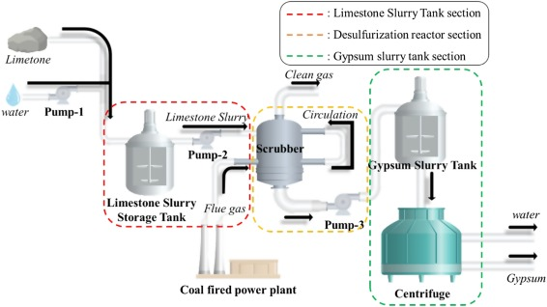
Removal of SO₂

Slide 27
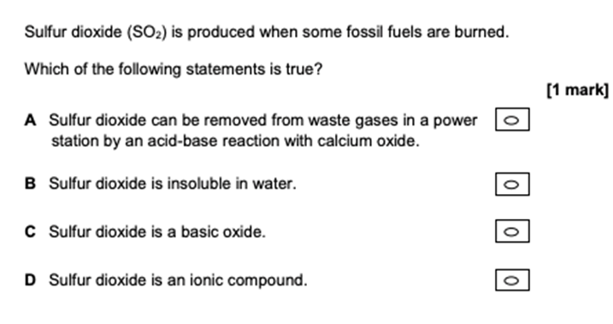
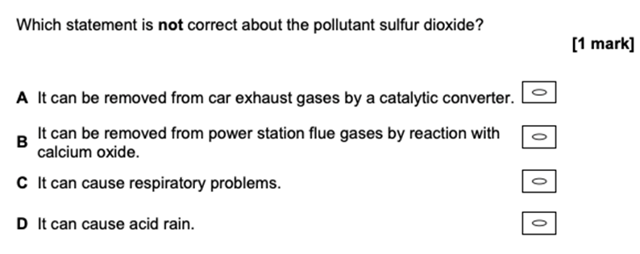
Example questions

Slide 28
Nitrogen-containing compounds
Nitrogen oxides, NO, NO₂ and N₂O₄ (or NO_{x}) may be produced in the high temperatures of, for example, the internal combustion engine. Nitrogen and oxygen from air, combine to make NO;
N_{2(g)} + O_{2(g)} --> 2NO_{(g)}
When these NO_{x} compounds react with water vapour and oxygen in air, they may form nitric acid (acid rain/photochemical smog). Car exhaust systems are fitted with catalytic converters to remove these (and other) compounds – see later slides.

Slide 29
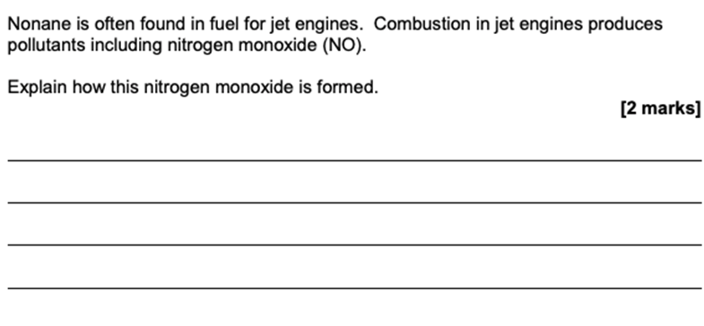
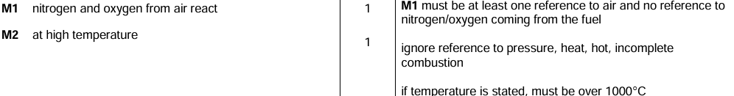
Example question

Slide 30
Catalytic converters
Petrol engine vehicles are fitted with catalytic converters on their exhaust systems to reduce the output of certain environmental contaminants formed during the combustion of fossil fuels. The catalyst metals are either platinum and rhodium, which are coated on honeycomb ceramic structure to provide a high surface area. The following reactions occur on the metal surface;
2CO_{(g)} + 2NO_{(g)} --> N_{2(g)} + 2CO_{2(g)}
Hydrocarbons + nitrogen oxide --> nitrogen + carbon monoxide + water

Slide 31
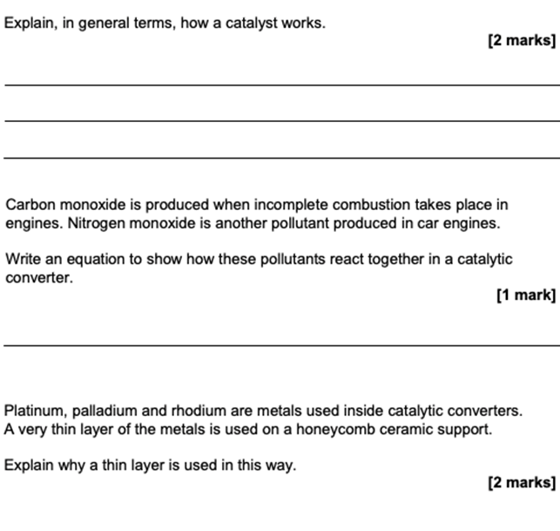
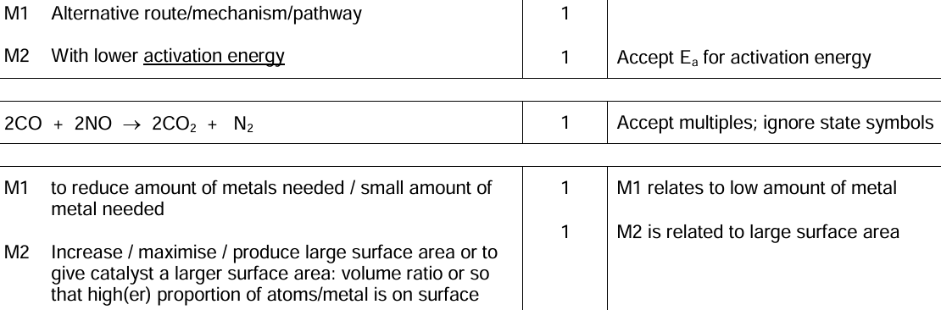
Example question

Slide 32
Summary
Pollutant | How is it formed? | Environmental/ health problem | How is pollutant dealt with?
Carbon monoxide (CO) | Incomplete combustion C₃H₈ + 3.5O₂ 3CO + 4H₂O | Poisonous gas | Catalytic converter
Nitrogen oxides (NO, NO₂ and N₂O₂) | N₂ +O₂ in air react at high temps N₂ + O₂ 2NO | React with water vapour and oxygen in the air to form nitric acid (Acid rain). Also contribute to photochemical smog | Catalytic converter
Carbon Dioxide (CO₂) | Complete combustion | Greenhouse gas – exaggerated greenhouse effect (global warming)
Sulphur Dioxide (SO₂) | Acid rain formation: SO₂ + H₂O → H₂SO₃ + 0.5O₂ → H₂SO₄ | Acid Rain | Flue gas desulphurisation SO₂ + CaCO₃ → CaSO₃ + CO₂ (PTO)
Carbon Particulates | Unburnt hydrocarbons | Asthma and cause cancer Global Dimming
Water Vapour | Combustion | Greenhouse gas

Slide 33
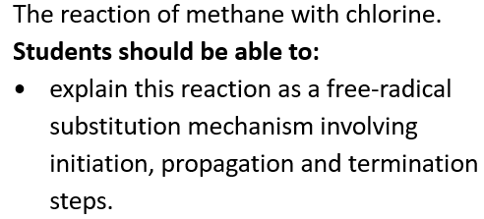
3.1.2.4 Chlorination of alkanes

Slide 34
Free-radical substitution
A method for synthesising haloalkanes from an alkane and a halogen.
The reaction mechanism requires high energy UV light, however sunlight does provide this
Overall general equation:
C_{n}H_{2n+2} + X₂ → C_{n}H_{2n+1}X + HX

Slide 35
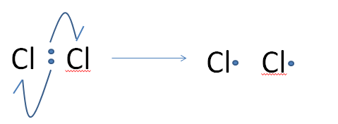
Free-radical substitution
Free-radical substitution reactions of alkanes with halogens to form halogenoalkanes occurs via a three step mechanism.
Initiation
Involves the formation of 2 halogen free radicals (which are highly reactive due to the unpaired electron) from a halogen molecule via homolytic fission caused by UV light (or heat).
Cl₂ ----> 2Cl
U.V. .
Homolytic fission
One electron from the two present in the covalent bond between the 2 Cl atoms goes to each Cl.

Slide 36
Free-radical substitution
2. Propagation (2 steps required)
Step 1 – The Cl. radical reacts with a methane molecule forming HCl and another radical species (the methyl free radical) .CH₃.
i.e. Cl. + CH₄ --> HCl + .CH₃
Step 2 – The methyl radical produced in step one, goes on to react with a chlorine molecule making another free radical product (chain reaction)
i.e. .CH₃ + Cl₂ --> CH₃Cl + Cl.
A propagation step requires a free radical to be present both in the reactants and products.

Slide 37
Free-radical substitution
3. Termination
When two free radicals come together, the reaction pathway comes to an end with the formation of a stable product (with no unpaired electrons).
This may happen by;
Cl. + Cl. → Cl₂
.CH₃ + Cl. → CH₃Cl
.CH₃ + .CH₃ → C₂H₆

Slide 38
Free-radical substitution
Since these chain reactions may result in further substitution of H-atoms with Cl-atoms, a mixture of products is often produced, such as , CH₃Cl, CH₂Cl₂, CHCl₃, CCl₄. This becomes even more complex with longer chain alkanes.
For this reason, haloalkanes are usually produced by alternative methods (see later in course)

Slide 39
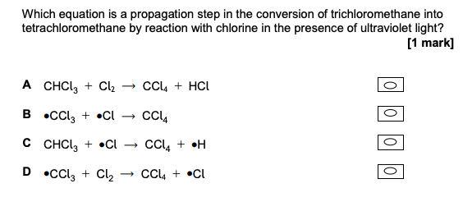
Example question

Slide 40
Free-radical substitution – Ozone layer depletion
N.B. – This topic comes under 3.3.3 Halogenoalkanes in the AQA specification
Chlorine free radicals have been found to be harmful to the protective ozone (O₃) layer in the Earth’s stratosphere. The ozone layer prevents too much harmful UV radiation from reaching us and without it, these rays may give rise to an increase in the incidence of skin cancers.
The Cl. radicals are formed from chlorofluorocarbons (CFCs) in the presence of UV radiation, in a similar way to that mentioned previously (homolytic fission, but this time of the C-Cl bonds).
CFCs are molecules which only contain C, F and Cl atoms (and no Hydrogen)

Slide 41
Free-radical substitution – Ozone layer depletion
The process of ozone depletion occurs by the following propagation steps;
1. Cl. + O₃ --> ClO. + O₂
2. ClO. + O₃ --> Cl. + 2O₂
Adding these two equations together shows that the chlorine radical acts as a catalyst as it is not destroyed in the process. The overall reaction being;
2O₃ --> 3O₂

Slide 42
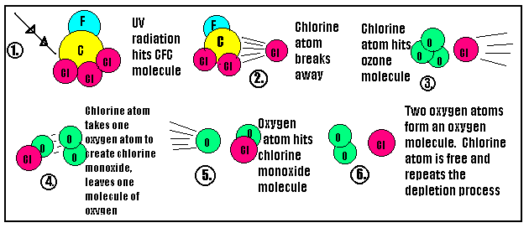
Free-radical substitution – Ozone layer depletion

Slide 43
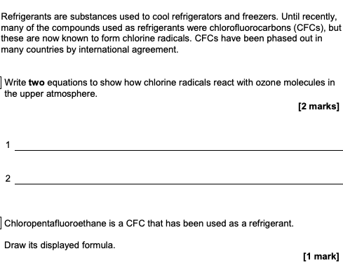
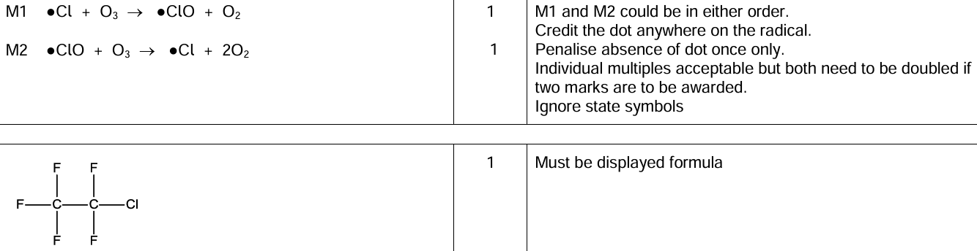
Example questions

