Slide 1


Organic Chemistry Year 1 - AS
3.3.3 Halogenoalkanes
Dr John R Griffiths
SciExcel Tuition
www.sciexcel.org

Slide 2
Organic Chemistry Year 1
3.3.3 Halogenoalkanes
3.3.3.1 Nucleophilic substitution
3.3.3.2 Elimination
3.3.3.3 Ozone depletion

Slide 3
General Introduction
Halogenoalkanes (also called haloalkanes) have the general formula (with a single halogen atom) C_{n}H_{2n+1}X, where X is a halogen atom (often represented as R-X, where R is an alkyl group). The C-X bond is polar due to the difference in electronegativities of carbon and the halogens, C being δ+ and X being δ-.
They are named with the prefix of the halogen (Fluoro-, Chloro-, Bromo-, Iodo-), and may contain more than one halogen atom
e.g. 1,2-dibromo-3-chloropropane
Br
Br
Cl

Slide 4
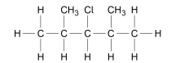
Example question
Name this halogenoalkane.
3-chloro 2,4-dimethyl pentane

Slide 5
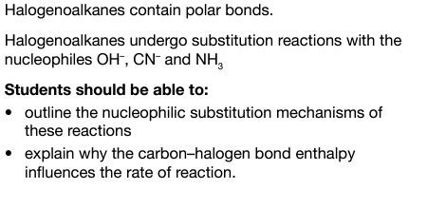
3.3.3.1 Nucleophilic substitution

Slide 6
Nucleophilic substitution
Nucleophile: An atom or molecule that donates an electron pair to form a covalent bond. They are attracted to electron-deficient areas (δ+). They possess a lone pair of electrons (:) and often, although not always, have a negative charge. Common nucleophiles are;
:NH₃
:OH⁻
:CN⁻
Halogenoalkanes are susceptible to nucleophilic attack due to the partial positive charge (electron deficiency) on the carbon atom directly attached to the halogen. The nucleophile (:Nu) directly replaces (substitutes for) the halogen atom.

Slide 7
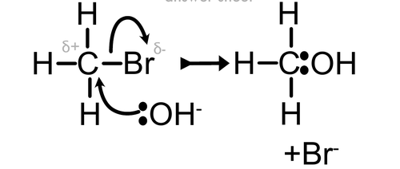

Nucleophilic substitution
General nucleophilic substitution mechanism
jjj
+
-
-Nu
Nu
+ :Br⁻

Slide 8
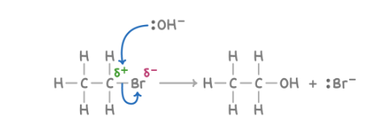
Nucleophilic substitution
Halogenoalkanes with AQUEOUS NaOH or KOH – Called a hydrolysis reaction
Reaction carried out in ethanol to enable both to mix.
Warm mixture to speed up the reaction. Forms an ALCOHOL.

Slide 9

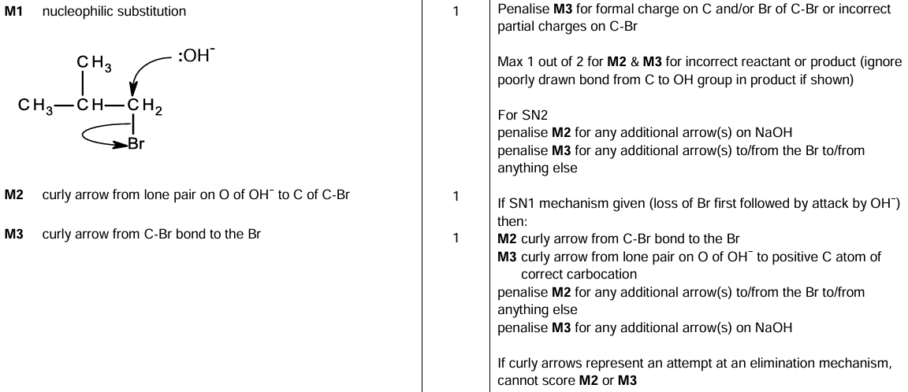
Example question

Slide 10
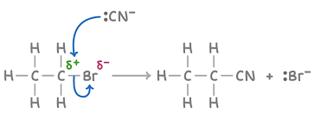
Nucleophilic substitution
Halogenoalkanes with aqueous alcoholic solution of KCN.
Warm mixture to speed up the reaction. Forms a NITRILE.

Slide 11
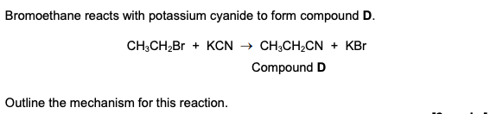
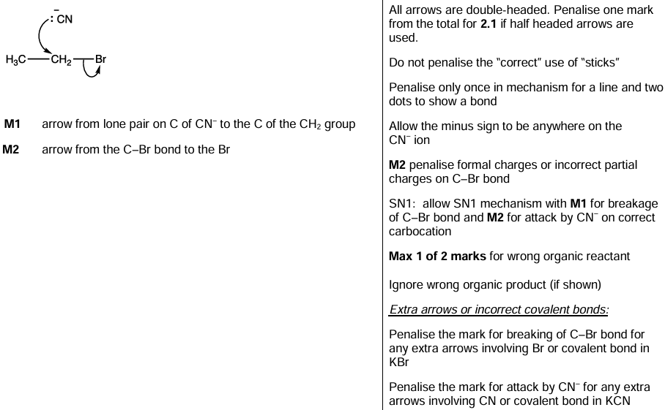
Example question

Slide 12
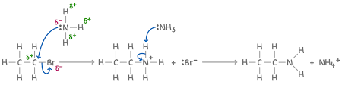
Nucleophilic substitution
Halogenoalkanes with ammonia, :NH₃ (Excess conc. ammonia solution in ethanol and under pressure) → Primary amine
R-X + 2NH₃ --> RNH₂ + NH₄X
NB – If excess haloalkane is present, further substitution reactions take place resulting in secondary, tertiary and quaternary amine products (See section 3.3.11 - Amines)

Slide 13
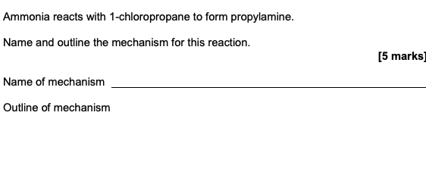
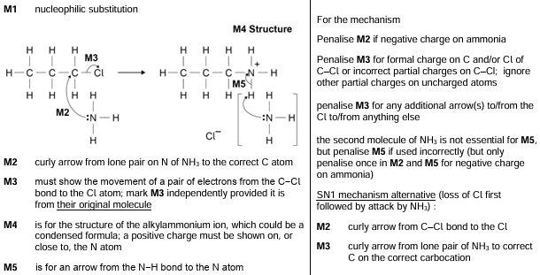
Example question

Slide 14
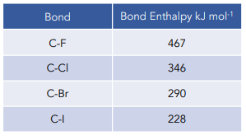
Nucleophilic substitution – Rates of reaction
The rate of reaction depends upon the strength of the C-X bond MUCH MORE THAN the bond polarity. Fluoroalkanes do not react at all due to the high bond enthalpy, whereas iodoalkanes react the fastest.
Increasing rate of reaction

Slide 15
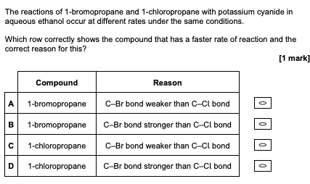
Example question

Slide 16
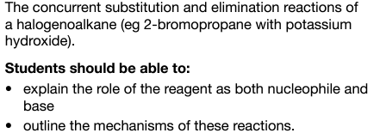
3.3.3.2 Elimination

Slide 17
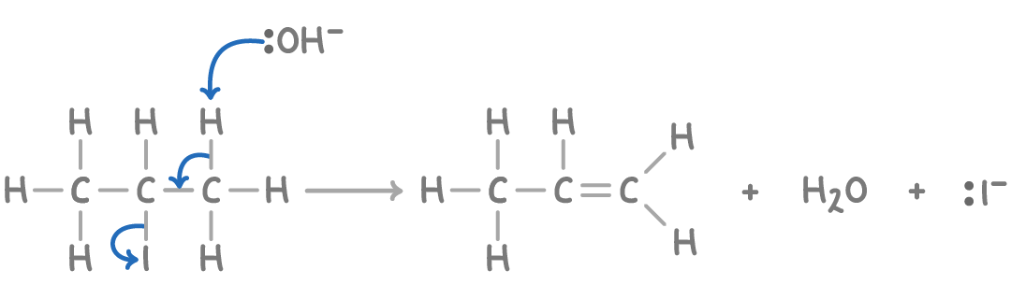
Elimination
In addition to the main nucleophilic substitution reaction, halogenoalkanes can also undergo elimination reactions under certain conditions. As already seen, reaction with hydroxide ions under warm, AQUEOUS conditions proceeds via a nucleophilic substitution mechanism and results in the formation of an alcohol (:OH⁻ behaves as a nucleophile).
However, under hot, ETHANOLIC conditions (with no water present), an alkene is formed via an ELIMINATION reaction. The OH⁻ base abstracts a proton from a carbon atom adjacent to (β) the carbon attached to a halogen:-

Slide 18
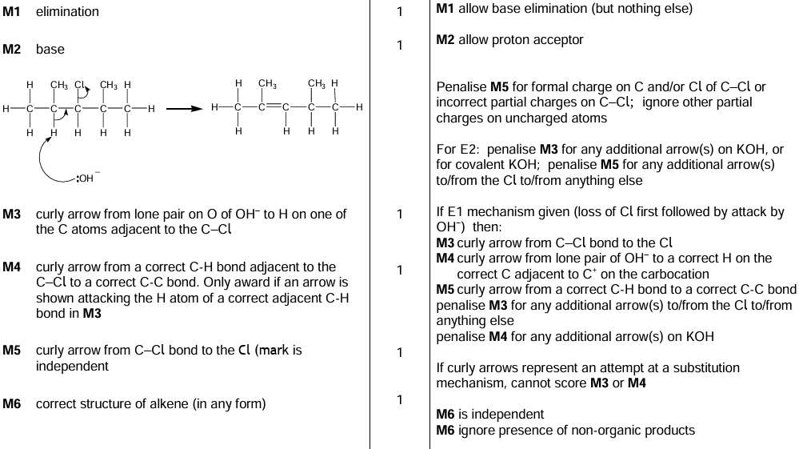
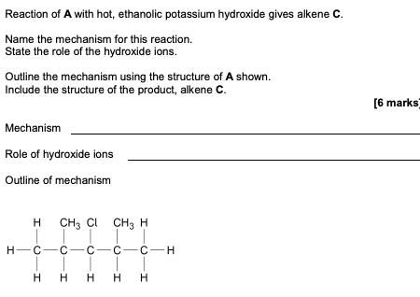
Example question

Slide 19
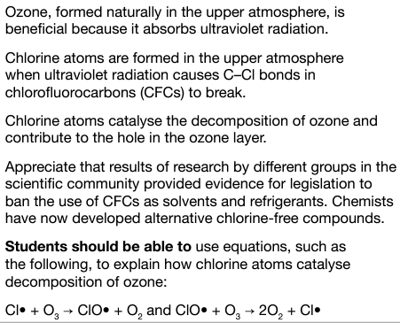
3.3.3.3 Ozone depletion

Slide 20
3.3.3.3 Ozone depletion
Chlorine free radicals have been found to be harmful to the protective ozone (O₃) layer in the Earth’s stratosphere. The ozone layer prevents too much harmful UV radiation from reaching us and without it, these rays may give rise to an increase in the incidence of skin cancers.
The Cl. radicals are formed from chlorofluorocarbons (CFCs) in the presence of UV radiation, in a similar way to that mentioned previously (homolytic fission, but this time of the C-Cl bonds).
CFCs are molecules which only contain C, F and Cl atoms (and no Hydrogen)

Slide 21
Free-radical substitution – Ozone layer depletion
The process of ozone depletion occurs by the following propagation steps;
1. Cl. + O₃ --> ClO. + O₂
2. ClO. + O₃ --> Cl. + 2O₂
Adding these two equations together shows that the chlorine radical acts as a catalyst as it is not destroyed in the process. The overall reaction being;
2O₃ --> 3O₂

Slide 22
Summary of ozone depletion
UV radiation interacts with CFC molecules in the atmosphere.
Chlorine radicals form via homolytic fission of C-Cl bonds.
Chlorine radicals go on to react with ozone molecules in a chain reaction.
The ozone layer becomes depleted

Slide 23
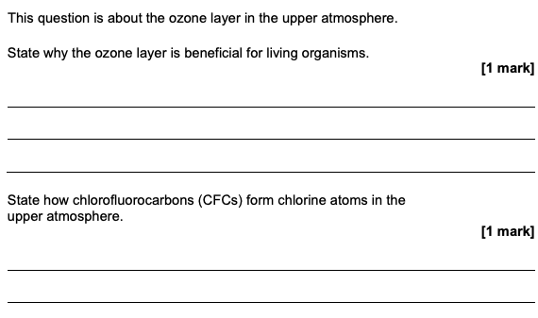
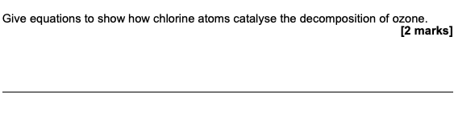

Example questions

