Slide 1


Organic Chemistry Year 1 - AS
3.3.4 Alkenes
Dr John R Griffiths
SciExcel Tuition
www.sciexcel.org

Slide 2
Organic Chemistry Year 1
3.3.4 Alkenes
In alkenes, the high electron density of the carbon-carbon double bond leads to attack on these molecules by electrophiles. This section also covers the mechanism of addition to the double bond and introduces addition polymers, which are commercially important and have many uses in modern society.

Slide 3
3.3.4 Alkenes
3.3.4.1 Structure, bonding and reactivity
3.3.4.2 Addition reactions of alkenes
3.3.4.3 Addition polymers

Slide 4
3.3.4.1 Structure, bonding and reactivity
Alkenes are unsaturated hydrocarbons.
Bonding in alkenes involves a double covalent bond, a centre of high electron density

Slide 5
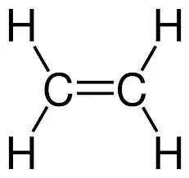
General Introduction
Alkenes are hydrocarbons and have the general formula (with one double bond) C_{n}H_{2n}. There is at least one C=C double bond – that makes them UNSATURATED.
They are named in a similar way to alkanes, but with the suffix –ENE, rather than –ane.
e.g. ethene (C₂H₄)
Alkenes are planar around the double bond. The bond angle is approximately 120º

Slide 6
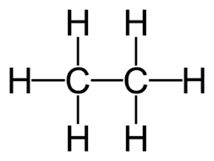
General Introduction
As a consequence of the nature of the carbon-carbon double bond, alkenes unlike alkanes, do not experience free rotation about this bond. Why is this ?
Free rotation about the single bond
No rotation about the double bond (fixed)

Slide 7

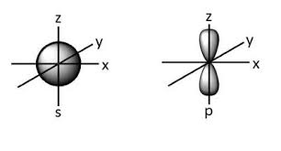
The nature of the C=C double bond
The carbon-to-carbon double bond consists of two types of bond. Firstly, a sigma ( ) bond, which is the same as a single bond in alkanes and is formed by end-on-end overlap of s, or p-orbitals. This makes it stronger. Secondly, a pi (π)bond. This comprises of sideways overlap of p-orbitals, above and below the sigma bond. This is weaker.
Pi bond
H
H
H
H
H
C C
H
C C
H
H
H
H
Orbital shapes
Sigma bond
Sigma bond
This is a slight oversimplification but is sufficient for A level understanding

Slide 8
Isomers
Position isomers
This refers to the position of the double bond. E.g.
​CH₃-CH₂-CH=CH₂ and CH₃-CH=CH-CH₃
but-1-e​ne but-2-ene

Slide 9
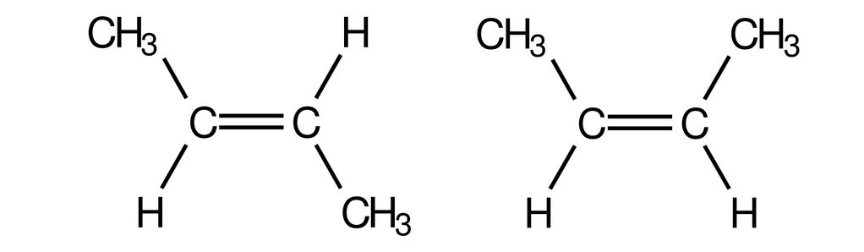
Isomers
Geometrical isomers
Restricted rotation about the carbon-to-carbon double bond results in a type of stereoisomerism called geometrical isomerism. This is often called E-Z isomerism (previously called cis/trans isomerism). In geometrical isomerism, the structural formulae are the same, but the bonds are arranged differently in space.
E = Entgegen = opposite
Z = Zusammen = together
This is the Cahn-Ingold-Prelog naming system
E-but-2-ene
Z-but-2-ene

Slide 10
Cahn-Ingold-Prelog notation
For an alkene to exhibit E-Z isomerism, there must be two DIFFERENT atoms/groups attached to each carbon atom of the double bond. Taking each carbon atom in turn, we assign a priority, based upon atomic number, as shown in the table opposite. Next, if both High priority atoms are on the same side of the double bond, it is the Z-isomer. If they are opposite, then it is the E-isomer.
H₃C
Cl
C=C
H
Br
Atom attached | Atomic number | Priority
C (from CH₃) | 12 | HIGH
H | 1 | LOW
Cl | 17 | LOW
Br | 35 | HIGH
Since the high priority atoms are on OPPOSITE sides of the double bond, this is the E-isomer; i.e. E-1-bromo-1-chloroprop-1-ene

Slide 11
Cahn-Ingold-Prelog notation
H₃C
CH₂Cl
In order to assign priority for larger groups, we must look for the first point of difference as we move along the chain. It is NOT the whole group which is considered for priority, but atom by atom until a difference occurs. So, -CH₂Cl has a higher priority than -CH₂CH₂Cl (first point of difference)
Hydrogen atoms will ALWAYS be a LOW priority.
C=C
H
CH₂CH₂Cl
Atom attached | Atomic number | Priority
C (from CH₃) | 12 | HIGH
H | 1 | LOW
C (from CH₂CH₂Cl) | 12 | LOW
Cl (from CH₂Cl) | 17 | HIGH
Since the high priority atoms are on the SAME side of the double bond, this is the Z-isomer; i.e. Z-3-(chloromethyl)-5-chloropent-2-ene

Slide 12
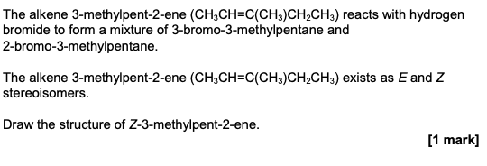
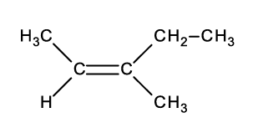
Try this ….

Slide 13
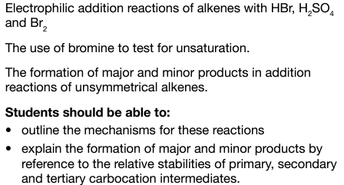
3.3.4.2 Addition reactions of alkenes

Slide 14
Electrophilic addition
Most of the reactions of alkenes are ELECTROPHILIC ADDITION reactions. This is due to the C=C bond being an electron-rich region of the molecule. This renders it susceptible to attack from electron pair acceptors – called ELECTROPHILES. An electrophile may have a formal positive charge, such as the H⁺ ion, or a partial positive charge, for example in a polar bond, e.g. H^{δ+} Br ^{δ-} , or an induced partial charge (see Br₂ later).
The general mechanism involves;
Electrophile accepts a pair of π-electrons from the double bond,
A carbocation (positive charge on carbon) intermediate forms,
A negatively charged species forms a bond with the carbocation.

Slide 15
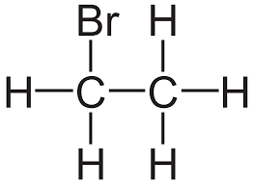
Electrophilic addition of HBr to ethene
H^{δ+} Br^{δ-}
:Br⁻
+
Pair of pi-electrons in the double bond form a new bond with the H atom and cause the electron pair between the H and Br to move to the Br atom (heterolytic cleavage).
A carbocation intermediate is formed and the lone pair on the bromide ion rapidly forms a new bond with the positively charged carbon.
NB
A curly arrow represents the movement of a PAIR of electrons and always originates from a bond or a lone pair of electrons. Always be accurate in drawing curly arrows.

Slide 16
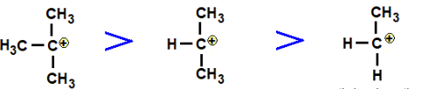
Electrophilic addition of HBr to propene
Unlike ethene, propene is unsymmetrical about the double bond. This results in the formation of two products upon the addition of HBr (and other electrophiles). One of these is favoured over the other and therefore we obtain a major and minor product. The major product is the one which is formed via the most stable carbocation intermediate.
According to MARKOVNIKOV’s rule, the H atom of HBr will preferentially add to the carbon atom in the double bond with the most H atoms already attached. This is because a tertiary carbocation is more stable than a secondary, which is more stable that a primary carbocation.
3°
2°
1°

Slide 17
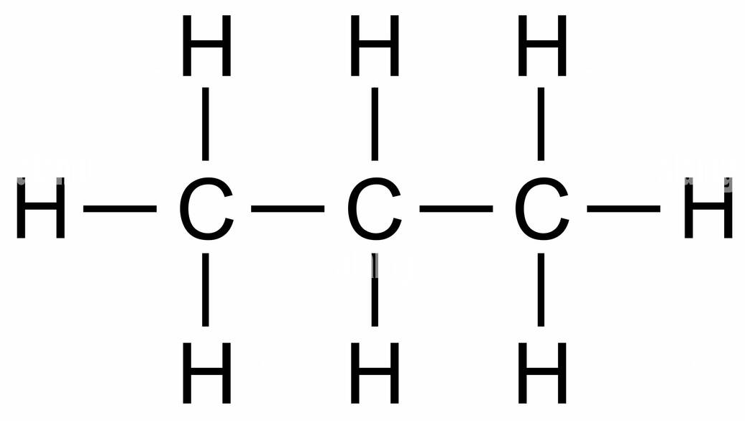
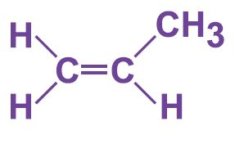
Electrophilic addition of HBr to propene
H
>
Carbocation for MINOR
PRODUCT
+
+ H-Br
:Br⁻
Carbocation for MAJOR
PRODUCT
H
>
>
+
:Br⁻

Slide 18
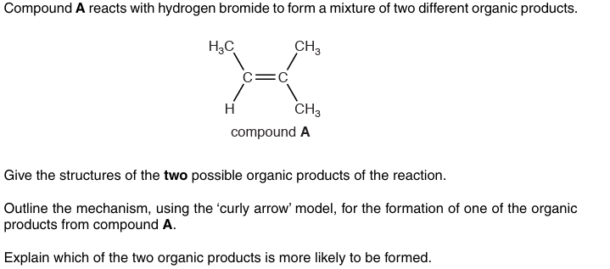
Try this for 6 marks

Slide 19
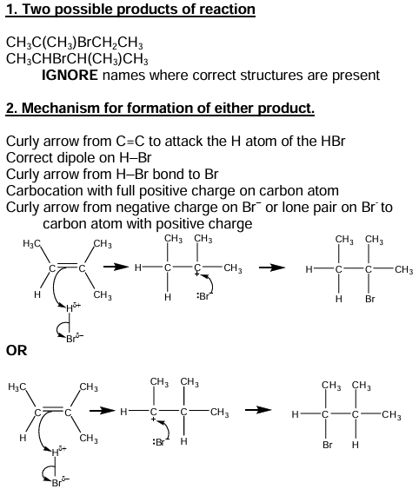
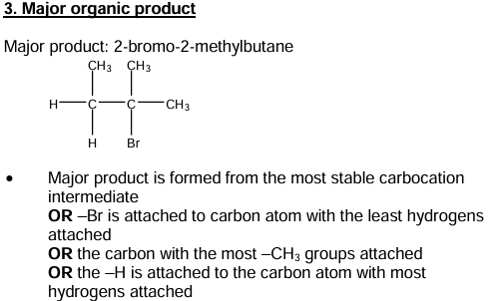
Answer (6 marks)

Slide 20
Electrophilic addition of conc. H₂SO₄ to an alkene
Concentrated sulphuric acid will react with an alkene via the usual electrophilic addition mechanism (see next slide). Markovnikov’s rule is obeyed in the usual way for asymmetrical alkenes. When water is added to the produce, an alcohol is formed and the sulphuric acid reforms (acts as a catalyst).
In industry, water (in the form of steam) may also add across the double bond in the presence of an acid catalyst (conc. phosphoric acid) to form alcohols.

Slide 21
Mechanism for propene + sulphuric acid
H
(Major product only is shown, however minor product is also formed)
+
^{δ+}H O^{δ-} SO₃H
:⁻OSO₃H
H
+ H₂O
Propan-2-ol + sulphuric acid
OSO₃H

Slide 22
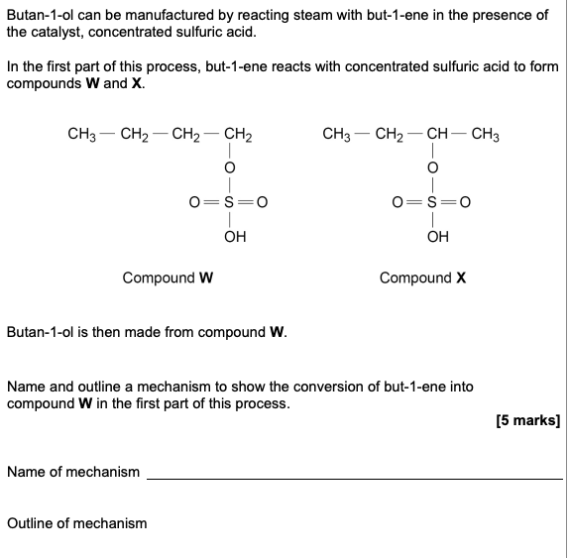
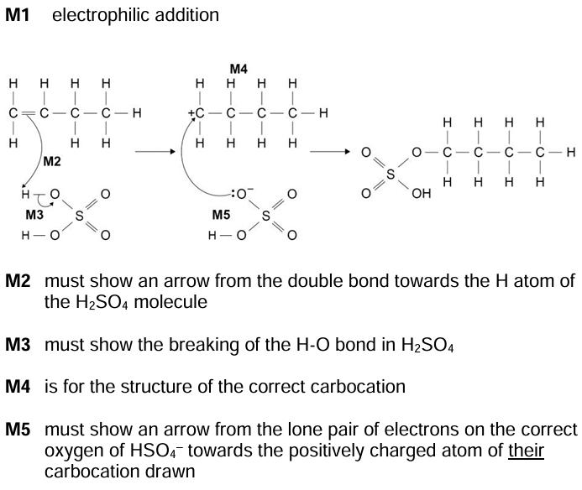
Try this ……..

Slide 23
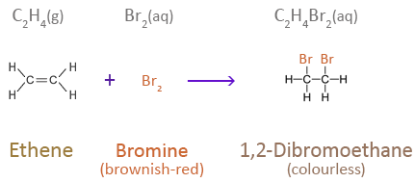
Test for alkenes (unsaturated compounds)
If an alkene is shaken with bromine water, the orange colour of the bromine water goes colourless since a dibromo compound forms via electrophilic addition across the carbon to carbon double bond.
Orange

Slide 24

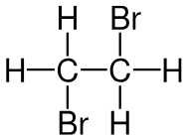
Test for alkenes (C=C) – Shake with bromine water
Br^{δ+} Br^{δ-}
ORANGE
COLOURLESS
:Br⁻
+
The electron cloud in the double bond repel the electron in the Br₂ causing an induced dipole. Reaction then proceeds in the same way as addition of HBr.
A carbocation intermediate is formed and the lone pair on the bromide ion rapidly forms a new bond with the positively charged carbon.
The dibromo product is colourless.

Slide 25
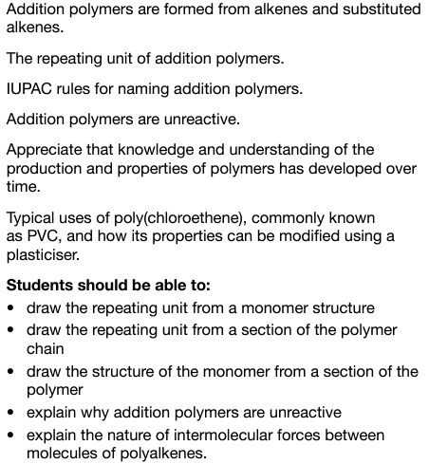
3.3.4.3 Addition polymers

Slide 26
Polymerisation
When ADDITION polymerisation occurs, the double bonds between the carbon atoms break, and single bonds form between the monomers forming long chains. The separate monomers ADD together with no other products formed.
Another type of polymerisation called CONDENSATION polymerisation is discussed in Year 13 (A2).

Slide 27
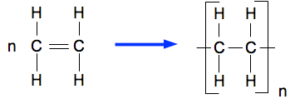
Alkene monomers
POLYMERS are large molecules made by the joining together of many small MONOMERS. They may be natural polymers such as proteins (made up of amino acids), or synthetic, such as PVC. Here we introduce simple ethene-based synthetic (addition) polymers. The simplest monomer is ethene;
Monomer - Ethene Polymer - Polyethene

Slide 28
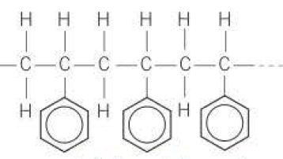
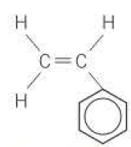
Polymer, monomer and repeat unit
It is important that, when given an addition polymer, we are able to identify the initial monomer and repeat unit for the given polymer. It is also necessary to identify the polymer from its monomer/repeat unit
REPEAT UNIT
OR
Poly(phenylethene)
MONOMER

Slide 29
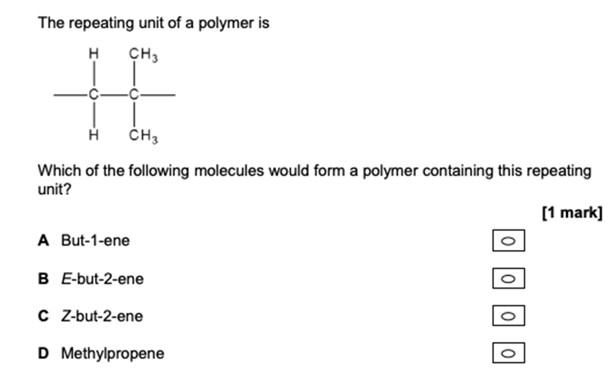
Try this …...

Slide 30
Modifying the properties of plastics
As well as by changing the R-group of the monomers, additives (such as plasticisers) may be used to modify the properties of plastics.
These small molecules get between the polymer chains, disrupting the intermolecular forces, enabling them to slide across one another. For example, both plastic bags and drainpipes may be made from PVC, by modification with plasticisers.
The properties of poly(ethene) may also be modified by changing the method of manufacture. High density polythene is made at lower temperatures and pressures than high density polythene by using a Ziegler-Natta catalyst.
R

Slide 31
Modifying the properties of plastics
When high temperatures and pressures are used to manufacture low density polythene, a free radical mechanism occurs, resulting in more branching and therefore less-tightly packing together of the polymer chains. This type of polyethene is used to make plastic bags.
Conversely, less branching, which resulted from the lower temperatures and pressures facilitated by a catalyst, enables the polymers to pack together more tightly resulting in a high density polyethene. This is used for harder products such as plastic buckets.

Slide 32
Environmental issues
Since addition polymers consist of very long alkyl chains, they are not susceptible to biodegradation form the action of agents such as enzymes. Also, the carbon-carbon single bonds are strong and non-polar as are the C-H bonds. As with alkanes, this makes them very unreactive. A consequence of these features is that they tend to remain in the environment long after their useful lifespan. One way of reducing the impact of plastics on the environment is to recycle them.
Mechanical recycling
Once sorted and washed, some plastics may be ground into small pellets, which can then be melted and remolded into new products. This may only be carried out a number of times before the plastics properties become too degraded

Slide 33
Environmental issues
2. Feedstock recycling
The polymer bonds may be broken, producing monomers, by heating the plastics to a certain temperature. These can then form a feedstock to make new plastics.

Slide 34
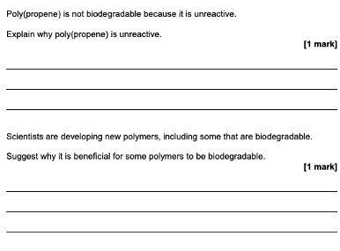
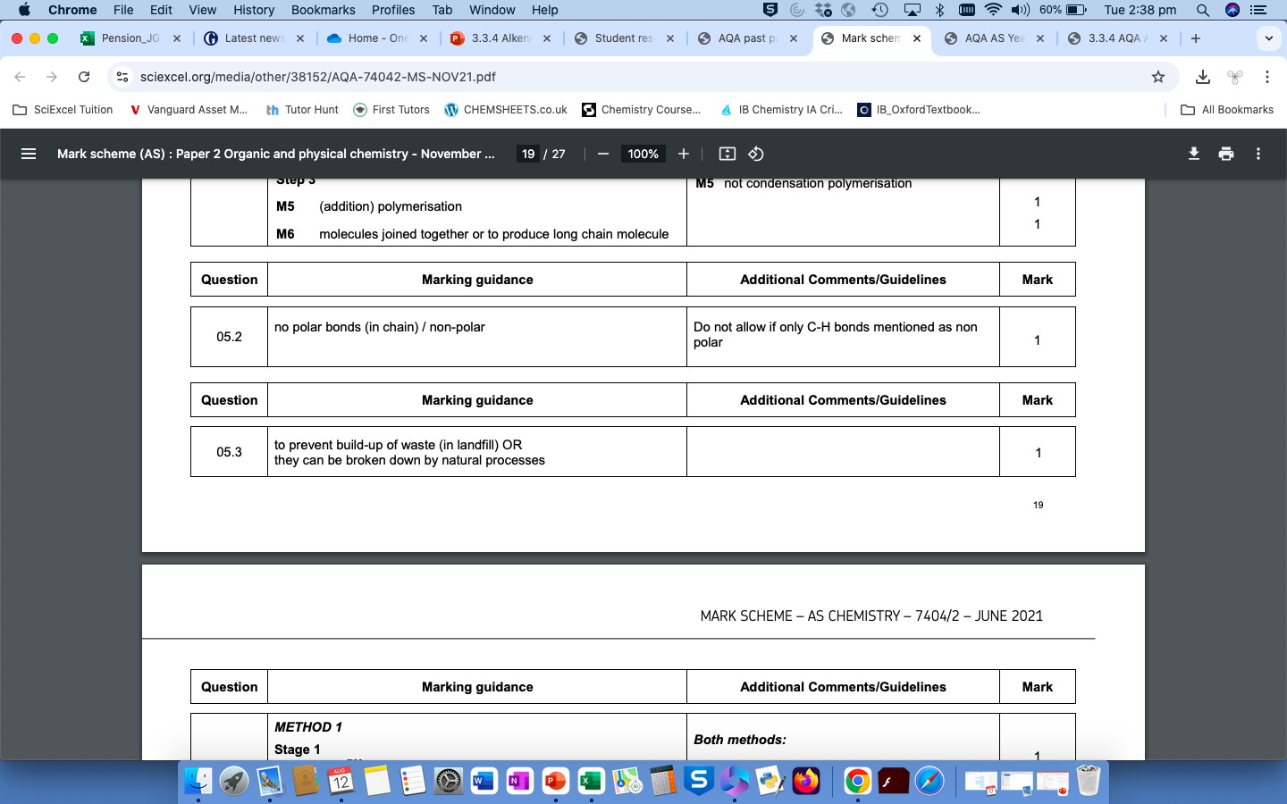
Try this …...

