Slide 1


Organic Chemistry Year 1 - AS
3.3.5 Alcohols
Dr John R Griffiths
SciExcel Tuition
www.sciexcel.org

Slide 2
Organic Chemistry Year 1
3.3.5 Alcohols
Alcohols have many scientific, medicinal and industrial uses. Ethanol is one such alcohol and it is produced using different methods, which are considered in this section. Ethanol can be used as a biofuel.

Slide 3
3.3.5 Alcohols
3.1.5.1 Alcohol production
3.1.5.2 Oxidation of alcohols
3.1.5.3 Elimination

Slide 4
General Introduction – Naming alcohols
Alcohols have the general formula C_{n}H_{2n+1}OH, or sometimes ROH. They are named in a similar way to alkanes, but with the suffix –OL, rather than –ane.
e.g. ethanol (C₂H₅OH). If more than one position of the –OH group is possible, then the carbon number of attachment must be given, e.g.
CH₃CH₂CH₂OH propan-1-ol
CH₃CH(OH)CH₃ propan-2-ol
If more than one –OH groups are present, the number and positions must be specified, e.g.
CH₂(OH)CH(OH)CH₂(OH) propane-1,2,3-triol

Slide 5
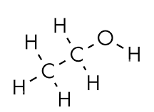
General Introduction – Shape and properties
Alcohols have an approximate bond angle around the C-O-H of 1O4.5º as a result of the two lone pairs on the oxygen atom (similar to the shape of H₂O i.e. V-shaped/bent)
Since alcohols possess the –OH group, they are capable of forming hydrogen bonds with themselves and with other suitable molecules, such as water.
This hydrogen bonding results in higher melting and boiling points compared to alkanes of a similar RMM.
Hydrogen bonding with water molecules enables the shorter chain alcohols to be soluble in water, however, longer chain alcohols become less soluble since the non-polar chain begins to dominate.

Slide 6
General Introduction – Classification
Alcohols may be classified as either primary, secondary or tertiary alcohols, depending upon how many other R-groups are attached to the carbon atom bonded to the –OH.
In addition to methanol, alcohols with only the one R group are primary (1º) e.g. pentan-1-ol
CH₃CH₂CH₂CH₂CH₂OH. The –OH is at the end of a chain.
Two substitutions results in a secondary (2º)alcohol e.g. pentan-2-ol
CH₃CH(OH)CH₂CH₂CH₃. The –OH is in the chain body.
Three R-groups attached to the carbon atom gives rise to a tertiary (3º) alcohol
e.g. 2-methylbutan-2-ol
CH₃CH₂C(OH)(CH₃)₂.
The –OH group is attached at a branch point in the chain.

Slide 7
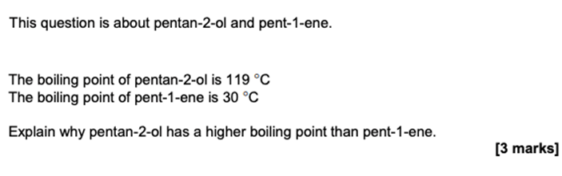
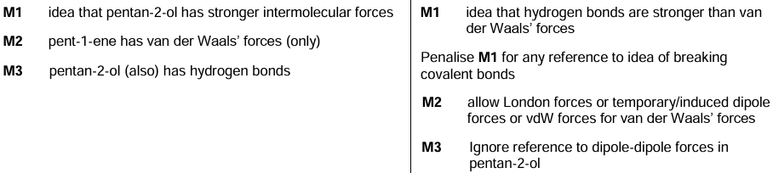
Example question

Slide 8
3.3.5.1 Alcohol production
Alcohols are produced industrially by hydration of alkenes in the presence of an acid catalyst.
Ethanol is produced industrially by fermentation of glucose. The conditions for this process are required. Ethanol produced industrially by fermentation is separated by fractional distillation and can then be used as a biofuel.
Students should be able to:
Explain the meaning of the term biofuel
Justify the conditions used in the production of ethanol by the fermentation of glucose.
Write equations to support the statement that ethanol produced by fermentation is a carbon-neutral fuel and give reasons why this statement is not valid
Outline the mechanism for the formation of an alcohol by the reaction of an alkene with steam in the presence of an acid catalyst
Discuss the environmental (including ethical) issues linked to decision making about biofuel use.

Slide 9
Ethanol via fermentation
At around 35°C and under ANAEROBIC respiration conditions (exclusion of oxygen), enzymes in yeast are able to convert the sugars from plant-derived carbohydrates (sugar beet or sugar cane), into ethanol by the slow process of fermentation. The ethanol produced may then be distilled from the fermentation mixture as its boiling point (78°C) is much lower than that of water.
The equation for this method of ethanol production is;
C₆H₁₂O_{6(aq)} --> 2C₂H₅OH_{(aq)} + 2CO_{2(g)}
glucose

Slide 10
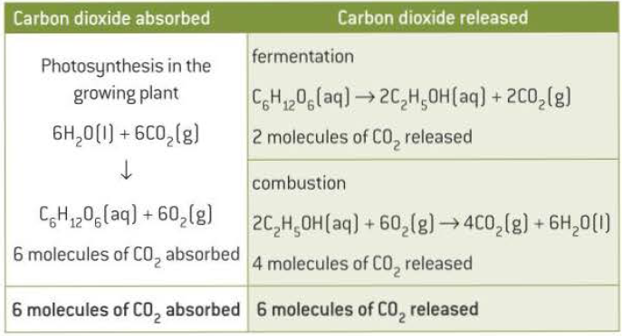
Is ethanol produced by fermentation a carbon neutral fuel source?
From the table opposite it can be seen that the number of molecules of CO₂ released by the fermentation process plus the combustion of ethanol (6 molecules), is equal to the number of molecules of CO₂ absorbed by the original plant (sugar) source for the fermentation. This suggests that this is a carbon neutral source.
However, this does not include other carbon dioxide releases during the transportation of the crops and fuel. It cannot therefore be said to be carbon neutral.

Slide 11
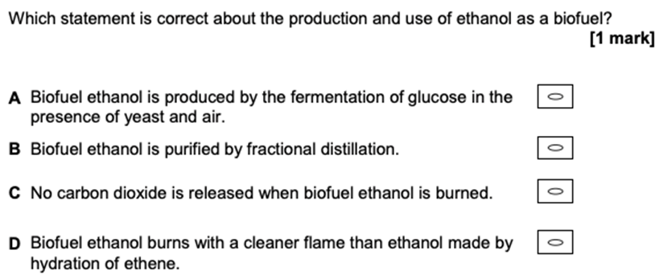
Example question

Slide 12
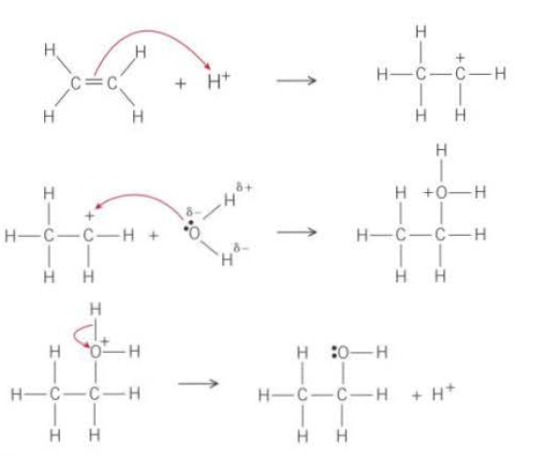
Ethanol from crude oil
Hydration of ethene, with phosphoric acid as catalyst, is used industrially to produce ethanol. The ethene feedstock is generally produced by cracking of crude oil fractions. This is a non-renewable resource.
By DEHYDRATING ethanol made by fermentation, ethene can be produced as a BIOFUEL (fuel made from a RENEWABLE biological source). (see later Elimination section)

Slide 13
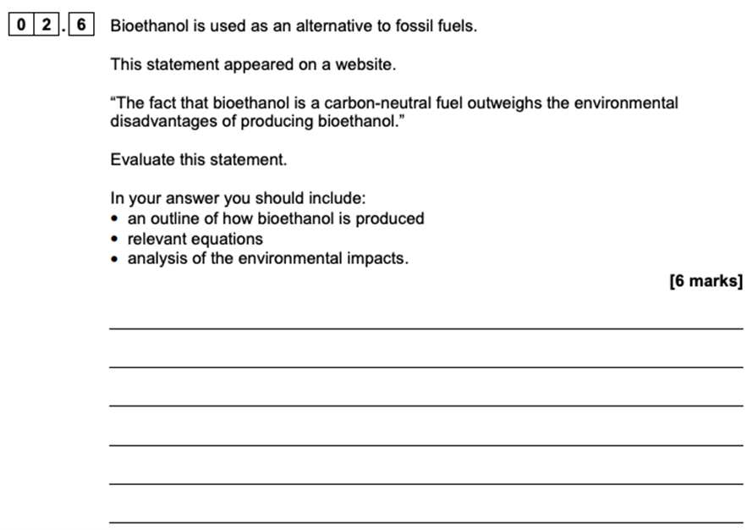
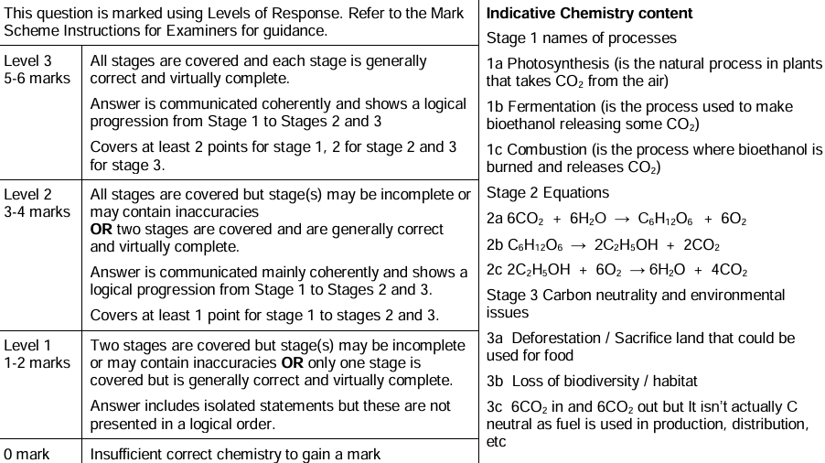
Example question

Slide 14
3.3.5.2 Oxidation of alcohols
Alcohols are classified as primary, secondary and tertiary.
Primary alcohols can be oxidised to aldehydes which can be further oxidised to carboxylic acids.
Secondary alcohols can be oxidised to ketones.
Tertiary alcohols are not easily oxidised.
Acidified potassium dichromate (VI) is a suitable oxidising agent.
Students should be able to:
Write equations for these oxidation reactions (equations showing [O] as oxidant are acceptable)
Explain how the method used to oxidise a primary alcohol determines whether an aldehyde or carboxylic acid is obtained
Use chemical tests to distinguish between aldehydes and ketones including Fehling's solution and Tollen's reagent

Slide 15
Oxidation of alcohols
The complete combustion of alcohols results in the formation of the two products of carbon dioxide and water (complete oxidation).
e.g. C₄H₉OH + 6O₂ → 4CO₂ + 5H₂O
Alcohols may also be partially oxidised in stages using less harsh conditions. The oxidising agent, acidified potassium dichromate (VI), K₂Cr₂O₇, is often used for this.
Primary alcohols are oxidised firstly to aldehydes, then further to carboxylic acids.
Secondary alcohols are oxidised to ketones, and no further.
Tertiary alcohols are not readily oxidised.

Slide 16
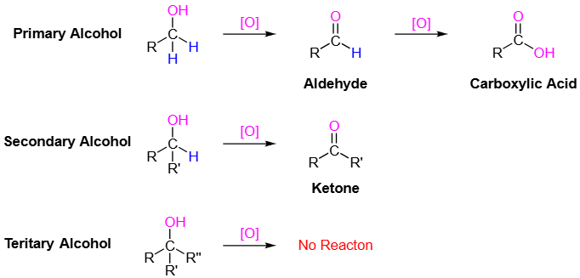
Oxidation of primary alcohols to aldehydes
Primary alcohol
+ H₂O
Aldehyde
To oxidise ethanol (a primary alcohol) to ethanal (an aldehyde), acidified potassium dichromate is heated with the ethanol in a round-bottomed or pear-shaped flask. A few anti bumping granules are added to allow small bubbles to form at their surface thus preventing large bubbles which may cause the apparatus to bump.
Dilute sulphuric acid is used and a limited amount of the dichromate, such that the ethanol is in excess. This helps to prevent further oxidation to ethanoic acid. Since ethanal boils at 21°C, it is distilled off from the mixture as it is formed. This also prevents further oxidation to ethanoic acid. [O] is used to represent the oxidising agent;
CH₃CH₂OH_{(l)} + [O] → CH₃CHO_{(g)} + H₂O_{(l)}

Slide 17
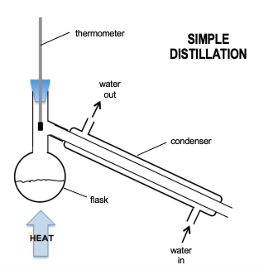
Distillation
In order to prevent the formation of a carboxylic acid by further oxidation of the aldehyde formed by oxidation of a primary alcohol, the aldehyde product is distilled from the reaction mixture using the apparatus shown.
water
out
water in

Slide 18
Oxidation of primary alcohols to carboxylic acids
Primary alcohol
2
+ H₂O
Carboxylic acid
To oxidise ethanol (a primary alcohol) to ethanoic acid (a carboxylic acid), excess acidified potassium dichromate is heated with the ethanol with concentrated sulphuric acid being used to help ensure complete oxidation to ethanoic acid. The mixture is also heated under reflux such that any volatile vapour (aldehyde) is returned to the reaction flask for further oxidation.
CH₃CH₂OH_{(l)} + 2[O] → CH₃COOH_{(l)} + H₂O_{(l)}

Slide 19
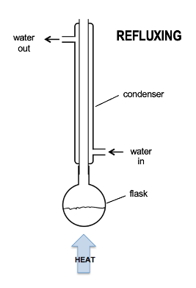
Reflux
To ensure further oxidation of a primary alcohol to form a carboxylic acid, a reflux system, using the apparatus opposite, is used which "returns" any aldehyde formed to the reaction vessel for further oxidation.
Reflux is also used for the complete reaction (via oxidation) of secondary alcohols to form ketones (see next slide).

Slide 20
Oxidation of secondary alcohols to ketones
Secondary alcohol
+ H₂O
Ketone
To oxidise a secondary alcohol to a ketone, the same reaction conditions and apparatus are used as for the complete oxidation of primary alcohols to carboxylic acids above.
e.g. for propan-2-ol to propanone;
CH₃CH(OH)CH₃ + [O] → CH₃COCH₃ + H₂O

Slide 21
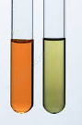
Test for alcohols (primary and secondary)
Primary and secondary alcohols may be oxidised by heating with acidified potassium dichromate (K₂Cr₂O₇). The chromium ions are subsequently reduced from the orange +6 oxidation state to green Cr³⁺. This will also happen with aldehydes (being oxidised to carboxylic acids), but NOT with tertiary alcohols.

Slide 22
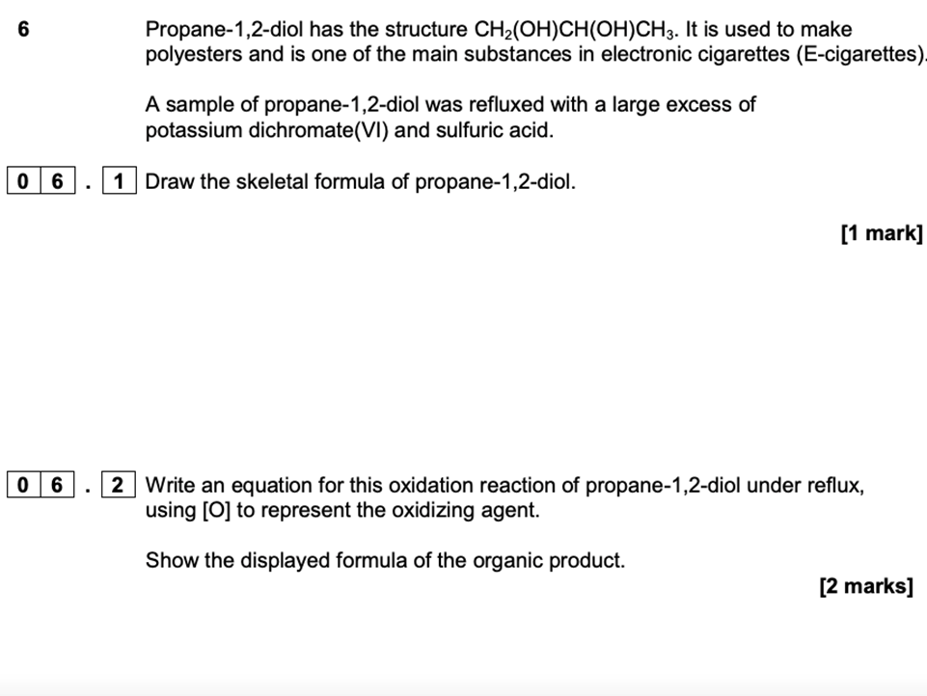
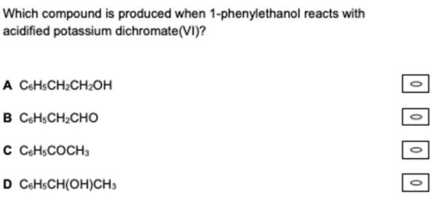
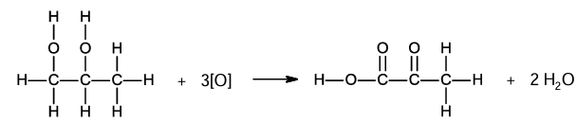

Example question

Slide 23
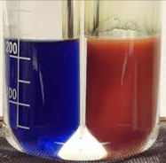
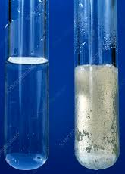
Distinguishing between aldehydes and ketones
Aldehydes may be identified (and distinguished from ketones) by one of two methods, which both involve their gentle oxidation.
Fehling's solution
When warmed with Fehling's solution the blue Cu²⁺ is reduced to Cu⁺, which is a brick-red precipitate (Cu₂O).
2. Tollen's reagent
A silver mirror is formed on the inside of a test tube when an aldehyde is warmed with Tollen's reagent. Ag⁺ ions are reduced to silver metal.

Slide 24
3.3.5.3 Elimination
Alkenes can be formed from alcohols by acid-catalysed elimination reactions
Alkenes produced by this method can be used to produce addition polymers without using monomers derived from crude oil
Students should be able to outline the mechanism for the elimination of water from alcohols.
Required practical 5
Distillation of a product from a reaction

Slide 25
Acid-catalysed dehydration
As well as the oxidation reactions already discussed, certain alcohols may undergo elimination of a water molecule (DEHYDRATION), resulting in the formation of one or more alkenes. In order for this type of elimination reaction to occur, there must by a hydrogen atom attached to a carbon adjacent to the carbon atom with the –OH group attached.
-C--C-
C C
H₂O
-C--C-
-C--C-
+
+
+
H⁺
H
:OH
H
O H
H
+
H
H⁺
(from hot conc. H₂SO₄ or H₃PO₄)

Slide 26
Elimination conditions
Dehydration of an alcohol to alkene often involves an acid catalyst. This is either concentrated sulphuric acid or concentrated phosphoric acid. Heat is also required so the reaction is typically performed at around 180° C.
As an alternative to an acid catalyst, and the method typically used in the school laboratory, the alcohol may be heated in a test tube and the vapour passed over aluminium oxide (Al₂O₃) granules at a temperature of 600 K.
When ethene is made by dehydrating ethanol which is produced by the fermentation of sugars, it is said to be from a renewable source, i.e. unlike when it is made from crude oil.

Slide 27
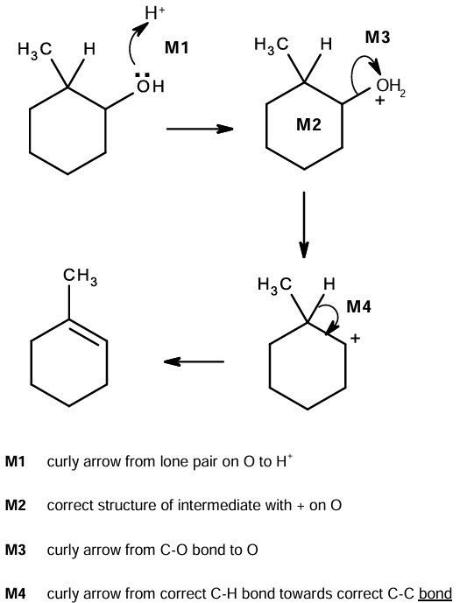
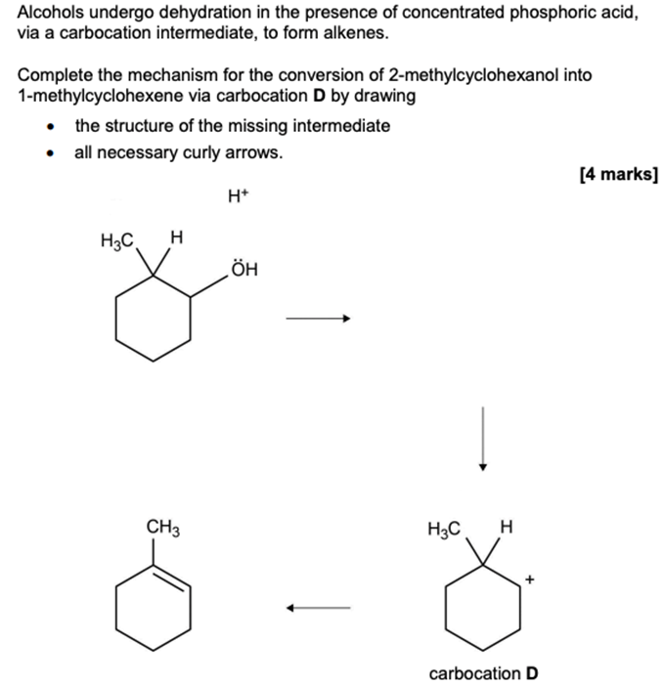
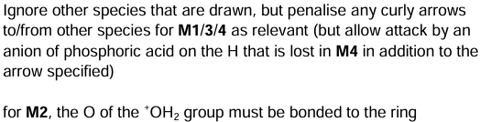
Example question

