Slide 1


Organic Chemistry Year 1 - AS
3.3.6 Organic analysis
Dr John R Griffiths
SciExcel Tuition
www.sciexcel.org

Slide 2
Organic Chemistry Year 1
3.3.6 Organic analysis
Our understanding of organic molecules, their structure and the way they react, has been enhanced by organic analysis. This section considers some of the analytical techniques used by chemists, including test-tube reactions and spectroscopic techniques.

Slide 3
3.3.6 Organic analysis
3.1.6.1 Identification of functional groups by test tube reactions
3.1.6.2 Mass spectrometry
3.1.6.3 Infrared spectroscopy

Slide 4
3.3.6.1 Identification of functional groups by test tube reactions
The reactions of functional groups listed in the specification.
Students should be able to identify the functional groups using reactions in the specification.
--------------------------------------------------------------------------------------------------------------------
Required practical 6
Tests for alcohol, aldehyde, alkene and carboxylic acid.

Slide 5
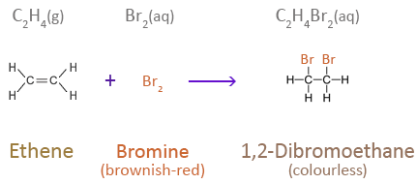
Test for alkenes (unsaturated compounds)
If an alkene is shaken with bromine water, the orange colour of the bromine water goes colourless since a dibromo compound forms via electrophilic addition across the carbon to carbon double bond.
Orange

Slide 6
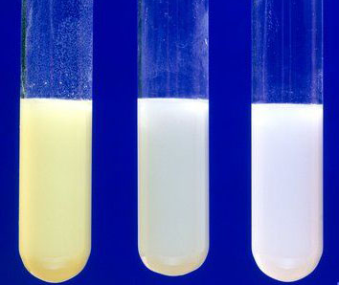
Test for halogenoalkanes
Warming with aqueous NaOH will release the halide ion from a halogenoalkane (via nucleophilic substitution). The identity of the halide may then be determined using the AgNO₃ test i.e. acidify with nitric acid and add silver nitrate solution. A silver halide precipitate will form, the colour of which indicates the halide
AgCl = White
AgBr = Cream
AgI = Yellow
Ammonia solution may then be used to confirm, since the chloride will dissolve in dilute ammonia solution and the bromide dissolves in concentrated ammonia solution. AgI does not dissolve in either.
AgI AgBr AgCl

Slide 7
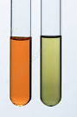
Test for alcohols (primary and secondary)
Primary and secondary alcohols may be oxidised by heating with acidified potassium dichromate (K₂Cr₂O₇). The chromium ions are subsequently reduced from the orange +6 oxidation state to green Cr³⁺. This will also happen with aldehydes (being oxidised to carboxylic acids), but NOT with tertiary alcohols.

Slide 8
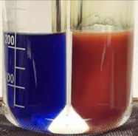
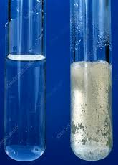
Test for aldehydes
Aldehydes may be identified (and distinguished from ketones) by one of two methods, which both involve their oxidation.
Fehling's solution
When warmed with Fehling's solution the blue Cu²⁺ is reduced to Cu⁺, which is a brick-red precipitate (Cu₂O).
2. Tollen's reagent
A silver mirror is formed on the inside of a test tube when an aldehyde is warmed with Tollen's reagent. Ag⁺ ions are reduced to silver metal.

Slide 9
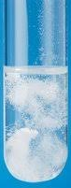
Test for carboxylic acids
From GCSE we know that;
acid + metal carbonate --> salt + water + carbon dioxide
Therefore, if we add a metal carbonate to a carboxylic acid, the CO₂
produced will cause effervescence.
The test for carboxylic acids is therefore to add a small amount of sodium carbonate/ sodium hydrogen carbonate solution, and test for CO₂

Slide 10
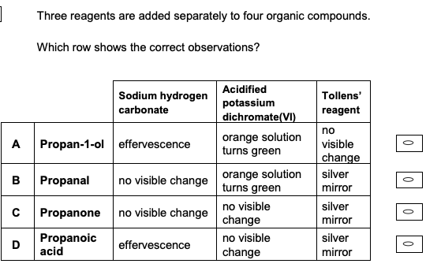
Quick test

Slide 11
3.3.6.2 Mass spectrometry
Mass spectrometry can be used to determine the molecular formula of a compound.
Students should be able to use precise atomic masses and the precise molecular mass to determine the molecular formula of a compound.

Slide 12


Ionisation - recap
In order for a molecule to be analysed by mass spectrometry, it must firstly be converted to an ion. For A-level, this is achieved in one of two ways;
Electrospray ionization (ESI)
The sample is dissolved in a volatile solvent (such as methanol) and injected through a narrow-bore metal needle with a high, positive voltage applied (1-3 kV). On being vapourised, each molecule gains a proton (H⁺ ion) from the solvent, to give a molecular ion [M+H]⁺, which is 1 mass unit above its M_{r}. Little fragmentation occurs since this is a relatively “soft” ionization technique.
Particles gain a proton as they leave the needle
Sample in volatile solvent
Positive ions are accelerated by a negative electric plate
Needle attached to positive terminal of high-voltage power supply
© www.chemsheets.co.uk

Slide 13
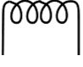
Ionisation - recap
An electron is knocked off each particle by the high-energy electrons to form 1+ ions
2. Electron Impact (EI)
Positive ions are accelerated by a negative electric plate
M_{(g)} → M⁺_{(g)} + e⁻
Sample is first vapourised
A heated filament emits a beam of high energy electrons (electron gun)
The gas-phase sample passes through the beam and becomes ionised by losing an electron
Electron gun
(hot wire filament)

Slide 14
The mass spectrum
100
A mass spectrum consists of a plot of ion current against the mass-to-charge ratio. The y-axis is usually normalized to 100%.
Under electron impact (EI) ionization conditions, the ion furthest to the right of the spectrum (molecular ion) is equal to the molecule’s M_{r} value – provided it is singly charged.
Relative abundance/%
Molecular ion
Fragment ions
¹³C isotope ion peak
0
10
50
m/z
A small ion is sometimes observed to the right of this (1 mass unit higher). This is due to the ¹³C isotope. Due to the high energy involved in EI, the molecule may also experience some fragmentation. These can aid in the identification of the molecule. The largest ion (100 %) is called the Base Peak. Under electrospray conditions, the molecular ion is an [M+H]⁺ ion.

Slide 15
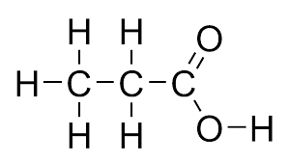
Fragmentation
Fragmentation of the molecular ion often occurs during electron impact ionisation due to the high energy of the ionising electrons. This fragmentation preferentially occurs at weaker (more labile) bonds and results in two radicals (i.e. with unpaired electrons), one of which carries the positive charge. Fragmentation patterns may sometimes aid in structure confirmation or enable isomer differentiation.
+
Possible fragment ion formation
+
m/z = 15
+
m/z = 29
Molecular ion
+
m/z = 74
m/z = 45

Slide 16
High resolution mass spectrometry
Although molecular ions (and fragment ions) in mass spectra are often displayed as a whole number, many modern, high-resolution instruments, are capable of a much higher level of precision. It is not unusual for mass spectrometers to be able to analyse ions to four decimal places.
Since;
Relative atomic mass is the weighted average mass of an atom of an element, taking into account its naturally occurring isotopes, relative to 1/12 the relative atomic mass of an atom of carbon-12.
Therefore, the “exact” masses are RAM of C = 12.00000 (by definition), RAM of H = 1.007829 and RAM of O = 15.99491
This means we are able to distinguish between many molecules with the same nominal M_{r}.
E.g.
Butane C₄H₁₀ Nominal Mr = 58 Accurate Mr = 58.07829
Propanal C₃H₆O Nominal Mr = 58 Accurate Mr = 58.04189

Slide 17
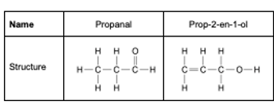
Quick test
Name
Propanal
Prop-2-en-1-ol
Structure
Explain why determining the precise relative molecular mass of propanal and prop-2-en-ol by mass spectrometry could not be able to distinguish between samples of these two compounds. [2 marks]
Both compounds have the same molecular formula and therefore the same exact mass

Slide 18
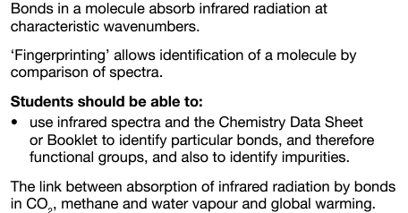
3.3.6.3 Infrared spectroscopy

Slide 19

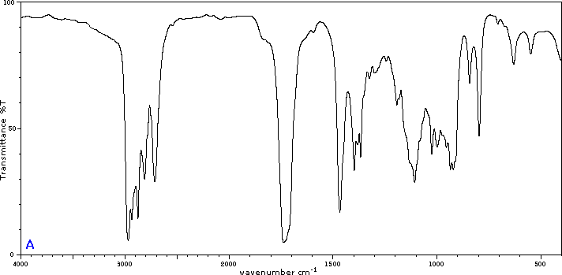
Basic theory of IR spectroscopy
Chemical bonds within compounds naturally vibrate at a unique frequency corresponding to the infra-red region of the electromagnetic spectrum. The bonds are analogous to springs, and when they are irradiated with energy of the correct wavelength (and therefore frequency) they absorb some of the energy and vibrate faster (resonate). Different bonds vibrate at different frequencies and may therefore by identified using infrared spectroscopy.
sample
detector
source

Slide 20
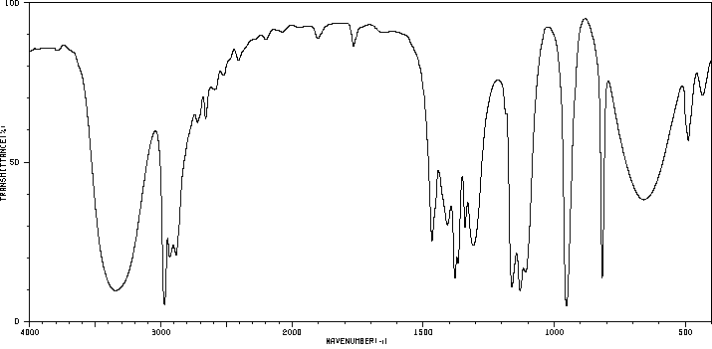
IR spectral interpretation
An IR spectra is a plot of % Transmittance vs wavenumber. It can be thought of as consisting of two regions. Above 1500 cm⁻¹ is where absorption bands associated with functional groups are (mainly) located, whereas, below 1500 cm⁻¹ is called the Fingerprint Region.
Fingerprint region
Can be used to check for purity.
Compare to a database for ID.
Distinguish certain isomers.
Functional groups
Fingerprint region

Slide 21
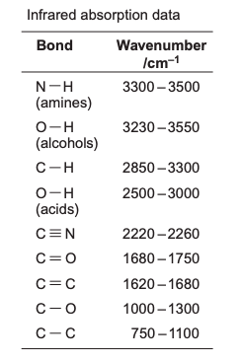
IR spectral interpretation
Functional groups
Firstly, look for a very large peak in the centre (1680-1750). This indicates the C=O bond. Care should be taken not to confuse with C=C which is much smaller and at slightly lower wavenumber.
Next, examine the region around 3000 cm⁻¹. See next slide for clarification.
Finally, check for nitrile at 2220-2260 cm⁻¹.
C-H bond is present in (almost) all organic compounds and should not be confused with anything else.

Slide 22
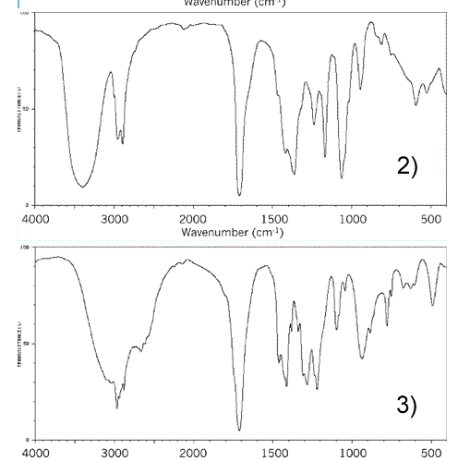
IR spectral interpretation
Distinguishing between a carboxylic acid (COOH) group and a compound with both a carbonyl (C=O) and a hydroxy group (-OH), e.g. between propanoic acid and hydroxypropanone.
Both have a strong peak in the centre at approximately 1700 cm⁻¹. This is caused by the C=O bond.
The top spectrum has a broad peak at approximately 3400 cm⁻¹ which corresponds to a O-H bond in alcohols. This peak is separated from the C-H band at 2900 cm⁻¹.
The lower spectrum also has a broad peak to the left side of the spectrum, but this is broader and occurs at approximately 3000 cm⁻¹. This is an acidic O-H bond. Note also, that it merges with the C-H band.
NB – The C-H band is present in (virtually) all organic compounds and may act as a helpful marker.
C-H
C-H

Slide 23
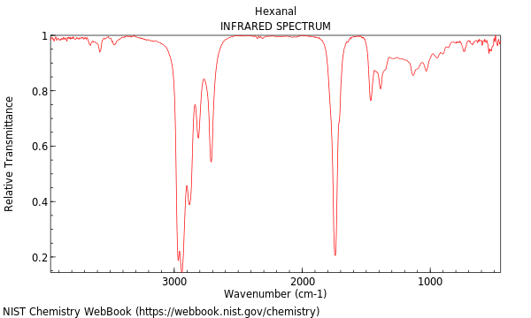
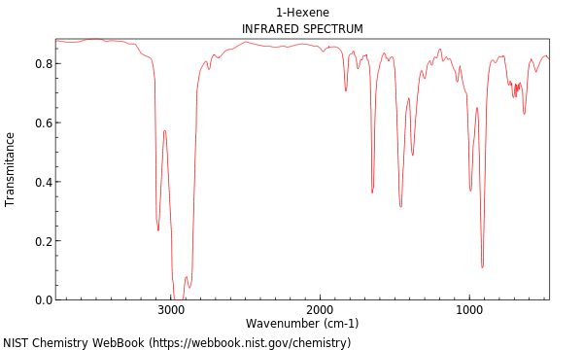
IR spectral interpretation
Distinguishing between a carbonyl (C=O) and an alkene (C=C) may sometimes be tricky.
Both have a peak close to 1700 cm⁻¹, although the C=C absorbance tends to be at a slightly lower wavenumber. The C=O absorbance is also very strong compared to the C=C absorbance
C=C
C=O
1700 cm⁻¹
1700 cm⁻¹

Slide 24
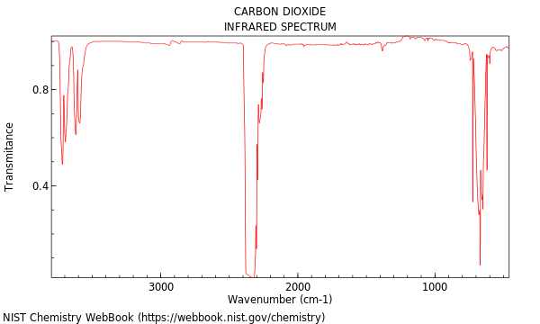
IR absorption and global warming
Certain gases present in the Earth’s atmosphere contain bonds which interact with infra-red radiation. Major greenhouse gases include carbon dioxide, methane and water vapour. Infra-red (heat) energy, re-emitted from the Earth’s surface, is absorbed by bonds such as the O=C=O bonds in carbon dioxide, preventing it escaping to space. This results in an increase in the overall global temperature. We know that the C=O bond in organic compounds resonates at around 1700 cm⁻¹, whereas the main absorbance for the C=O bonds in carbon dioxide is a little higher.

Slide 25
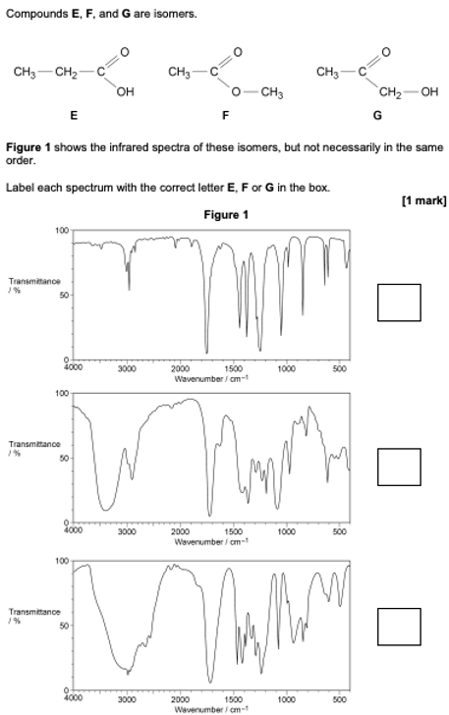
Quick test
F
G
E

