Slide 1


AQA Past paper questions
3.1.2 Amount of substance
Dr John R Griffiths
SciExcel Tuition

Slide 2
AS Papers

Slide 3
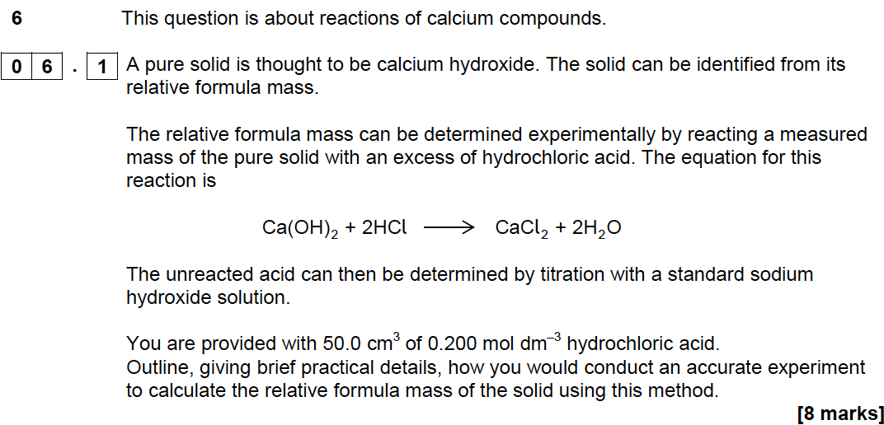
Specimen AS Paper 1

Slide 4
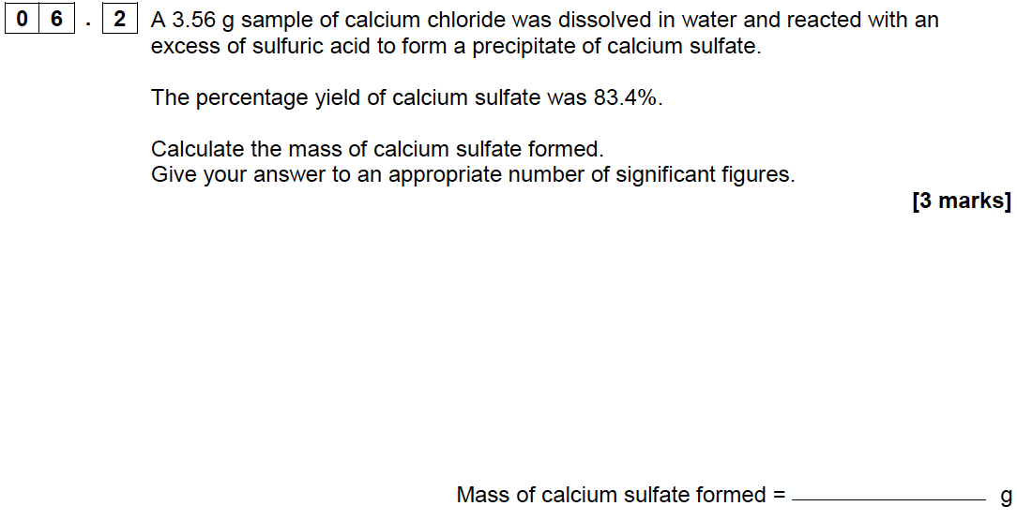
Specimen AS Paper 1

Slide 5
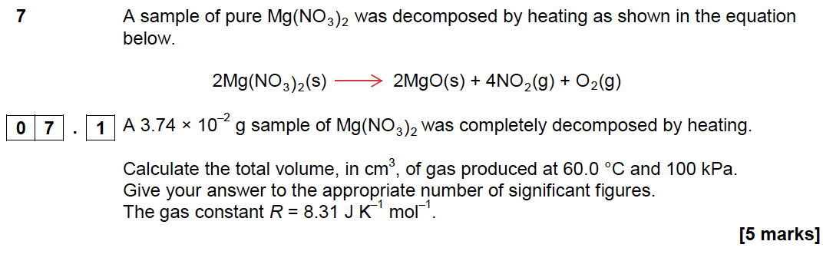
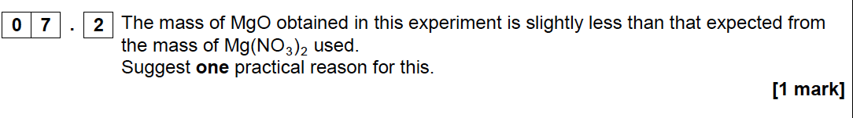
Specimen AS Paper 1

Slide 6
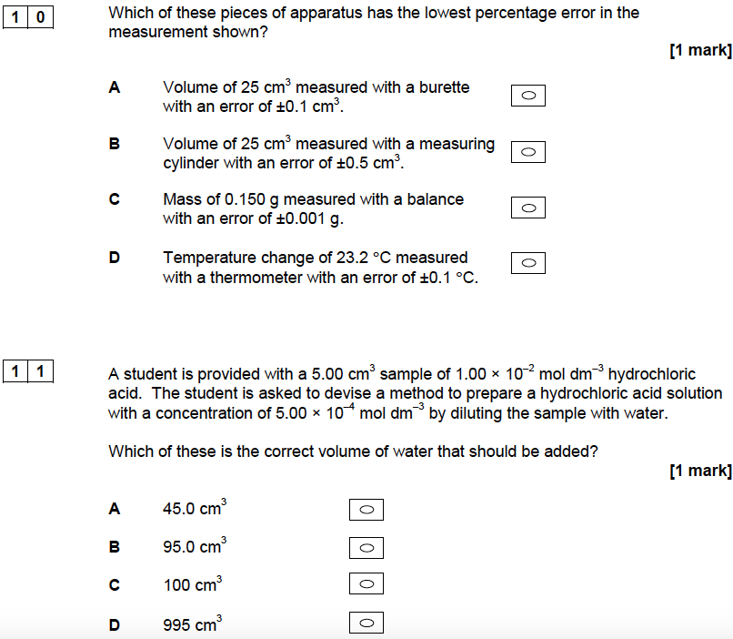
Specimen AS Paper 1

Slide 7
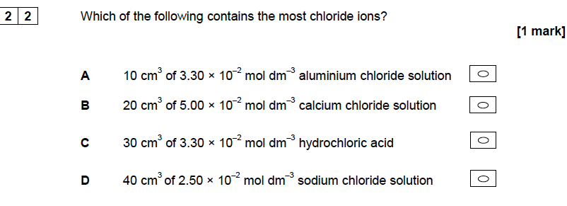
Specimen AS Paper 1

Slide 8
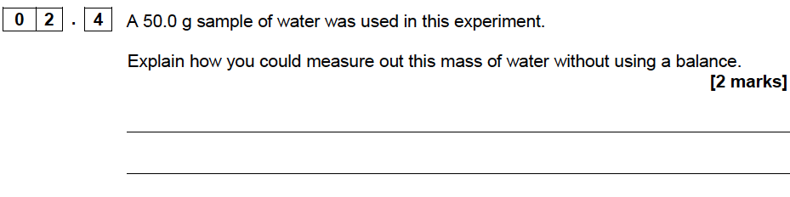
Specimen AS Paper 2

Slide 9
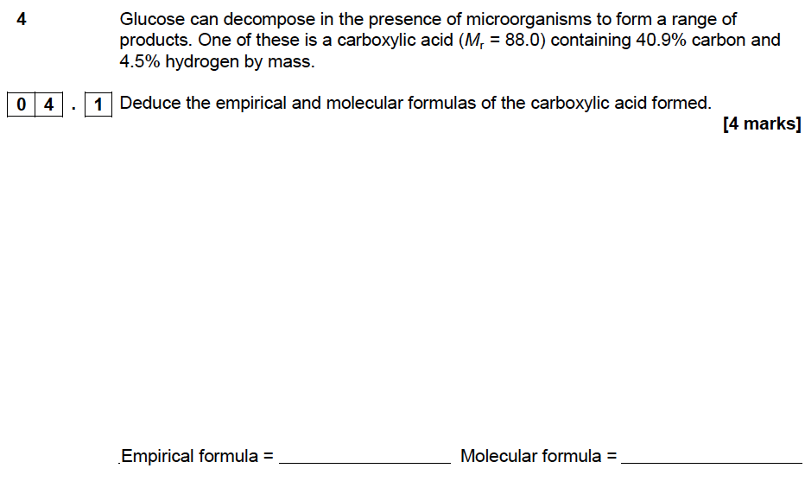
Specimen AS Paper 2

Slide 10
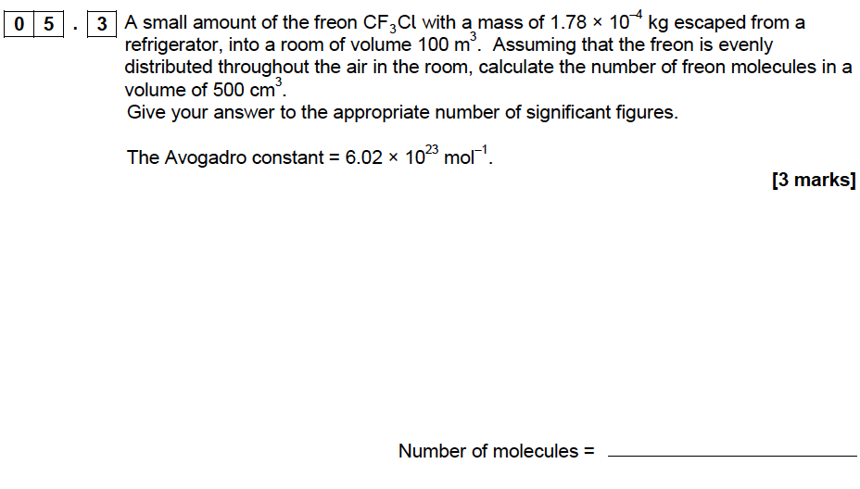
Specimen AS Paper 2

Slide 11
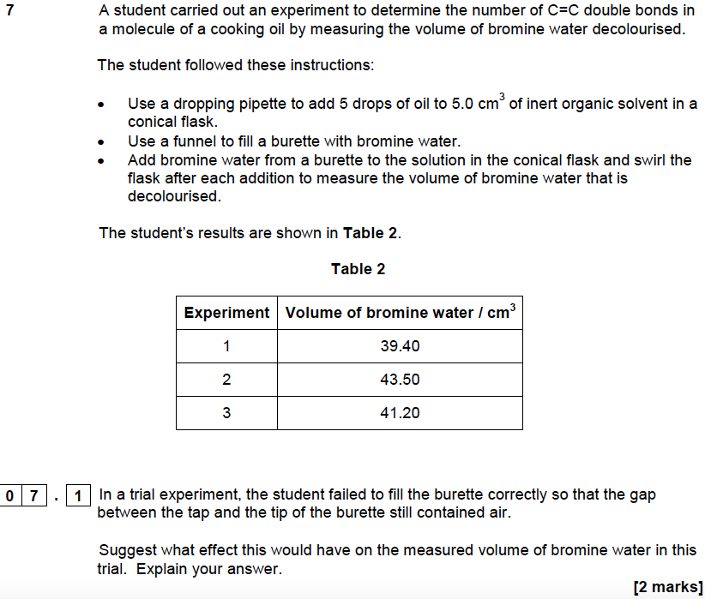
Specimen AS Paper 2

Slide 12
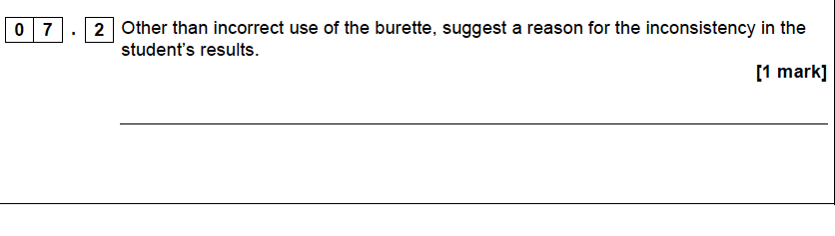
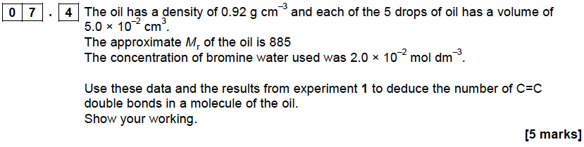
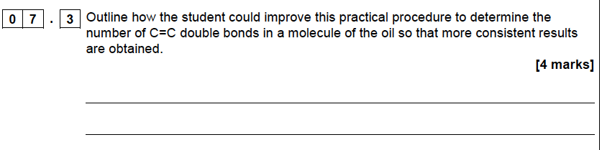
Specimen AS Paper 2

Slide 13
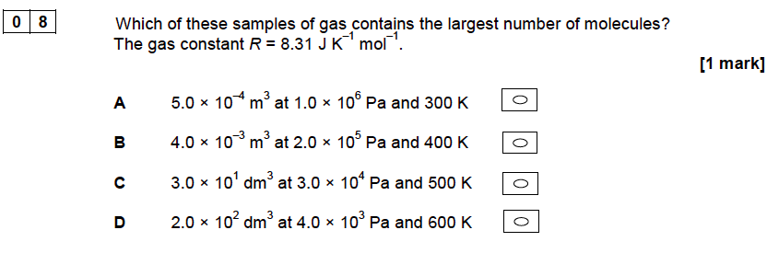
Specimen AS Paper 2

Slide 14
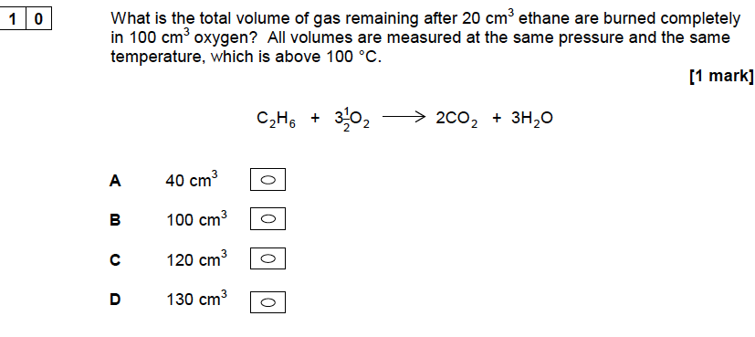
Specimen AS Paper 2

Slide 15
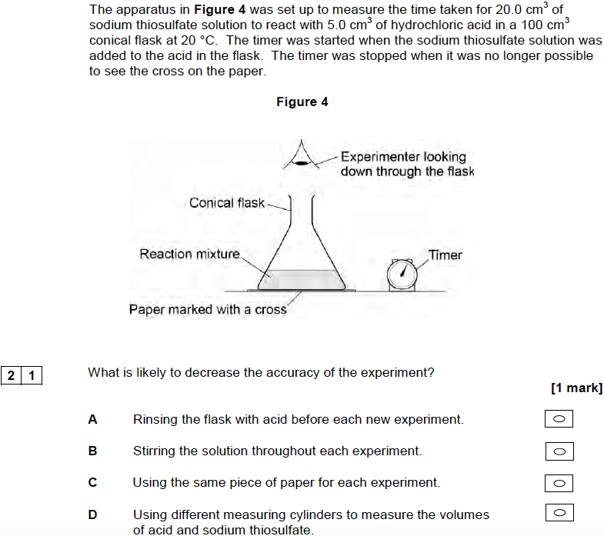
Specimen AS Paper 2

Slide 16
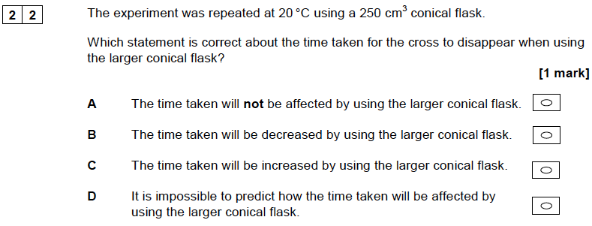
Specimen AS Paper 2

Slide 17
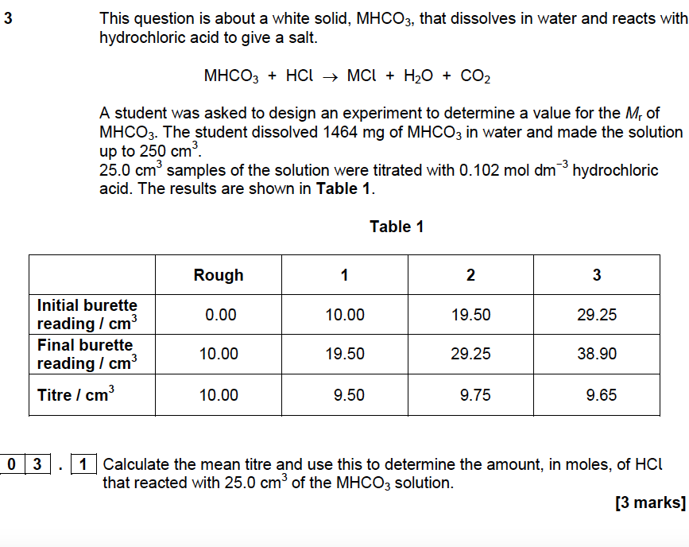
2016 AS Paper1

Slide 18
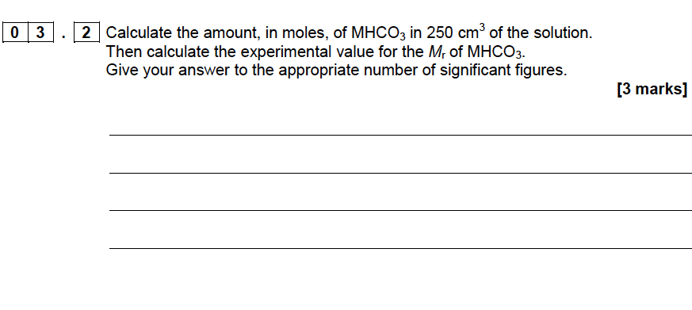
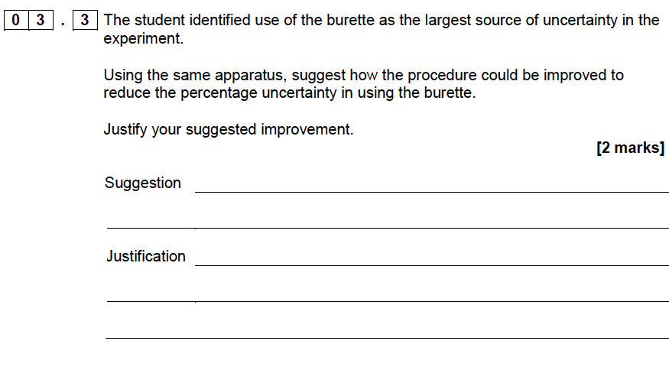
2016 AS Paper1

Slide 19
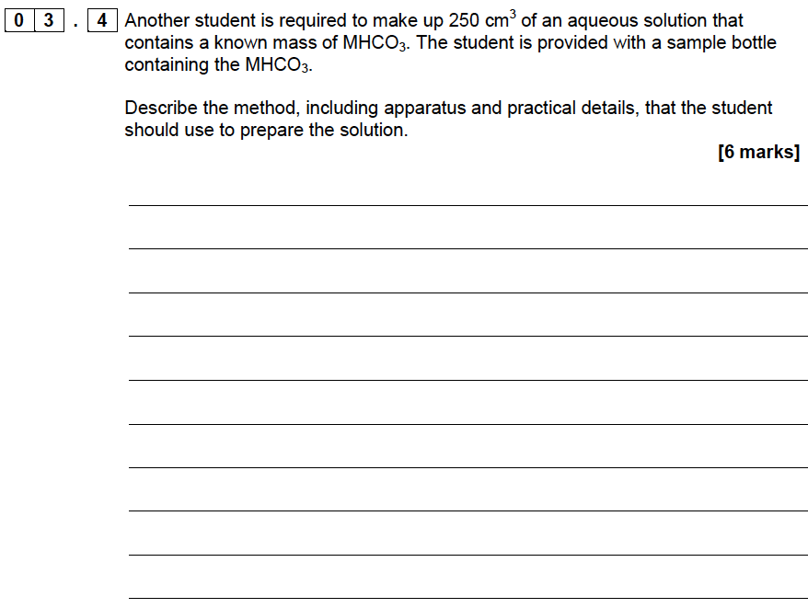
2016 AS Paper1

Slide 20
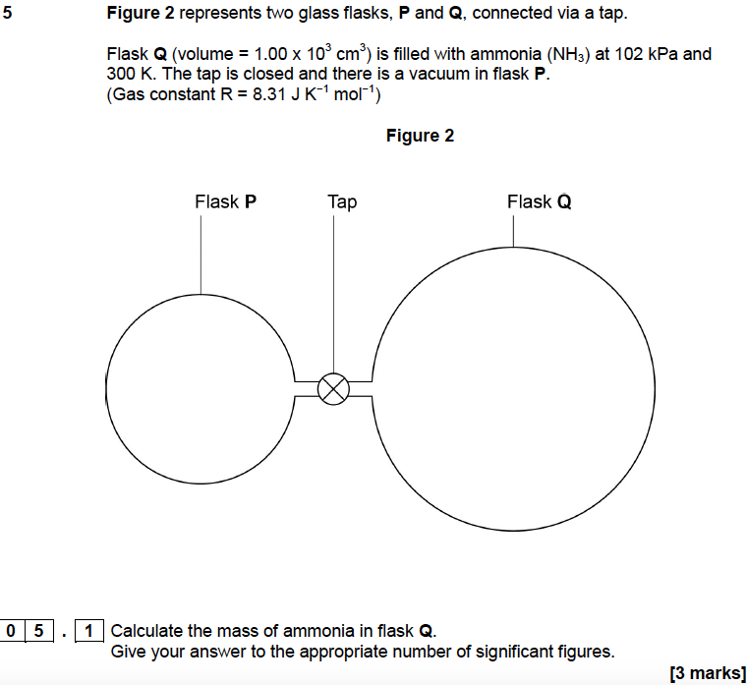
2016 AS Paper1

Slide 21
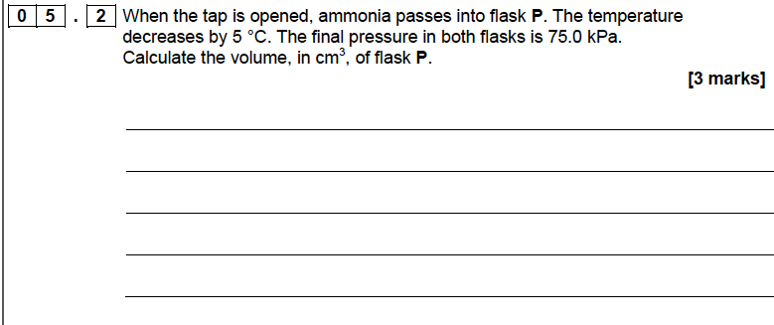
2016 AS Paper1

Slide 22
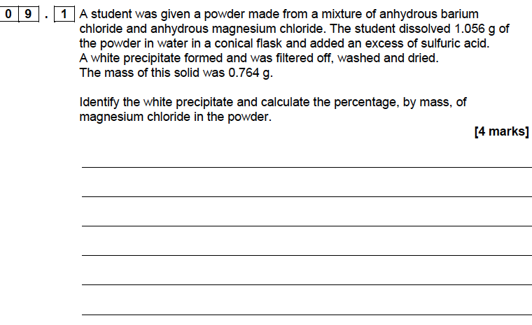
2016 AS Paper1

Slide 23
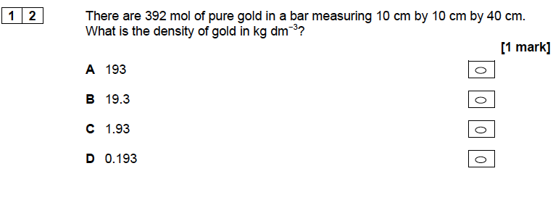
2016 AS Paper1

Slide 24
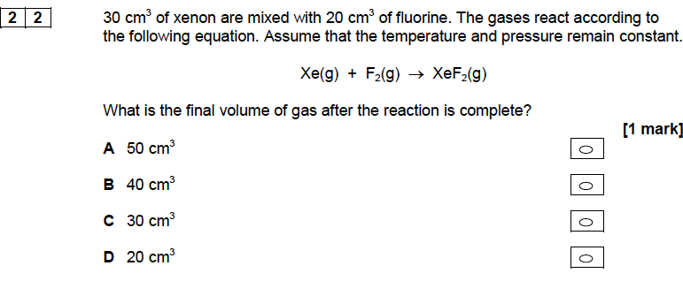
2016 AS Paper1

Slide 25
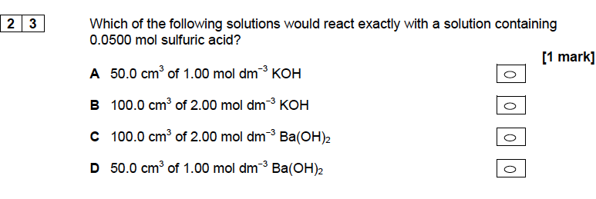
2016 AS Paper1

Slide 26
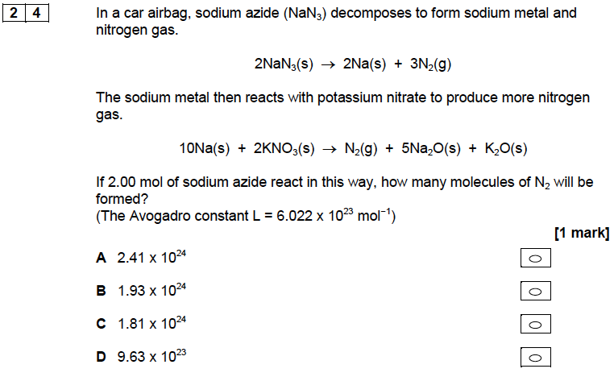
2016 AS Paper1

Slide 27
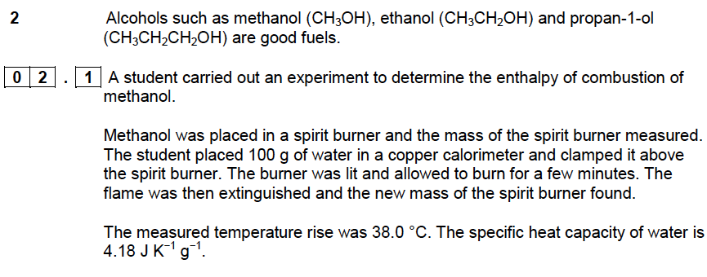
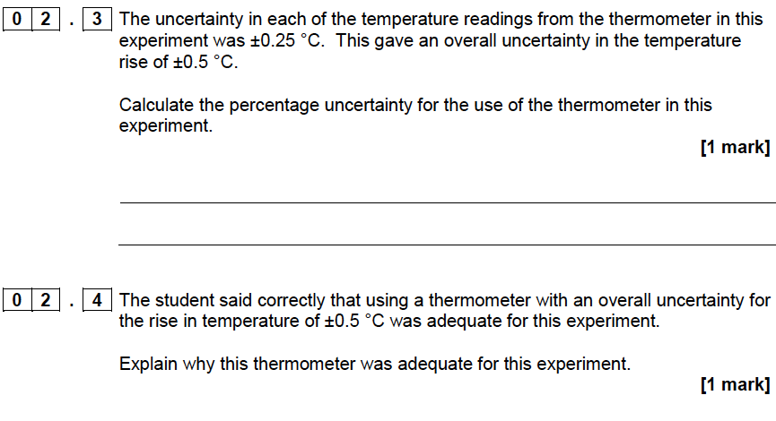
2016 AS Paper2

Slide 28
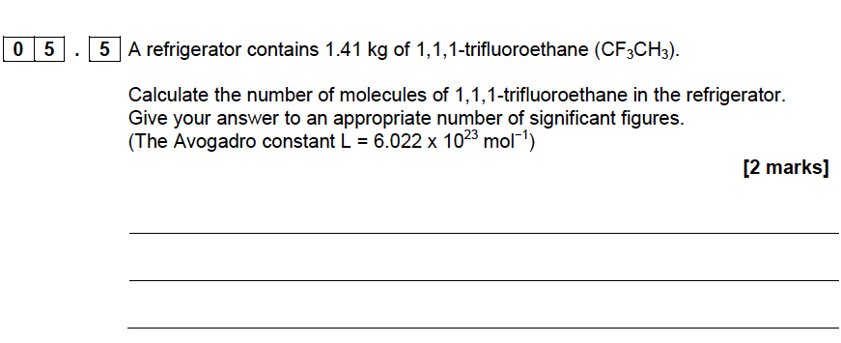
2016 AS Paper2

Slide 29
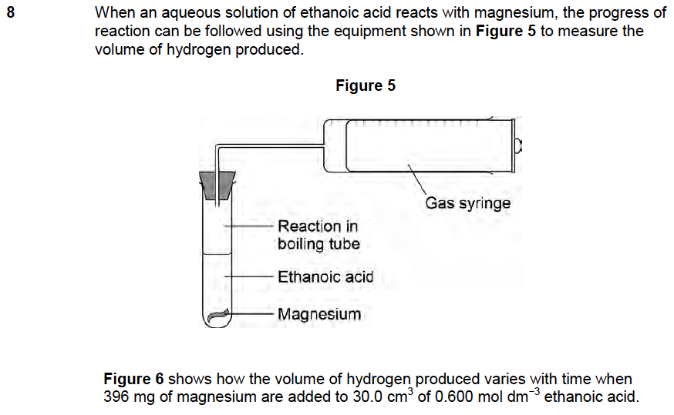
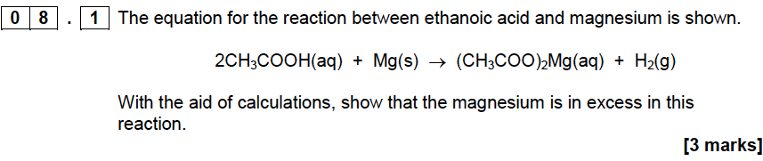
2016 AS Paper2

Slide 30
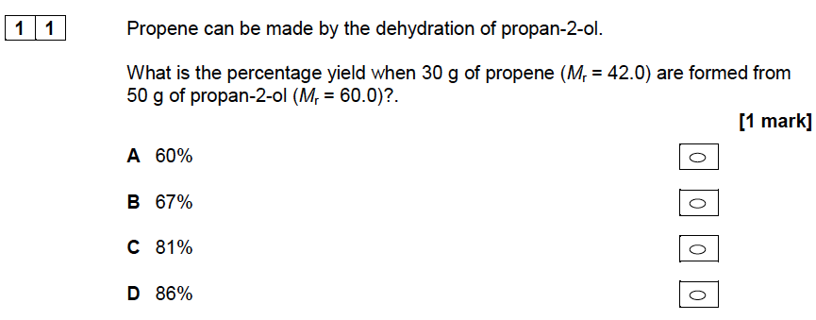
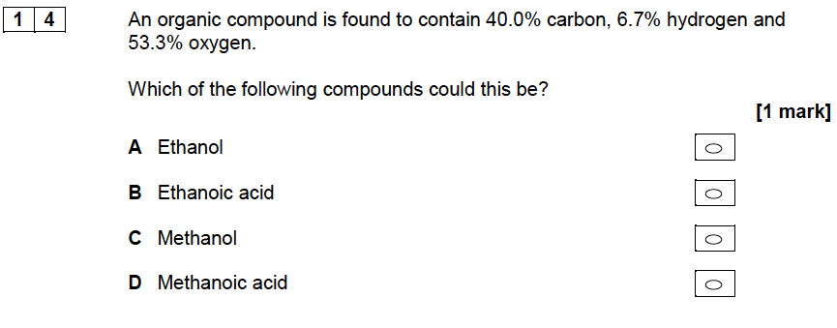
2016 AS Paper2

Slide 31
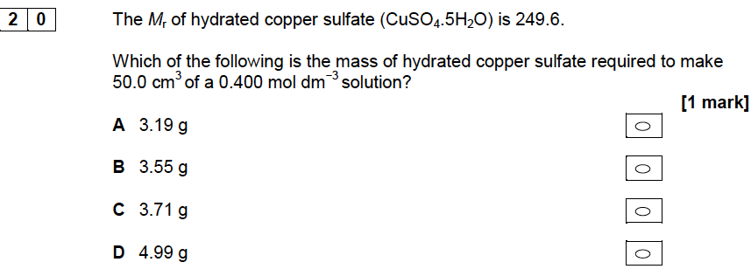
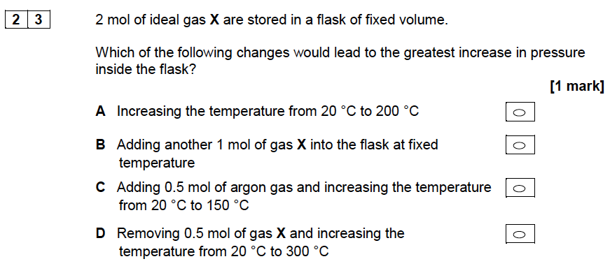
2016 AS Paper2

Slide 32
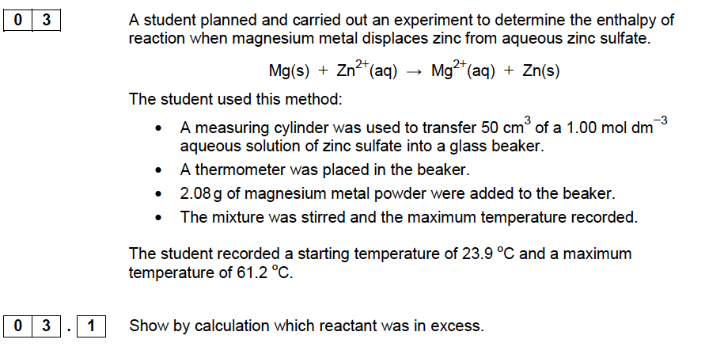
2017 AS Paper1

Slide 33
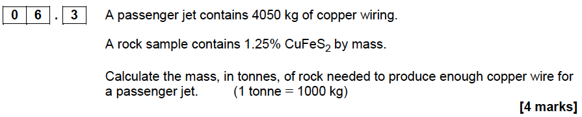
2017 AS Paper1

Slide 34
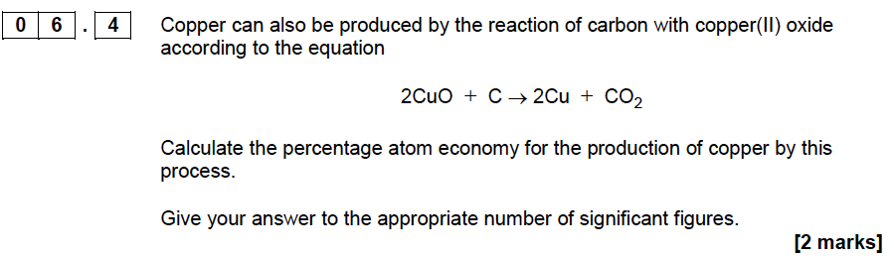
2017 AS Paper1

Slide 35
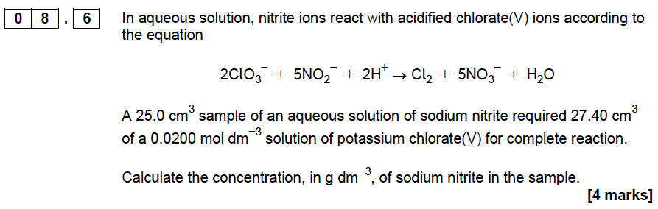
2017 AS Paper1

Slide 36
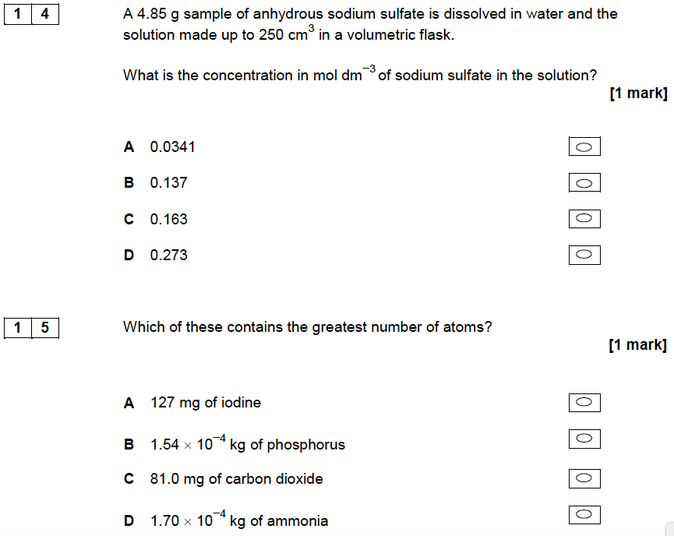
2017 AS Paper1

Slide 37
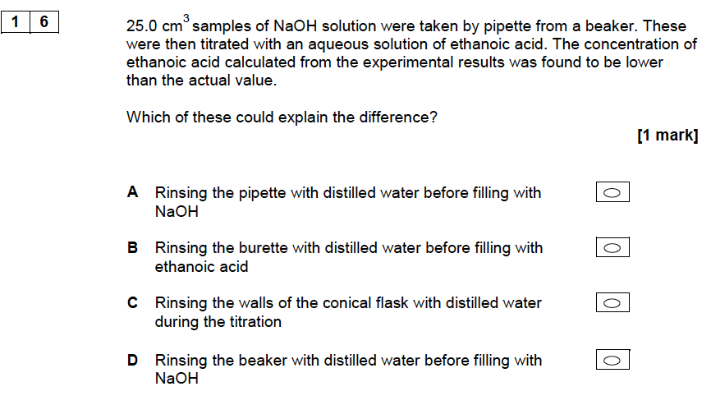
2017 AS Paper1

Slide 38
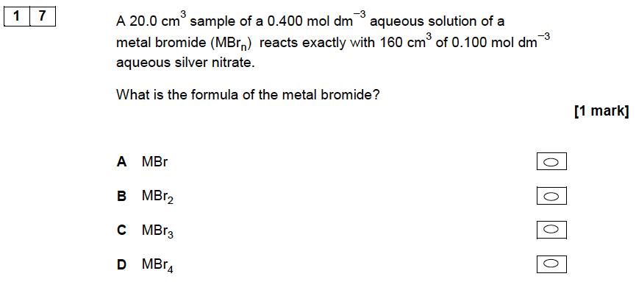
2017 AS Paper1

Slide 39
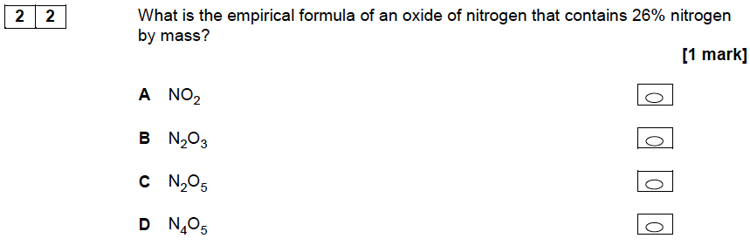
2017 AS Paper1

Slide 40
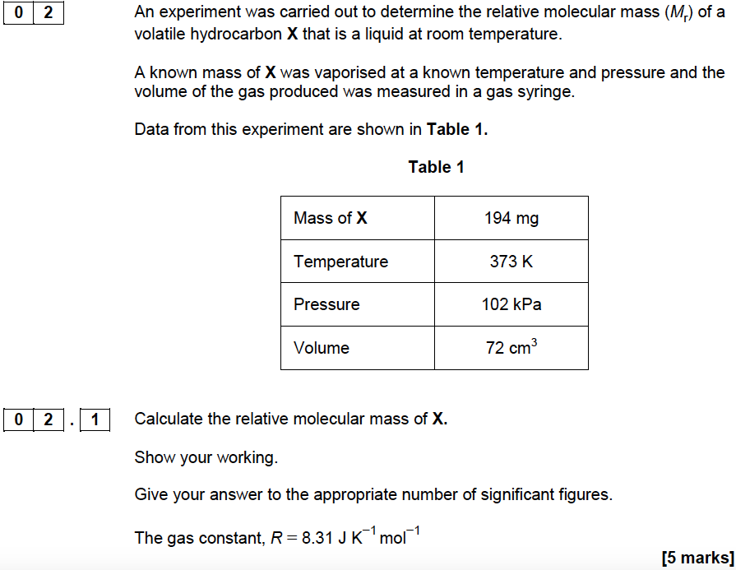
2017 AS Paper 2

Slide 41
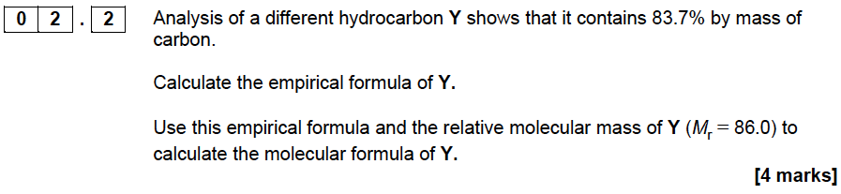
2017 AS Paper 2

Slide 42
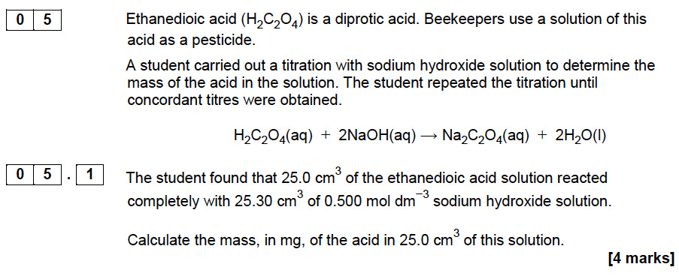
2017 AS Paper 2

Slide 43
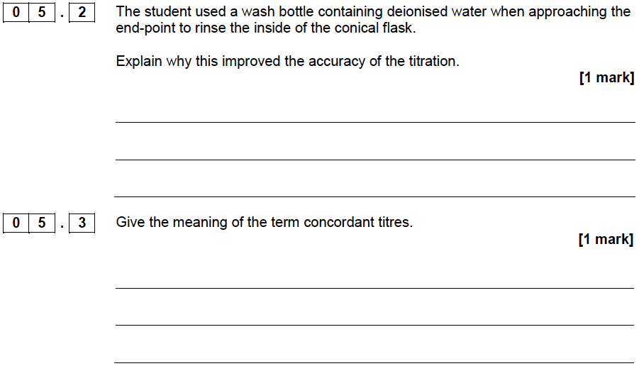
2017 AS Paper 2

Slide 44
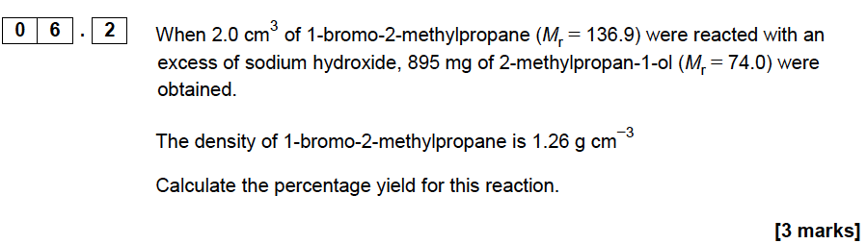
2017 AS Paper 2

Slide 45

2017 AS Paper 2

Slide 46

2017 AS Paper 2

Slide 47

2017 AS Paper 2

Slide 48

2017 AS Paper 2

Slide 49

2017 AS Paper 2

Slide 50

2017 AS Paper 2

Slide 51

2018 AS Paper 1

Slide 52


2018 AS Paper 1

Slide 53

2018 AS Paper 1

Slide 54

2018 AS Paper 1

Slide 55


2018 AS Paper 1

Slide 56

2018 AS Paper 1

Slide 57

2018 AS Paper 1

Slide 58


2018 AS Paper 1

Slide 59

2018 AS Paper 1

Slide 60

2018 AS Paper 1

Slide 61


2018 AS Paper 1

Slide 62

2018 AS Paper 1

Slide 63

2018 AS Paper 2

Slide 64

2018 AS Paper 2

Slide 65


2018 AS Paper 2

Slide 66


2018 AS Paper 2

Slide 67

2018 AS Paper 2

Slide 68

2018 AS Paper 2

Slide 69

2019 AS Paper 1

Slide 70

2019 AS Paper 1

Slide 71

2019 AS Paper 1

Slide 72

2019 AS Paper 1

Slide 73

2019 AS Paper 1

Slide 74

2019 AS Paper 1

Slide 75

2019 AS Paper 2

Slide 76

2019 AS Paper 2

Slide 77

2019 AS Paper 2

Slide 78

2019 AS Paper 2

Slide 79

2019 AS Paper 2

Slide 80

2019 AS Paper 2

Slide 81

2019 AS Paper 2

Slide 82


2020 AS Paper 1

Slide 83


2020 AS Paper 1

Slide 84



2020 AS Paper 1

Slide 85

2020 AS Paper 2

Slide 86

2020 AS Paper 2

Slide 87




2020 AS Paper 2

Slide 88



2021 AS Paper 1

Slide 89

2021 AS Paper 1

Slide 90




2021 AS Paper 2

Slide 91



2021 AS Paper 2

Slide 92




2022 AS Paper 1

Slide 93

2022 AS Paper 1

Slide 94



2022 AS Paper 2

Slide 95




2022 AS Paper 2

Slide 96
A2 Papers

Slide 97

2017 A2 Paper 1

Slide 98

2017 A2 Paper 2

Slide 99


2017 A2 Paper 3

Slide 100




2017 A2 Paper 3

Slide 101



2017 A2 Paper 3

Slide 102



2018 A2 Paper 1

Slide 103

2018 A2 Paper 1

Slide 104


2018 A2 Paper 3

Slide 105



2019 A2 Paper 1

Slide 106



2019 A2 Paper 2

Slide 107

2019 A2 Paper 2

Slide 108




2019 A2 Paper 3

Slide 109


2020 A2 Paper 1

Slide 110


2020 A2 Paper 2

Slide 111



2020 A2 Paper 3

Slide 112


2020 A2 Paper 3

Slide 113

2021 A2 Paper 1

Slide 114


2021 A2 Paper 2

Slide 115




2021 A2 Paper 3

Slide 116



2022 A2 Paper 1

Slide 117




2022 A2 Paper 2

Slide 118



2022 A2 Paper 3

