Slide 1


AQA Past paper questions
3.1.3 Bonding and structure
Dr John R Griffiths
SciExcel Tuition

Slide 2
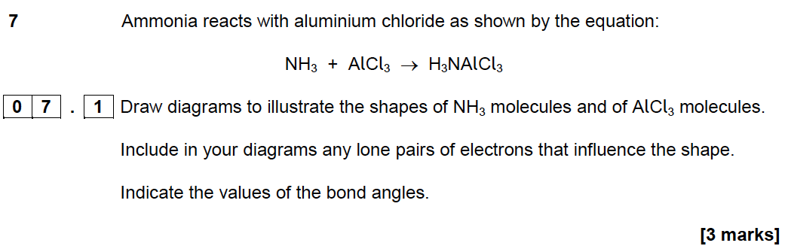
AS 2016 Paper 1

Slide 3
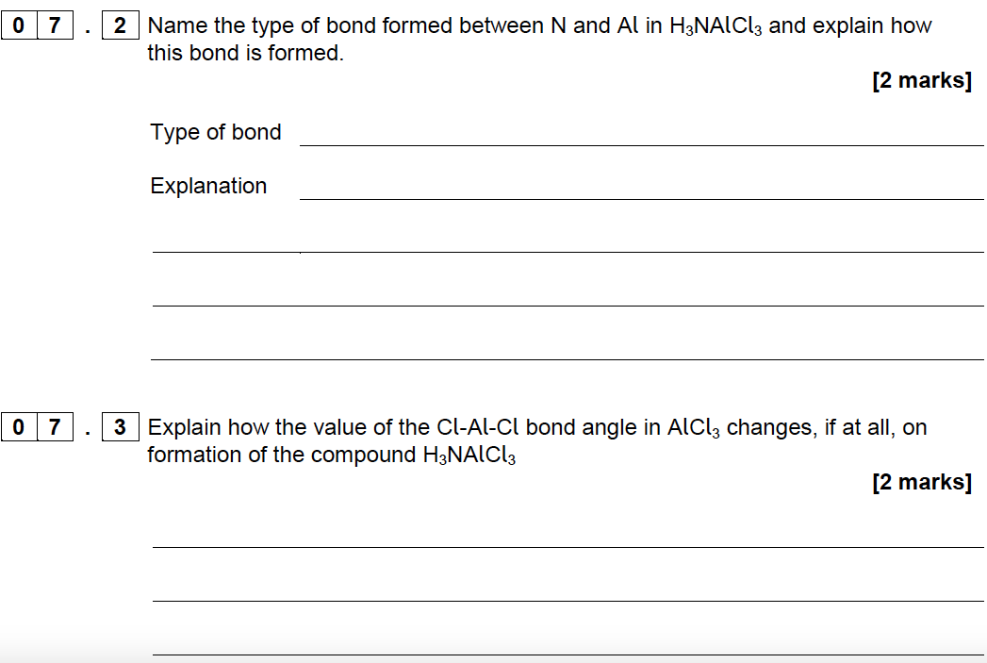
AS 2016 Paper 1

Slide 4
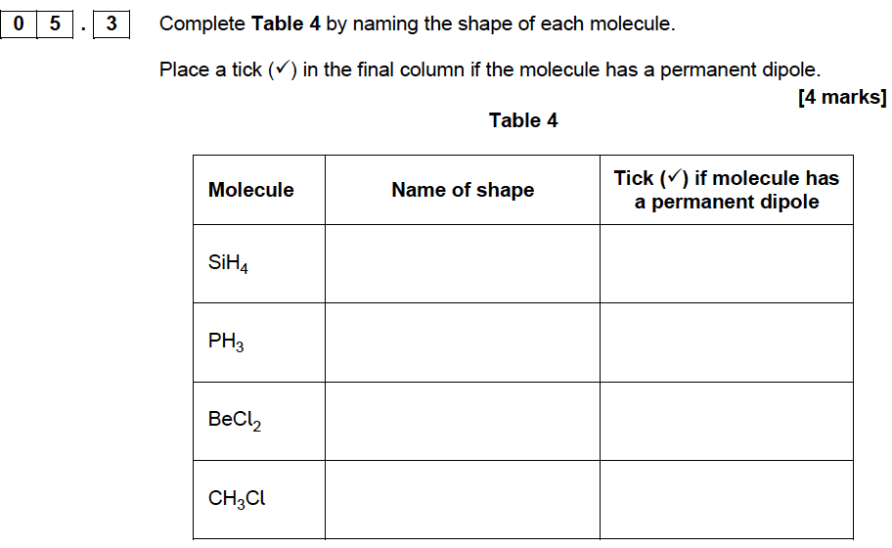
AS 2017 Paper 1

Slide 5
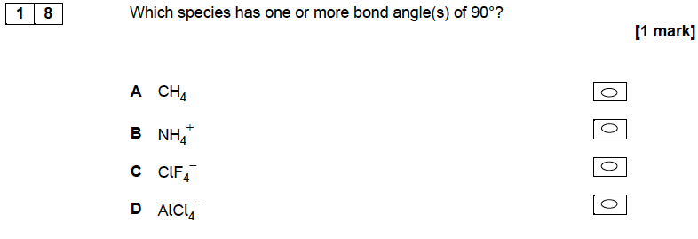
AS 2017 Paper 1

Slide 6
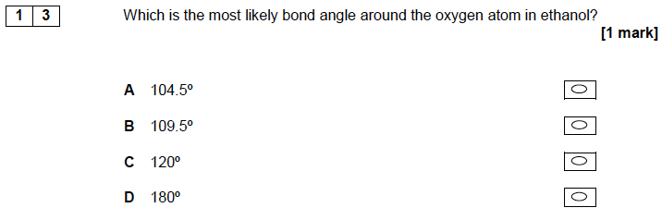
AS 2017 Paper 2

Slide 7
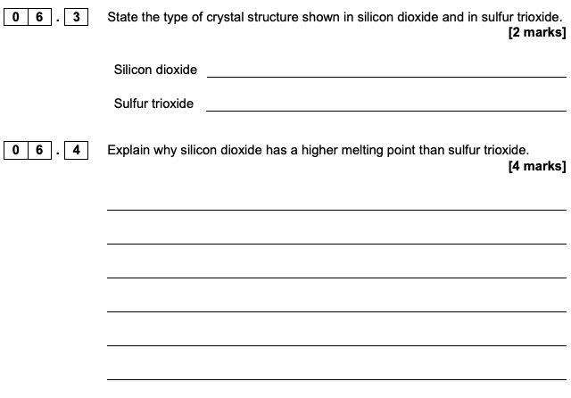
A2 2017 Paper 1

Slide 8
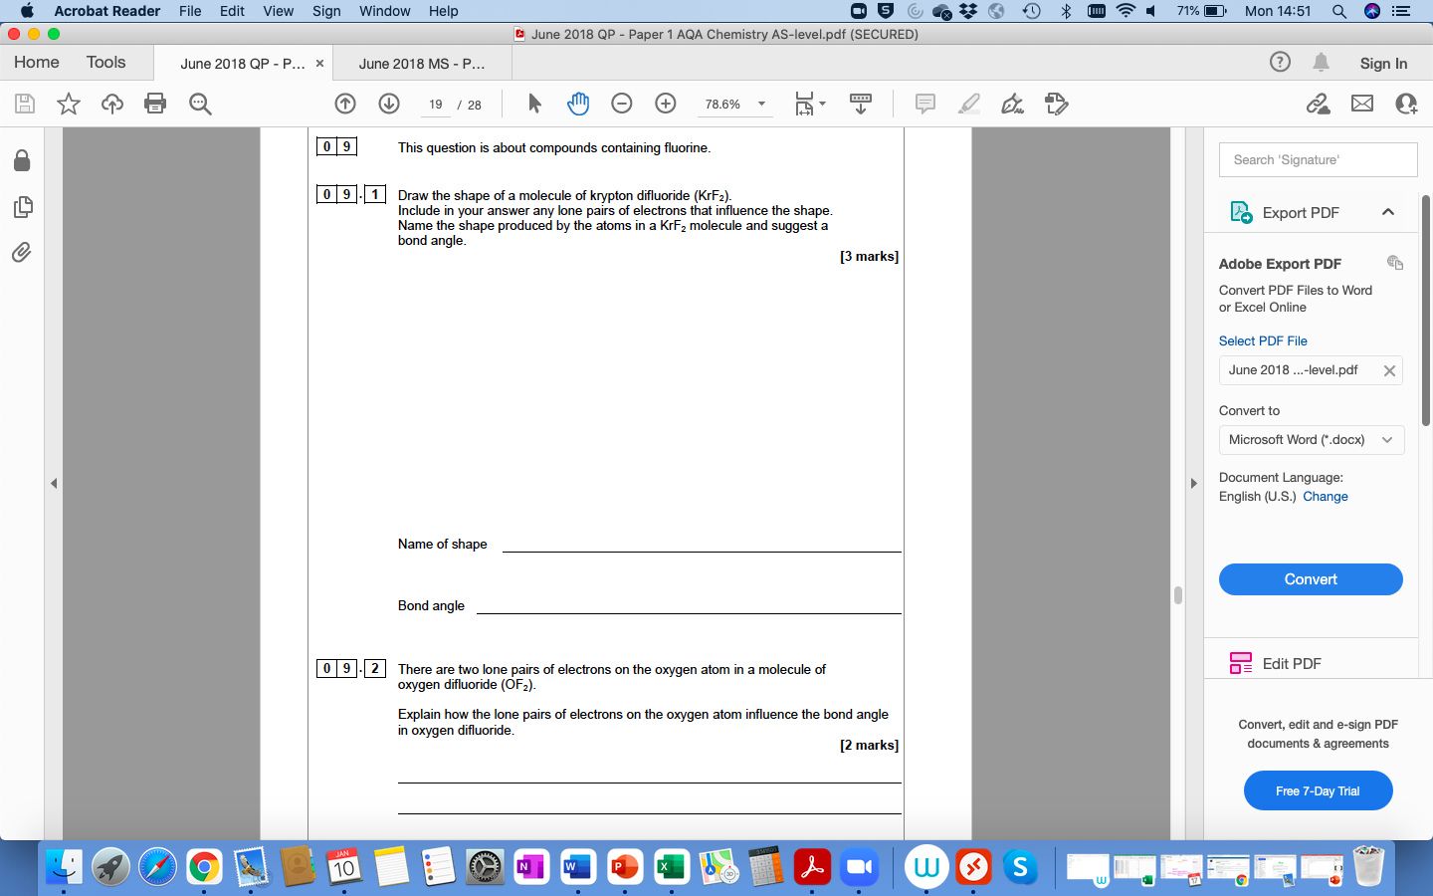
AS 2018 Paper 1

Slide 9
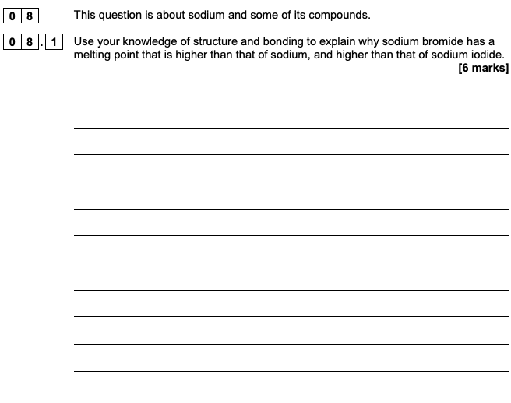
A2 2018 Paper 1

Slide 10
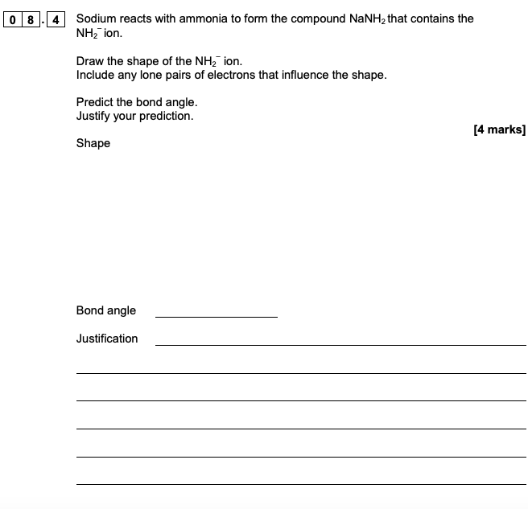
A2 2018 Paper 1

Slide 11
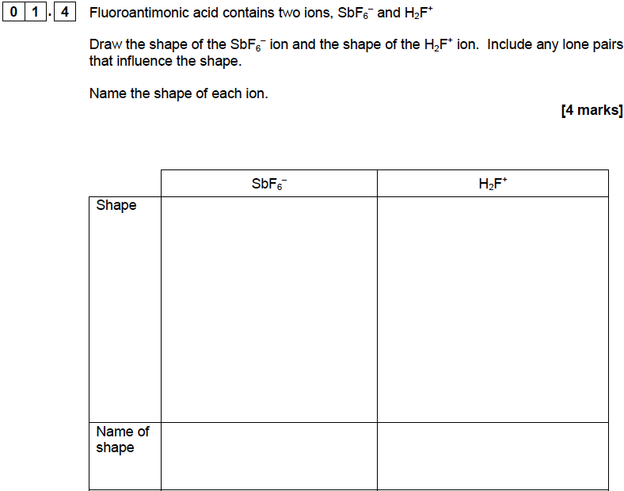
AS 2019 Paper 1

Slide 12
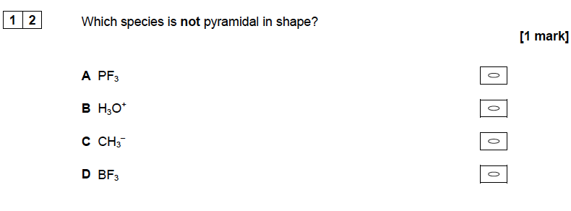
AS 2019 Paper 1

Slide 13
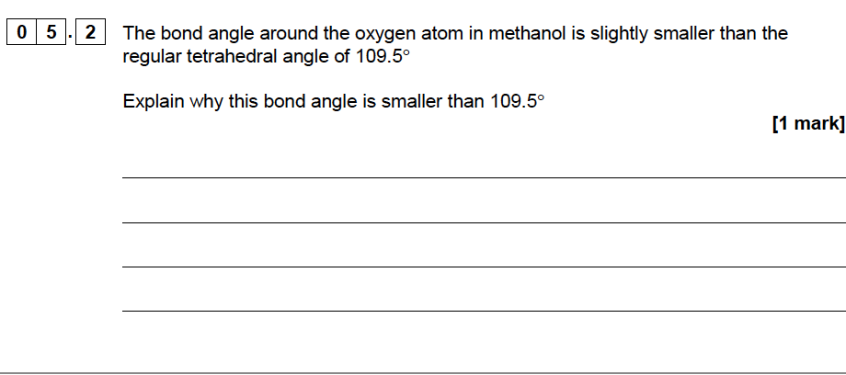
AS 2019 Paper 2

Slide 14
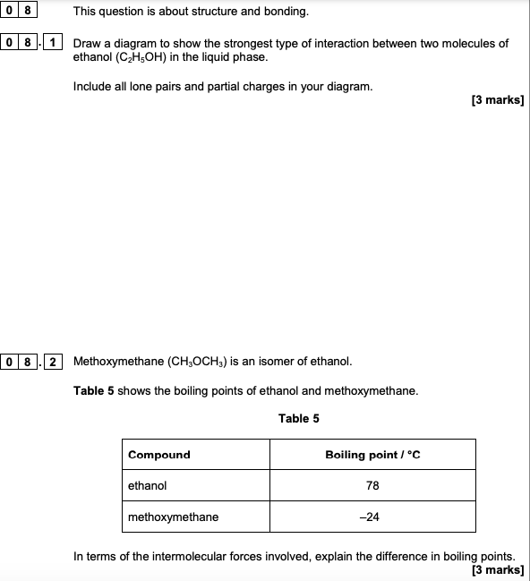
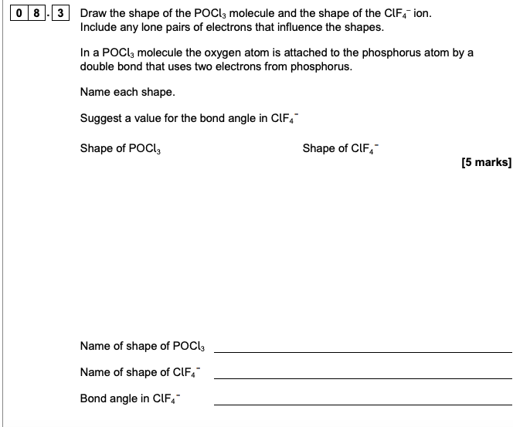
A2 2019 Paper 1

Slide 15
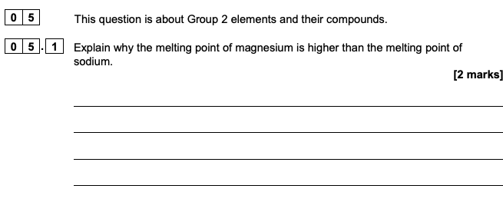
AS 2020 Paper 1

Slide 16
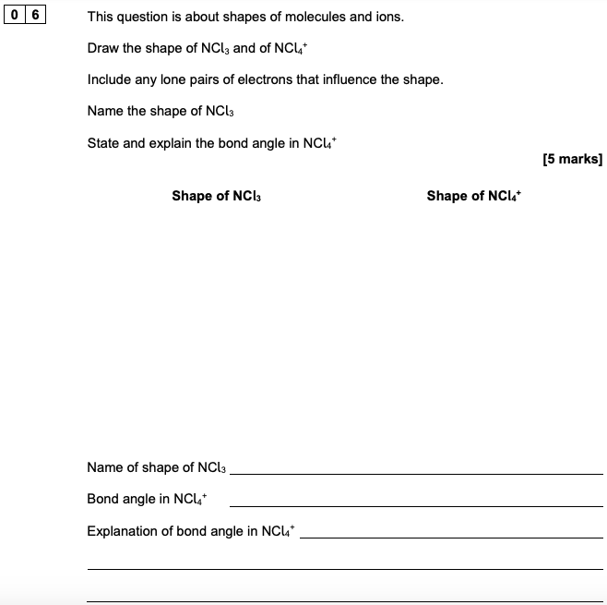
AS 2020 Paper 1

Slide 17
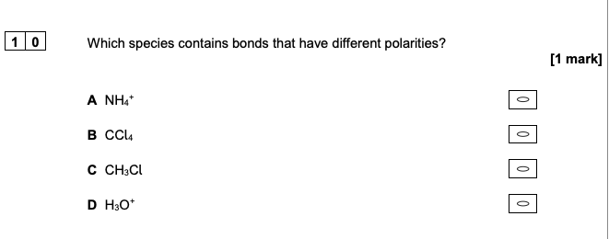
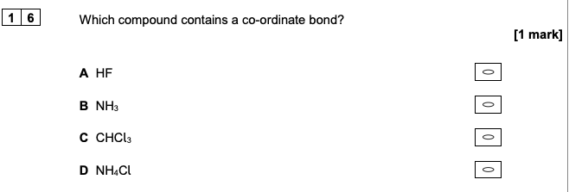
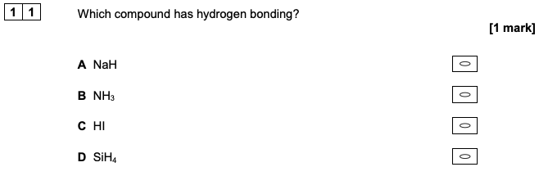
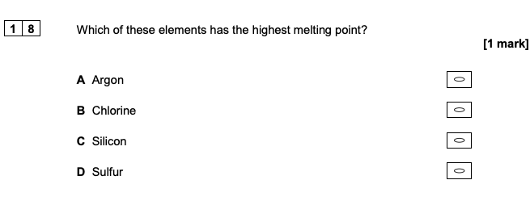
AS 2020 Paper 1

Slide 18
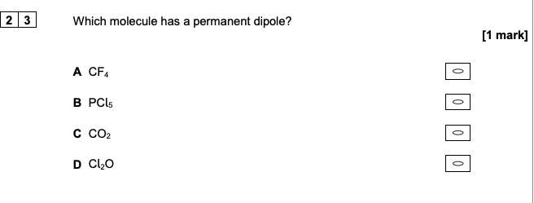
AS 2020 Paper 1

Slide 19

A2 2020 Paper 1

Slide 20
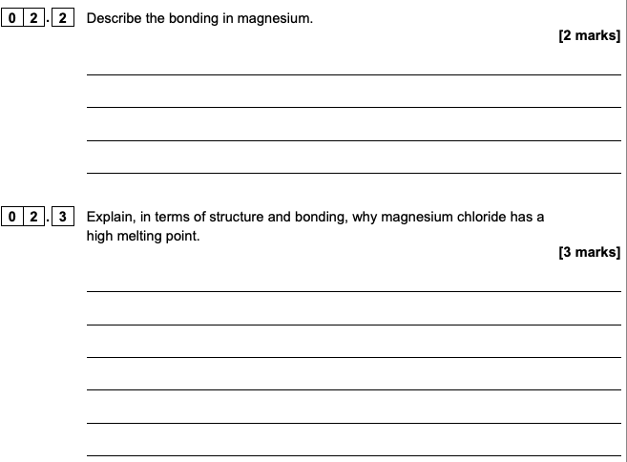
AS 2021 Paper 1

Slide 21
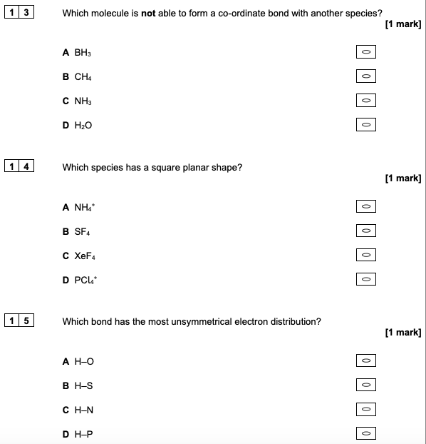
AS 2021 Paper 1

Slide 22
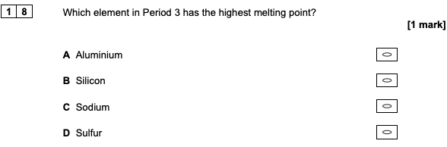
AS 2021 Paper 1

Slide 23
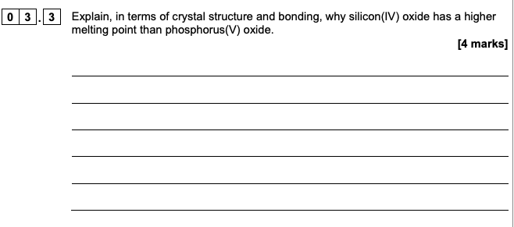
A2 2021 Paper 1

Slide 24
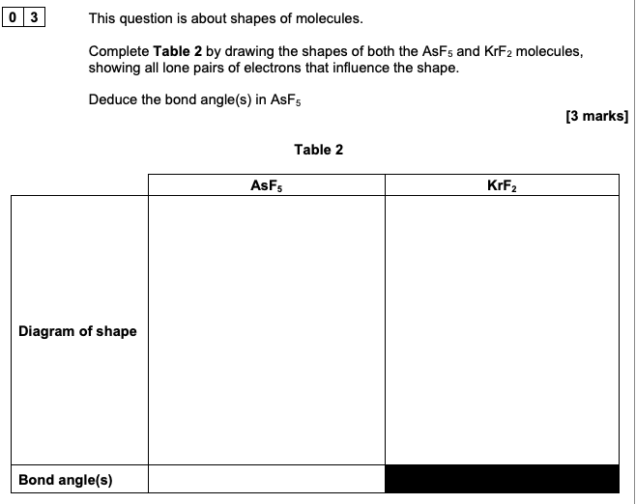
AS 2022 Paper 1

Slide 25
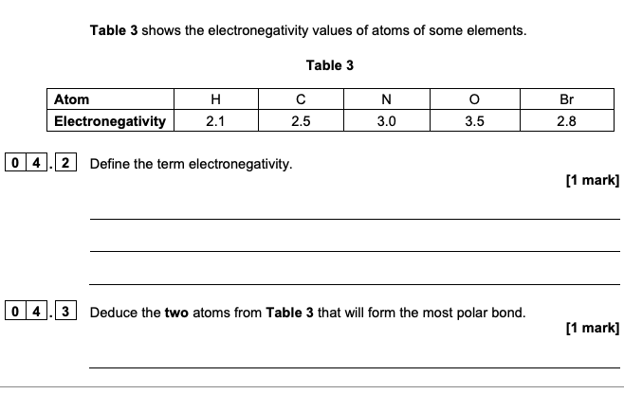
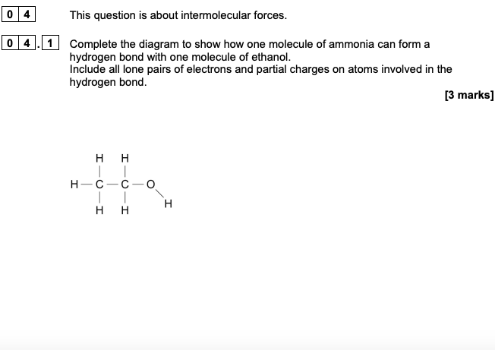
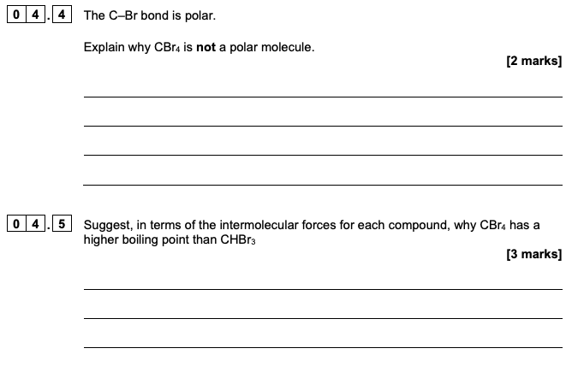
AS 2022 Paper 1

Slide 26
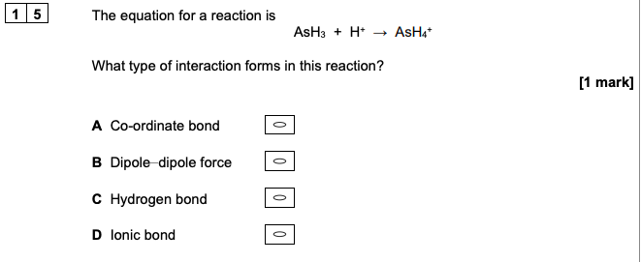
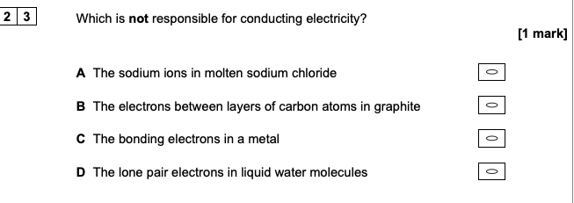
AS 2022 Paper 1

Slide 27


A2 2022 Paper 1

Slide 28
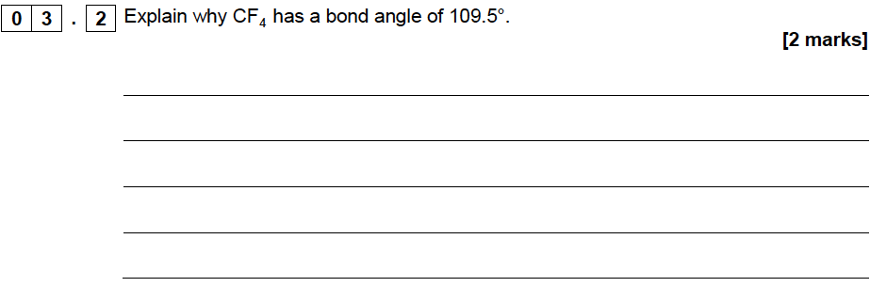
AS Specimen Paper 1

Slide 29
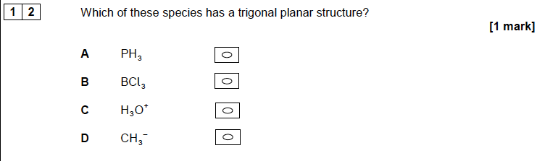
AS Specimen Paper 1

