Slide 1


AQA Past paper questions
3.2.6 Reactions of aqueous ions in solution
Dr John R Griffiths
SciExcel Tuition

Slide 2
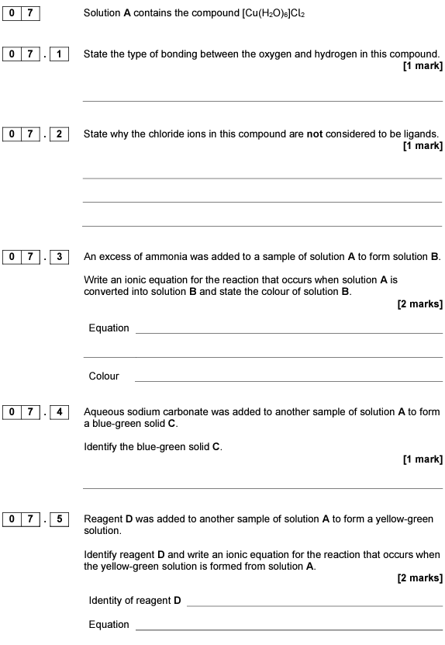
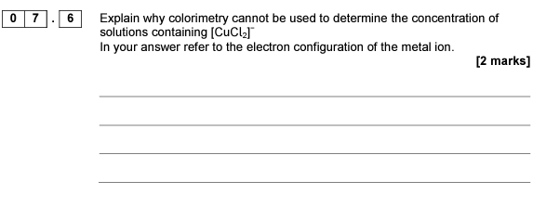
2017 A2 Paper 1

Slide 3
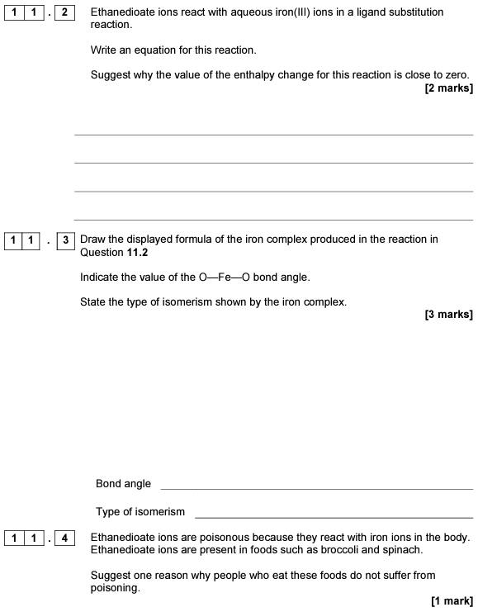
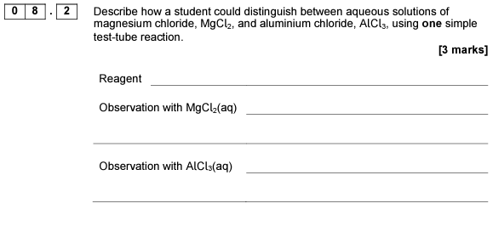
2017 A2 Paper 1

Slide 4
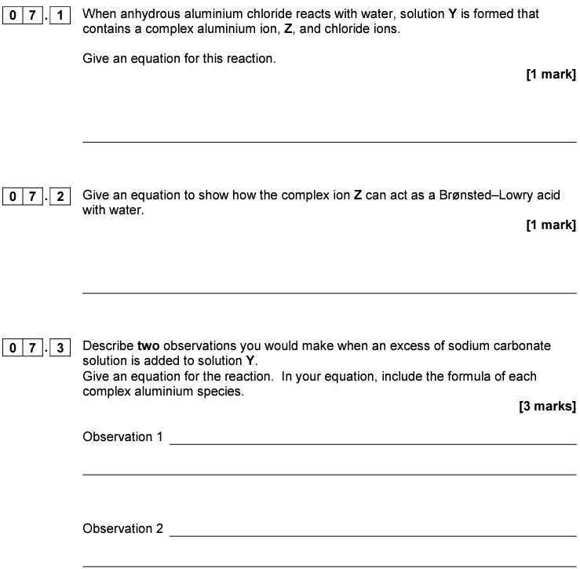
2018 A2 Paper 1

Slide 5
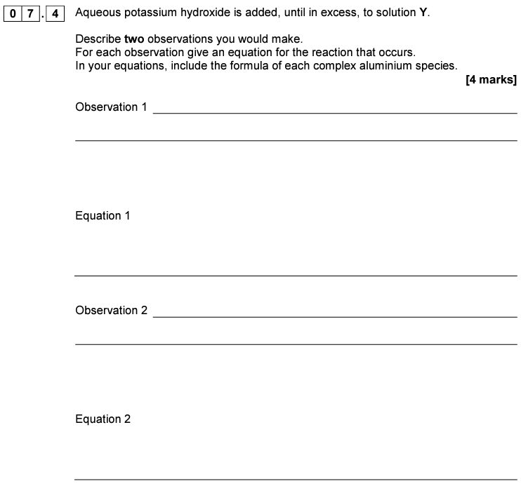
2018 A2 Paper 1

Slide 6
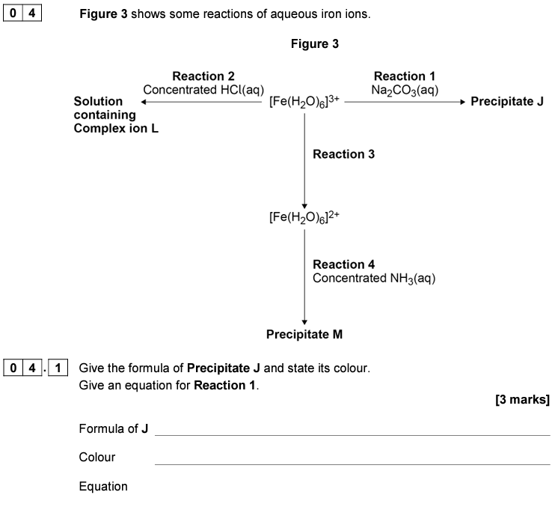
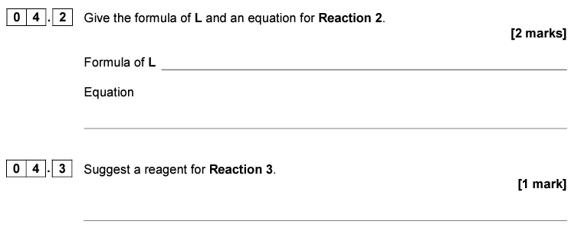
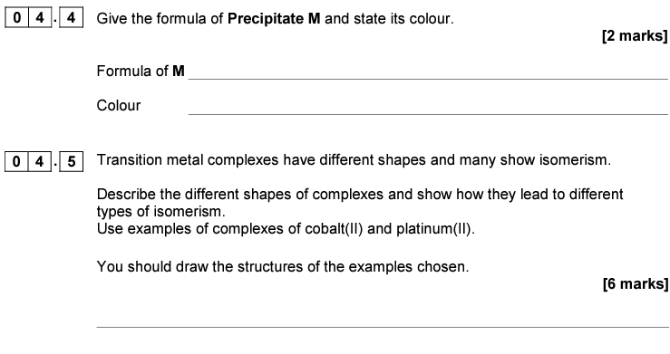
2019 A2 Paper 1

Slide 7
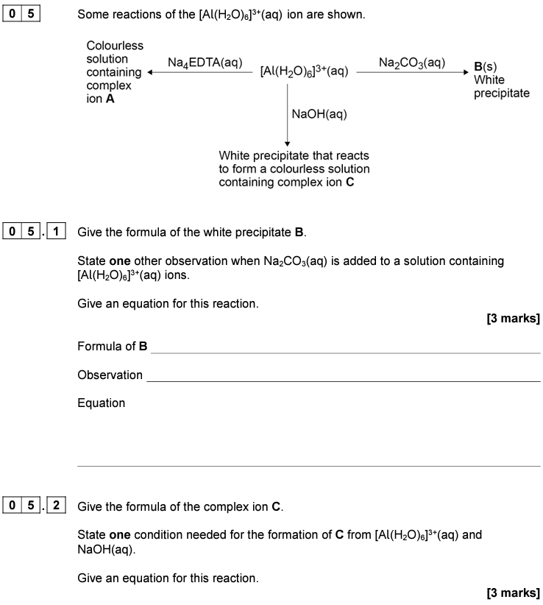
2020 A2 Paper 1

Slide 8
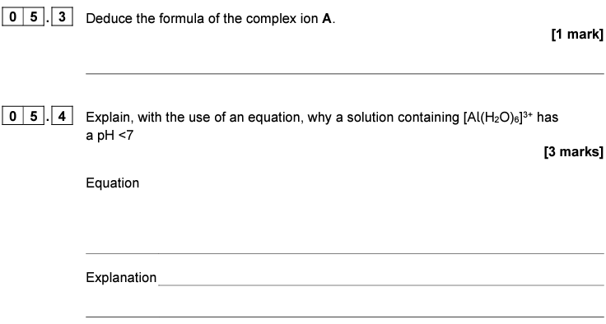
2020 A2 Paper 1

Slide 9
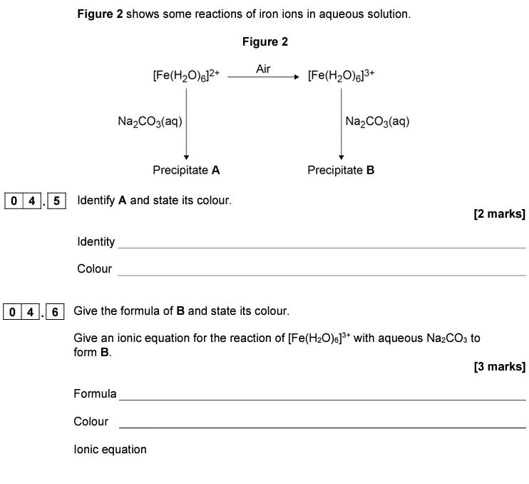

2021 A2 Paper 1

Slide 10
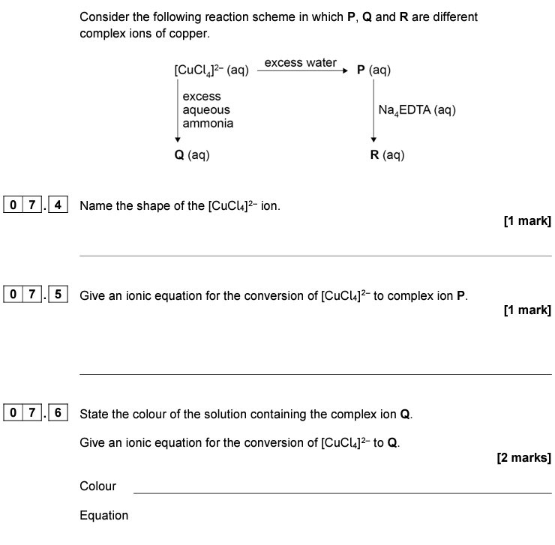

2022 A2 Paper 1

Slide 11
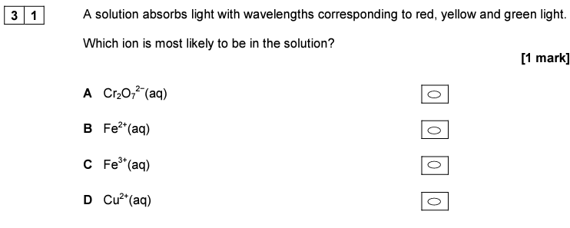
2017 A2 Paper 3

Slide 12

2020 A2 Paper 3

Slide 13
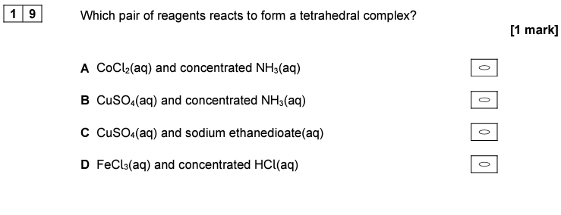
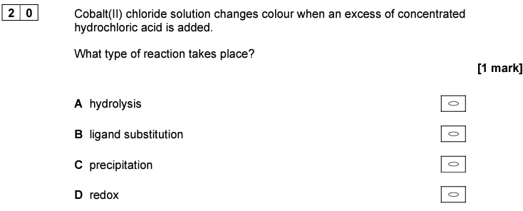
2022 A2 Paper 3

