Slide 1


AQA Past paper questions
3.3.16 - Chromatography
Dr John R Griffiths
SciExcel Tuition

Slide 2
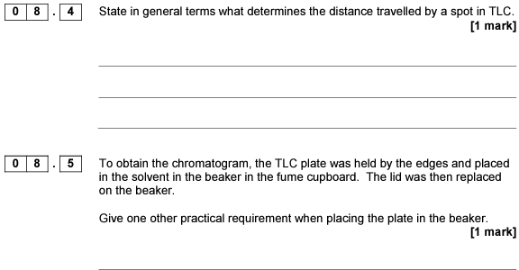
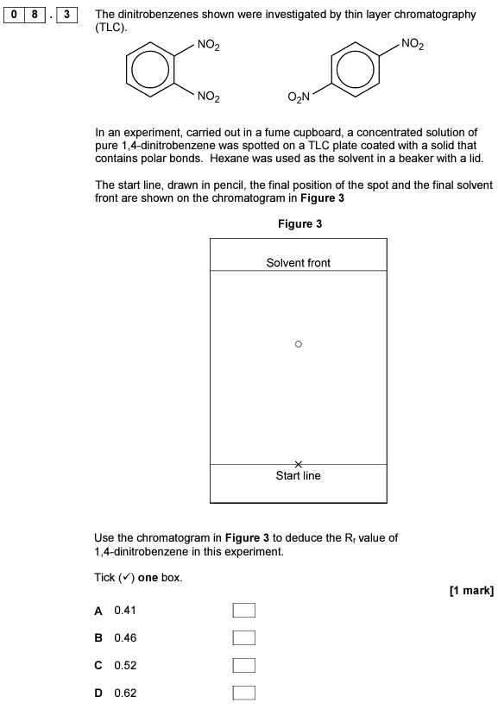
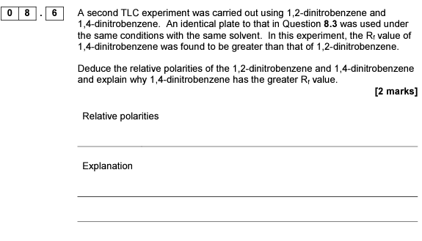

2017 A2 Paper 2

Slide 3
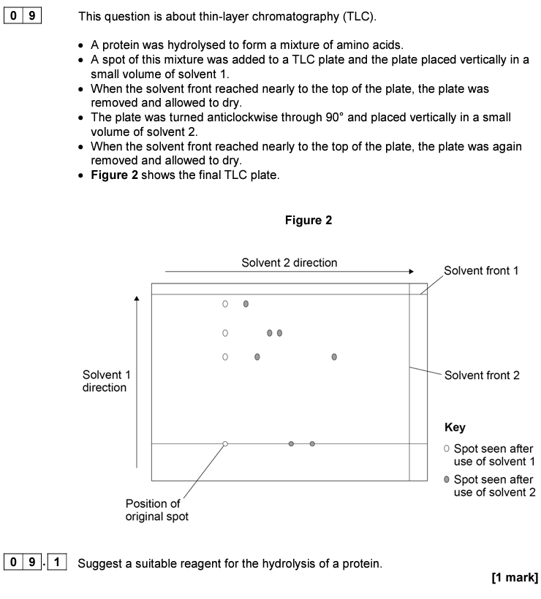
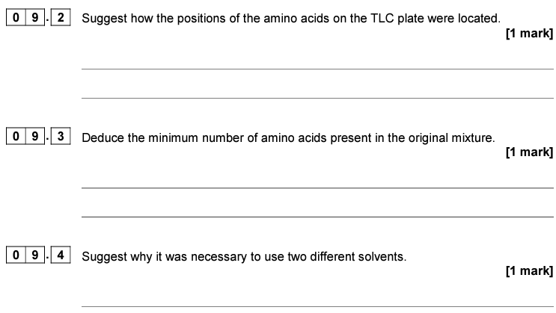
2019 A2 Paper 2

Slide 4
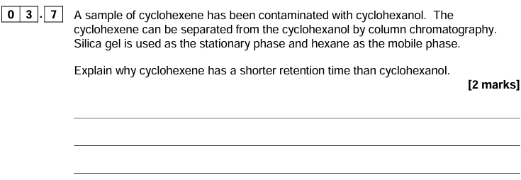
2018 A2 Paper 3

Slide 5
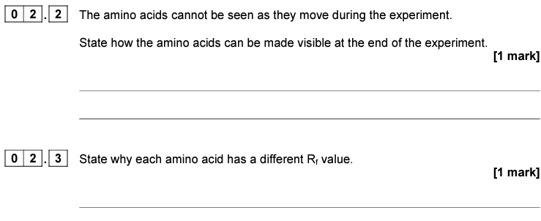
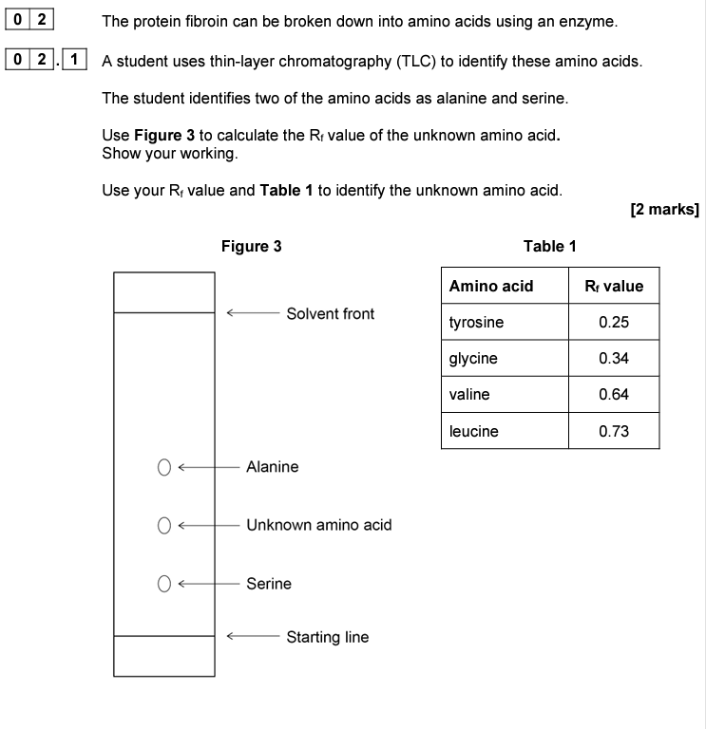
2021 A2 Paper 3

