Slide 1


AQA Past paper questions
3.3.7 - Optical isomerism
Dr John R Griffiths
SciExcel Tuition

Slide 2
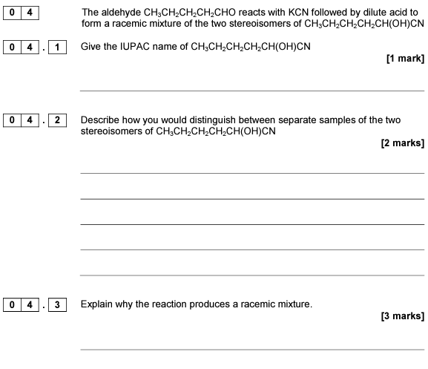
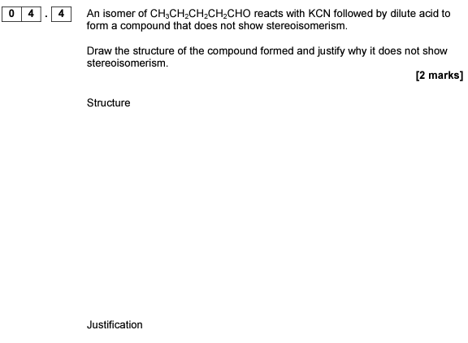
2017 A2 Paper 2

Slide 3
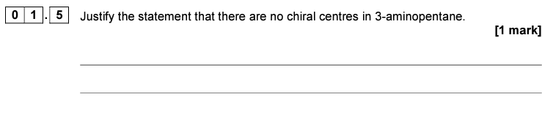
2019 A2 Paper 2

Slide 4
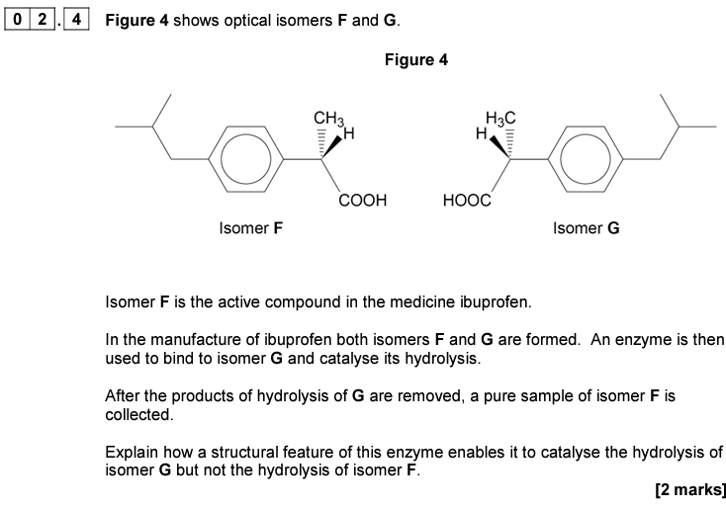
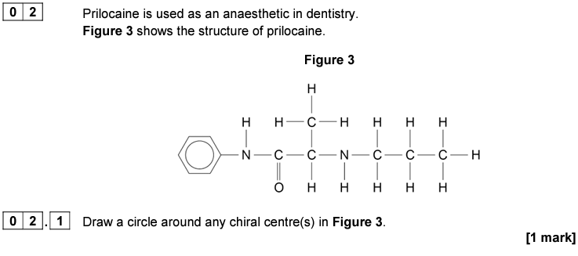
2020 A2 Paper 2

Slide 5
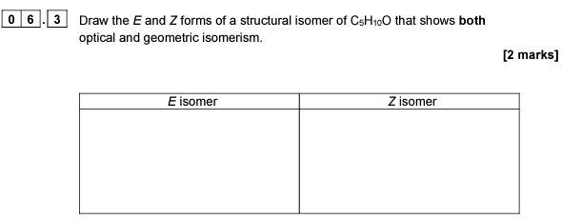
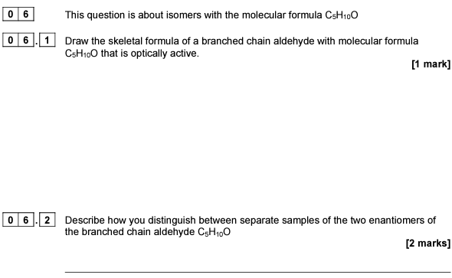
2021 A2 Paper 2

Slide 6
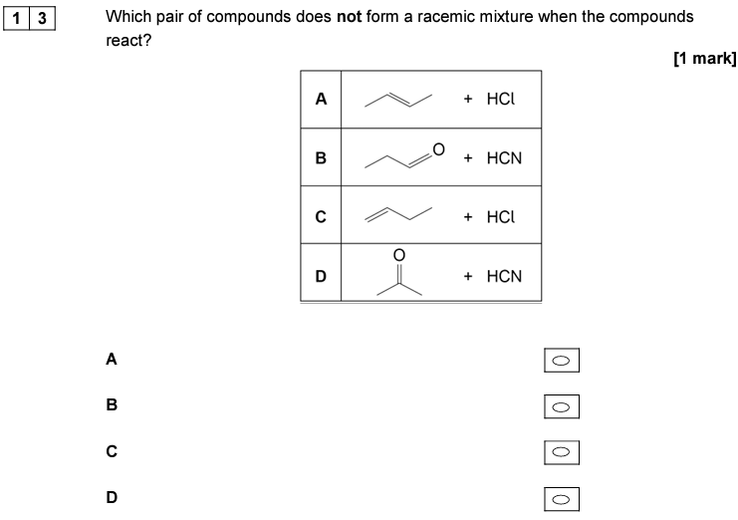
2017 A2 Paper 3

Slide 7
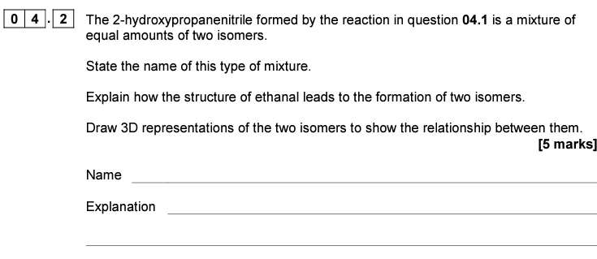
2019 A2 Paper 3

Slide 8
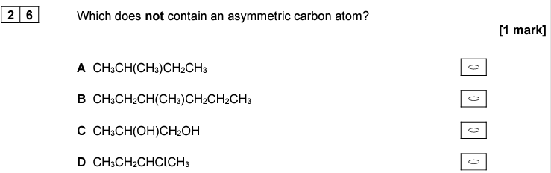
2020 A2 Paper 3

Slide 9
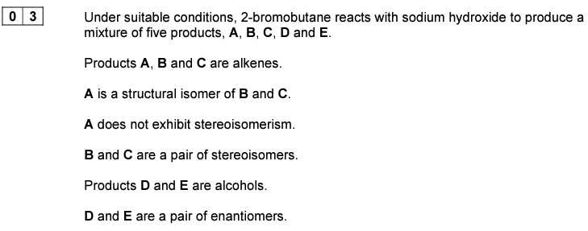

2022 A2 Paper 3

