Slide 1


AQA Past paper questions
3.3.9 - Carboxylic acids and derivatives
Dr John R Griffiths
SciExcel Tuition

Slide 2
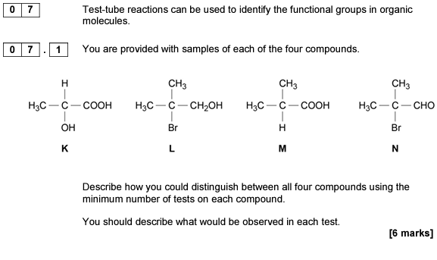

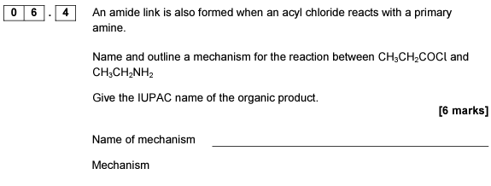
2017 A2 Paper 2

Slide 3
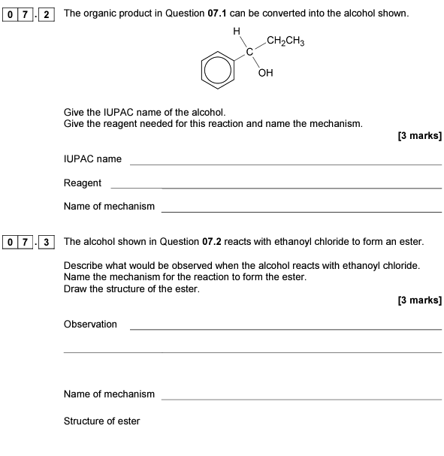
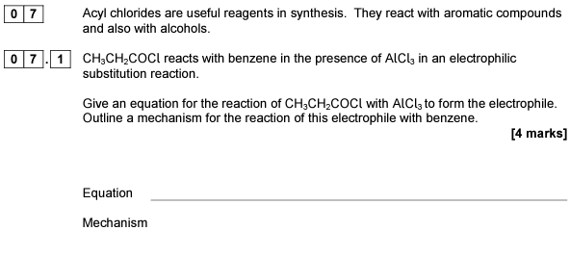
2018 A2 Paper 2

Slide 4
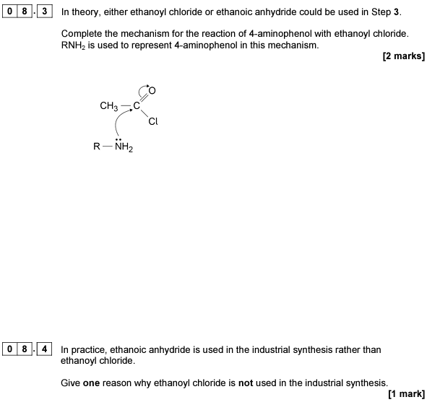
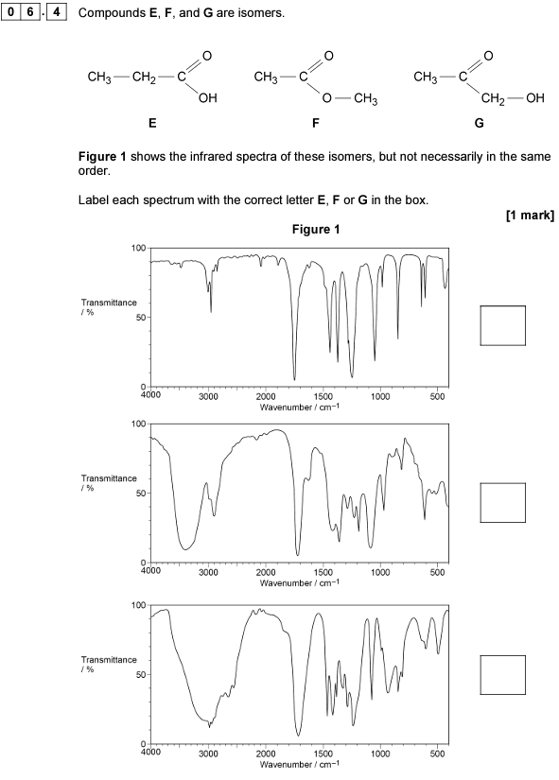
2019 A2 Paper 2

Slide 5
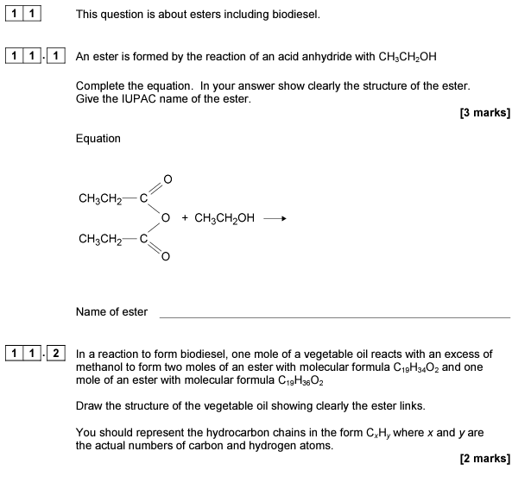
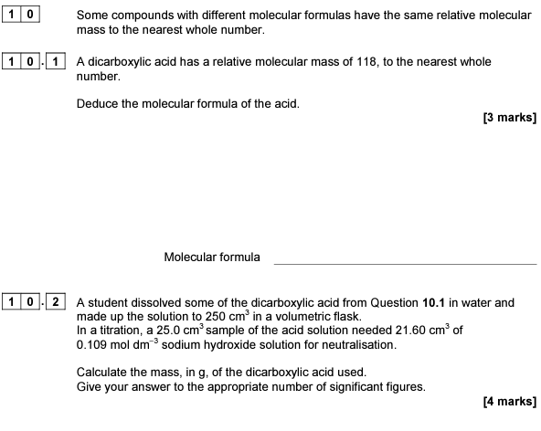
2019 A2 Paper 2

Slide 6
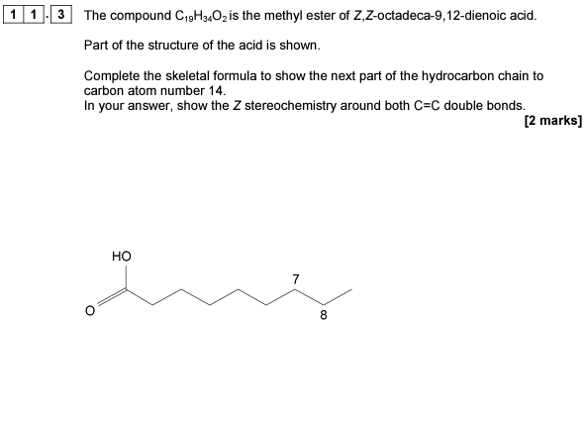
2019 A2 Paper 2

Slide 7
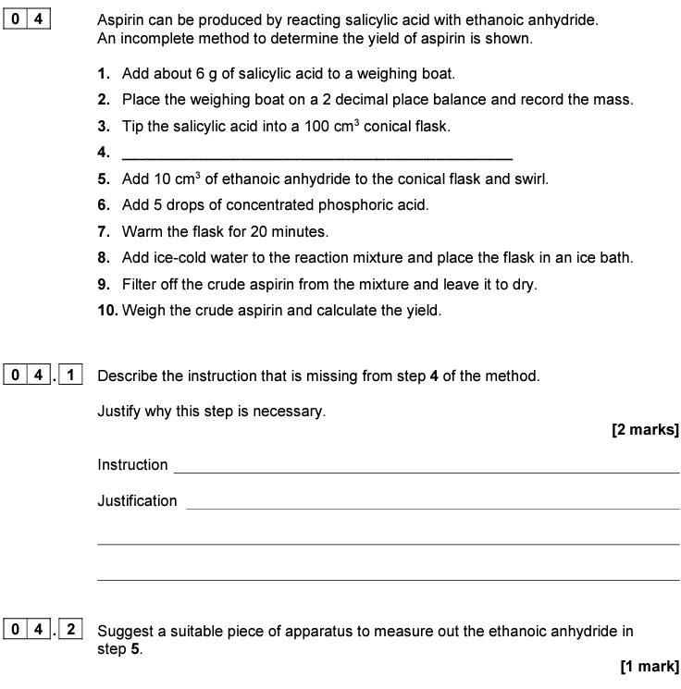
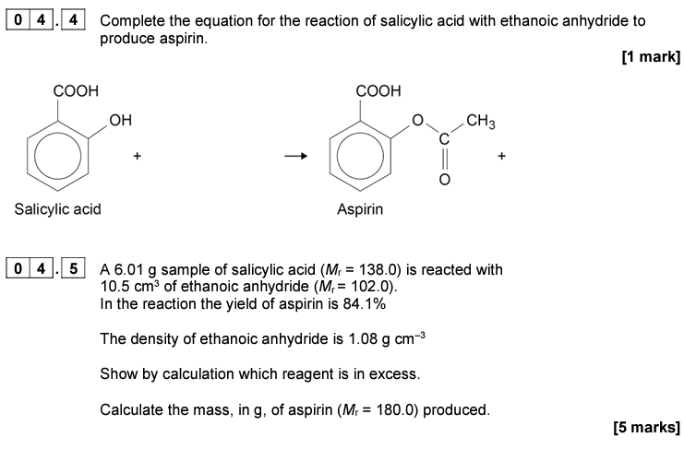
2020 A2 Paper 2

Slide 8
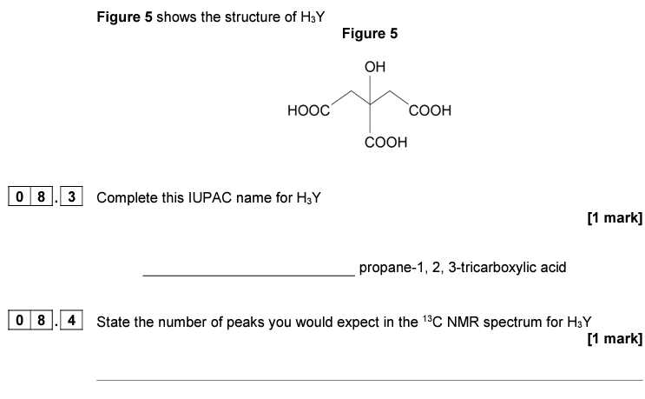


2020 A2 Paper 2

Slide 9

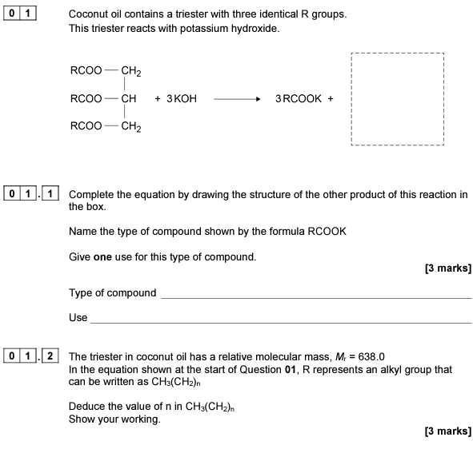
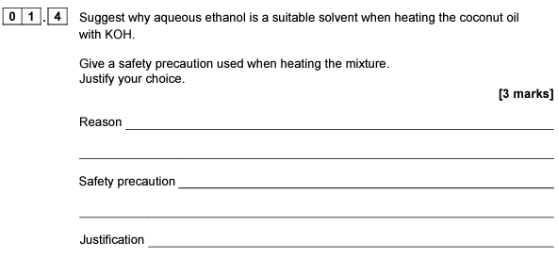
2021 A2 Paper 2

Slide 10
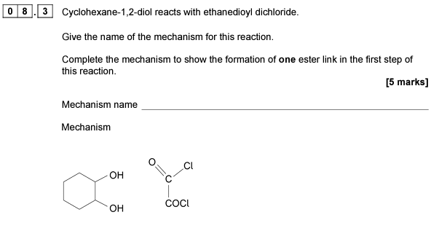
2021 A2 Paper 2

Slide 11
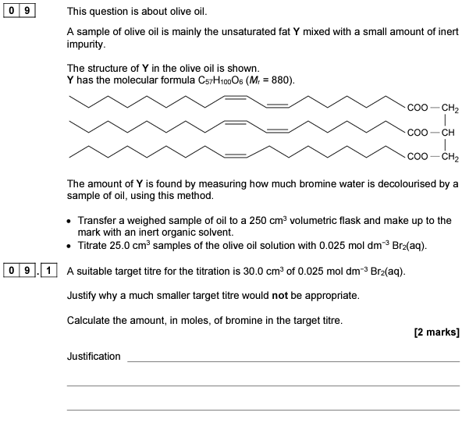
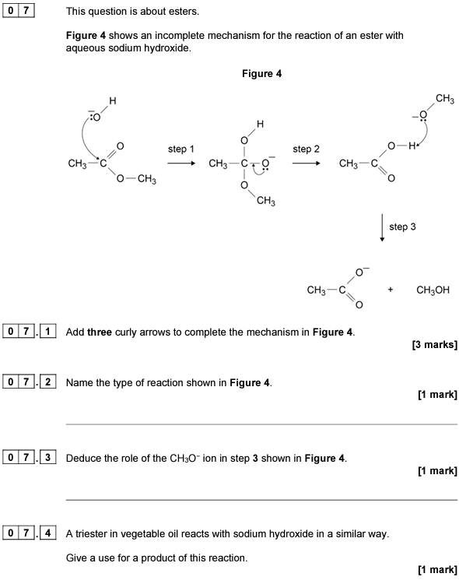

2022 A2 Paper 2

Slide 12
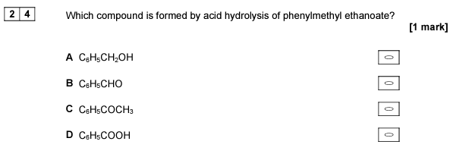
2019 A2 Paper 3

Slide 13

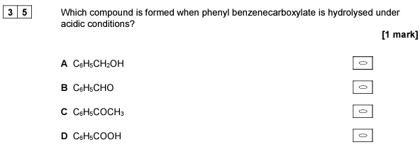
2020 A2 Paper 3

Slide 14

2021 A2 Paper 3

Slide 15
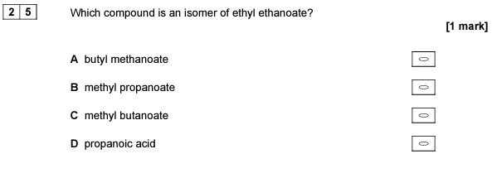
2022 A2 Paper 3

