Slide 1

Physical Chemistry Year 2 – A2
5.1.2 The equilibrium constant, K_{c} (Part 2) and K_{p}
Dr John R Griffiths
Sci-Excel Tuition

Slide 2
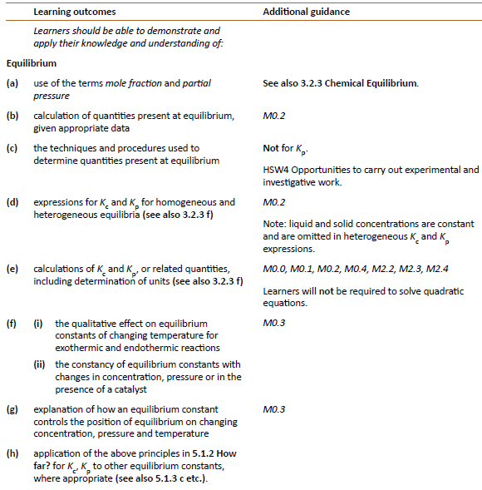
OCR Specification
5.1.2 How far?

Slide 3
Equilibrium constant, K_{c}, in homogeneous systems
- A recap from 3.2.3
If the concentrations of all the substances present at equilibrium are raised to the power of the number of moles they appear in the equation, the product of the concentrations of the products divided by the product of the concentrations of the reactants is a constant, provided the temperature remains constant
There are several forms of the constant; all vary with temperature.
K_{c} the equilibrium values are expressed as concentrations of moldm⁻³
K_{p} the equilibrium values are expressed as partial pressures (only for gases)
The partial pressure expression can be used for reactions involving gases as only gases have partial pressures (see later)

Slide 4
Equilibrium constant, K_{c}, in homogeneous systems
- A recap from 3.2.3
The position of a system at equilibrium may be expressed by the equilibrium constant, K_{c} – the larger the value, the further the position of equilibrium lies towards the products.
e.g. for an equilibrium reaction of the form...
aA + bB cC + dD
then (at constant temperature) [C]^{c} . [D]^{d} = a constant, K_{c}
[A]ª . [B]^{b}
where [ ] denotes the equilibrium concentration in moldm⁻³

Slide 5
Homogeneous versus heterogeneous systems
In a homogeneous equilibrium, all species are present in the same state or phase
e.g.
H_{2(g)} + I_{2(g)} 2HI_{(g)} all species are in the gas phase.
In a heterogeneous equilibrium, species may be in different states
e.g.
C_{(s)} + H₂O_{(g)} CO_{(g)} + H_{2(g)} any solids or liquids are omitted from the K_{c} expression, so;
K_{c} = [H_{2(g)}] [CO_{(g)}]
[H₂O_{(g)}]

Slide 6
Units of K_{c}
The units depend upon the stoichiometry of the chemical equation, i.e. the number of concentration terms (moldm⁻³) on the top and bottom.
e.g.
H_{2(g)} + I_{2(g)} 2HI_{(g)} K_{c} = [HI_{(g)}]² = (moldm⁻³)² = NO UNITS [H_{2(g)}][I_{2(g)}] (moldm⁻³) (moldm⁻³)
Find the units of K_{c} for,
N₂O_{4(g)} 2NO_{2(g)}
2SO_{2(g)} + O_{2(g)} 2SO_{3(g)}
Note: By convention, units have positive indices before negative ones

Slide 7
Units of K_{c}
The units depend upon the stoichiometry of the chemical equation, i.e. the number of concentration terms (moldm⁻³) on the top and bottom.
e.g.
H_{2(g)} + I_{2(g)} 2HI_{(g)} K_{c} = [HI_{(g)}]² = (moldm⁻³)² = NO UNITS [H_{2(g)}][I_{2(g)}] (moldm⁻³) (moldm⁻³)
Find the units of K_{c} for,
N₂O_{4(g)} 2NO_{2(g)} UNITS = moldm⁻³
2SO_{2(g)} + O_{2(g)} 2SO_{3(g)} UNITS = dm³mol⁻¹
Note: By convention, units have positive indices before negative ones

Slide 8
Calculating K_{c}
1. Finding the amounts (mol) at equilibrium
Consider the following esterification reaction;
If we react together 1 mol of ethanol with 1 mol of ethanoic acid, and at equilibrium we have 0.33 mol ethanol, how do we find the other equilibrium amounts ?
C₂H₅OH + CH₃COOH
CH₃COOC₂H₅ + H₂O

Slide 9
C₂H₅OH + CH₃COOH
CH₃COOC₂H₅ + H₂O
Initial moles
1mol
1mol
0mol
0mol
Equilibrium moles
0.33mol
?mol
?mol
?mol
Reagent | Initial moles | Final moles (at equilibrium)
C₂H₅OH | 1.0 | 0.33
CH₃COOH | 1.0
CH₃COOC₂H₅ | 0.0
H₂O | 0.0

Slide 10
C₂H₅OH + CH₃COOH
CH₃COOC₂H₅ + H₂O
Reagent | Initial moles | Final moles (at equilibrium)
C₂H₅OH | 1.0 | 0.33
CH₃COOH | 1.0 | 0.33
CH₃COOC₂H₅ | 0.0 | 0.67
H₂O | 0.0 | 0.67

Slide 11
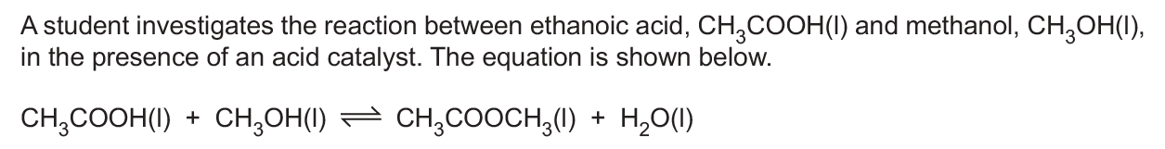
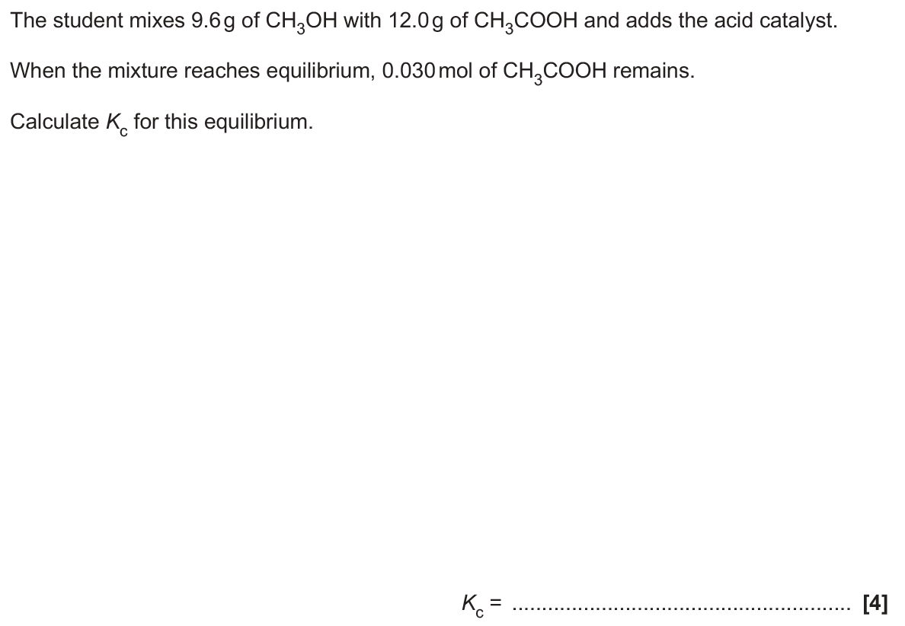

Slide 12
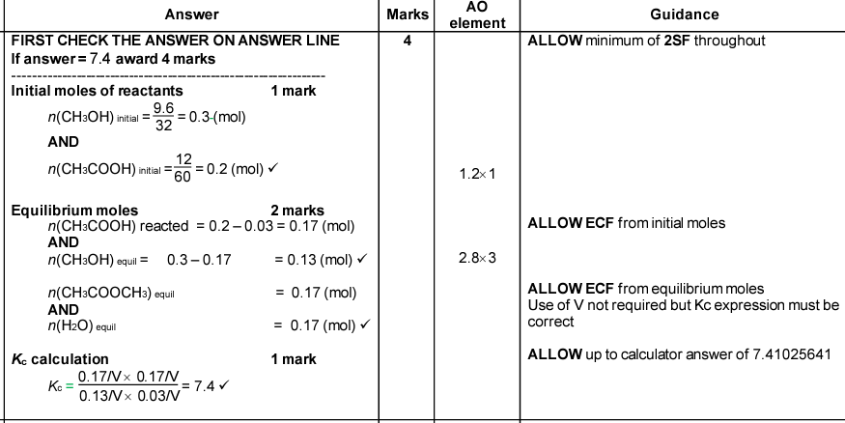

Slide 13
The Equilibrium constant, K_{p}
When a reversible reaction takes place in the GAS PHASE, we may use partial pressures, p( ), rather than concentrations, [ ], in the equilibration equation, and K_{p} instead of K_{c}.
Such that:
aA_{(g)} + bB_{(g)} cC_{(g)} + dD_{(g)}
K_{p} = p(C)^{c}_{(g)} x p(D)^{d}_{(g)} NB Kp ONLY includes gases (ignore other states)
p(A)ª_{(g)} x p(B)^{b}_{(g)}
Units of K_{p} depend on the chemical equation and may be kPa, Pa, atm etc.

Slide 14
Partial pressures and mole fractions
Mole fraction
Since 1 mole of ANY gas occupies the same volume at constant T and P (24.0 dm⁻³ at RTP) its mole fraction is the same is its proportion by volume to the total volume of gases in a mixture
e.g.
Air consists of 78% N₂, 21% O₂ and 1 % other gases
The mole fraction of,
N₂, x (N₂) = 78/100 = 0.78,
O₂, x (O₂) = 21/100 = 0.21, and
Other gases x = 1/100 = 0.01 (The sum of mole fractions must = 1)

Slide 15
Partial pressures and mole fractions
Partial pressure
For a gas A in a gas mixture,
Its partial pressure, p(A) = mole fraction A x total pressure of the gas mixture
e.g.
In a gas mixture of total pressure 10 atm, containing 1 mol nitrogen, 1.5 mol oxygen and 2.5 mol helium, the partial pressures of the gases would be;
p(N₂) = 1/5 x 10 atm = 2 atm
p(O₂) = 1.5/5 x 10 atm = 3 atm
p(He) = 2.5/5 x 10 atm = 5 atm
The sum of the partial pressures MUST equal the total pressure of the system

Slide 16
Check point
A gas mixture contains 10 cm² of O_{2 (g)},25 cm² of N_{2 (g)} and 15 cm² of H_{2 (g)}.
The total pressure of the mixture is 500 kPa.
Calculate the mole fraction and partial pressure of each gas.
O₂: mole fraction = 0.2 p = 100 kPa
N₂: mole fraction = 0.5 p = 250 kPa
H₂: mole fraction = 0.3 p = 150 kPa

Slide 17
Factors affecting the position of equilibrium –
Concentration
The equilibrium constant is not affected by a change in concentration at constant temperature. To maintain the constant, the composition of the equilibrium mixture changes.
If you increase the concentration of a substance, the value of K_{c} will theoretically be affected. As it must remain constant at a particular temperature, the concentrations of the other species change to keep the constant the same.

Slide 18
Factors affecting the position of equilibrium –
Concentration
example CH₃CH₂OH + CH₃COOH CH₃COOC₂H₅ + H₂O
the equilibrium constant K_{c} = [CH₃COOC₂H₅] [H₂O] = 4 (at 298K)
[CH₃CH₂OH] [CH₃COOH]
increasing
[CH₃CH₂OH] - will make the bottom line larger so K_{c} will be smaller
- to keep it constant, some CH₃CH₂OH reacts with CH₃COOH
- this reduces the value of the bottom line and increases the top
- eventually the value of the constant will be restored

Slide 19
Factors affecting the position of equilibrium –
Concentration
example CH₃CH₂OH + CH₃COOH CH₃COOC₂H₅ + H₂O
the equilibrium constant K_{c} = [CH₃COOC₂H₅] [H₂O] = 4 (at 298K)
[CH₃CH₂OH] [CH₃COOH]
decreasing
[H₂O] - will make the top line smaller
- some CH₃CH₂OH reacts with CH₃COOH to replace the H₂O
- more CH₃COOC₂H₅ is also produced
- this reduces the value of the bottom line and increases the top

Slide 20
The effect of changing temperature and pressure
The effect of temperature and pressure on both the equilibrium position and on K_{p} is determined by Le Chatelier’s principle.
For gases, an INCREASE in pressure will shift the equilibrium position to the side with fewer gas molecules. K_{p} is unaffected by a change in pressure.
An INCREASE in temperature will shift the equilibrium position towards the endothermic direction and vice versa. If this moves to the left then K_{p} will decrease and if it moves to the right then K_{p} will increase.
A catalyst has no effect on the position of equilibria or on the value of K_{p.} A catalyst will simply increase the rate at which equilibrium is attained (as will an increase in P and T due to collision theory).

Slide 21
Check point
Using Le Chatelier’s principle, predict the effect of increasing the temperature and increasing the pressure on both the equilibrium position and (if at all) on K_{p} for the following reactions:
2SO_{2(g)} + O_{2(g)} 2SO_{3(g)} ∆H = -197 kjmol⁻¹
N₂O_{4(g)} 2NO_{2(g)} ∆H = +58 kjmol⁻¹
H_{2(g)} + CO_{2(g)} H₂O _{(g)} + CO_{(g)} ∆H = +40 kjmol⁻¹

Slide 22
Questions – Try this first….
In an experiment using equimolar amounts of H₂ and I₂, equilibrium was established at 230 KPa and 700 K. The flask was found to contain 0.181 mol of gas which included 0.143 mol of HI.
Calculate the value of the equilibrium constant, K_{p} for this reaction at 700 K.

Slide 23
Answer
In an experiment using equimolar amounts of H₂ and I₂, equilibrium was established at 230 KPa and 700 K. The flask was found to contain 0.181 mol of gas which included 0.143 mol of HI.
Calculate the value of the equilibrium constant, K_{p} for this reaction at 700 K.
H₂ _{(g)} + I₂ _{(g)} ⇔ 2HI _{(g)}
Mole fraction of HI = 0.143/0.181 = 0.79
Therefore, mole fraction of H₂ = mole fraction I₂ = (1-0.79)/2
= 0.105

Slide 24
Answer – Continued
Total pressure = 230 KPa
p(HI) = 230 KPa x 0.79
= 181.7 KPa
p(I₂) = 230 KPa x 0.105
= 24.15
p(H₂) = = 230 KPa x 0.105
= 24.15
Kp = p(HI)²/ (p(I₂)x p(H₂))
= 181.7²/24.15²
= 33,014.89/583.2225
= 56.6 (there are no units as the pressures cancel out)

