Slide 1


OCR Past paper questions
5.3.2 Qualitative analysis
Dr John R Griffiths
SciExcel Tuition

Slide 2
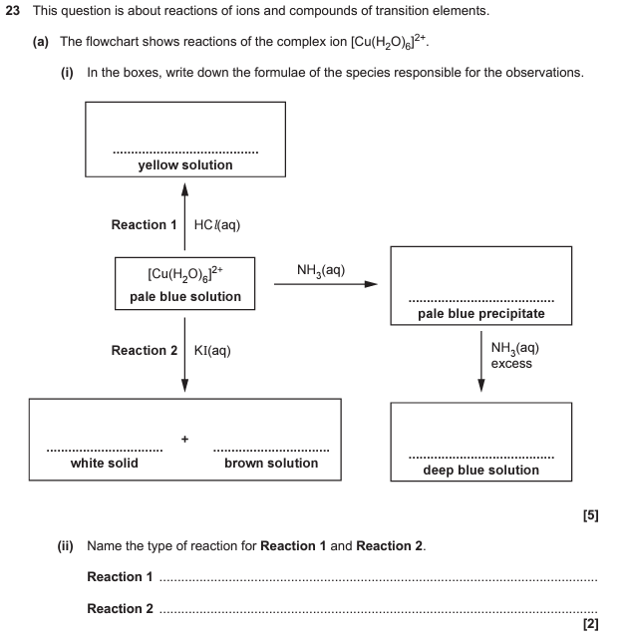
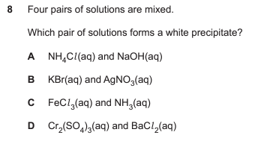
A2 Paper 1 2017

Slide 3
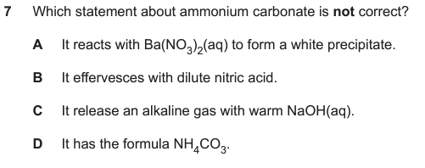
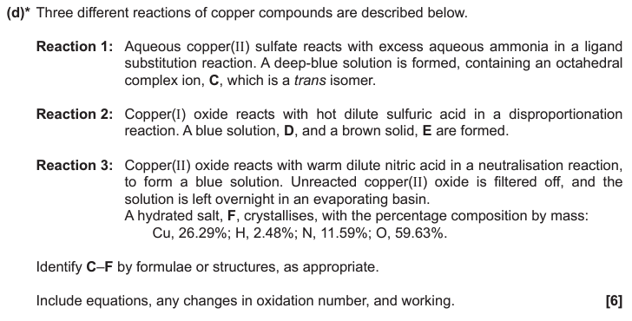
A2 Paper 1 2018
21

Slide 4
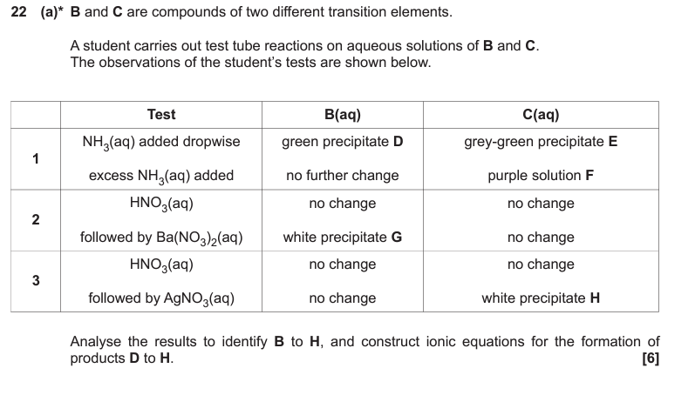
A2 Paper 1 2020

Slide 5
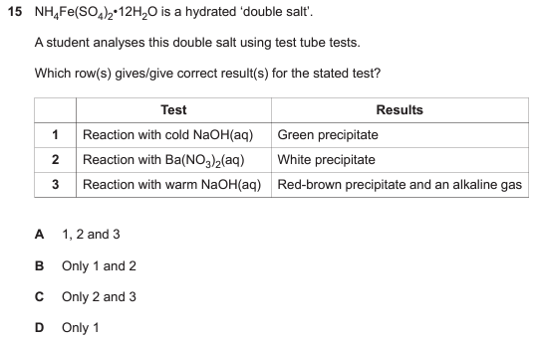
A2 Paper 1 2021

Slide 6
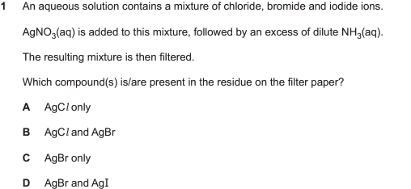
A2 Paper 1 2022

Slide 7
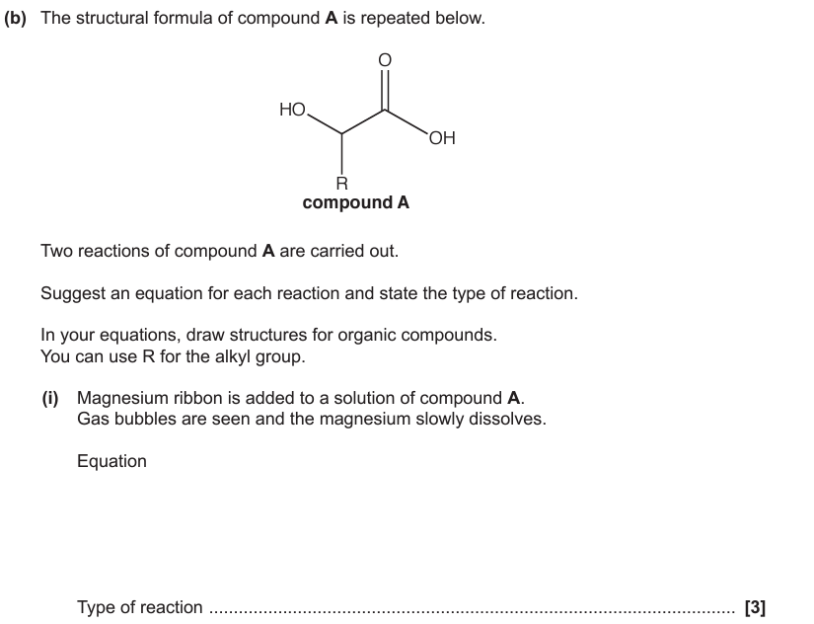
A2 Paper 3 2017
4

