Slide 1


OCR Past paper questions
6.3.2 Spectroscopy
Dr John R Griffiths
SciExcel Tuition

Slide 2
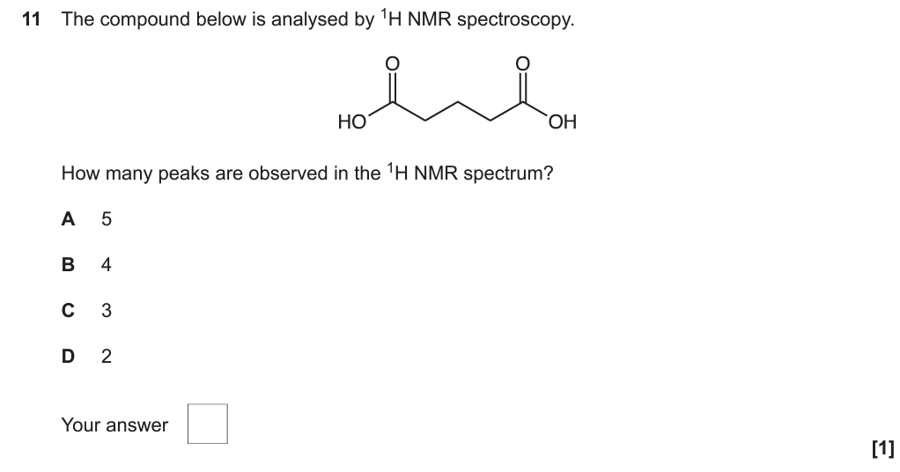
A2 Paper 2 2017

Slide 3
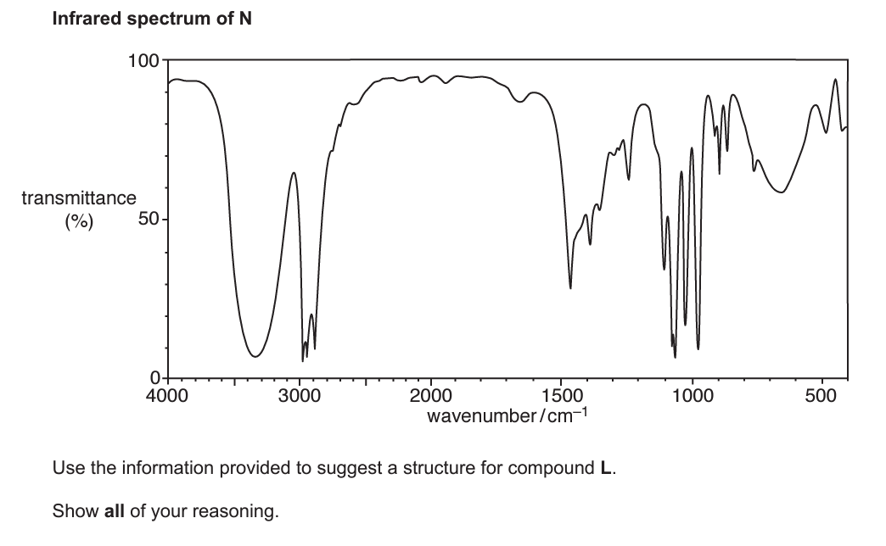
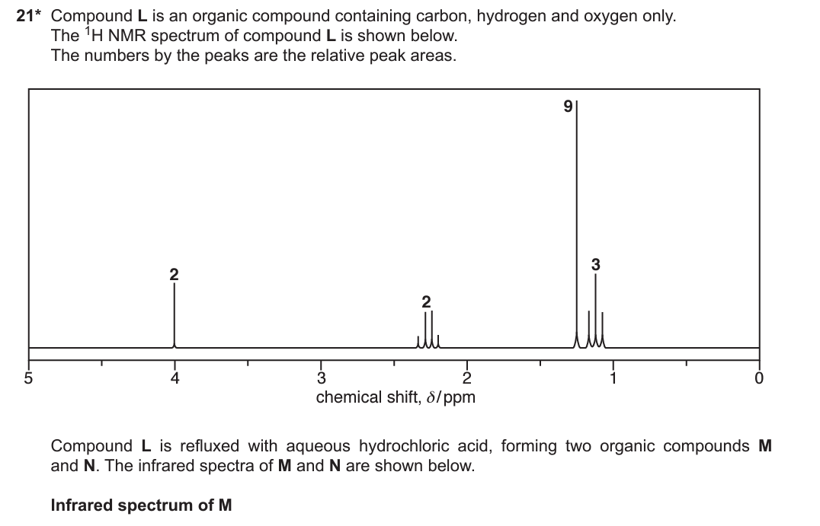
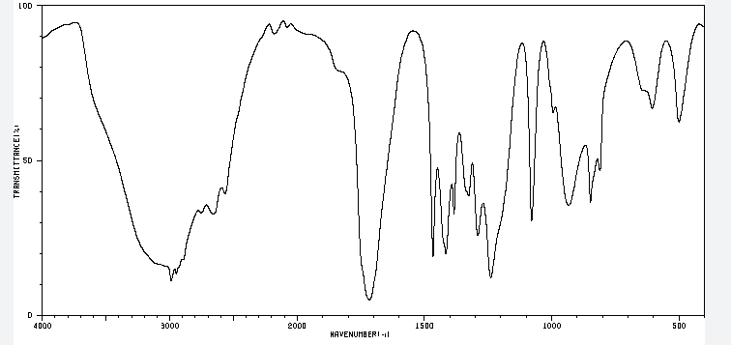
A2 Paper 2 2017

Slide 4
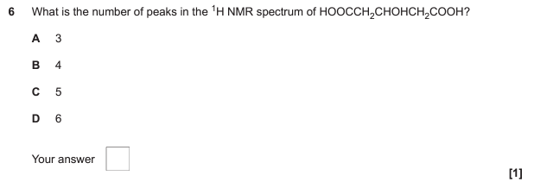
A2 Paper 2 2018

Slide 5
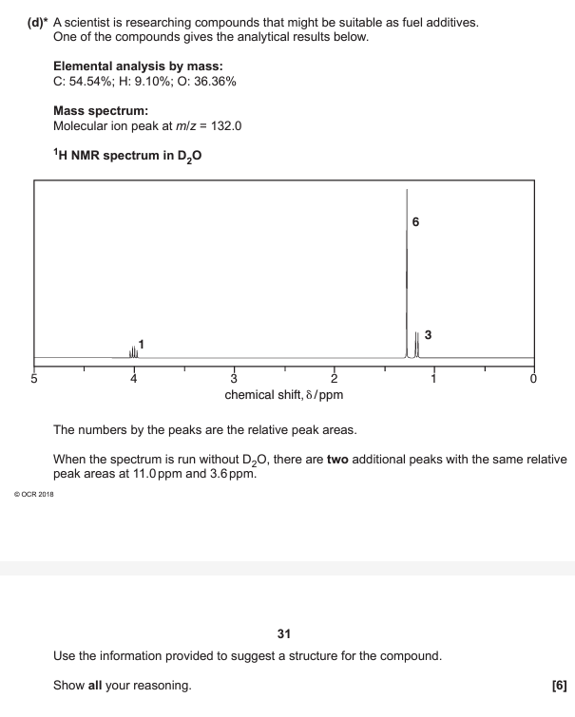
A2 Paper 2 2018
22

Slide 6
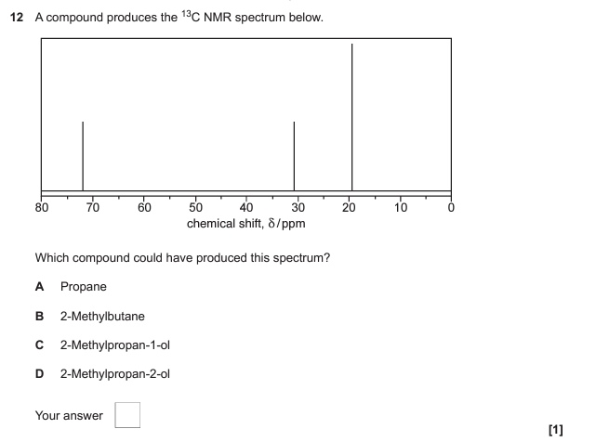
A2 Paper 2 2019

Slide 7
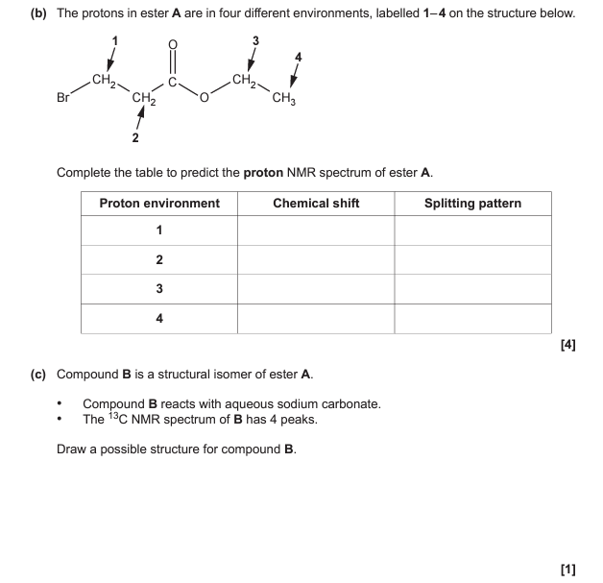
A2 Paper 2 2019
18

Slide 8
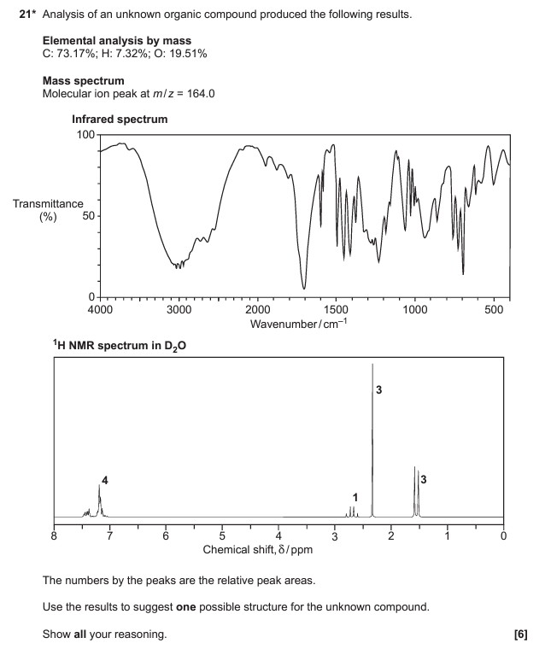
A2 Paper 2 2019

Slide 9
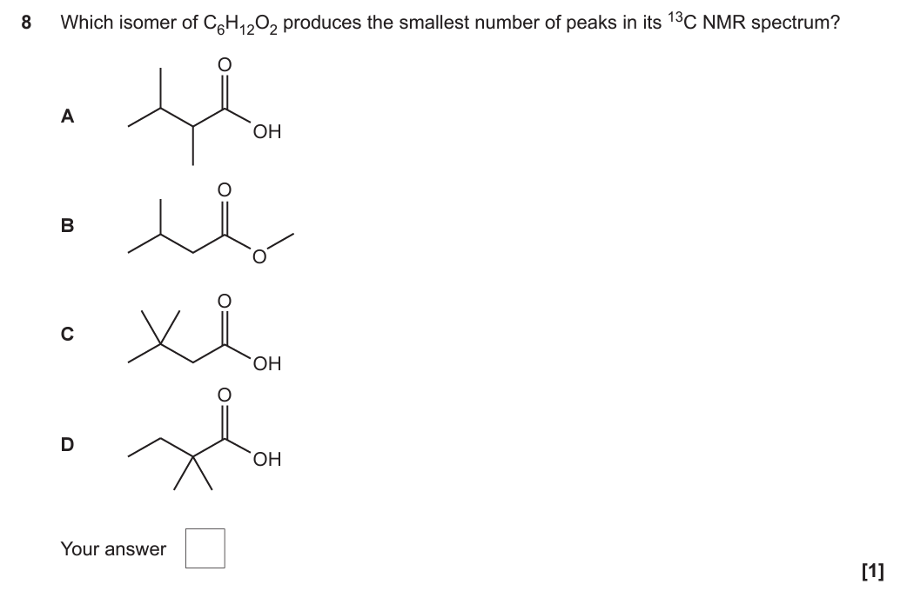
A2 Paper 2 2020

Slide 10
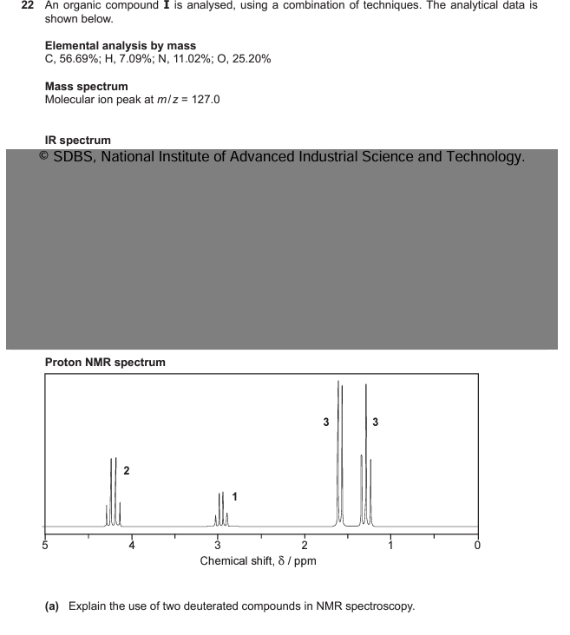
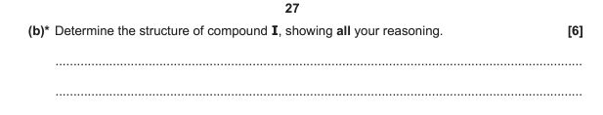

A2 Paper 2 2020

Slide 11
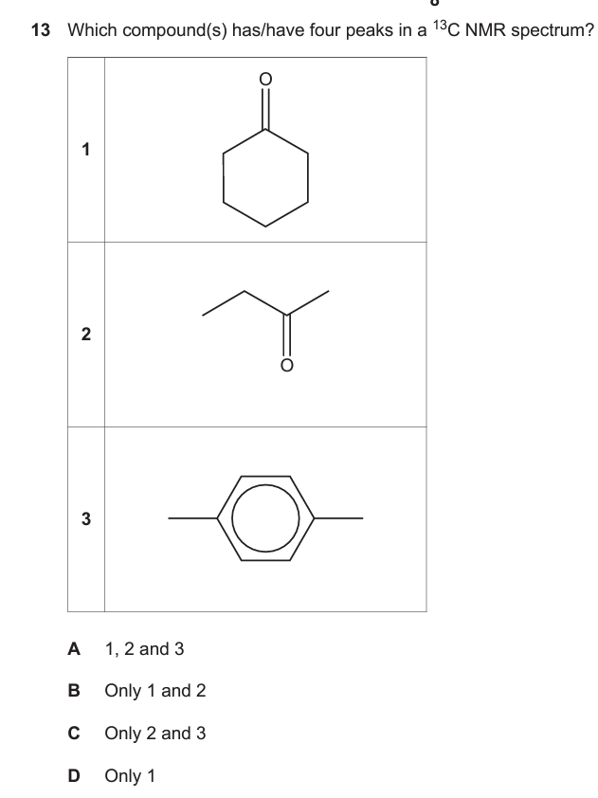
A2 Paper 2 2021

Slide 12
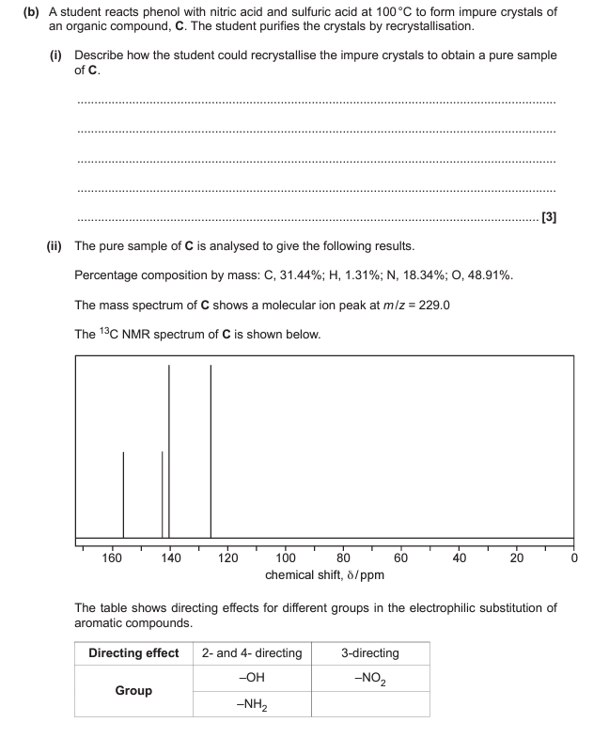

A2 Paper 2 2021
20

Slide 13
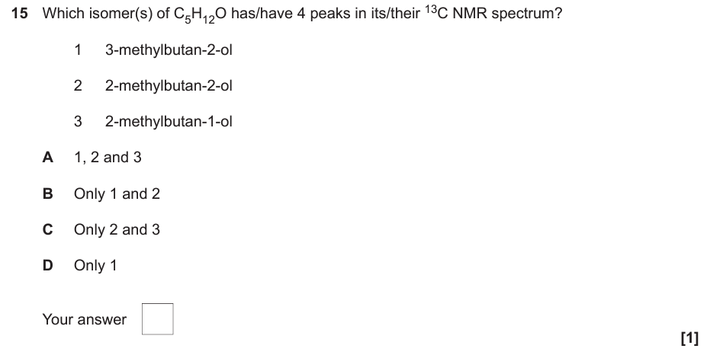
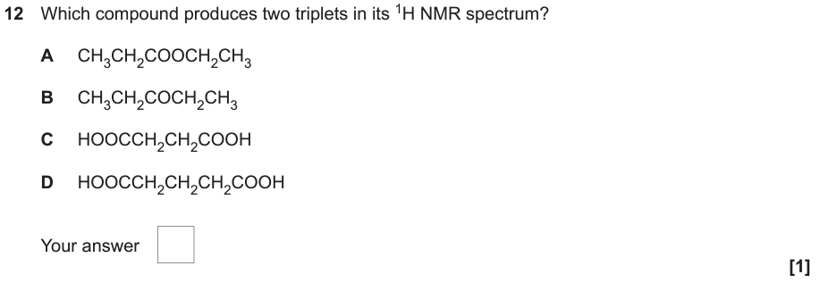
A2 Paper 2 2022

Slide 14
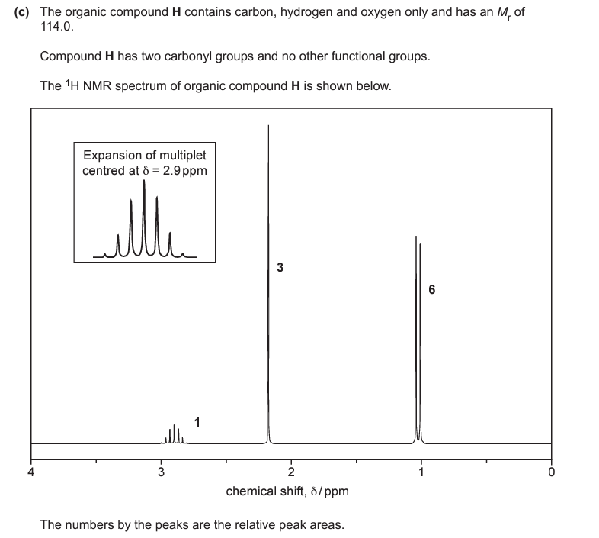
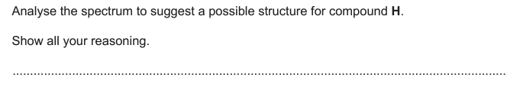
A2 Paper 2 2022
18

Slide 15
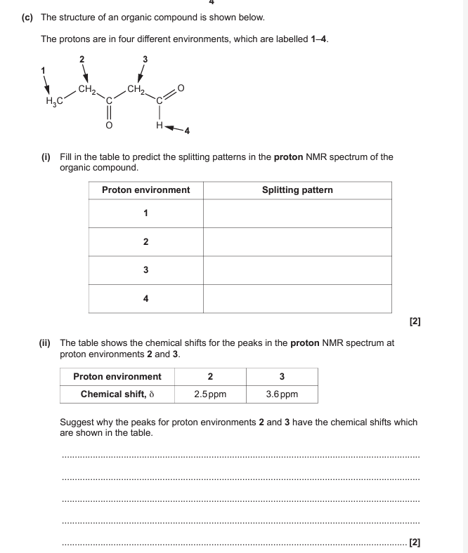
A2 Paper 3 2022
1

